Slide 1
Pathways of Proprioception
Dr Abdulrahman Alhowikan
Collage of medicine
Physiology Dep.

Slide 2
Objectives
To know the somatotopic organization of ascending sensory pathways
To k now the types of receptors needed
To know the names of tracts in dorsal column
To understand the gracilus and cuneatus tracts with its functions.
To know the role of spinocerebellar tracts.
Role of cerebral cortex in perception of proprioceptive sensation.

Slide 3
Introduction
All sensory information from the somatic segments of the body enters the spinal cord through the dorsal roots of the spinal nerves. then to the brain.
It carried through two sensory pathways:
(1) the dorsal column-medial lemniscal system or
(2) the anterolateral system.
!! These two systems come back together partially at the level of the thalamus.

Slide 4
The Dorsal Column-medial Lemniscal System
Carries signals upward to the medulla of the brain mainly in the dorsal columns of the cord.
Then, after the signals synapse and cross to the opposite side in the medulla.
They continue upward through the brain stem to the thalamus by way of the medial lemniscus

Slide 5
The Dorsal Column-medial Lemniscal System Cont..
It composed of large, myelinated nerve fibers that transmit signals to the brain at velocities of 30 to 110 m/sec
It has a high degree of spatial orientation ( decide places and time )of the nerve fibers with respect to their origin
For sensory information that must be transmitted rapidly.

Slide 6
Sensations Transmitted ByDorsal Column-medial Lemniscal
Touch sensations requiring a high degree of localization of the stimulus
Touch sensations requiring transmission of fine degrees of intensity
Phasic (continuous) sensations, such as vibratory sensations
Sensations that signal movement against the skin
Position sensations from the joints
Pressure sensations related to fine degrees of judgment of pressure intensity

Slide 7
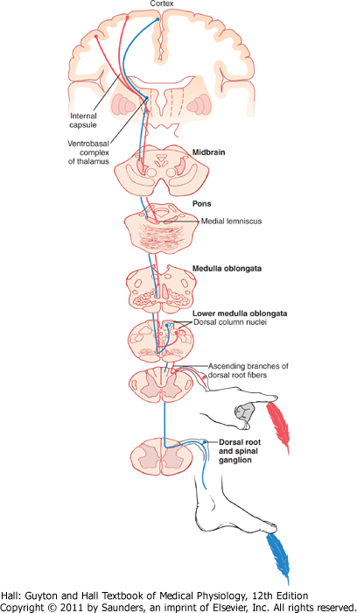
Dorsal Column-Medial Lemniscal Pathway
nerve fibers entering the dorsal columns pass uninterrupted up to the dorsal medulla, where they synapse in the dorsal column nuclei then cross to the opposite side of the brain stem and continue upward through the medial lemnisci to the thalamus. each medial lemniscus is joined by additional fibers from the sensory nuclei

Slide 8
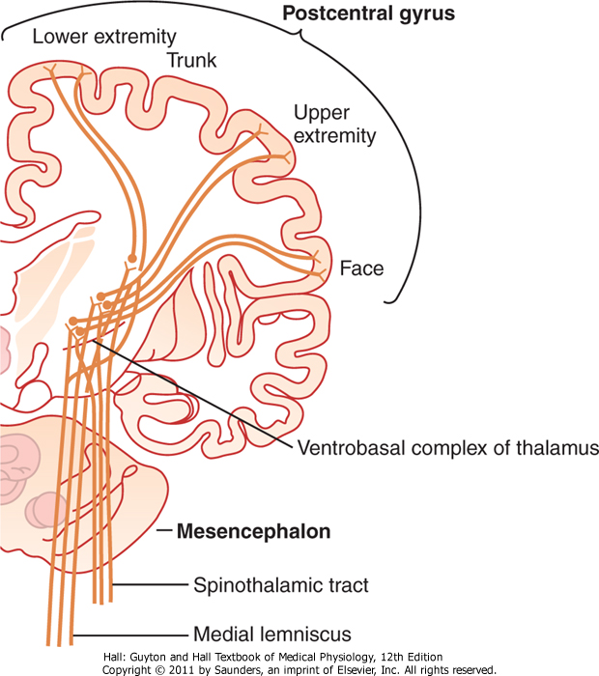
Dorsal Column-Medial Lemniscal Pathway Cont..
In the thalamus, the medial lemniscal fibers terminate in the thalamic sensory relay area, called the ventrobasal complex. From the ventrobasal complex,third-order nerve fibers project.
Notes:
1.The first order sensory neurons are in the dorsal root ganglia or the sensory ganglia of cranial nerves. 2. The second order sensory neurons are in the dorsal gray column or various sensory nuclei of the brainstem. 3. The third order sensory neurons are in the thalamic nuclei.

Slide 9
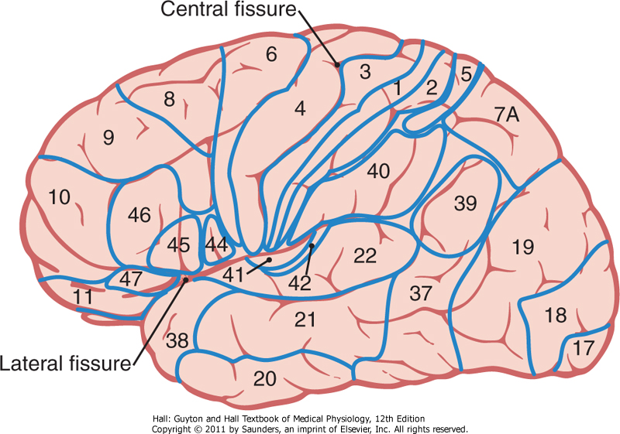
Somatosensory Cortex
The various areas of the cortex. Is a map of the human cerebral cortex, showing that it is divided into about 50 distinct areas called brodmann's areas based on histological structural differences
Figure 47-5 Structurally distinct areas, called Brodmann's areas, of the human cerebral cortex. Note specifically areas 1, 2, and 3, which constitute primary somatosensory area I, and areas 5 and 7, which constitute the somatosensory association area.

Slide 10
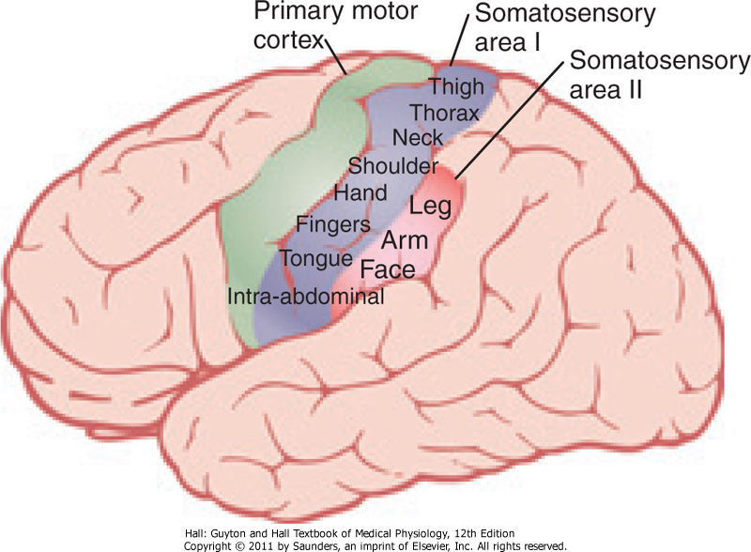
Somatosensory Areas I and II
Somatosensory area I is so much more extensive and so much more important than somatosensory area II
Somatosensory area I has a high degree of localization of the different parts of the body
Two somatosensory cortical areas,
somatosensory areas I and II.

Slide 11
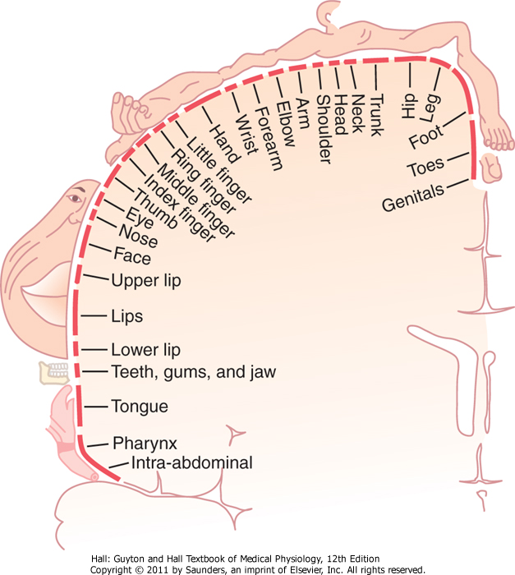
Different Parts of the Body in Somatosensory Area I
Some areas of the body are represented by large areas in the somatic cortex-the lips the greatest of all, followed by the face and thumb-whereas the trunk and lower part of the body are represented by relatively small areas.
different areas of the body in somatosensory area I of the cortex. (From Penfield W, 1968.)

Slide 12
Functions Cerebral Cortex Six Layers
Incoming sensory signal stimulate neuronal layer IV first; then spreads toward surface and deeper layers of cortex.
Layers i and ii receive diffuse, nonspecific input signals from lower brain centers
Layers II and III send axons to related portions of the cerebral cortex on the opposite side of the brain.
The neurons in layers v and vi send axons to the deeper parts of the nervous system. Layer V to more distant areas, layer VI, especially large numbers of axons extend to the thalamus.

Slide 13
Functions of gracilus and cuneatus tracts
gracilis and cuneate tracts offer the same functions but can be differentiated by the vertebral level
Cuneatus
carries information from vertebral level T6 and up.
transmits information from the arms fine touch, fine pressure, vibration, and proprioception information
Gracilus
carries information from vertebral levels below T6
provides proprioception of the lower limbs and trunk to the brain stem.

Slide 14
Functions of Somatosensory Area I
Bilateral removal of somatosensory area I causes loss of the following types of sensory judgment:
The person is unable to localize discretely the different sensations in the different parts of the body.
Unable to judge degrees of pressure against the body.
Unable to judge the weights of objects.
Unable to judge shapes or forms of objects. This is called astereognosis.
Unable to judge feel of materials by movement of the fingers over the surface to be judged.

Slide 15
Somatosensory Association Areas
Play important roles in interpret deeper meanings of the sensory information in the somatosensory areas.
It combines information arriving from multiple points in the primary somatosensory area to interpret its meaning.
areas 5 and 7, which constitute
the somatosensory association area.

Slide 16
Somatosensory Association Areas cont..
It receives signals from (1) somatosensory area I, (2) the ventrobasal nuclei of the thalamus, (3) other areas of the thalamus, (4) the visual cortex, and (5) the auditory cortex
areas 5 and 7, which constitute
the somatosensory association area.

Slide 17
Anterolateral System
Entering the spinal cord from the dorsal spinal nerve roots, synapse in the dorsal horns of the spinal gray matter
Then cross to the opposite side of the cord and ascend through the anterior and lateral white columns of the cord.
They terminate at all levels of the lower brain stem and in the thalamus

Slide 18
Anterolateral System Cont..
Composed of smaller myelinated fibers that transmit signals at velocities ranging from a few meters per second up to 40 m/sec.
It has much less spatial orientation ( decide places and time ).
Does not need to be transmitted rapidly or with great spatial fidelity ( accuracy)

Slide 19
Sensations Transmitted By Anterolateral System
Pain
Thermal sensations, warmth and cold sensations
Crude touch (gross) and pressure sensations capable only of crude localizing ability on the surface of the body
Tickle and itch sensations
Sexual sensations

Slide 20
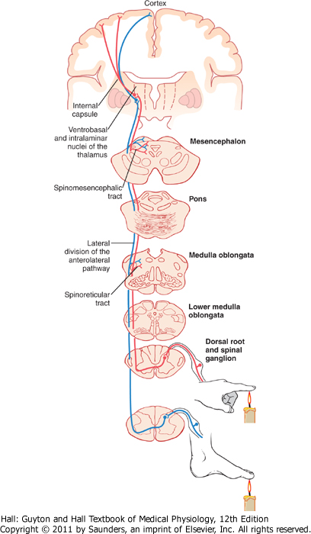
Anterolateral Pathway
Anterolateral fibers cross immediately in the anterior commissure of the cord to the opposite anterior and lateral white columns, where they turn upward toward the brain by way of the anterior spinothalamic and lateral spinothalamic tracts
Anterior and lateral divisions of
the anterolateral sensory pathway.

Slide 21
Characteristics of Transmission in the Anterolateral Pathway
Same principles of transmission in anterolateral pathway as in the dorsal column-medial lemniscal system, except :
(1) the velocities of transmission are only one-third to one-half those in the dorsal column-medial lemniscal system, 8 and 40 m/sec;
(2) the degree of spatial localization of signals is poor
(3) the gradations of intensities are also far less accurate,
(4) the ability to transmit signal rapidly is poor.

Slide 22
Reference book
Guyton & Hall: Textbook of Medical Physiology 12E
Thank you

