Slide 1
Physiology of Postural Reflexes
Dr Abdulrahman Alhowikan
Collage of medicine
Physiology Dep.

Slide 2
Objectives;
Postural reflexes are needed to keep the body in a proper position while standing, moving.
Body posture is suddenly altered it is corrected by several reflexes. At spinal cord, medulla, mid-brain and cortical levels.
Students are required to know posture regulating parts of cns.
Understand these reflexes lesions in the various part of cns
To define spinal shock and able to describe the initial and long term changes in spinal reflexes that follow transaction of the spinal cord

Slide 3
Intoduction
Postural reflexes :group of reflexes (automatic movements) which maintain body position and equilibrium either during rest or during movement.
It stereotyped motor response to a specific sensory stimulus
SENSORY STIMULUS MOTOR RESPONSE
E.g Righting reflexes: bring the body into normal position in space and resist forces acting to displace it out of normal position.

Slide 4
Reflex Arc
Five components
1. Receptor (sensory cell)
2. Sensory neuron
3. Integration center (association neuron, synapses)
4. Motor neuron
5. Effector (muscle or gland cells)

Slide 5
Control of movement: movement originate in cortical association areas. The movements are planned in the cortex as well as in the basal ganglia and the lateral portions of the cerebellar hemispheres, as indicated by increased electrical activity before the movement. Thebasal ganglia and cerebellum funnel information to the premotor and motor cortex by way of the thalamus.
Notes:
The basal ganglia (or basal nuclei) are a group of nuclei of varied origin in the brains of vertebrates that act as a cohesive functional unit. They are situated at the base of the forebrain and are strongly connected with the cerebral cortex, thalamus, and other brain areas. The basal ganglia are associated with a variety of functions, including voluntary motor control, procedural learning relating to routine behaviors or "habits" such as bruxism, eye movements, cognitive,

Slide 6
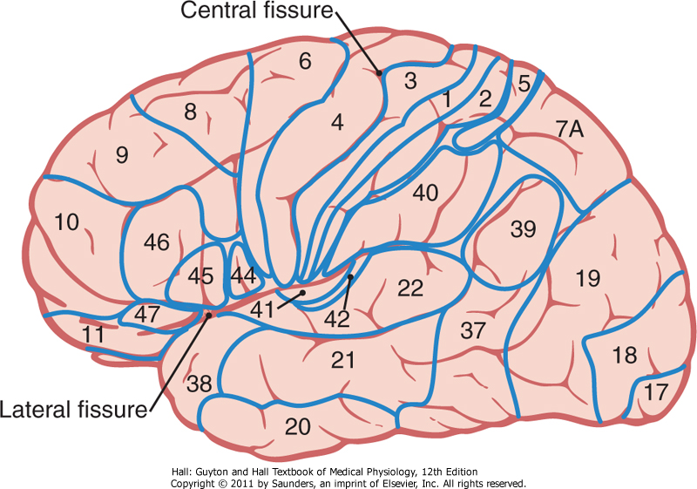
Somatosensory Association Areas
play important roles in interpret deeper meanings of the sensory information in the somatosensory areas.
it combines information arriving from multiple points in the primary somatosensory area to interpret its meaning.
areas 5 and 7, which constitute
the somatosensory association area.

Slide 7
Control of voluntary movement: Commands for voluntary movement originate in cortical association areas. The cortex,basal ganglia, and cerebellum work cooperatively to plan movements. Movement executed by the cortex is relayed via the corticospinal tracts and corticobulbar tracts to motor neurons. The cerebellum provides feedback to adjust and smooth movement.

Slide 8
POSTURE-REGULATING SYSTEMS
If neural axis is transected, the activities integrated below the section are cut off, or released from the control of higher brain centers.
Animal experimentation has led to information on the role of cortical and brain stem in control of voluntary movement and posture e.G

Slide 9
POSTURE-REGULATING SYSTEMS Con..
Decerebration is the elimination of cerebral brain function in an animal by removing the cerebrum, cutting across the brain stem, or severing certain arteries in the brain stem

Slide 10
POSTURE-REGULATING SYSTEMS Con..
DECEREBRATION: transaction of the brain stem between the superior and inferior colliculi permits the brain stem pathways to function independent of their input from higher brain structures.
This is called a midcollicular decerebration
and is diagramed in next figure by the dashed line labeled A.

Slide 12
DECEREBRATION CONT…
In midcollicular decerebrate cats, section of dorsal roots to a limb (dashed line labeled B in next figure immediately eliminates the hyperactivity of extensor muscles. This suggests that decerebrate rigidity is spasticity due to facilitation of the myotatic stretch reflex.

Slide 14
DECEREBRATION CONT…
If the anterior lobe of the cerebellum is removed in a decerebrate animal (dashed line labeled C in next figure , extensor muscle hyperactivity is exaggerated
(decerebellate rigidity)

Slide 16
DECORTICATION
Removal of the cerebral cortex (decortication;
dashed line labeled D in next figure produces decorticate rigidity which is characterized by flexion of the upper extremities at the elbow and extensor hyperactivity in the lower extremities
Decorticate rigidity is seen on the hemiplegic side in humans after hemorrhages or thromboses in the internal capsule.

Slide 18
Reflex integrated in medulla
1. Tonic labyrinthic reflexes
Receptors: Otolith organs of vestibular apparatus via vestibulospinal tract
Stimulus: Gravity, change body position
Response: Supine position – maximum rigidity
in extensor ; Prone position – minimum rigidity
2. Tonic neck reflexes
Receptors: neck proprioceptors
Stimulus: Head turned to side
Response: Extension of limbs on side to which head is turned, up-hind leg flex, down-foreleg flex

Slide 19
Reflex integrated in midbrain
1. Labyrinthine righting reflexes
Receptors: Otholithic organs
Stimulus: Gravity
Response: Head is kept at level
2. Body on head righting reflexes
Stimulus: Pressure on side of body exteroceptors
Response: Righting to head (correct head position)
3. Body on body righting reflexes
Stimulus: Pressure on side of body exteroceptors
Response: Righting of body even when head is prevented to right
Notes:
interoceptor: responds to stimuli arising within the body exteroceptor: reacts to stimuli in external environment, and typically they are found close to the body surface.

Slide 20
Reflex integrated in midbrain cont..
4. Body on neck righting reflexes Stimulus: Stretch of neck muscle Response: Contraction of neck muscles rights thorax and abdomen
5. Group reflex When an object is brought close to limbs, animals grasp object and limb are extended.
6. Vestibular placing reaction When blindfolded animal is brought down from height rapidly, forearm of animal extend and toes spread which assist animal to steadily land on ground.

Slide 21
Reflexes integrated in cerebral cortex
1. Optical righting reflex
Stimulus: Visual clues
Response: Righting of head
2. Hopping reactions If a standing animal is pushed laterally, it hops (jumps) to maintain equilibrium.
3. Placing reaction
Stimulus: Visual, exteroceptive and proprioceptive receptors
Response: Foot placed on supporting surface in position to support body

Slide 22
Neuronal mechanism of the flexor reflex
Eliciting the flexor reflex do not pass directly to the anterior motor neurons pass first into the spinal cord interneuron only secondarily to the motor neurons.
Pattern of withdrawal
Stimulus side of the arm contraction of the flexor muscles and abductor muscles it integrative centers

Slide 23
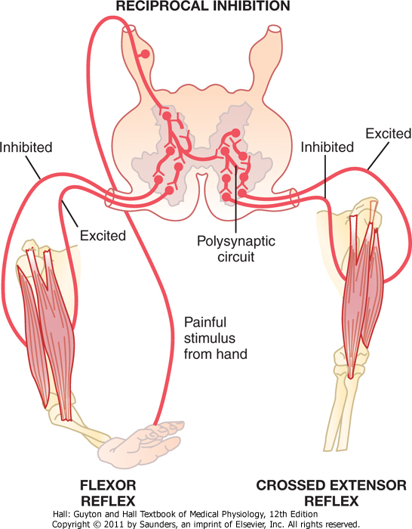
crossed extensor reflex
following a stimulus elicits a flexor reflex in one limb, the opposite limb begins to extend.
signals from sensory nerves cross to the opposite side of the cord to excite extensor muscles
the crossed extensor reflex usually does not begin until 200 to 500 milliseconds after onset of the initial pain stimulus,

Slide 24
Reciprocal Inhibition and Reciprocal Innervation
Excitation of one group of muscles is often associated with inhibition of another group.
This is the phenomenon of reciprocal inhibition, and the neuronal circuit called reciprocal innervation
It exist between the muscles on the two sides of the body

Slide 25
Reflexes of Posture and Locomotion
Positive Supportive Reaction: Pressure on the footpad of a decerebrate animal causes the limb to extend against the pressure applied to the foot
magnet reaction: pressure on one side causes extension in that direction ;avoid falling to that side.
Cord "Righting" Reflexes: if animal is laid on side uncoordinated movements to be in standing position
Rhythmical Stepping Movements of a Single Limb: flexion of limb followed by backward extension. Then flexion occurs again

Slide 26
Reflexes of Posture and Locomotion cont…
Reciprocal Stepping of Opposite Limbs: stepping occurs in the forward direction in one limb, the opposite limb ordinarily moves backward. This effect results from reciprocal innervation between the two limbs.
Diagonal Stepping of All Four Limbs Reflex : stepping occurs diagonally between the forelimbs and hindlimbs. This diagonal response is another manifestation of reciprocal innervation,

Slide 27
Video Clip Illustrate Some Reflex
Tonic Labyrinthine Reflex
https://www.youtube.com/watch?v=75HOIjFx1ME
-------------- --------- --------

Slide 28
Spinal Shock
Suddenly transected of spinal cord in the upper neck, cord reflexes, immediately become depressed to the point of total silence
After a few hours to a few weeks, the spinal neurons gradually regain their excitability

Slide 29
Spinal Shock Cont…
Functions affected in spinal shock :
arterial blood pressure falls to as low as 40 mm hg
Skeletal muscle reflexes are blocked then return to normal; some reflexes become hyperexcitable,.
The sacral reflexes for control of bladder and colon evacuation (Constipation) are hidden few weeks after cord transection, but in most cases they eventually return.

Slide 30
Reference book
Guyton & Hall: Textbook of Medical Physiology 12E
Thank you

