Slide 1
Physiology of the Proprioceptors in Balance
Dr Abdulrahman Alhowikan
Collage of medicine
Physiology Dep.

Slide 2
Objectives:
Definition of proprioceptors and its role in body balance.
The muscle spindles and their role in stretch reflex.
The Golgi tendon organs and analyze their function as part of a feedback system that maintain muscle tone.
Reciprocal innervations, inverse stretch reflex, clonus and lengthening reaction.

Slide 3
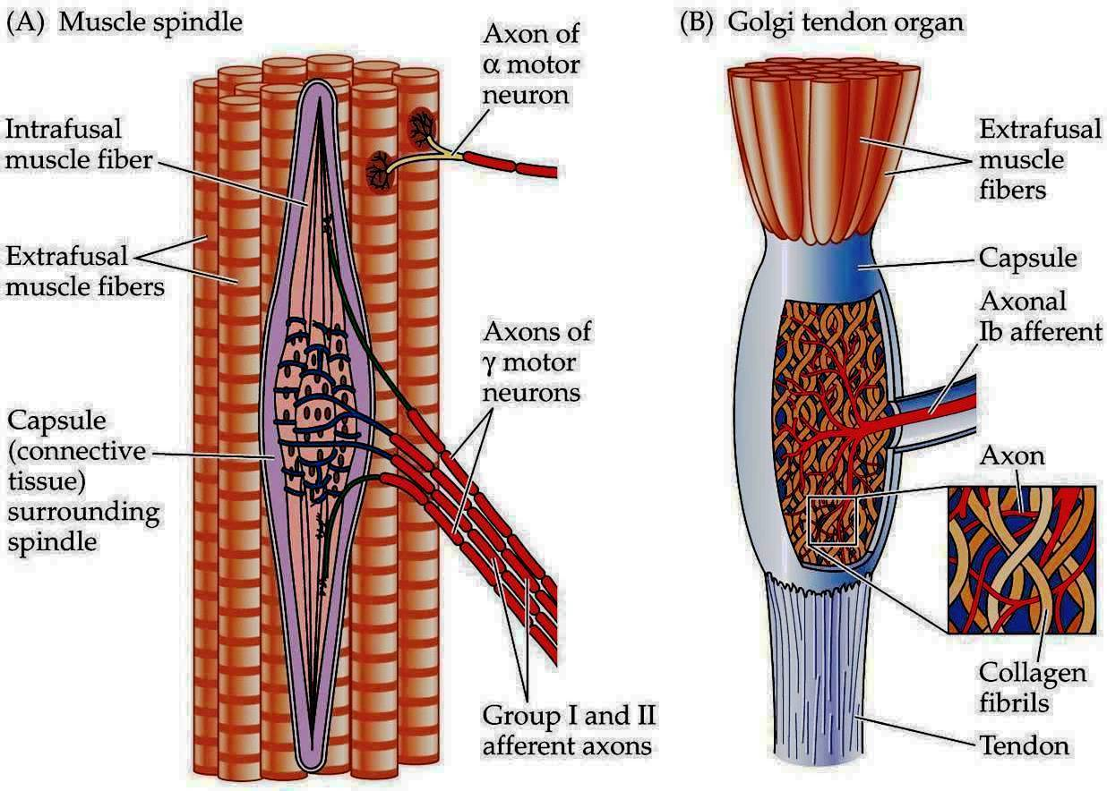
Muscle Sensory Receptors (Proprioceptors)
Proprioceptors provide information about the position of body parts
Muscle spindle
Response to stretch
Within muscle fibers as intrafusal fibrer
Automonic with gamma motor neurons
Golgi tendon organ
Muscle tension especially during isometric
Relaxation reflex - protective

Slide 4
Muscle Spindles
spread throughout the belly of the muscle.
send information to the CNS about muscle length or rate of change of length.
Each spindle is 3 to 10 millimeters long.
It is built around 3 to 12 tiny intrafusal muscle fibers , has few or no actin and myosin filaments

Slide 5
Sensory Innervation of the Muscle Spindle
Excited in two ways:
Lengthening whole muscle- stretches the midportion - excites the receptor.
if length of the whole muscle- does not change, contraction of intrafusal fibers stretches the midportion of the spindle and excites the receptor.

Slide 6
Sensory endings of muscle spindle
Primary ending (annulospiral ending) :
A large sensory nerve fiber
Encircles the central portion of intrafusal fiber.
Type ia fiber averaging 17 micrometers in diameter
Transmits sensory signals to the spinal cord at a velocity of 70 to 120 m/sec
Notes:
A type Ia sensory fiber, or a primary afferent fiber is a type of sensory fiber It is a component of a muscle fiber's muscle spindle which constantly monitors how fast a muscle stretch changes

Slide 7
Sensory endings of muscle spindle
Secondary Ending:
Usually one or two smaller sensory nerve fibers
type II fibers, average diameter of 8 micrometers-innervate the receptor region on one or both sides of the primary ending,
it encircles the intrafusal fibers in the same way that the type Ia fiber does.
Notes:
type II fibers type of sensory fiber the second of the two main groups of stretch receptors. They are non-adapting, meaning that even when there is no change in muscle length, they keep responding to stimuli

Slide 8
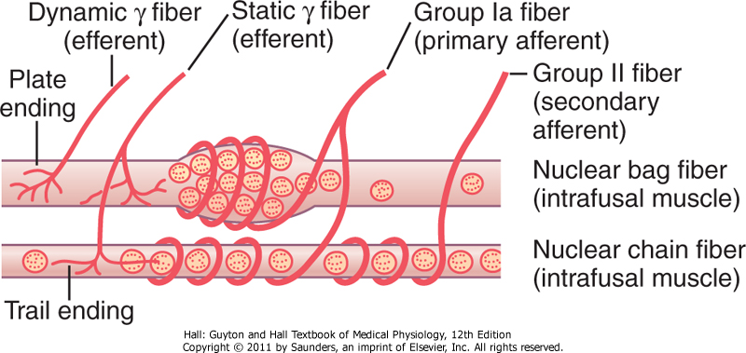
types of muscle spindle intrafusal fibers:
(1) nuclear bag muscle fibers (one to three in each spindle), in which several muscle fiber nuclei are meet in expanded "bags"
(2) nuclear chain fibers (three to nine) half as large in diameter and half as long as the nuclear bag fibers and have nuclei aligned in a chain throughout the receptor area

Slide 9
types of muscle spindle intrafusal fibers cont..
The primary sensory nerve ending (the 17-micrometer sensory fiber) is excited by both the nuclear bag intrafusal fibers and the nuclear chain fibers.
Conversely, the secondary ending (the 8-micrometer sensory fiber) is usually excited only by nuclear chain fibers.

Slide 10
Response of Both the Primary and the Secondary Endings
Response of Primary and the Secondary Endings to "Static" Response
muscle spindle is stretched slowly-impulses transmitted from primary and secondary endings transmit these impulses for several minutes (static response )
Response of the Primary Ending (Not the Secondary Ending) "Dynamic" Response
spindle receptor increases suddenly, the primary ending (but not the secondary ending) is stimulated powerfully.

Slide 11
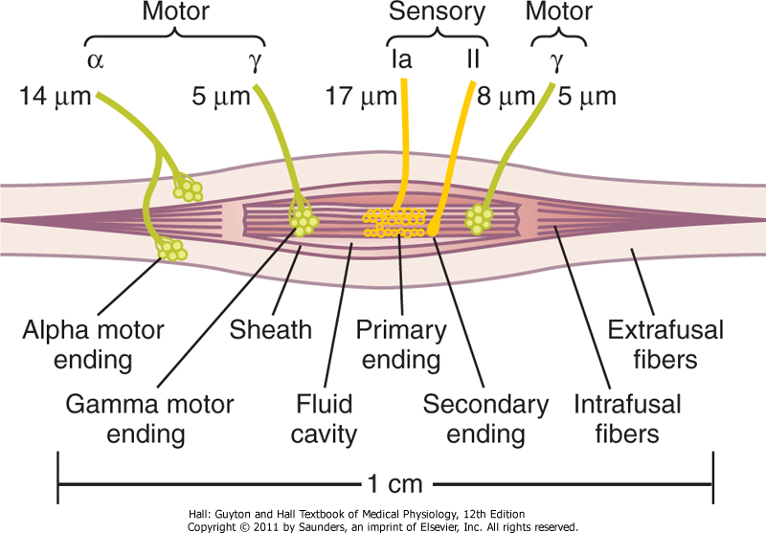
Control Intensity of Static and Dynamic Responses Gamma Motor Nerves
gamma motor nerves to the muscle spindle can be divided into two types: gamma-dynamic (gamma-d) excites mainly the nuclear bag intrafusal fibers
gamma-static (gamma-s). excites mainly the nuclear chain intrafusal fibers

Slide 12
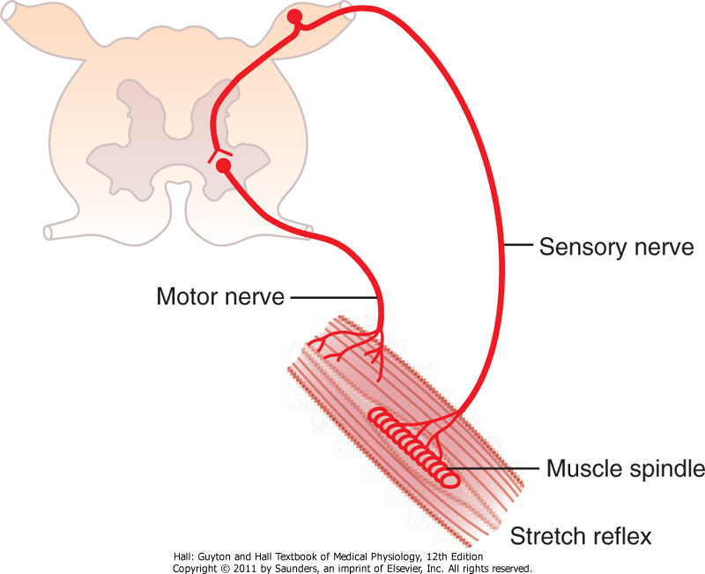
Muscle Stretch Reflex
muscle spindle signal entering a dorsal root of the spinal cord. A branch of this fiber then goes directly to the anterior horn of the cord gray matter and synapses with anterior motor neurons that send motor nerve fibers back to the same muscle from which the muscle spindle fiber originated.

Slide 13
Dynamic snd Static Stretch Reflex
The dynamic stretch reflex elicited by the strong dynamic signal from the primary sensory endings,
caused by rapid stretch or unstretch. That is, when a muscle is suddenly stretched or unstretched;
causes strong reflex contraction (or decrease in contraction) of muscle

Slide 14
Dynamic snd Static Stretch Reflex
static stretch reflex
elicited by the continuous static receptor
signals transmitted by both primary and secondary endings.
continues for a prolonged period

Slide 15
Clinical Applications of the Stretch Reflex
Determine how much background excitation, or "tone," the brain is sending to the spinal cord. Eg
Knee jerk striking the patellar tendon by hammer; this instantaneously stretches the quamuscle and excites a dynamic stretch reflex driceps
Reflexes can be obtained from any muscle of the body
Showing the degree of facilitation of spinal cord centers

Slide 16
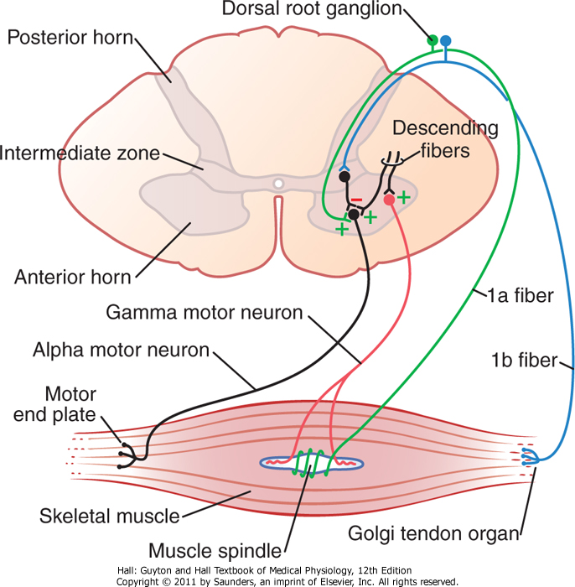
Second Muscle Sensory Receptors-Golgi Tendon cont..
(2) Golgi tendon organs located in the muscle tendons
transmit information about tendon tension or rate of change of tension.

Slide 17
Golgi Tendon Organ Helps Control Muscle Tension
is an encapsulated sensory receptor
About 10 to 15 muscle fibers are usually connected to each Golgi tendon organ
is stimulated when this small bundle of muscle fibers is "tensed" by contracting or stretching the muscle.

Slide 18
Difference Between Golgi Tendon Organ And Muscle Spindle
the major difference in excitation of the Golgi tendon organ versus the muscle spindle is that
the spindle detects muscle length and changes in muscle length,
whereas the tendon organ detects muscle tension as reflected by the tension in itself.

Slide 19
Inhibitory Nature Of The Tendon Reflex And Its Importance
When the Golgi tendon organs of a muscle tendon are stimulated by increased tension in the connecting muscle, signals are transmitted to the spinal cord to cause reflex effects in the respective muscle.
This reflex is entirely inhibitory.
Thus, this reflex provides a negative feedback mechanism that prevents the development of too much tension on the muscle and a protective mechanism to prevent tearing of the muscle or avulsion of the tendon from its attachments to the bone.

Slide 20
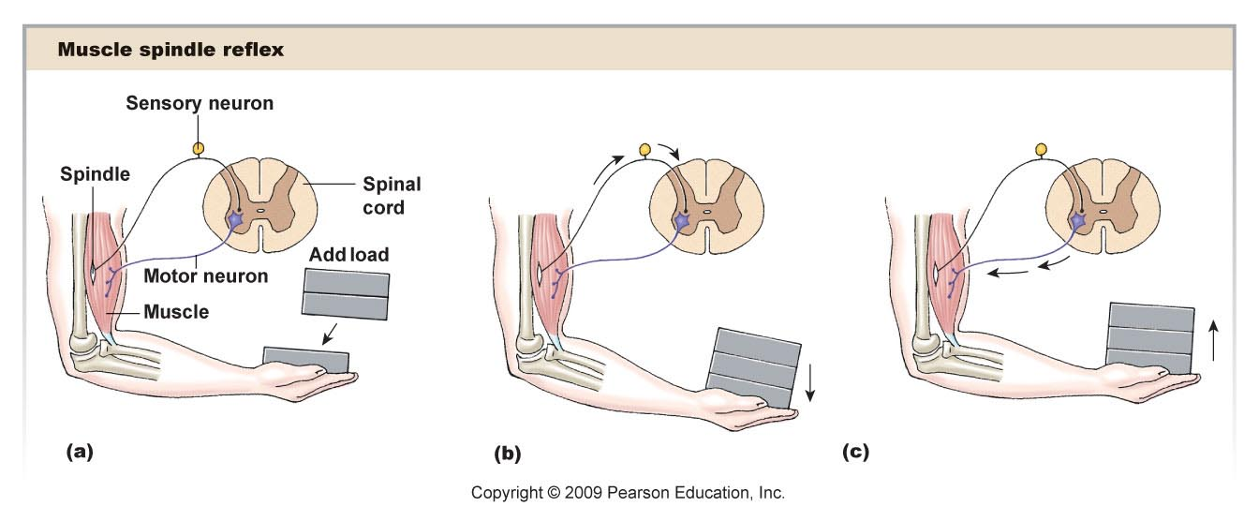
Muscle Reflexes Help Prevent Damage
Figure 13-6b

Slide 21
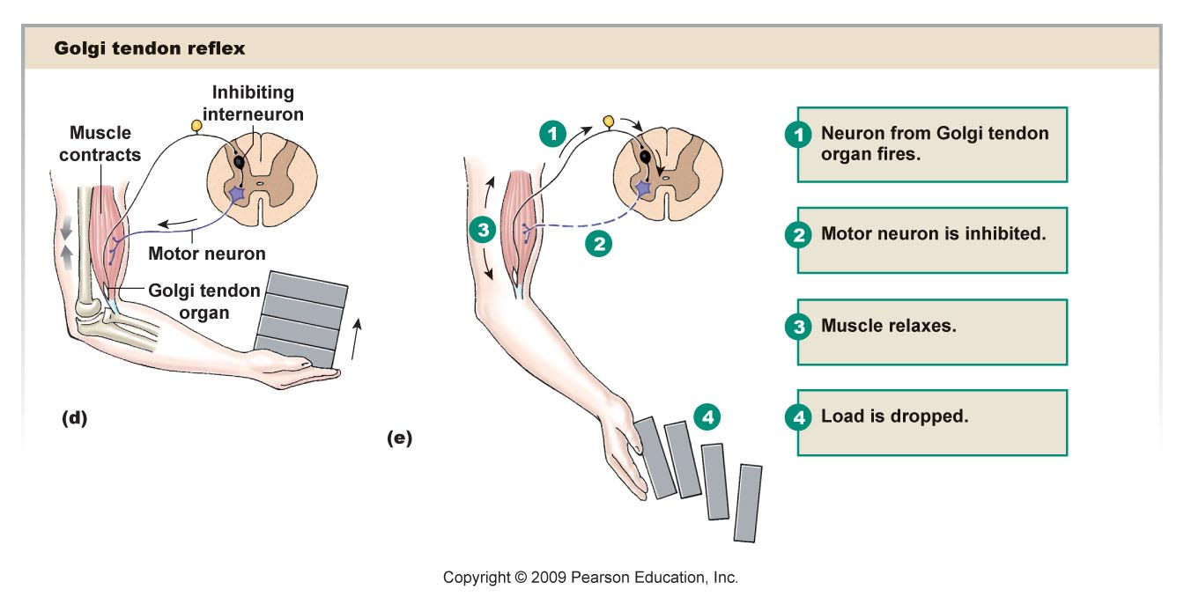
GTO’s
Figure 13-7

Slide 22
Clonus
involuntary, rhythmic muscular contractions and relaxations. Clonus is a sign of certain neurological conditions, particularly associated with upper motor neuron lesions
sustained clonus with five or more beats is considered abnormal.
Clonus may be seen in patients with stroke, multiple sclerosis and spinal cord damage

Slide 23
Reference book
Guyton & Hall: Textbook of Medical Physiology 12E
Thank you

