Slide 1
Spasticity and Increased Muscle Tone
Dr. Taha Sadig Ahmed,
Consultant , Clinical Neurophysiology
& Associate Professor , College of medicine , King Saud University , Riyadh

Slide 2
Objectives
At the end of this lecture the student should be able to :
(1) define what is meant by the term spasticity .
(2) appreciate that spasticity is an important condition that is encountered present in a broad spectrum of medical conditions frequently encountered in the Kingdom such as stroke , multiple sclerosis , cerebral palsy , traumatic spinal cord and brain injury , cerebral and spinal tumors , spinal cord disc lesions ; and in less common but important & preventable conditions such as tetanus and spinal cord infections such as tuberculosis of the spine . .
(3) explain the neurophysiological basis of clinical features associated with multiple sclerosis , cerebral palsy , traumatic spinal cord injury , tuberculosis of the spine and tetanus .

Slide 3
Some Resources
(1) Ganong’s Review of Medical Physiology
(2) Dobkin BH. Principles and practices of neurological rehabilitation. In: Bradley WG, Daroff RB, Fenichel GM, Jankovic J, eds. Bradley: Neurology in Clinical Practice. 5th ed. Philadelphia, Pa: Butterworth-Heinemann Elsevier; 2008:chap 52.
(3) Griggs R, Jozefowicz R, Aminoff M. Approach to the patient with neurologic disease. In: Goldman L, Ausiello D, eds. Cecil Medicine. 23rd ed. Philadelphia, Pa: Saunders Elsevier; 2007:chap 418.

Slide 4
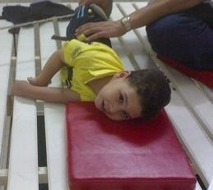
Q : What is Spasticity ?
It is velocity-dependent resistance to stretch
Spasticity is an important conditions that is encountered in a broad spectrum of medical specialities such as pediatrics , surgery , neurology , rehabilitation medicine , and others
It is due to imbalance between exitatory and inhibitory influences on motoneurons .

Slide 5
Q: What is spasticity ?
Clinically, spasticity is defined as “ velocity-dependent resistance to stretch” .
{For further reading you can look up refrences such as Lancet (1980), Ivanhoe CB and Reistetter (2004) }.
Taha : to be differentiated from “ rigidity ” which is not velocity-dependent & involves both flexors & extensors almost equally
It is caused by diseases that disrupt the normal physiological inhibition mechanisms of the the CNS →
leading to increased excitabilty of the stretch reflex → continuous , unremitting contraction of the muscles involved → hypertonia , tightness & stiffness of the muscles concerned ; and ,
depending on which muscle groups are involved , posture, voluntary movement and speech can be interferred with.

Slide 6
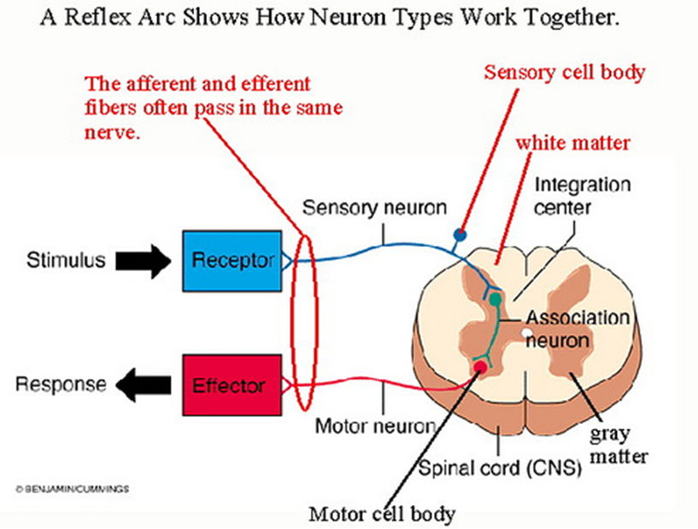
Some medical practitioners use the terms “spasticity” and “UMN syndrome/lesion ” interchangeably
However , althogh hypertonia ( & spasticity) are features of UMNL , not every condition of spasticity
is due to UMN lesion .
In UMN syndrome the lower motor neuron is freed from the descending inhibitory influence of the Higher Motor-Controlling centers
This results in →
(1) State of ongoing ( unremitting ) contraction of muscles, due to hyperactive gamma activity contraction , with
(2) decreased ability to control movement
(3) increased resistance felt on passive stretch.
Upper Motor Neuron

Slide 7
Main Features of UMN (Upper Motor Neuron) Syndrome
(1) Weakness and decreased muscle control .
(2) No remarkable muscle wasting , except from disuse
( disuse atrophy)
(3) Spasticity ( hypertonia ) , frequently called
“ clasp-knife spasticity ”
(4) Absent abdominal reflexes
(5) Extensor plantar reflex , Babinski sign
(6) Clonus
(7) Brisk ( exaggerated ) tendon jerks

Slide 8
Some conditions associated with spasticity :
(1) Cerebral palsy
(2) Stroke
(3) Spinal cord injury
(4) Multiple Sclerosis
(5) Acquired brain injury (trauma , etc)
(6) Tetanus

Slide 9
Spinal Cord Injury
Can be :
(I ) Complete transecion of spinal cord
(II) Hemisection of the spinal cord .

Slide 10
(I) Complete Transection of Paraplegia the Spinal Cord
Due to trauma , tumor , etc

Slide 11
The higher the level of the section, the more serious are the consequences.
If the transection is in the upper cervical region → immediate death follows, due to paralysis of all respiratory muscles;
Quadriplegia ( Tetraplegia )
Lesion ( e.g., bullet injury , car accident, fall) inn the lower cervical region at/below the 5th cervical segment → diaphragmatic respiration is still possible, but the patient suffers complete paralysis of all four limbs (quadriplegia
Paraplegia
Transection lower down in the thoracic region allows normal respiration but the patient ends up with paralysis of both lower limbs (paraplegia).

Slide 12
Spasticity does not occur immediately following a spinal cord injury. When an injury occurs to the spinal cord, the body goes into spinal shock, and this may last several weeks. During this time changes take place to the nerve cells which control muscle activity.
Once spinal shock wears off, the natural reflex which is present in everyone reappears.
Spasticity is an exaggeration of the normal reflexes that occur when the body is stimulated in certain ways

Slide 13
Stages of paraplegia
A/ Spinal shock ( 2-6 weeks )
B/ Recovery of reflex activity
C/ Paraplegia in extension
A/ Spinal shock
In the immediate period following transection
there is :
(1) complete loss of spinal reflex activity below the
level of the lesion .
(2) Loss of all sensations (anesthesia) and voluntary movement( paralysis) below the level of the lesion
(3) Loss of tendon reflexes and superficial reflexes
(abdominal , plantar & withdrawal reflexes ) .

Slide 14
(6) The wall of the urinary bladder becomes paralysed and urine retention retained occurs
(7) Loss of vasomotor tone occurs → vasodilatation causes a fall in blood pressure; the higher the level of the section, the lower the blood pressure.
This stage varies in duration but usually lasts a maximum of 2-6 weeks, after which some reflex activity recovers.

Slide 15
B/ Stage of return of reflex activity
As the spinal shock ends , spinal reflex activity appears again this partial recovery may be due to increase in the natural degree of excitability of the spinal cord neurons below the level of the section ,
Proably related to disinhibition of motoneurons as a result of absence of inhibitory impulses from higher motor controlling centers + sprouting of fibrers from remaining other + denervation supersensitivity to excitatory neurotransmitters ).

Slide 16
Features of the stage of recovery of reflex activity
(A) Gradual rise of arterial blood pressure due to return of spinal vasomotor activity in the lateral horn cells. But, since vasomotor control from the medulla is absent, the blood pressure is not stable.
(B) Return of spinal reflexes, but stretch reflexes are exaggerated .
Flexor reflexes ( e.g., Withdrawal Reflex ) return earlier than extensor ones.
As a result of recovery of flexor tone before extensor tone→ the lower limbs to take a position of slight flexion i.e., Paraplegia in Flexion.
Extensor plantar reflex or complete Babiniski sign
( dorsiflexion of big toe +
fanning of the other toes )) occurs

Slide 17
(II) Recovery of visceral reflexes: return of micturition, reflex → Automatic Bladder
However , voluntary control over micturition and
defecation , and the sensation of bladder and rectal
fullness are permanently lost.

Slide 18
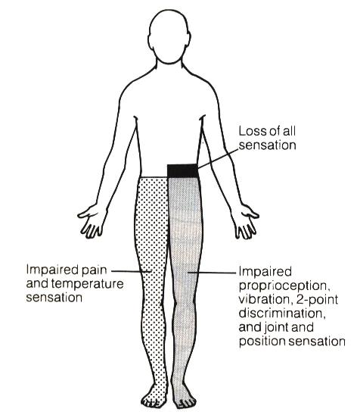
Hemisection of the Spinal Cord ( Brown-Sequard syndrome
A/ At the level of the lesion, all
manifestations occur on the same side:
1. Paralysis of the lower motor neuron type
2. Loss of all sensations in the areas supplied by
the afferent fibres that enter the spinal cord
in the damaged segments
B/ Ipsilaterally below the level of the lesion :
1. spastic lower limb .
2.Fine touch, position and vibration sense are lost
3.Vasodilatation
C/ Contralaterally below the level of the lesion :
Pain and temperature sensations are lost, Why ?

Slide 19
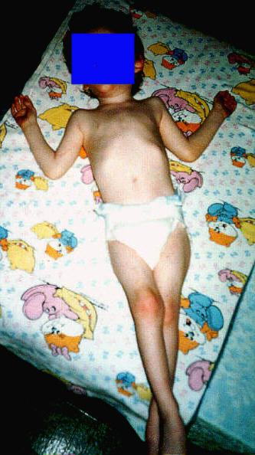
Cerebral palsy (CP)
CP is an umbrella term encompassing a group of non-progressive , motor conditions
that cause physical disability in human development ,
chiefly in the various areas of body movement .
Cerebral palsy is caused by damage to the motor control centers of the developing brain
and can occur during pregnancy , during childbirth or after birth up to about age three

Slide 20
Stroke

Slide 21
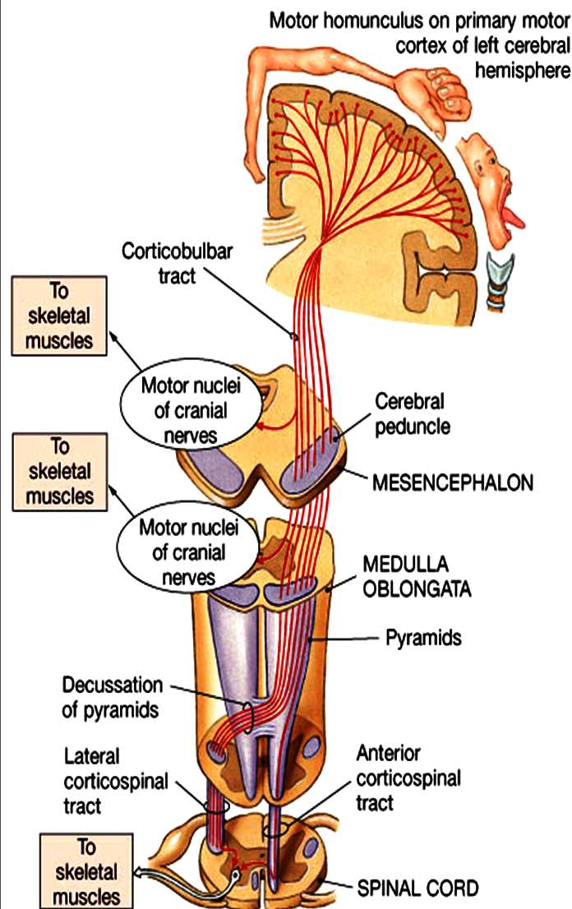
Causes :
cerebral heamorrhage , thrombosis or embolism in the Internal Capsule →results in paralysis in the oppsite half of the body .

Slide 22
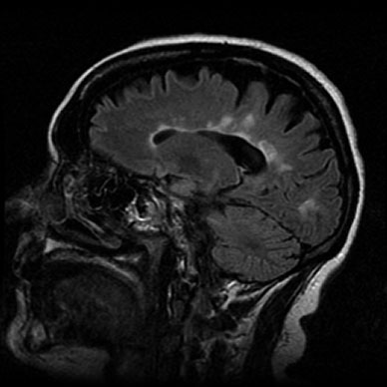
Multiple Sclerosis ( MS)
( abbreviated MS, also known as disseminated sclerosis
or encephalomyelitis disseminata)

Slide 23
Multiple sclerosis , MS ( first described in 1868 by Charcot )) is an auto-immune demyelinating disease , in which the body's own immune system attacks and damages the myelin.
Loss of myelin sheath myelin (demyelination) prevents axons from conducting action potentials .
Disease onset usually occurs in young adults, and it is more common in females .
The disease frequently shows remissions & relapses
The disease can attack any part of the CNS , and when it causes demyelination of motor tracts in the brainstem , the subject develops spasticity and other signs of UMNS .

Slide 24
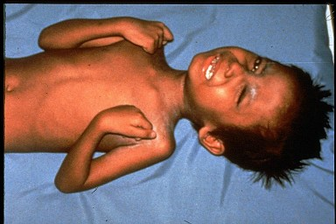
Tetanus
This is a medical condition characterized by a prolonged contraction of skeletal muscle fibers.
The primary symptoms are caused by a neurotoxin produced by the Gram-positive anaerobic bacterium Clostridium Tetani .
Infection generally occurs through wound contamination
As the infection progresses, the patient develops spastic muscle spasms in the jaw (thus the name "lockjaw“ ) , face ( Sardonic Smile, Risus Sardonicus ) and elsewhere in the body ( e.g. opisthotonus )

Slide 25
Thank you

