Slide 1
Pain Modulation
Dr Abdulrahman Alhowikan
Collage of medicine
Physiology Dep.

Slide 2
Objectives:
Students should know gate-control hypothesis and role of body’s own morphines.
Students are required to know about descending pain ratifying pathway from brain.
Terms frequently used to explain pain

Slide 3
Introduction
Pain modulation means pain perception variability which is influenced by endogenous and exogenous mechanism
Thing that can increase or decrease pain threshold
Enhancement and inhibition all levels of the nervous system. Modulation at the peripheral nerve, spinal cord, brain sites influences pain perception.

Slide 4
Pain Modulation Can Be Explained Via
Spinal modulation of pain input
Gate theory of pain
Supra spinal modulation
Role of periaqueductal grey (PAG) matter
Role of Nucleus Raphe Magnus (NRM)
Pain modulation by use of Opioid neurotransmitters eg: endorphin, enkaphalin Dynorphin.

Slide 5
Spinal Modulation
"Gate Control" theory was proposed by Melzack and Wall 1960s.
:non-painful input closes the gates to painful input

Slide 6
Gate Control Theory
Large sensory fibers carrying cutaneous sensory input (skin) activate inhibitory interneurons, which inhibit (modulate) pain transmission information carried by the pain fibers.
Non-noxious (harmful) input stop pain, or sensory input “closes the gate” to noxious input .

Slide 7
Gate Control" theory
The gate theory predicts that at the spinal cord level
Non-noxious stimulation will produce presynaptic inhibition on dorsal root nociceptor fibers that synapse on nociceptors spinal neurons
This presynaptic inhibition will block incoming noxious information from reaching the CNS close the gate to incoming noxious information.

Slide 8
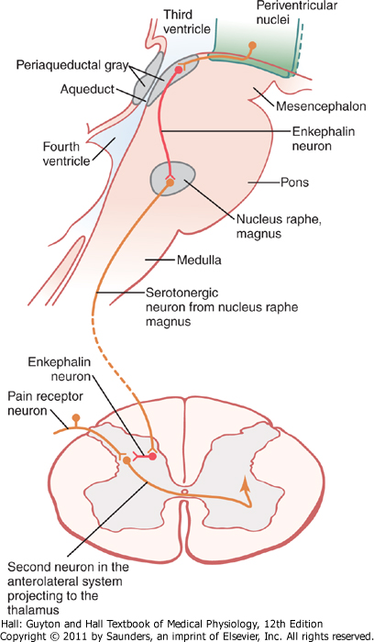
Supraspinal Modulation
(1) The periaqueductal gray and periventricular areas of the mesencephalon and upper pons
(2) the raphe magnus nucleus, a thin midline nucleus located in the lower pons and upper medulla, and the nucleus reticularis paragiganto cellularis
Notes:
The midbrain or mesencephalon
periaqueductal plays a role in the descending modulation of pain

Slide 9
Supraspinal modulation
Activation of opiate (anesthetic )receptors at the interneuronal level result in the inhibition of pain by stop release of substance P (neurotransmitter ) so blocking pain transmission.
The circuit that consists of the periaqueductal gray (PAG) matter in the upper brain stem,
the nucleus raphe magnus (NRM) contribute to the descending pain suppression pathway, which inhibits incoming pain information at the spinal cord level

Slide 10
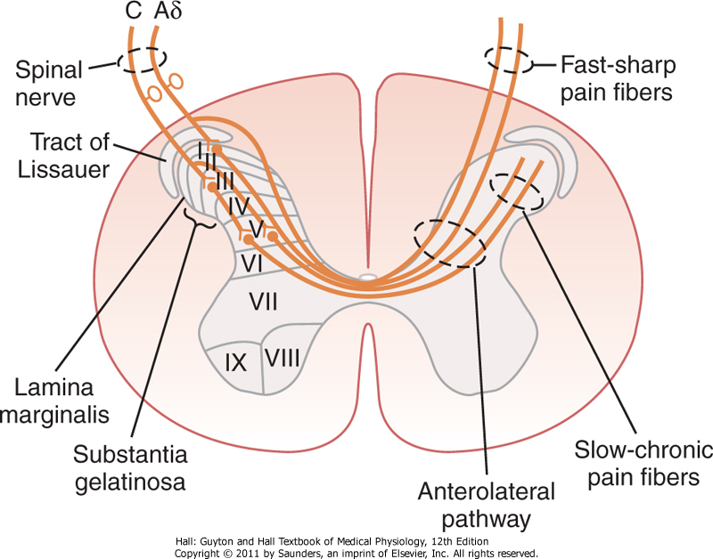
Mechanism Of Opioid Neurotransmitter Action :
ENDORPHIN:
Neurons using endorphin or enkaphalin are found in periaqueductal gray PAG where they inhibit GABAnergic interneurons (nurotransmitter) that normally stop the anti-nociceptor neurons
ENKAPHALIN:
It is used by interneurons
in lamina II responsible for
inhibiting the lamina – I
nocioceptor-specific
spinothalamic neurons
ENDOGENOUS MORPHIN:
It has been identified in terminals forming synapses with neuron having μ-opioid receptors in pain modulating pathways.
Notes:
Opioid: (morphine)
endogenous morphine: peptides that function as neurotransmitters, produced by pituitary gland and the hypothalamus invertebrates

Slide 11
Chronic Pain
Chronic pain can be considered as bad pain because it persist long after injury and is often refractory (anti) to pain killers.
longer than 3-6 months
Chronic pain caused by nerve injury is called neuropathic pain, brain still receives signals from damage nerves
From known cause, eg. surgery or inflamed joints. Many times the cause is unknown.

Slide 12
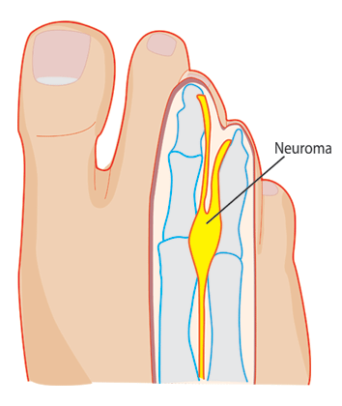
Neuropathic pain
Caused by the damage to peripheral nerve
( adrenalin release by sympathetic discharge)
The distal cut end develops a scar tissue forming rounded ball ( neuroma) which is sensitive to pressure.
Repeated activation causes continuous pain.
Examples are like, post herpetic neuralgia (chickenpox ) and diabetic neuropathy. (Injuries of small blood vessels that supply nerves)

Slide 13
Phantom pain
Pain felt in an amputated part long after amputation was done.
Many explanations
1-network connecting the thalamus, cortex brain. And body has schema and orientated conscious awareness of body parts.
2-injured nerve endings able to fir abnormal action potentials

Slide 14
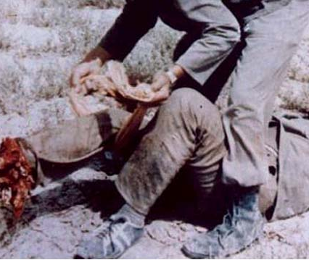
Stress induced analgesia
It’s a well known phenomenon seen when the soldier is wounded in battle field but feels no pain until the battle is over. The cause is not known may be it is similar to Gate control hypothesis.

Slide 15
Terms frequently used to explain pain
Hyperalgesia: Excessive Pain
Allodynia: Pain caused by any other sensation
e.g. touch will cause pain.
Muscular Pain: Less blood flow in the muscles (ischemia).
Stress analgesia: Mild degree of pain is not felt if the other part of the body has excessive pain.
Causalgia: Burning pain.

Slide 16
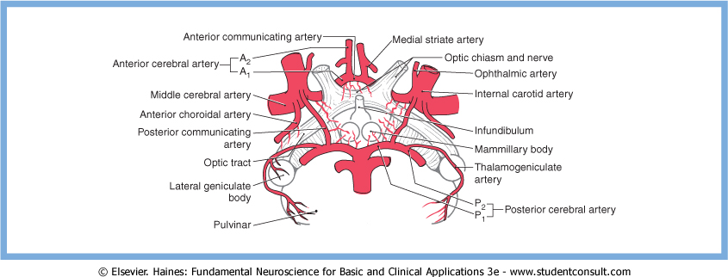
Terms frequently used to explain pain
Thalamic Syndrome
Obstruction of the thalmogeniculate branch of the posterior cerebral artery Affects posterior thalamic nuclei.
Prolonged severe pain.

Slide 17
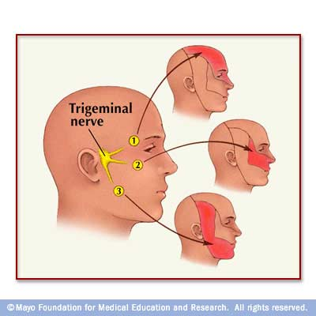
Terms frequently used to explain pain
Trigeminal neuralgia
It is excruciating intermittent pain by stimulation of trigger area in the face as for eg. Washing of face, combing hair, blast of air on face.
It results from compression of trigeminal nerve root by blood vessels
Affects the trigeminal or 5th cranial nerve, one of the most widely distributed nerves in the head.

Slide 18
Reference book
Guyton & Hall: Textbook of Medical Physiology 12E
Textbook : Review of Medical Physiology (Ganong)
Thank you

