Slide 1
Physiology of Motor Tracts
Dr. Taha Sadig Ahmed,

Slide 2
Objectives of Lecture of Physiology of motor tracts
At the end of this lecture the student should :
(A) Appreciate what is upper motor neuron and lower motor neuron .
(B) The main differences between the pyramidal and extrapyramidal systems .
(C) explain the origin , course and functions of the following motor tracts :
(1) corticospinal.
(2) tectospinal .
(3) rubrospinal .
(4) vestibulospinal .
(5) reticulospinaql .
(6) olivospinal .

Slide 3
For performance of voluntary movements two levels of neurons are essential:
- Upper motor neurons (UMN)
These are the cortical & brainstem neurons which send motor signals through the pyramidal and extrapyramidal tracts to the cranial and spinal motor nuclei.
- Lower motor neurons: (LMN)
These are the neurons of the motor nuclei of the cranial nerves and anterior motor neurons in the spinal cord, their axons, and the muscles innervated by them.
Motor Cortex ( Cortical Motor Areas)
The motor cortex lies anterior to the central sulcus and occupies the posterior third of the frontal lobe. Motor signals from the motor cortex are sent through pyramidal and extrapyramidal tracts to terminate on motor neurons in the spinal cord and brain stem.
The activity of the lower motor neuron (LMN, spinal or cranial) is influenced by →
(1) Upper Motor Neurons (UMNs ) coming from supraspinal centers via ) via descending motor tracts .
(2) Interneurons
(3) Afferent (sensory nerves ) .

Slide 4
Functions of the two UMN systems :
Pyramidal system :
Initiates & controls voluntary , fine , discreteدقيق , skilled ( manipulative ) movements
This type of movement is carried mainly by the distal limb muscles .
Output goes to the brain stem nuclei (corticobulbar tracts ) & spinal cord (corticospinal tracts ).
Pyramidal fibres are comparatively slow conducting , because at least half of the pyramidal tract fibers are unmyelinated .
Extrapyramidal system :
(1) sets the postural background needed for performance of skilled movements and,
(2) controls subconscious gross movements.
Impulses along the extrapyramidal tracts reach the muscles much faster than impulses passing along the pyramidal tracts .
Notes:
البيراميدال : يستهل و يظبط ( ينسق ) الحركة الأرادية والأكسترابيراميدال : يهيء الخلفية الوضعية اللازمة ( كتثبيت الجسم في وضع ثابت و المحافظة علي توازنه ) لأداء الحركة الأرادية + زائدا عمل الحركات المصاحبة للحركة الأرادية ( زي تحريك اليدين لوراء وقدام ) و التي تحت سيطرة اللاوعي subconscious

Slide 5
Pyramidal Tracts

Slide 6
Areas Contributing Pyramidal ( Corticospinal ) Fibers
(1) The primary motor area ( M1 . Motor area 4)
occupies the precentral gyrus & contains large , highly excitable Betz cells.
MI of one side controls skeletal muscles of the opposite side of the body
(2) The Supplementary Motor Area ( SMA,M2)
Lies in front of area 4 and above the pre­motor area
This area projects mainly to M1 and is concerned with planning and programming motor sequences ( sequence of movements)
(3) Premotor Area ( M3)
lies in front of the primary motor area & below supplementary motor area.
Stimulation of the premotor area produces complex coordinated movements, such as setting the body in a certain posture to perform a specific task.
(4) Pareital lobe :
The Parietal lobe contributes about 40% of the fibers that run in
the pyramidal tracts
Notes:
الهيمنة الدماغية cerebral dominance

Slide 7
Supplementary Motor Area (M2)
Located on the lateral side
in front of area 4
This area projects mainly to M1 and is concerned with planning and programming
The primary motor area ( M1, Area4 )
occupies the precentral gyrus & contains large , highly excitable Betz cells.
MI of one side controls skeletal muscles of the opposite side of the body
M2,SMA
M1
PPC( Posterior
Parietal Cortex)
S1
M3
PM
The Parietal lobe contributes about 40% of the fibers that run in the pyramidal tracts
(3) Premotor Area ( PM, M3)
lies in front of the primary motor area & below supplementary motor area.
Stimulation of the premotor area produces complex coordinated movements, such as setting the body in a certain posture to perform a specific task.

Slide 8
Corticospinal ( Pyramidal) Tracts
Cells of origin →
30% originate from the primary motor area,
30% from the premotor areas , and
40% from the somatic sensory areas posterior to the central sulcus.
3% of the fibres are large myelinated fibres, derived from the large , highly excitable pyramidal Betz cells of MI . These fibers form monosynaptic connections with motor neurons of the spinal cord.
But most of pyramidal fibers are unmyelinated
Fibers from the cerebral cortex descend in corona radiata to reach the internal capsule
( occupying the genu and the anterior two-thirds of the posterior limb)

Slide 9
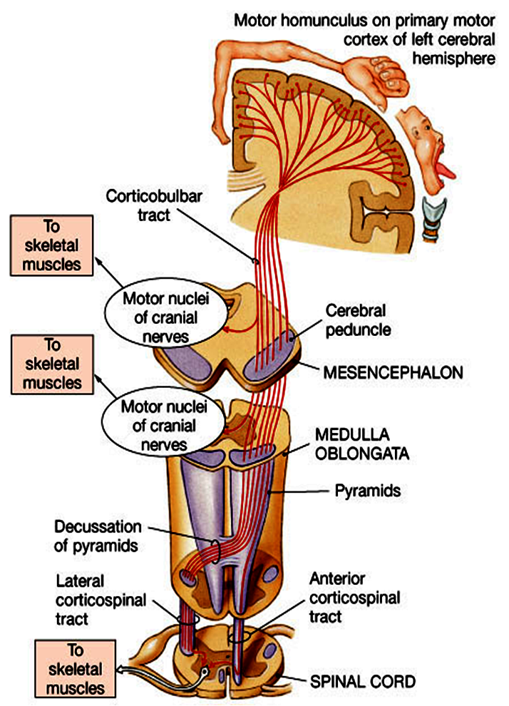
Then descend through the
midbrain and pons.
Some fibers cross in brainstem to
supply contralateral cranial nerve nuclei
constitute the Corticobulbar tract .
In the lower medulla
around 80% of the fibre cross to the
opposite side,
and descend in the lateral column of
spinal cord as the Lateral Corticospinal
Tract .
They synapse on the
contralateral spinal motoneurons , or on
interneurons

Slide 10
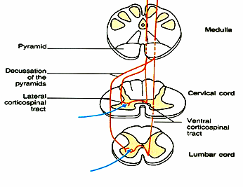
The remaining 20 % of
corticospinal fibers do not
decussate in the medulla .
They descend ipsilaterally
in the ventral column of the
spinal cord white matter ,
Constitutingthe Ventral
( Antrior) Corticospinal
Tract .
Finally they decussate
(cross to the opposite side )
& synapse on the
contralateral spinal
motoneurons

Slide 11
Extrapyramidal Tracts

Slide 12
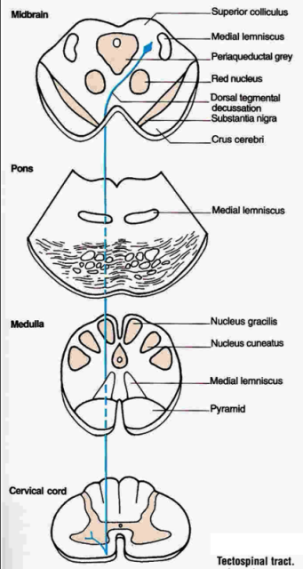
Tectospinal Tract
Originates in Superior Colliculus in midbrain) → then decussate in the dorsal tegmentum
Axons descend in ventral white column of spinal cord
And terminate on Contralateral cervical AHCs
Function :This tract produces reflex turning of the head and neck ( in response to visual and auditory stimuli) → toward the direction of the stimulus

Slide 13
Reticulospinal Tracts
Functions : These tracts influence both Alpha & Gamma motoneuron activities .They regulate muscle tone and inhibit unwanted reflex contractions .
(1) Pontine (Medial) Reticulospinal Tract:
Cells of origin: Pontine Reticular Formation
Axons descend in ventral white column of spinal cord
Axons terminate in ipsilateral spinal motoneurons
Pontine Reticulospinal Tract increases activity ,
( consequently , increases muscle tone )

Slide 14
(1) Medullary (Lateral) Reticulospinal Tract:
Cells of origin: Medullary Reticular Formation
Axons descend in ventral white column of spinal cord on both sides (both crossed & uncrossed)
Axons terminate in ipsilateral & contralateral ventral horn cells of spinal cord
Medullary Reticulospinal Tract, on the other hand , inhibits Gamma Efferent activity ( consequently, decreases muscle tone ) .

Slide 15
Vestibulospinal Tracts

Slide 16
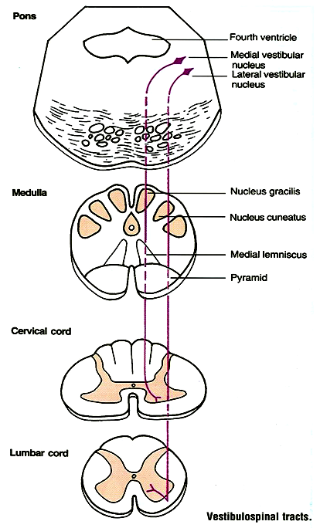
Vestibular Apparatus detects changes head position ) →
sends fibers to Vestibular Nuclei in Pons + to Cerebellum → correction obody position + moves eyes to help in help in correction ( correction consciously by vision )

Slide 17
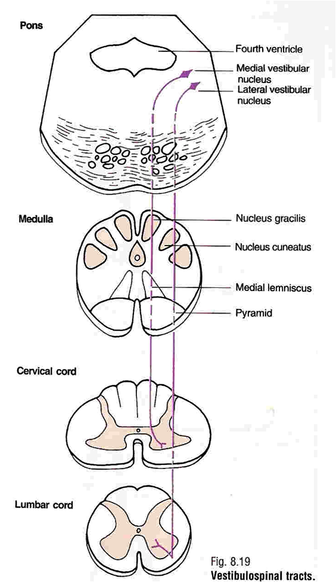
Vestibulospinal Tracts
Fibers originate in vestibular nuclei in pons (which receive inputs from inner ear Vestibular Apparatus and Vestibulocerebellum)
Axons descend in the ipsilateral ventral white column of spinal cord
Excitatory to ipsilateral spinal motoneurons
( including gamma efferents ) that supply axial & postural muscles

Slide 18
Functions of Vestibulospinal Tracts
Vestibulospinal tracts control reflexes e.g. Postural & righting ( which correct body position ) + control eye movements.
The lateral vestibulospinal
Cells of origin : Lateral Vestibular Nucleus
Axons desend in the ipsilateral ventral white column of spinal cord .
This tract mediates excitatory influences upon extensor motor neurones to maintain posture
The medial vestibulospinal tract :
Cells of origin : Medial Vestibular Nucleus
As its axons desend ipsilaterally in the ventral white column of spinal cord , they form part of the Medial Longitudinal Fasciculus
The medial longitudinal fasciculus consists of both ascending & descending fibers that link vestibular nuclei to nuclei supplying the extraocular muscles for coordination of head and eye movements

Slide 19
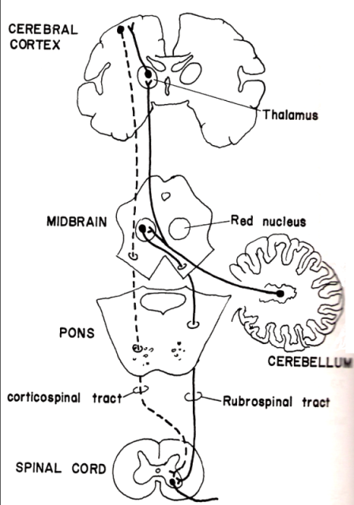
Rubrospinal Tracts
After emerging from Red Nucleus in midbraln , fibers decussate at same level of red nucleus
Descend with the lateral corticospinal tract
In spinal cord tract occupies the lat. white column , & fibers synapse on the contralateral AHCs

Slide 20
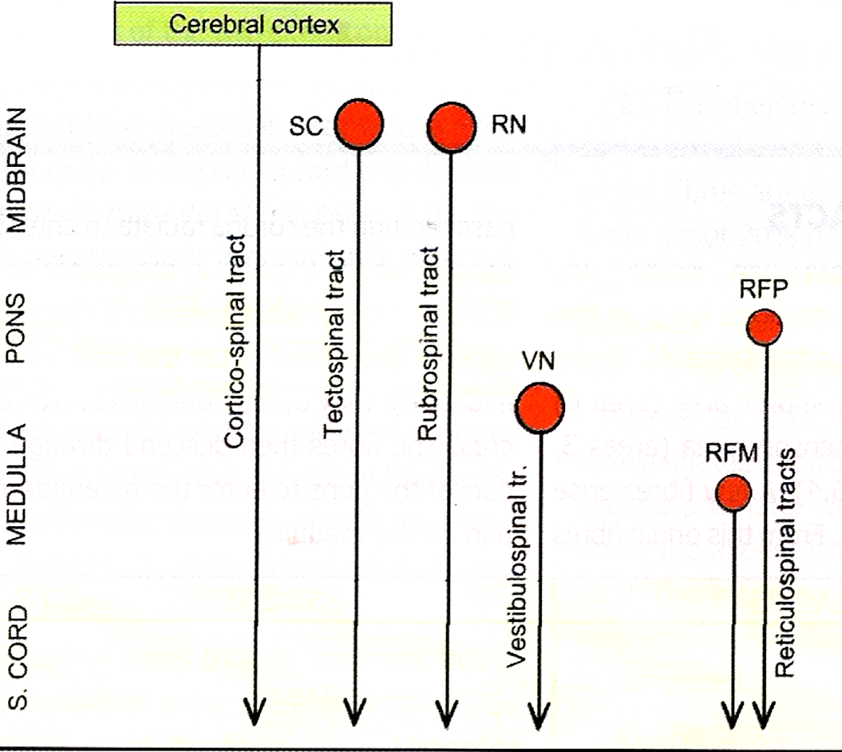
Summary of motor Tracts

Slide 21
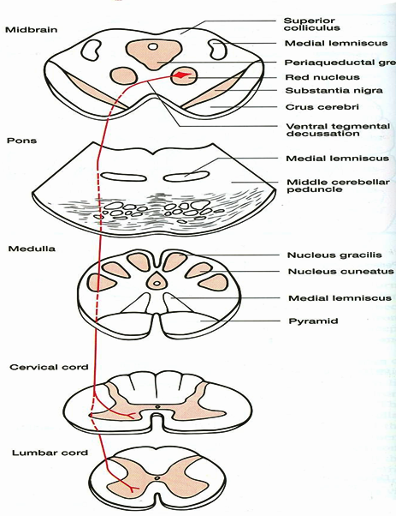
Red nucleus is connected by fibers with with the cerebral cortex ( e BG) & cerebellum .
Fibers are inhibitory to AHCs controlling extensor muscles ( & excitatory to the antagonist flexor muscles + do not forget reciprocal inhibition property also comes into play here )
& distributed, similar to corticospinal fibers
( which are largely excitatory ) , to distal limb motoneurons that control skilled movement
Notes:
Movement produced by Cortex & BG contains errors ( added movements ) + can be inccordinated . Red nucleus is used by cortex & cerebellum & BG to smmothen out these movements + coordinate them → prevenyt movement disoreders & Ataxia

Slide 22
Thank you

