Slide 1
Physiology of Pain
Dr Abdulrahman Alhowikan
Collage of medicine
Physiology Dep.

Slide 2
Objectives of lecture:
After the lectures student should be able to:
To know about the receptor of pain.
The types of neuron responsible for conduction of impulses e.g A-delta andC- types.
Two types of pain e.g fast and slow.
Know the tracts involved and its functions.
Know the role of thalamus and cortex in the perception of pain.

Slide 3
Pain Is a Protective Mechanism
Definitions:
An unpleasant sensory and emotional experience associated with actual or potential tissue damage.
Pain occurs whenever tissues are being damaged, and it causes the individual to react to remove the pain stimulus
!!! Measuring the pain ???

Slide 4
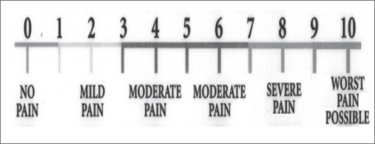
!!! Measuring the pain ???
Visual Analogue Scale (VAS) is a subjective measure of pain.
baseline assessment of pain with follow-up

Slide 5
Types of Pain
Fast pain or (sharp pain, pricking pain, acute pain, and electric pain) felt within about 0.1 second after a pain stimulus is applied
Absent in most deeper tissues of the body
Eg. Skin cut with a knife, needle
slow pain (slow burning pain, aching pain, throbbing pain, nauseous pain, and chronic pain) begins only after 1 second or more and then increases slowly over many seconds and sometimes even minutes.

Slide 6
Pain Receptors and Their Stimulation
The pain receptors: all free nerve endings
widespread in the superficial layers of the skin and internal tissues, such as the periosteum, the arterial walls, the joint surfaces,
Types of Stimuli Excite Pain: mechanical, thermal, and chemical pain stimuli
fast pain: elicited by the mechanical and thermal stimuli
slow pain: can be elicited by all three types of stimuli.

Slide 7
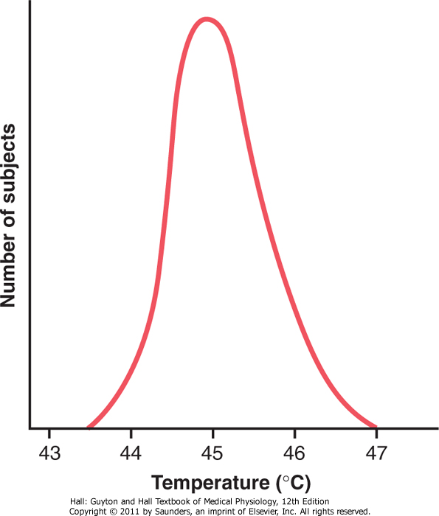
Cont.. Pain Receptors and Their Stimulation
If pain stimulus continues. This increase in sensitivity of the pain receptors is called hyperalgesia
hyperalgesia keep the person apprised of a tissue-damaging e.g slow-aching-nauseous pain
Rate of Tissue Damage as a Stimulus for Pain
E.g if skin is heated above 45 °C
Chemical Pain Stimuli During Tissue Damage
bradykinin might be the agent most responsible for causing pain following tissue damage or enhance the sensitivity of pain endings
Notes:
Bradykinin is a peptide that causes blood vessels to dilate (enlarge)

Slide 8
Cont.. Pain Receptors and Their Stimulation
Tissue Ischemia as a Cause of Pain lead to (accumulation of large amounts of lactic acid and bradykinin )
E.g
1-blood flow to a tissue is blocked
2-Exercise of muscles cause muscle pain within 15 to 20 s
Muscle Spasm as a Cause of Pain: !!!Due to
1- direct by stimulating mechanosensitive pain receptors
2-indirect due to ischemia

Slide 9
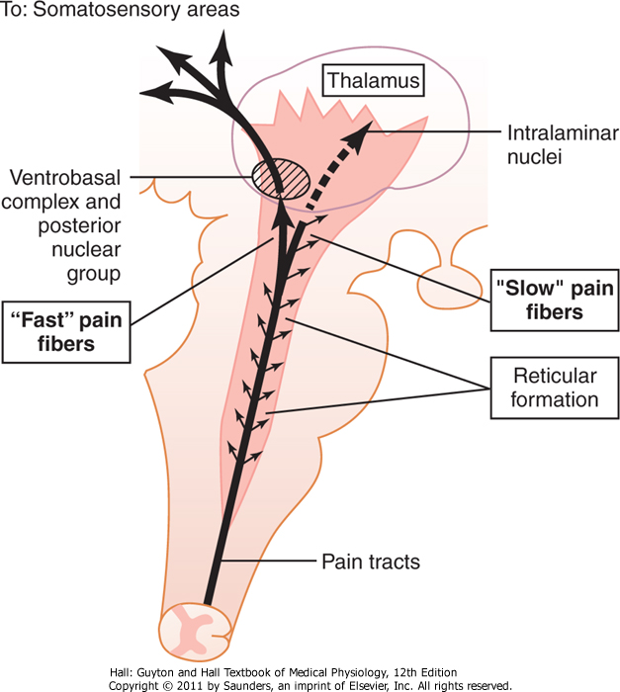
Pathways for Transmission of Pain Signals
two separate pathways:
fast-sharp pain pathway
elicited by mechanical or thermal stimuli
transmitted in the peripheral nerves by small type Aδ fibers at velocities 6 - 30 m/sec.
slow-chronic pain pathway
elicited mostly by chemical stimuli but sometimes by mechanical or thermal stimuli. transmitted to the spinal cord by type C fibers at velocities 0.5 - 2 m/sec.

Slide 10
Cont.. Pathways for Transmission of Pain Signals
consequently, Fast and slow entering the spinal cord the pain signals take two pathways to the brain
(1) neospinothalamic tract
(2) paleospinothalamic tract.

Slide 11
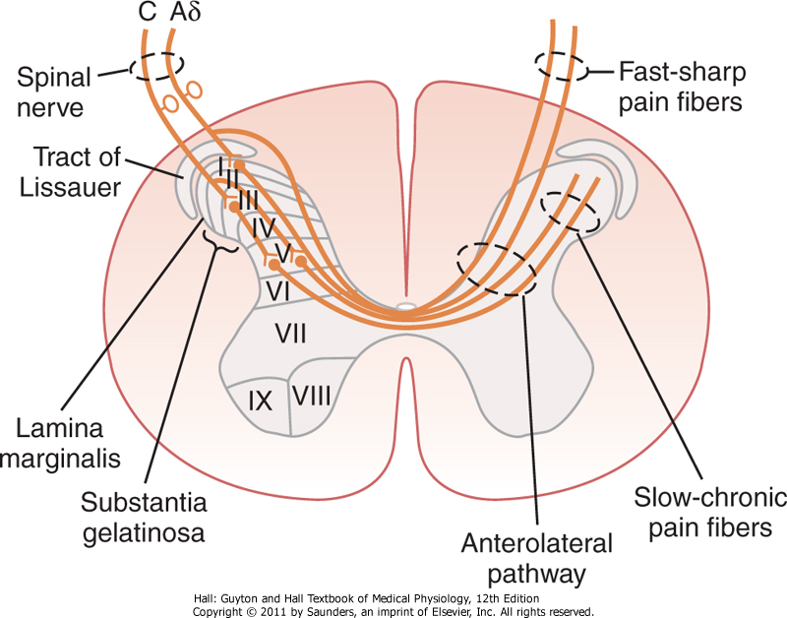
Cont.. Pathways for Transmission of Pain Signals
(1) neospinothalamic tract
fast type Aδ pain fibers transmit mechanical and acute thermal pain ( glutamate is the neurotransmitter in the spinal cord
terminate mainly in lamina I (lamina marginalis)

Slide 12
Cont.. Pathways for Transmission of Pain Signals
(2) the paleospinothalamic tract.
transmits pain via slow-chronic type C pain fibers
terminate in the spinal cord in laminae II and III (together called substantia gelatinosa
however, type C pain fiber release two transmitter glutamate (fast pain) and substance P (slow pain )

Slide 13
Surgical Interruption of Pain Pathways
the pain nervous pathways can be cut at any points
If pain in lower part of the body, a cordotomy in the thoracic region of the spinal cord often relieves the pain for a few weeks to a few months

Slide 14
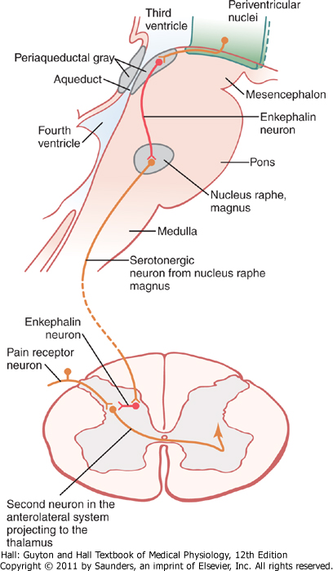
Pain Suppression (Analgesia) in Brain and Spinal Cord
consists of three components:
(1) The periaqueductal gray and periventricular areas of the mesencephalon and upper pons
(2) the raphe magnus nucleus, a thin midline nucleus located in the lower pons and upper medulla, and the nucleus reticularis paragiganto cellularis
(3) a pain inhibitory complex located in the dorsal horns of the spinal cord.
Notes:
The midbrain or mesencephalon
periaqueductal plays a role in the descending modulation of pain

Slide 15
Nociceptive Pain
https://www.youtube.com/watch?v=PMZdkac4YLk&list=PL696DB7FD0EA1C59E

Slide 16
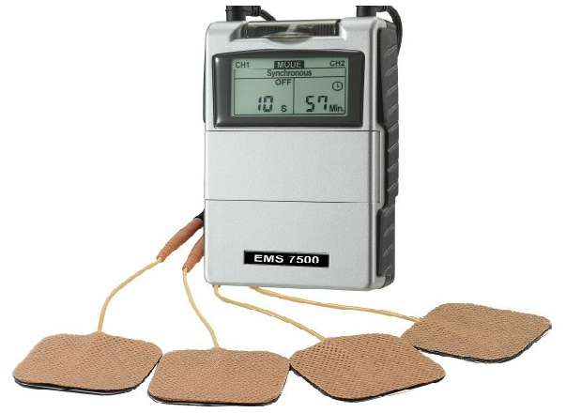
Treatment of Pain by Electrical Stimulation
electrodes are placed on selected
areas of the skin or, on occasion,
implanted over the spinal cord,
supposedly to stimulate the
dorsal sensory columns.
in appropriate intralaminar
nuclei of the thalamus or in the periventricular or periaqueductal area of the diencephalon. The patient can then personally control the degree of stimulation. pain relief has been reported to last for as long as 24 hours after only a few minutes of stimulation.
Notes:
Tdiencephalon is the region of the vertebrate neural tube which gives rise to posterior forebrain structures

Slide 17
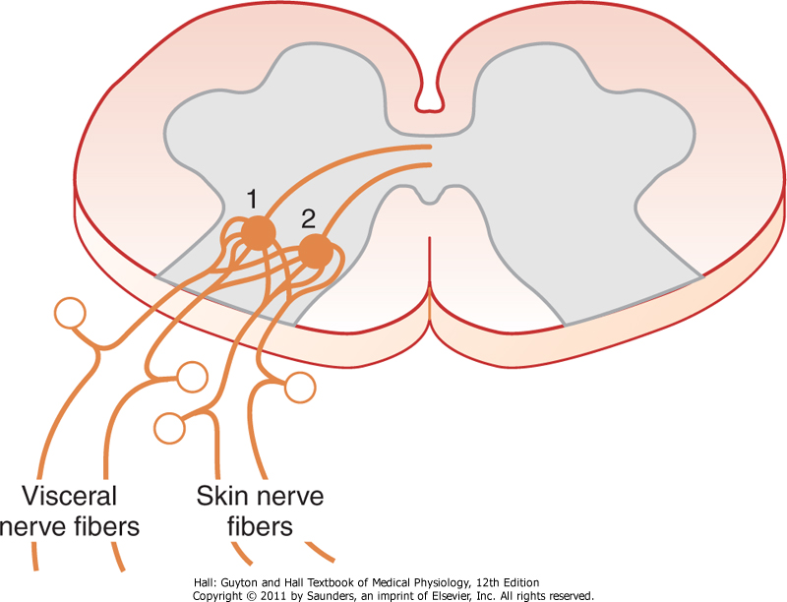
Referred Pain
feels of pain in a part of the body that is fairly remote from the tissue causing the pain
E.g pain in one of the visceral organs often is referred to an area on the body surface It is important in clinical diagnosis because in many visceral ailments the only clinical sign is referred pain

Slide 18
Cont.. Referred Pain
Visceral Pain: Pain from viscera of the abdomen and chest, used for diagnosing visceral inflammation
visceral pain differs from surface pain:
1- visceral pain localized types of damage to the viscera e.g surgeon can cut the gut
surface pain by stimulation of pain nerve endings e.g ischemia caused by occluding the blood supply to a large area of gut

Slide 19
Cont.. Referred Pain
Causes of True Visceral Pain
Ischemia formation of acidic metabolicor tissue-degenerative products such as bradykinin, proteolytic enzymes
Chemical Stimuli substances leak from the gastrointestinal tract into the peritoneal cavity. For instance, proteolytic acidic gastric juice may leak through a ruptured gastric or duodenal ulcer.
Spasm of a Hollow Viscus Spasm of a portion of the gut, the gallbladder, a bile duct, a ureter, or any other hollow viscus can cause pain

Slide 20
Cont.. Referred Pain
Overfilling Hollow Viscus because of overstretch of the tissues . May lead to collapse the blood vessels and cause ischemic pain.
Insensitive Viscera A few visceral areas are insensitive to pain e.g parenchyma of the liver and the alveoli of the lungs.

Slide 21
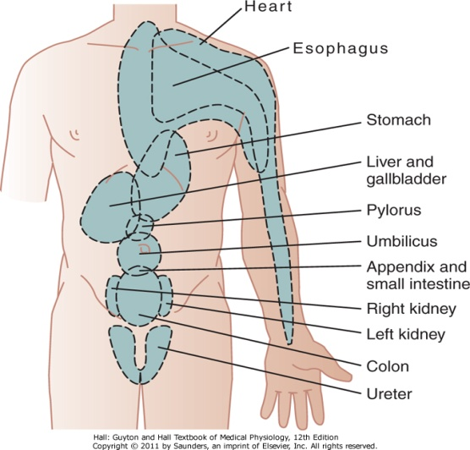
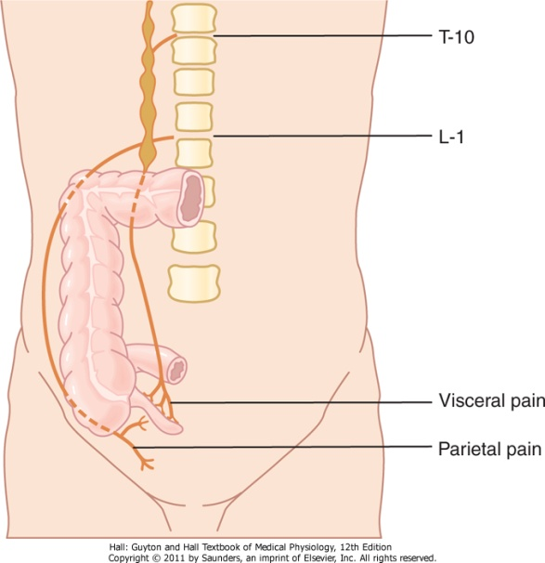
Localization of Referred Pain Transmitted via Visceral Pathways
visceral pain is referred to the surface of the body, which originated from visceral organ
E.g
Pain impulses pass first from the appendix then into the spinal cord at about T-10 or T-11; this pain is referred to an area around the umbilicus and is of the aching, cramping type.

Slide 22
Cont..Localization of Referred Pain Transmitted via Visceral Pathways
Meninges Back of head and neck
Heart Central chest arms (usually left), neck, occasionally abdomen.
Trachea Behind sternum
Diaphragm Shoulder tip
Oesophagus Behind sternum
Stomach, duodenum Upper abdomen, epigastrium
Small bowel, pancrea Around umbilicus
Large bowel, bladder Lower abdomen above pubic bone

Slide 23
Some Clinical Abnormalities of Pain
Hyperalgesia nervous excessively excitable; to hyperalgesia, (hypersensitivity to pain).
causes of hyperalgesia :
(1) sensitivity of the pain receptors (primary hyperalgesia )
(2) facilitation of sensory transmission, secondary hyperalgesia.
Tic Douloureux pain over one side of the face , sudden electrical shocks, for a few seconds
Brown-Séquard Syndrome if the spinal cord is transected on only one side

Slide 24
Reference book
Guyton & Hall: Textbook of Medical Physiology 12E
Thank you

