Slide 1
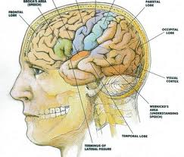
Schizophrenia
Fahad Alosaimi MD
psychiatry and psychosomatic
medicine consultant
Assistant professor
KSU, Riyadh

Slide 2
Case of Mr.Schi
Mr. Schi is a 28 year-old single male who was brought to Emergency room by his family because of gradual changes in his behavior started 9 months ago. Since then, he became agitated; eat only canned food but not cooked food made by his family, afraid of being poisoned. He talks to himself and stares occasionally on the roof of his room.

Slide 3
Case of Mr.Schi
He had two brief psychiatric hospitalizations in last 3 years that were precipitated by anger at his neighbor and voices commenting about his behavior.
His personal history indicated that he was a healthy child, but his parents reported that he was a bed wetter and seemed slower to develop than his brothers and sisters.
Schi smokes tobacco frequently to calm himself. During his early adolescence he used to smokes Hash heavily plus occasional use of amphetamine. He stopped both Hash and Amphetamine use 5 years ago.

Slide 4
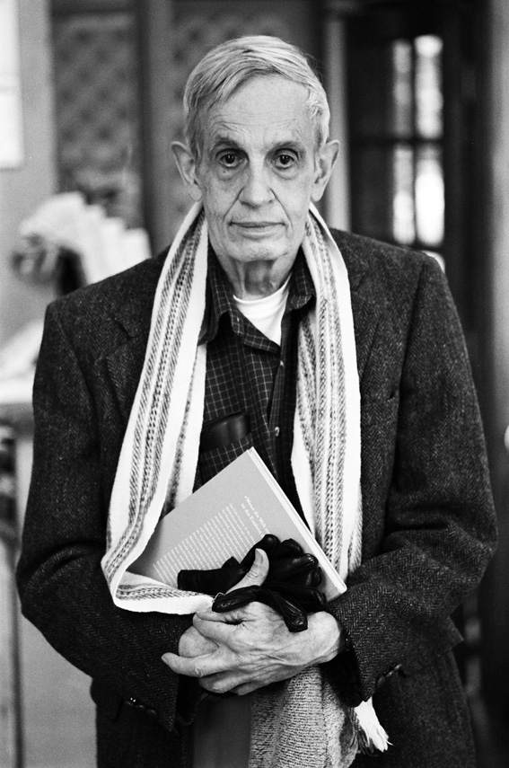
Both has schizophrenia
Lives at group home for
the mentally ill
Won Nobel prize

Slide 5
Schizophrenia
- It is not a single disease but a group of disorders with heterogeneous etiologies.
- Found in all societies and countries with equal prevalence & incidence worldwide.
- A life prevalence of 0.6 – 1.9 %
- Annual incidence of 0.5 – 5.0 per 10,000
- Peak age of onset are 10-25 years for ♂ & 25-35 years for ♀

Slide 6
Etiology
Exact etiology is unknown.
1- Stress-Diathesis Model:
Integrates biological, psychosocial and environmental factors in the etiology of schizophrenia.
Symptoms of schizophrenia develop when a person has a specific vulnerability that is acted on by a stressful influence.

Slide 7
2- Neurobiology
* Certain areas of the brain are involved in the pathophysiology of schizophrenia: the limbic system, the frontal cortex, cerebellum, and the basal ganglia.
a- Dopamine Hypothesis;
Too much dopaminergic activity ( whether it is ↑ release of dopamine, ↑ dopamine receptors, hypersensitivity of dopamine receptors to dopamine, or combinations is not known ).
b- Other Neurotransmitters;
Serotonin, Norepinephrine, GABA, Glutamate & Neuropeptides

Slide 8
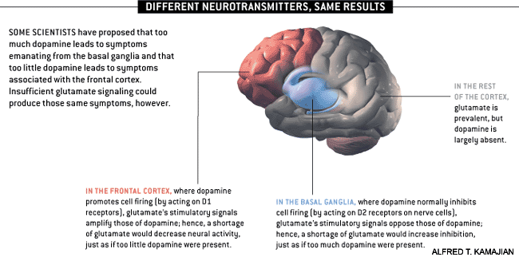
Notes:
http://www.schizophrenia.com/schizpictures.html

Slide 9
c- Neuropathology;
Neuropathological and neurochemical abnormalities have been reported in the brain particularly in the limbic system, basal ganglia and cerebellum. Either in structures or connections.

Slide 10
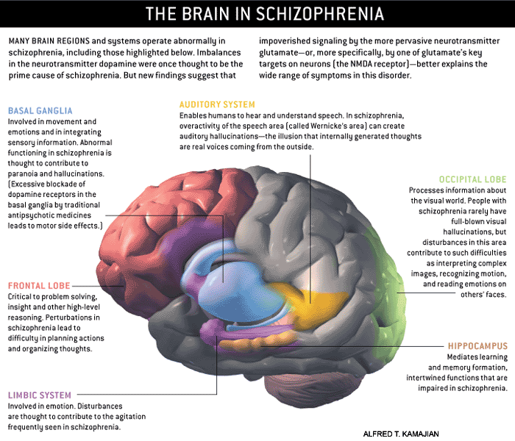
Notes:
http://www.schizophrenia.com/schizpictures.html

Slide 11
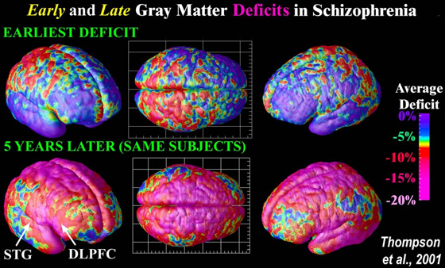
Notes:
Image Source: UCLA Laboratory of Neuro Imaging, UCLA, Derived from high-resolution magnetic resonance images (MRI scans), the above images were created after repeatedly scanning 12 schizophrenia subjects over five years, and comparing them with matched 12 healthy controls, scanned at the same ages and intervals. Severe loss of gray matter is indicated by red and pink colors, while stable regions are in blue. STG denotes the superior temporal gyrus, and DLPFC denotes the dorsolateral prefrontal cortex. Note: This study was of Childhood onset schizophrenia (defined as schizophrenia diagnosed in children under the age of 13 or so) which occurs in approximately 1 of every 40,000 people and is frequently a significantly more aggressive form of schizophrenia (than regular schizophrenia that typically begins when people are aged 15 to 25 (slightly later for women) - and impacts approximatley 1 of every 100 people).

Slide 12
d- Psychoneuroimmunology;
↓ T-cell interlukeukin-2 & lymphocytes, abnormal cellular and humoral reactivity to neurons and presence of antibrain antibodies.
These changes are due to neurotoxic virus ? or endogenous autoimmune disorder ?
e- Psychoneuroendocrinology;
Abnormal dexamethasone-suppression test
↓ LH/FSH
A blunted release of prolactin and growth hormone on stimulation.

Slide 13
3- Genetic Factors
- A wide range of genetic studies strongly suggest a genetic component to the inheritance of schizophrenia that outweights the environmental influence.
- These include: family studies, twin studies and chromosomal studies.

Slide 14
Notes:
http://www.schizophrenia.com/prevention.htm
Before going into the specific risk reduction strategies its important to know the initial risks that a person may face of getting schizophrenia. In the general population, for someone who has no family history of mental illness, the average risk is estimated at approximately 1% (and therefore a 99% probability that the person will not get schizophrenia). If someone who is genetically related to a person in the extended family that does have schizophrenia, then the risk is higher - and the chart below provides a rough estimate of that risk. If, for example, you have an aunt or uncle who developed schizophrenia, then your risk (on average) is estimated at approximately 3% (and therefore there is a 97% probability you won't get schizophrenia). Even for the situation where one parent has schizophrenia the risk is estimated at 13% for a child, which means there is an 87% probability that the person will not develop schizophrenia. If a family has a history of more than one person developing schizophrenia then the risk goes up. People who have a strong history of mental illness in their family may want to consider genetic counseling in addition to the schizophrenia prevention tactics identified below

Slide 15
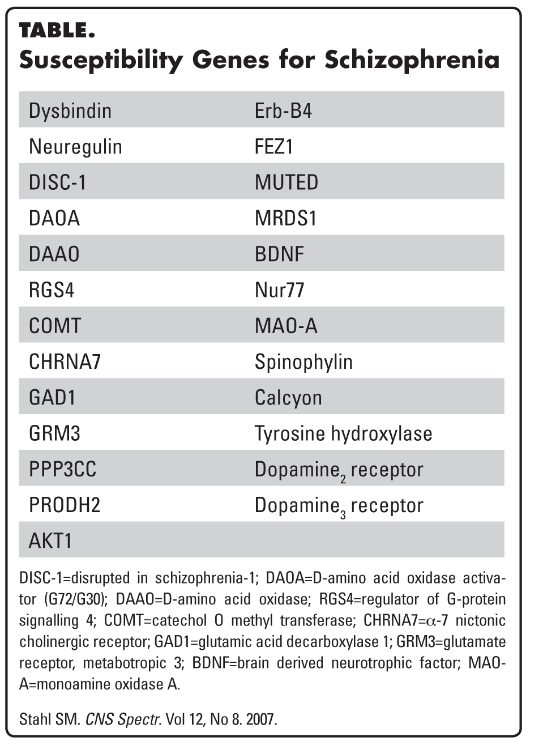
Schizophrenia: genes plus stressors
Schizophrenia is mostly caused by various possible combinations of many different genes (which are involved in neurodevelopment, neuronal connectivity and synaptogenesis) plus stressors from the environment conspiring to cause abnormal neurodevelopment.
There is also abnormal neurotransmission at glutamate synapses, possibly involving
hypofunctional NMDA receptors .
Stephen M The Genetics Of Schizophrenia Converge,Upon,The NMDA Glutamate Receptor, CNS Spectr. 2007

Slide 16
4- Psychosocial Factors:
In family dynamics studies, no well-controlled evidence indicates specific family pattern plays a causative role in the development of schizophrenia.
High Expressed Emotion family : increase risk of relapse.

Slide 17
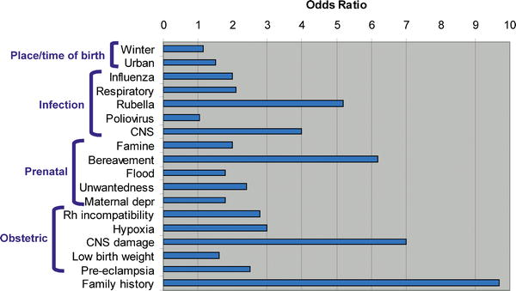
Weight of different RF: Family history comes first
PLOS Medicine
Notes:
Its also important to keep in mind as you read about the risk factors, that most of these risk factors are associated with approximately a doubling of risk (also called the "Odds Ratio") - which might sound high, but that means that overall for someone with no family history of schizophrenia, that the risk goes from about 1% to 2% (with risk of not getting schizophrenia declining from 99% to 98%). Therefore, for the average person with no family history of schizophrenia or mental illness most of these risk factors may not make a significant difference in terms of total risk of schizophrenia which remains low. At the same time good healthcare, nutrition and a positive emotional environment for women during pregnancy are always important factors for the health of a baby and always recommended by doctors. Research also suggests that nurturing, sensitive child care is also important for the healthy emotional development of children
Image: Some of the Schizophrenia Environmental Risk Factors - Source; PLOS Medicine (Note: different studies suggest different risk factors - so you will see some variance in the risk number that we quote below for some environmental factors).
The factors listed below matter most significantly for people who have a history of schizophrenia or other mental illness in their family which suggests that a person may have some of the genes that are associated with schizophrenia risk. At this time little is known about exactly how the environmental exposures identified below increase risk in those with some sort of genetic vulnerability - so don't get too worried if you have in the past experienced a given environmental factor, as its impossible to know for sure how that environmental factor might impact you or your child. Focus on the environmental factors that you still have some influence over.
The take home message is that if you have a family history of mental illness it would probably be beneficial to take some reasonable steps to reduce or avoid exposure to the risk factors -- especially those factors involved in pregnancy, prenatal care and early child care. For teens interested in lowering their risk of schizophrenia, the avoidance of street drugs, maintenance of healthy friendships, and early treatment for any depression, sadness and anxiety is likely to be valuable. At the same time, all of the actions below are likely to help the mental health of any child or person - so the more steps you can take, the better your (or your child's) mental health is likely to be.

Slide 18
Diagnosis
# DSM-5 Diagnostic Criteria for Schizophrenia:
A- ≥ two characteristic symptoms for one month, at least one of them is (1),(2) or (3)
1- Delusions
2- Hallucinations
3- Disorganized speech (frequent derailment or incoherence)
4- Grossly disorganized or catatonic behavior
5- Negative symptoms ( diminished emotional expression or lack of drive (avolition))

Slide 19
B- Social, Occupation or self-care dysfunction
C- Duration of at least 6 months of disturbance (include at least one month of active symptoms that meet Criterion A; in addition of periods of prodromal and residual symptoms).
D- Schizoaffective & mood disorder exclusion
E- The disturbance is not due to Substance or another medical condition.
F- If there is history of autism spectrum disorder or a communication disorder of childhood onset, schizophrenia diagnosis is made only if delusion or hallucinations plus other criteria are present.

Slide 20
Clinical Features
No single clinical sign or symptom is pathognomonic for schizophrenia
Patient's history & mental status examination are essential for diagnosis.
Premorbid history includes schizoid or schizotypal personalities, few friends & exclusion of social activities.
Prodromal features include obsessive compulsive behaviors , attenuated positive psychotic features.

Slide 21
- Picture of schizophrenia includes positive and negative symptoms.
- Positive symptoms like: delusions & hallucinations.
- Negative symptoms like: affective flattening or blunting, poverty of speech, poor grooming, lack of motivation, and social withdrawal.

Slide 22
Cognitive deficits in schizophrenia

Slide 23
Mental status examination
- Appearance & behavior ( variable presentations)
- Mood, feelings & affect ( reduced emotional responsiveness, inappropriate emotion)
- Perceptual disturbances ( hallucinations, illusions )
- Thought: Thought content ( delusions)
Form of thought ( looseness of association)
Thought process ( thought blocking, poverty of thought content, poor abstraction, perseveration )
- Impulsiveness, violence, suicide & homicide
- Cognitive functioning
- Poor insight and judgment

Slide 24
Course
Acute exacerbation with increased residual impairment
Full recovery: very rare
Longitudinal course: downhill

Slide 26
Prognosis
Good P.F | Poor P.F
Late age of onset Acute onset Obvious precipitating factors Presence of mood component Good response to Tx Good supportive system | Young age of onset Insidious onset Lack of P.F. Multiple relapses Low IQ Poor premorbid personality Negative symptom Positive family history

Slide 27
Differential Diagnosis
Secondary psychiatric disorders:
-Substance-induced disorders
-Psychotic disorders due to another medical disorder :
Epilepsy ( complex partial)
CNS diseases
Trauma
Others
Primary Psychiatric disorders:
Schizophreniform disorder
Brief psychotic disorder
Delusional disorder
Schizoaffective disorder
Mood disorders
Personality disorders ( schizoid, schizotypal & borderline personality)
Factitious disorder
Malingering

Slide 28
Criteria of other Psychotic Disorders
Psychotic Disorders due to another medical condition
Substance-induced psychotic disorder
Schizophreniform disorder ;
1-6 month of disturbance
Brief psychotic disorder:
<1month of disturbance
Delusional disorder(delusion only >1m)
Schizoaffective disorder: An uninterrupted period of illness during which there is a major mood episode (major depressive or manic) concurrent with Criterion A of schizophrenia. There is Delusions or hallucinations for 2 or more weeks in the absence of a major mood episode during the illness course.

Slide 29
Treatment
What are the indications for hospitalization?
Diagnostic purpose
Patient & other's safety
Initiating or stabilizing medications
Establishing an effective association between patient & community supportive systems

Slide 30
Biological therapies
Antipsychotic medications are the mainstay of the treatment of schizophrenia.
Generally, they are remarkably safe.
Two major classes:
-Conventional, (1st generation) e.g. haloperidol, chlorpromazine.
-Atypical, 2nd generation (Serotonin-dopamine receptor antagonists) e.g. Risperidone, clozapine, olanzapine ).
Depot forms of antipsychotics eg. Risperidone Consta is indicated for poorly compliant patients.
Electroconvulsive therapy (ECT) for catatonic or poorly responding patients to medications

Slide 31
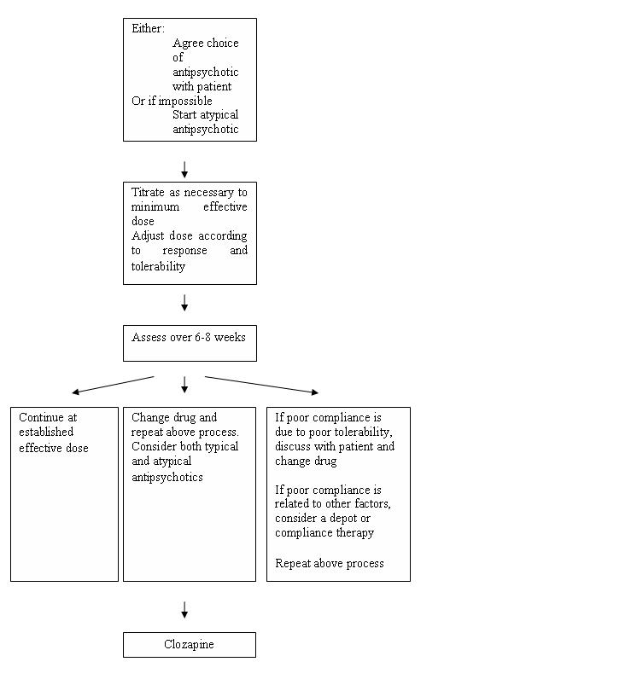
Pharmacological Treatment Algorithm Adapted from the Maudsley prescribing Guidelines

Slide 32
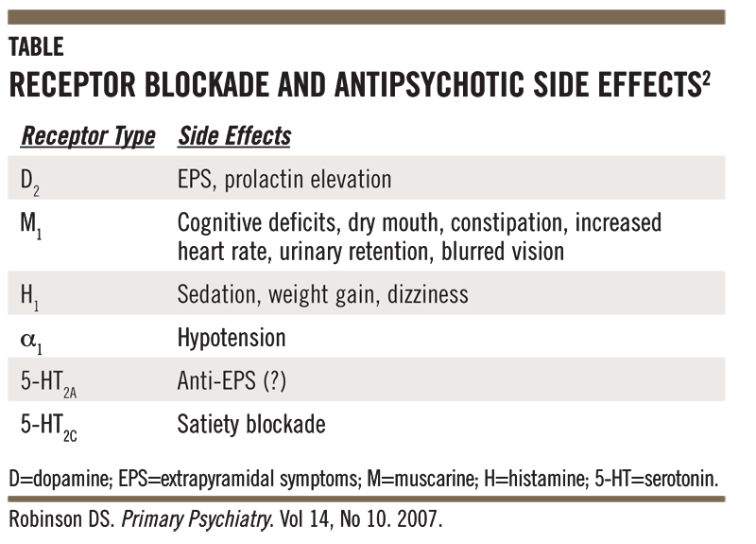
Side effects of antipsychotics
High Potency typical antipsychotics: Neurological side effects
Low Potency typical and atypical antipsychotics: many other side effects

Slide 33
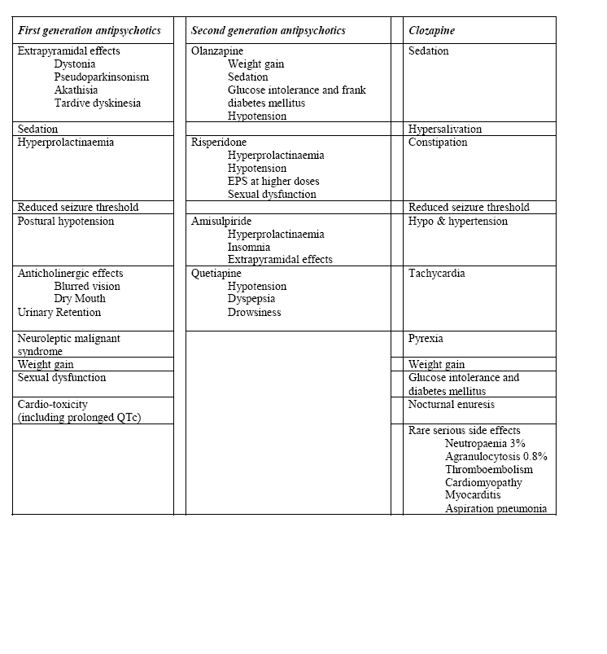
Common side effects of antipsychotic medication (Taylor et al, 2005)

Slide 34
Psychosocial therapies
Social skills training
Family oriented therapies
Group therapy
Individual psychotherapy
Assertive community treatment
Vocational therapy
Notes:
Psychosocial treatments with demonstrated efficacy include family interventions,
supported employment,
assertive community treatment,
social skills training, and
cognitive behaviorally oriented psychotherapy
he defining characteristics of ACT include:
a clear focus on those participants (clients) who require the most help from the service delivery system;
an explicit mission to promote the participants' independence, rehabilitation, and recovery, and in so doing to prevent homelessness and unnecessary hospitalization;
an emphasis on home visits and other in vivo (out-of-the-office) interventions, eliminating the need to transfer learned behaviors from an artificial rehabilitation or treatment setting to the "real world";^{[2]}
a participant-to-staff ratio that is low enough to allow the ACT "core services team" to perform virtually all of the necessary rehabilitation, treatment, and community support tasks themselves in a coordinated and efficient manner -- unlike traditional case managers, who broker or "farm out" most of the work to other professionals;
a "total team approach" in which all of the staff work with all of the participants, under the supervision of a qualified mental health professional who serves as the team's leader;
an interdisciplinary assessment and service planning process that typically involves a psychiatrist and one or more nurses, social workers, substance abuse specialists, vocational rehabilitation specialists, and certified peer specialists (individuals who have had personal, successful experience with the recovery process);
a willingness on the part of the team to take ultimate professional responsibility for the participants' well-being in all areas of community functioning, including most especially the "nitty-gritty" aspects of everyday life;
a conscious effort to help people avoid crisis situations in the first place or, if that proves impossible, to intervene at any time of the day or night to keep crises from turning into unnecessary hospitalizations; and
a promise to work with people on a time-unlimited basis, as long as they demonstrate a continuing need for this highly intensive and integrated form of professional help.^{[3][4][5][6][7]}
In the array of standard mental health service types, ACT is considered a "medically monitored non-residential service" (Level 4), making it more intensive than "high intensity community based services" (Level 3) but less intensive than "medically monitored residential services" (Level 5) on the widely accepted LOCUS utilization management instrument.^{[8]}

Slide 35
Thank you

