Slide 1
Normal flora of the GIT and introduction to infectious diarrhea
GIT Block
Prof .Hanan Habib
Department of Pathology & Laboratory Medicine,
KSU

Slide 2
Introduction to Normal Flora
Normal flora are microorganisms that are frequently found in various body sites in normal healthy individuals.
Constituents and number vary according to the age and physiologic status.
Able to colonize and multiply under the exiting condition of different body sites.
Inhibit competing intruders.
Have symbiotic relationship that benefit the host.
Can cause disease in immunocompromised patients.

Slide 3
Normal Flora of the GIT
the oral cavity contain very high number which varies from site to site of the mouth.
Saliva contain mixed flora :10x8 organism /ml
Stomach : very few in health due to HCL and peptic enzymes
Small intestine : very scanty except near colon
Colon of adults: 10x 10 org/gm stool, >90% are Bacteriodes ( anaerobic), 10 % other bacteria.
Direct effect of diet composition.

Slide 4
Normal flora of the GIT
Mouth: Viridans streptococci, Neisseria spp., Moraxella, Peptostreptococcus.
Nasopharynx :
Niesseria spp., Viridans sterpt. Moraxella, Peptostreptococcus.
Stomach : streptococci, Peptosterptococcus, others from mouth.
Small intestine: scanty, variable
Colon of adults :Bacteriodes, Fusobacterium, Bifidobacteria, Lactobacillus, enterobacteria, Clostridium
Colon of Breastfeeding infants: Bifidobacterium, Lactobacillus
Mouth: Candida albicans
Nasopharynx: S.pneumoniae, N.meningitidis, H.infuenzae,S.pyogenes, S.aureus
Stomach: none
Small intestine : none
Colon of adults: B.fragilis, E.coli, Psudomonas, Candida, Clostridium
Colon of Breast feeding infants: none
Normal flora ( low virulence)
Potential pathogen (carrier)

Slide 5
Role of GIT Normal Flora in Disease
Many are opportunistic pathogens, examples, perforation of the colon from ruptured diverticulum, feces enters into peritoneal cavity and cause peritonitis.
Viridans strept. of oral cavity enters blood and colonize damaged heart valves.
Mouth flora play a role in dental caries.
Compromised defense systems increase the opportunity for invasion.
Death after lethal dose of radiation due to massive invasion of normal flora.

Slide 6
Role of normal flora in diarrheal diseases
E.coli is the most common Enterobacteriacae , a facultative flora of colon followed by Klebsiella, Proteus and Enterobacteria.
Salmonella, Shigella and Yersinia are NOT a normal flora of the intestinal tract.
Some strains of E.coli ,Salmonella ,Shigella and Yersinia enterocolitica are able to produce diseases in the intestinal tract.

Slide 7
Intestinal Pathogens
Invasive and cytotoxic strains produce inflammatory diarrhea ( dysentry) with WBCs and /or blood in the stool.
Enterotoxin –producing strains cause watery diarrhea with loss of fluid.
Some produce systemic illness due to spread to multiple organs such as enteric ( typhoid) fever

Slide 8
Acute Diarrheal Illnesses and Food Poisoning

Slide 9
Background
Acute diarrheal illness is one of the most common problems evaluated by clinicians.
A major cause of morbidity and mortality world wide.
Most of healthy people have mild illness but others might develop serious squeals so it is important to identify those individuals who require early treatment.

Slide 10
Definitions of Diarrhea
Stool weight in excess of 200 gm/day
Three or more loose or watery stools/day
Alteration in normal bowel movement characterized by decreased consistency and increased frequency
Less than 14 days in duration

Slide 11
Etiology
Viral: 70-80% of infectious diarrhea in developed countries
Bacterial: 10-20% of infectious diarrhea but responsible for most cases of severe diarrhea
Protozoan: less than 10%

Slide 12
Epidemiology
1.2 - 1.9 episodes per person annually in the general population
2.4 episodes per child <3 years old annually
5 episodes per year for children <3 years old in daycare
Seasonal peak in the winter

Slide 13
Classifications
Infectious diarrhea: Viral (eg. Rota virus ), Bacterial (eg. Campylobcator, Shigella, Salmonella, Yersinea, Vibrio cholerae, E.coli)
Food poisoning: S.aureus, Clostridium perfringnes, Bacillus spp.
Traveler diarrhea : Enterotoxogenic E.coli.
Incubation period: >1 day and lasts on average 3 days
Antibiotic associated diarrhea: due to Clostridium difficile.

Slide 14
Risk Factors
Food from restaurants
Family member with gastrointestinal symptoms
Recent travel to developing countries
Patient underlying illness and medication, low stomach acidity, cyst, spores
Abnormal peristalsis
Low Immunoglobulin IgA
Antibiotics : decrease the normal flora to less 10¹²
Median infective dose (ID₅₀)

Slide 15
Clinical Presentation and Pathogenic Mechanism I
Enterotoxin mediated
Lack of pus in the stool (no gut invasion)
Lack of fever
Rapid onset of preformed toxin :<12 hrs
Small intestine affected
Vomiting ,non-bloody diarrhea, abdominal cramps.
Vibreo cholerae, Staphylococcus aureus, Clostridium perfringens and Bacillus cereus
Other viral and some parasitic infections.

Slide 16
Clinical Presentation and Pathogenic Mechanism II
Invasive
Pus and blood in the stool
Fever due to inflammation
Shigella, Solmonella spp., Campylobacter, some E.coli and Entameoba histolytica
Affect colonic mucosal surface of the bowel
Extension to lymph nodes
Incubation period 1-3 days
Dysentery syndrome- gross blood and mucous
EHEC bloody diarrhea
Entameoba histolytica 1-3 wk

Slide 17
Campylobacter
Family :Campylobacteraceae
Genus: Archobacter-spiral shape
Common species : C. jejuni, C. coli, C fetus.
Epidemiology
Source: dog , cat, birds, poultry ,water, milk, meat, person to person transmission can occur.

Slide 18
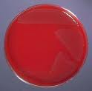
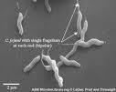
Campylobacter

Slide 19
Clinically
IP: 2-6 days
Abdominal cramps, bloody diarrhea , nausea and vomiting are rare
Self limiting after 2-6 Days
Chronic carrier
Guailian Barrie’ syndrome and Reactive arthritis may result.

Slide 20
Laboratory diagnosis and treatment
Laboratory diagnosis:
Transport media :Cary Blair
CAMPYBAP media contain antibiotics
Incubate in 5%O₂ 10%CO₂ 85%N @ 42°C except C.fetus 37°C
Gram stain/culture /biochemical/Serology
Treatment:
Resistance to Ciprofloxacin , Sensitive to Erythromycin or Tetracycline

Slide 21
E.coli
Only about 10 -15% strains of E. coli strains are associated with diarrhea.
Based on virulence factors, clinical manifestation, epidemiology and different O and H serotypes. There are five major categories of diarrheagenic E.coli:
Types of E. coli diarrhea
Enterotoxigenic E. coli (E T E C)
Enteropathogenic E. coli (E P E C)
Enteroinvasive E. coli (E I E C)
Enterohaemorrhagic E. coli (E H E C )
Enteroadherent E.coli (EAEC)

Slide 22
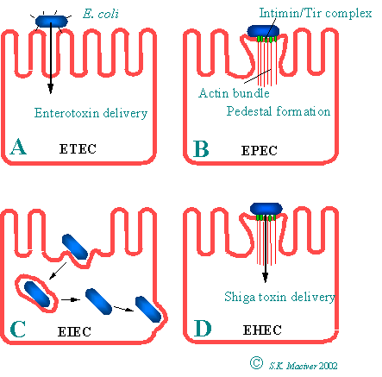

Slide 23
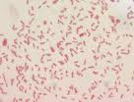
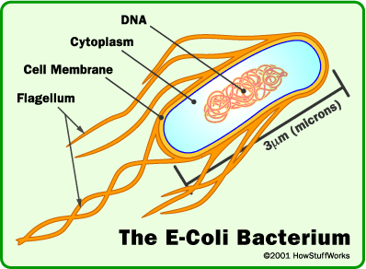
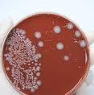
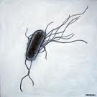
E.coli

Slide 24
1. Enterotoxigenic E.coli (ETEC)
Major cause of traveler's diarrhea in infant and adult in developing countries from contaminated food and water
It has high infective dose 10⁶-10¹⁰
Produce heat-labile toxin (LT) and heat-stable toxin (ST) each has two fragment (A and B) .
LT leads to accumulation of CGMP, which lead to hypersecretion.
Symptoms :watery diarrhea, abdominal cramps and sometimes vomiting
No routine diagnostic method.

Slide 25
2. Enteroinvasive E.coli ( EIEC)
Produce dysentery (penetration, invasion and distraction)
Similar to Shigella spp. (non motile, non-lactose fermenter)
Fecal -oral route
Fever, severe abdominal cramps, malaise and watery diarrhea
Infective dose 10⁶
Diagnosis : Sereny test and DNA probes.

Slide 26
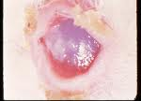
Sereny test

Slide 27
3-Enteropathogenic E.coli (EPEC)
Infantile diarrhea
Cause outbreak in hospital nurseries and day care centers.
Low grade fever, malaise, vomiting and diarrhea.
mucous in stool but no blood.

Slide 28
4-Enterohemorrhagic E.coli ( EHEC)
O157:H7, Hemorrhagic diarrhea, colitis and hemolytic uremic syndrome (HUS):low Platelet count, hemolytic anemia and kidney failure
Bloody diarrhea, low grade fever and stool has no leucocytes
Fatal disease in young and elderly persons in nursing homes
Undercooked hamburgers, unpasteurized dairy products, apple cider, cookie dough
Cytotoxin =Vertoxin І and Vertoxin ІІ similar to (Shiga-toxin I &II)
E.coli other than O157:H7 can cause HUS
Diagnosis by culture on SMAC(sorbitol MacConkey agar cefixime), Vertoxin detection by immunological test or PCR

Slide 29
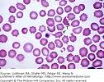
HUS

Slide 30
5. Enteroadherent E.coli (EAEC)
Pediatric diarrheal disease
Adhering to the surface of the intestinal mucosa ,can cause UTI.
Aggregative stacked brick in the mucosa
Watery diarrhea, vomiting, dehydration and abdominal pain for two or more weeks

Slide 31
Yersinia enterocolitica
Mesenteric lymphadenitis in children and septicemia in immunocompromised hosts
Common in Europe, USA, Canada . Cats, dogs& swine (chitterlings)
Survive cold temperatures and associated with transfusion of packed red blood cells.
Present with enteritis, arthritis and erythema nodosum
Generalize infection in adult and children 1-5 yrs, usually mild but in old children and adult it mimic appendicitis
Grow at 25°-30°C , media: Cefsulodin-Igrasan-Novobiocin.

Slide 32
Clostridium difficile
Antibiotic associated diarrhea
Transmit from person to person via fecal-oral route
Have been cultured from inanimate hospital surfaces
Disruption of the indigenous bacterial flora of the colon
Produce toxin A and B that can bind to surface epithelial cell receptors leading to inflammation, mucosal injury and diarrhea

Slide 33
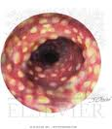
C.Difficile & pseudomembraneous colitis

Slide 34
Clostridium difficile
Patient presents with fever, leukocytosis, abdominal pain and diarrhea
Pseudomembrane (consists of neutrophils, fibrin, and cellular debris in the colonic mucosa) and toxic megacolon
Diagnosis: toxin detection by enzyme immunoassay (EIA)
Treatment :Metronidazole ± Vancomycin and supportive treatment

Slide 35
Selected Clinical and Epidemiologic Characteristics of Typical Illness Caused By Common Foodborne Pathogens*
Pathogen | Typical Incubation Period | Duration | Typical Clinical Presentation | Assorted Foods
Bacterial
Salmonella species | 1-3 Days | 4-7 Days | Gastroenteritis | Undercooked eggs or poultry, produce
Campylobacter jejuni | 2-5 Days | 2-10 Days | Gastroenteritis | Undercooked poultry, unpasteurized dairy products
E. coli, Enterotoxigenic | 1-3 Days | 3-7 Days | Gastroenteritis | Many foods
Shigella species | 1-2 Days | 4-7 Days | Gastroenteritis | Produce, egg salad

Slide 36
Listeria monocytogenes | 2-6 weeks | Variable | Gastroenteritis, meningitis abortion | Deli meat, hotdogs, unpasteurized dairy products
Bacillus cereus | 1-6 hour | <24 hour | Vomiting, Gastroenteritis | Fried rice, meats
Clostridium botulinum | 12-72 hour | Days-months | Blurred vision, paralysis | Home-canned foods, fermented fish
Staphylococcus aureus | 1-6 hour | 1-2 Days | Gastroenteritis, particularly nausea | Meats, potato & pork, unpasteurized dairy products.
Yersinia enterocolitica | 1-2 Days | 1-3 weeks | Gastroenteritis, appendicitis-like syndrome | Undercooked pork, unpasteurized dairy products.

