Slide 1
Blood borne hepatitis
By: Dr. Mona Badr
Assistant Professor & Consultant Virologist

Slide 2
Viral Hepatitis
Hepatitis feature of many diseases usually as a part of a generalized infection e.g. cytomegalovirus, yellow fever, Epstein-Barr virus.
However, some viruses primarily target the liver to cause viral hepatitis.
Viral Hepatitis presents more or less similar clinical picture whatever the causative viruses.
Laboratory tests can differentiate between different
viruses.
We have to determine the causative virus to know how
to treat and what the prognosis.

Slide 3
Viral Hepatitis
Enterically transmitted viral Hepatitis
HAV
HEV
Parenterally Transmitted viral Hepatitis
HBV
HDV ( Defective virus)
HCV
HGV

Slide 4
HBV :classification & structure
Family : hepadnaviridae.
The complete virus particle is 42-nm in diameter .
It consists of an outer envelope containing hepatitis B surface antigen (HBsAg).
And internal core ( nucleocapsid) composed of hepatitis B core antigen (HBcAg).
The viral genome is small partially circular ds-DNA.
There are eight known genotypes (A – H ).
Genotype D is the dominant in Saudi patients .
The virus contains the polymerase enzymes.

Slide 5
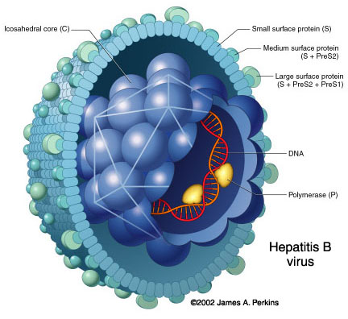

Slide 6
Types of HBV particles
The serum of infected individual contains three types of hepatitis B particles:
Large number of small spherical free HBsAg particles .
Some of these HBsAg particles are linked together to take the form of filaments .
In addition to the complete HBV-particles ( Dane particles ) .

Slide 7
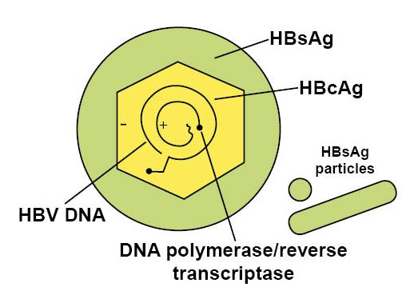

Slide 8
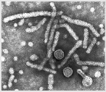
Electron micrograph of particles in the blood of a patient infected with HBV

Slide 9
Transmission of HBV
1- Infected blood (parenterally ):
Direct exposure to infected blood.
Using contaminated needles, syringes, dental and surgical instruments
Using contaminated instruments in the practice of tattooing, body piercing, cupping, sharing contaminated tooth brushes and nail clipper.
Sharing contaminated tooth brushes, razors, cuticle scissors and nail clippers.
2- Sexually:
By having sexual contacts with infected person ,virus is present in semen and vaginal secretion.
3- from mother to child
Mostly( perinatally) during delivery ,nursing ,breast feeding and less likely through placenta (vertical transmission)

Slide 10
The following groups are at high risk of acquiring hepatitis B
Intravenously drug users.
Hemodialysis patients.
Patients receiving clotting factors.
Individuals with multiple sexual partners.
Recipient of blood transfusion , before 1992.
Health care workers with frequent blood contact.
Individuals exposed to risk factors such as tattooing, body piercing and cupping.

Slide 11
HEPATITIS B VIRUS
Infection with HEPATITIS B VIRUS (HBV)
Can result in ; acute hepatitis, fulminant hepatitis, chronic asymptomatic carrier, chronic active hepatitis, cirrhosis or hepatocellular carcinoma.
HBV replicates in HEPATOCYTES and possibly the entire genome can be integrated into the host genome.
.

Slide 13
The clinical outcome of HBV infection
About 90 % of infected adult individuals will develop acute hepatitis B infection and recover completely.
Less than 9 % of the infected adult will develop chronic hepatitis.
Less than 1 % will develop fulminant hepatitis , characterized by massive liver necrosis, liver failure and death.
90% of infected infants and 20% of infected children will progress to chronic hepatitis .

Slide 14
Hepatitis B virus
Acute hepatitis B infection;
Incubation period varies from 2 4 months.
Most of HBV infection are asymptomatic
An-icteric hepatitis: fever, malaise , anorexia, rash, nausea, vomiting and high upper quadrant abdominal pain with raised liver enzyme.
Icteric hepatitis: about 25% of the patient become icteric Jaundice with raised bilirubin, dark bile containing urine and pale stools ,
Acute hepatitis B infection usually last for several weeks to maximally 6 months.

Slide 15
Hepatitis B markers
1-- Hepatitis B surface antigen (HBsAg):
Marker of infection.
2-- Hepatitis B e antigen (HBeAg) :
Marker of active virus replication, the patient is highly infectious, high viral load, the virus is present in all body fluids.
3-- Antibody to hepatitis B e antigen (Anti-HBe):
Marker of low infectivity, the patient is less infectious.
4-- Antibody to hepatitis B surface antigen (Anti-HBs):
Marker of immunity
(natural or vaccination).
5-- Antibody to hepatitis B core IgG (Anti-HBc IgG ) :
It indicates exposure to hepatitis B infection.(only natural infection)

Slide 16
Serological profile of acute HBV infection
Antibody to the core (IgM anti-HBcore Ag ) is the first antibody that appears in the blood and followed by IgG anti HBcore Ag)usually persists for several years .
with the disappearance of HBeAg, anti- HBe appears and usually persists for several weeks to several months .
Antibodies to hepatitis B surface antigen (anti-HBsAg) is the last marker that appears in the blood.
Hepatitis B DNA is the first marker that appears in circulation, 3-4 weeks after infection(PCR) .
Hepatitis B surface antigen(HBsAg) is the second marker that appears in the blood and persists for less than 6-months, then disappears.
Hepatitis B e-antigen ( HBeAg) is the third maker that appears in circulation ..

Slide 18
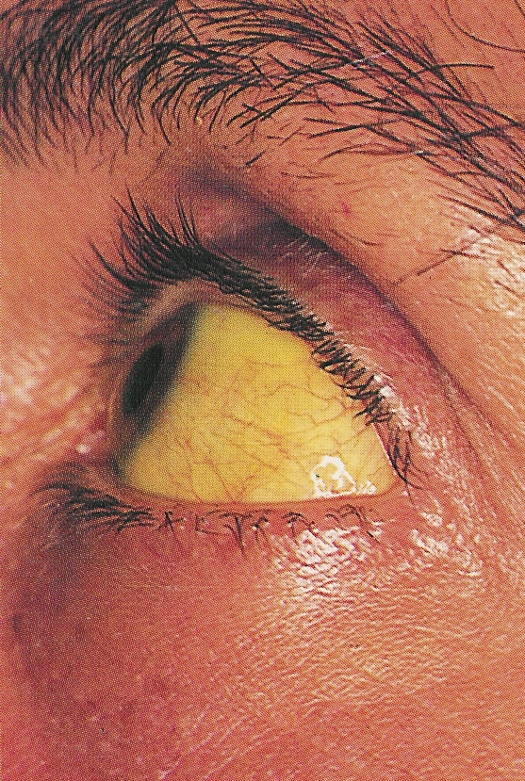
Jaundice

Slide 19
Notice tattooing

Slide 20
Chronic asymptomatic hepatitis B infection
Chronic hepatitis B is defined by the presence of HBsAg or HBV-DNA in the blood for more than> 6 months.
The majority of patients with chronic hepatitis B are asymptomatic may only be detected by elevated liver enzyme on a routine blood chemistry profile , some have mild fatigue, RT upper quadrant abdominal pain or enlarged liver &spleen
.

Slide 21
Serological profile of chronic HBV infection
Chronic hepatitis B infection is defined by the presence of HBsAg in the blood for more than 6-momths .
HBsAg may persists in the blood for life
Some patients may clear HBsAg and develop anti surface (Anti-HBs) ,they become immune.

Slide 23
Chronic active hepatitis
The major long term risk of chronic HBV infection are cirrhosis with hepatic failure and hepatocellular carcinoma ,when HBV genome integrates into hepatocytes DNA.

Slide 24
Liver cirrhosis and ascites

Slide 25
Hepatocellular carcinoma ( HCC )

Slide 26
Lab diagnosis of hepatitis B infection
Hepatitis B infection is diagnosed by detection of HBsAg in the blood.
Positive results must be repeated in duplicate.
Repeatedly reactive results must be confirmed by neutralization test .
Additional lab investigations :
1- Liver function tests ( LFT ) .
2- Ultrasound of the liver .
3- Liver biopsy, to determine the severity of the diseases .

Slide 27
Hepatitis B virus
Prevention and Control:
Proper screening of blood donor and use of plastic syringe.
Pre-exposure prophylaxis:
Active vaccination given to all newborn, children or adult.
Post exposure prophylaxis.
Persons exposed to needle prick or infant born to +ve HBsAg mother should immediately receive both: Active Vaccine & Hepatitis B specific immunoglobulin.

Slide 28
Hepatitis B vaccine
It contains highly purified preparation of HBsAg particles , produced by genetic engineering in yeast.
It is not live attenuated nor killed vaccine The vaccine is administered in three doses IM injection at 0.1 & 6 months Booster doses may be reacquired after 3-5 years.
.
.

Slide 29
HBV treatment
Criteria for treatment :
Treatment is limited to patients having chronic hepatitis B, based on liver biopsy.
Positive for HBsAg
Positive for HBV-DNA , > 20,000 IU/ml .
ALT(Alanine aminotransferase) > twice the upper normal limit .
Moderate liver damage .
Age > 18 years

Slide 30
Treatment
The hepatitis B infection does not usually require treatment because most adults clear the infection spontaneously.
On the other hand, treatment of chronic infection may be necessary to reduce the risk of cirrhosis and liver cancer. Chronically infected individuals with persistently elevated serum alanine aminotransferase, a marker of liver damage, and HBV DNA levels are candidates for therapy. Treatment lasts from six months to a year, depending on medication and genotype.
Antiviral drugs as Lamivudine or Adefovir and Iinterferon are used.

Slide 31
HBV treatment
There are several approved anti-viral drugs.
1- pegylated alpha interferon, one injection per week, for 6- 12 months .
2- Lamivudine, nucleoside analogue . .
3- Adefovir, , nucleoside analogue.

Slide 33
Hepatitis D Delta Hepatitis
Hepatitis D virus is a Defective virus cause infection only in people with acute or chronic hepatitis B virus infection,
HDV requires HBV as a helper virus and cannot produce infection in absence of HBV.
Hepatitis D is a RNA virus.
Its mode of transmission is similar to HBV.
It participates in increasing the incidence of complication leading to chronic active hepatitis or cirrhosis
Diagnosis by detection of Anti-HDV antibodies.

Slide 34
Transmission of HDV can occur either via simultaneous infection with HBV (coinfection) or superimposed on chronic hepatitis B or hepatitis B carrier state (superinfection). Both super infection and co infection with HDV results in more severe complications compared to infection with HBV alone. These complications include a greater likelihood of experiencing liver failure in acute infections and a rapid progression to liver cirrhosis, with an increased chance of developing liver cancer in chronic infections. In combination with hepatitis B virus, hepatitis D has the highest mortality rate of all the hepatitis infections of 20%

Slide 36
HEPATITIS C
There are 7 genotypes of HCV .
HCV is extremely HETEROGENOUS, and has a high mutation rate.
HCV is a Flaviviridia virus
The hepatitis C virus particle consists of a core of genetic material (RNA), surrounded by an icosahedral protective shell of protein, and further encased in a lipid (fatty) envelope of cellular origin. Two viral envelope glycoproteins, E1 and E2, are embedded in the lipid envelope.
HCV replicate in hepatocyte of the liver.
.

Slide 37
HCV replication

Slide 39
Electron micrograph of HCV

Slide 40
Transmission of HCV
1- parenterally:
Direct exposure to infected blood .
Using contaminate needles, surgical instruments .
Using contaminate instruments in the practice of tattooing, ear piercing & cupping .
Sharing contaminated razors 7 tooth brushes .
2- sexually .
3- From mother to child,, perinatally

Slide 41
The clinical picture of HCV
Incubation period from 2 to 7 weeks.
Clinically ,the acute infection with HCV is milder than infection with HBV.
Fever ,anorexia, nausea, vomiting , and jaundice are common.
Dark urine ,pale feces , and elevated liver enzyme (transaminase) are seen.

Slide 42
The clinical outcome of HCV infection
About 20 % of the infected individuals will develop self-limiting acute hepatitis C and recover completely.
About 80 % of the infected patients will progress to chronic hepatitis C.
Less than 1 % will develop fulminant hepatitis C , liver failure and death.

Slide 43
Hepatitis C markers
Hepatitis C virus – RNA .
Is the first marker that appears in the serum, it appears as early as 2-3 weeks after exposure , It is a marker of infection
.
IgG Antibody to hepatitis C.
Antibodies to hepatitis C virus is the last marker that appears in the serum , usually appear 50 days after exposure long window period present in both Acute or chronic patient.

Slide 44
Hepatitis C Virus (Continued)
Laboratory Diagnosis:
Detection of Anti HCV in the serum by ELISA which dose not distinguish between an acute , chronic, or resolved infection, we have to repeated it in duplicate.
Then we do confirmatory test with RIBA .
PCR for detection of viral RNA to detect viral replication

Slide 45
Criteria for treatment
Positive for HCV –RNA .
Positive for anti-HCV .
Known HCV genotype .
ALT > twice the upper normal limit .
Moderate liver damage , based on liver biopsy .

Slide 46
Treatment of HCV
The currently used treatment is the combined therapy, using
pegylated alpha interferon and ribavirin
Treatment is limited to those positive for , HCV-RNA , HCV Ab, elevated ALT and moderate liver injury based on liver biopsy
Hepatitis C vaccine NOT AVAILABLE:
At the present time, there is no vaccine available to hepatitis C

Slide 47
Hepatitis G virus
Hepatitis G virus or GB-virus was discovered in 1995.
Family: flaviviridae .
.
Enveloped, ss-RNA with positive polarity.
Transmission : Parenterally, sexual and from mother to child have been reported
Cause mild acute and chronic hepatitis G cases .
Usually occurs as co-infection with HCV , HBV and HIV.

Slide 48
THANK YOU

