Slide 1
Gastrointestinal Block Pathology lecture Nov, 2013
Peptic Ulcer Disease
Dr. Maha Arafah
Dr. Ahmed Al Humaidi

Slide 2
Objectives
Define ulcer and erosion
Describe the following aspects of acute gastric ulcers:
a. pathogenesis
b. Pathology
c. clinical features
3. Describe the following aspects of chronic peptic ulcers:
a. pathogenesis (H pylori, NSAID, Z-E syndrome)
b. clinical features
c. pathology (gross and microscopic features)
d. complications (bleeding, perforation, obstruction)

Slide 3
Book
Basic pathology, 9th edition: page 565 -569
Figure 14-13, p. 565
Figure 14-14, p. 566
Figure 14-15, p. 568
Figure 14-16, p. 571

Slide 4
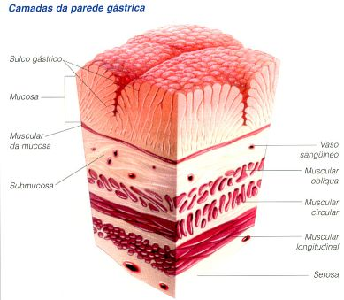
Ulcer: a breach in the mucosa of the alimentary tract extending through muscularis mucosa into submucosa or deeper.
Erosion: is a breach in the epithelium of the mucosa only.
erosion
ulcer

Slide 5
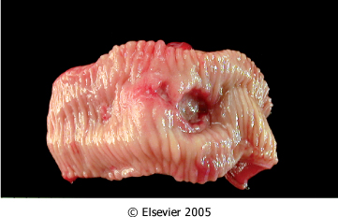
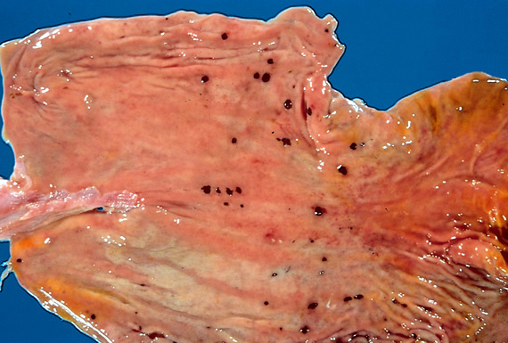
Ulcer Types
Ulcer: a breach in the mucosa of the alimentary tract extending through muscularis mucosa into submucosa or deeper.
Chronic Peptic ulcer
Stress ulcers (acute peptic ulcers)
Chronic peptic ulcer
Acute gastric ulcers

Slide 6
Acute peptic ulcers
Acutely developing gastric mucosal defects that may appear after severe stress

Slide 7
Acute peptic ulcers Pathophysiology
As part of an acute gastritis
As a complication of a severe stress response
As a result of extreme hyperacidity.

Slide 8
Acute peptic ulcers
Pathophysiology
As part of an acute gastritis
As a complication of a severe stress response
As a result of extreme hyperacidity
acute response to an irritant 'chemical' injury by drugs e.g. NSAID or alcohol
severe burns (Curling's ulcer)
major trauma (Stress ulcer)
cerebrovascular accidents ( Cushing ulcer)
Zollinger-Ellison syndrome

Slide 9
Acute peptic ulcers Morphology
Acute stress ulcers are found anywhere in the stomach
They range in depth from very superficial lesions (erosion) to deeper lesions that involve the entire mucosal thickness (true ulceration)
Prognosis:
The gastric mucosa can recover completely if the person does not die from the primary disease

Slide 10
Chronic Peptic Ulcer

Slide 11
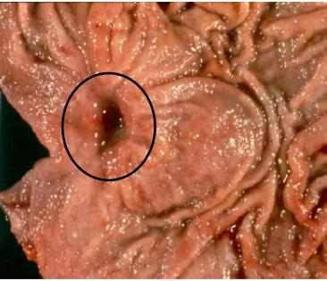
Chronic Peptic Ulcer
Peptic ulcers are chronic, recurring lesions that occur most often in middle-aged to older adults without obvious precipitating conditions, other than chronic gastritis.
Chronic Peptic Ulcers are, most often solitary
Peptic ulcer

Slide 12
Pathophysiology of Chronic Peptic Ulcers
Defensive Factors
Aggressive Factors

Slide 13
Pathophysiology of Chronic Peptic Ulcers
Defensive Factors
Mucus
bicarbonate
Blood flow
cell renewal
Prostaglandins
Phospholipid

Slide 14
Pathophysiology
imbalance
Aggressive Factors
H. pylori
Drugs (NSAIDs)
Acid
pepsin
Bile salts
Defensive Factors
Mucus
bicarbonate
Blood flow,
cell renewal
Prostaglandins
Phospholipid
Defensive Factors
Aggressive Factors

Slide 15
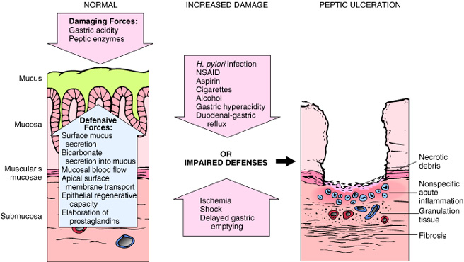

Slide 16
Pathophysiology of Chronic Peptic Ulcers
Helicobacter pylori infection
H pylori infection of gastric mucosa is present in 100% of patients with duodenal ulcer and 70% of those with gastric ulcer. H pylori infection is a major factor in the pathogenesis of peptic ulcer.
H pylori induces an intense inflammatory and immune response and increased production of proinflammatory cytokines.
H pylori secretes a urease that breaks down urea to form toxic compounds such as ammonium chloride and monochloramine. Thrombotic occulsion of surface capillaries is promoted by a bacterial platelet-activating factor. Other antigens, including lipopolysaccharides, recruit inflammatory cells to the mucosa. The chronically inflamed mucosa is more susceptible to acid-peptic injury and peptic ulceration.
In addition, chronic inflammation of the mucosa is possibly important in the pathogenesis of gastric carcinoma and a low-grade gastric lymphoma, also known as MALToma (MALT = Mucosa-Associated Lymphoid Tissue).

Slide 17
Pathophysiology of Chronic Peptic Ulcers
NSAID and aspirin stop prostaglandin synthesis
The protective effects of prostaglandins: enhanced bicarbonate secretion and increased vascular perfusion.
High-dose corticosteroids, which suppress prostaglandin synthesis and impair healing.
Cigarette smoking: impairs mucosal blood flow and healing
Chronic renal failure, and hyperparathyroidism: associated with hypercalcemia: stimulates gastrin production and therefore increases acid secretion

Slide 18
Chronic peptic ulcer Peptic Ulcer Disease Locations
May occur in any portion of the GI tract exposed to acidic gastric juices
98% located in first portion of duodenum or stomach, ratio duodenum : stomach = 4:1

Slide 19
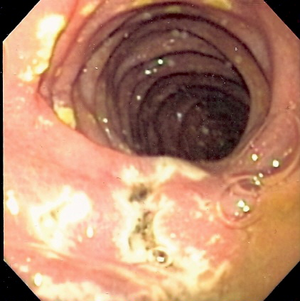
Chronic peptic ulcer Peptic Ulcer Disease Other Locations
Esophagus……. as a result of GERD or acid secretion by ectopic gastric mucosa.
Gastric mucosa within a Meckel diverticulum can result in peptic ulceration of adjacent mucosa.
In Zollinger-Ellison syndrome: multiple
peptic ulcerations in the stomach,
duodenum, and even the jejunum.
multiple ulcers in Zollinger-Ellison syndrome

Slide 20
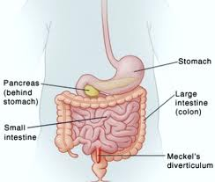
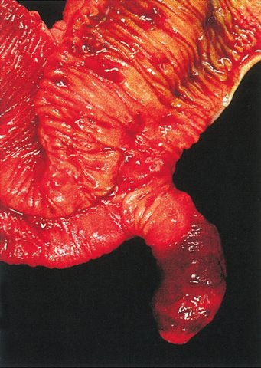
Meckel diverticulum

Slide 21
Gastric ulcers
Pathophysiology
The mucosal defenses against acid attack consist of:
Mucus-bicarbonate barrier
The surface epithelium.

Slide 22
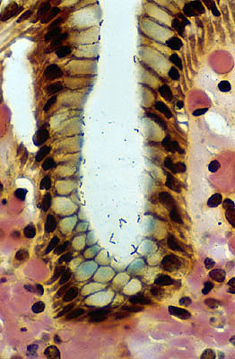
Peptic Ulcer Disease Gastric ulcers
Pathophysiology
The mucosal defences against acid attack consist of:
Mucus-bicarbonate barrier
2. The surface epithelium.
Duodeno-gastric reflux ( bile )
NSAIDs (blocking the synthesis of the prostaglandins)
H. pylori infection, ( cytotoxins and ammonia)
In Peptic ulcers of the stomach, breakdown of mucosal defence is much more important than excessive acid production.

Slide 23
Pathophysiology of Chronic Peptic Ulcers in Stomach

Slide 24
Peptic Ulcer Disease Duodenal ulcers
Pathophysiology
Increased production of acid assumes more importance in the pathogenesis of duodenal ulceration
H. pylori-infected individuals secrete 2-6 times as much acid as non-infected controls
Helicobacter Pylori does not colonise normal duodenal epithelium
Helicobacter is involved in duodenal ulceration because there is gastric metaplasia in response to excess acid. Gastric metaplasia paves the way for colonisation by Helicobacter
+
=
Increased production of acid
Helicobacter P
Duodenal ulcers

Slide 25
Pathophysiology of Chronic Peptic Ulcers in Duodenum

Slide 26
Chronic Peptic Ulcer Disease Pathophysiology
Duodeno-gastric reflux ( bile )
Hyperacidity
Gastric
ulcers
H. pylori
Duodenal
ulcers
NSAIDs
H pylori infection of the pyloric antrum is present in nearly all patients with chronic duodenal ulcer and approximately 75% of patients with chronic gastric ulcer.
Although more than 70% of individuals with PUD are infected by H. pylori, fewer than 20% of H. pylori–infected individuals develop peptic ulcer.

Slide 27
Pathophysiology

Slide 28
Morphology
Gross
usually less than 20 mm in diameter but they may > 100 mm in diameter.
The classic peptic ulcer is a round to oval, sharply punched-out defect
Benign peptic ulcer

Slide 29
Morphology
Duodenal ulcers usually occur within a few centimeters of the pyloric valve at the anterior duodenal wall.
Gastric peptic ulcers are predominantly located near the interface of the body and antrum.

Slide 30
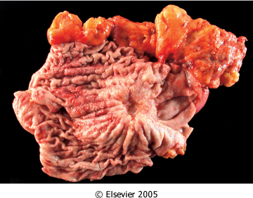
Morphology
Gross
In contrast, heaped-up margins are more characteristic of cancers
Benign peptic ulcer
Malignant peptic ulcer

Slide 31
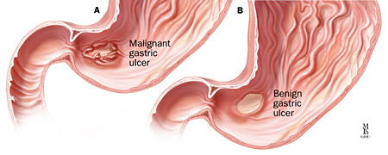

Slide 32
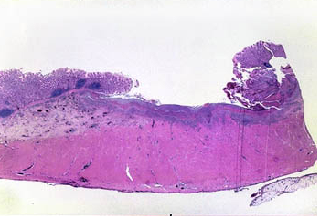
Morphology
Microscopy
the base consists of necrotic tissue and polymorph exudate overlying inflamed granulation tissue which merges with mature fibrous (scar) tissue.

Slide 33
The presence of neutrophils within the gastric glands signifies active inflammation and, most of the time, the presence of H pylori.

Slide 34
Clinical features
Epigastric pain (the most common symptom)
Gnawing ( burning sensation)
Occurs 2-3 hours after meals
Relieved by food or antacids
Patient awakens with pain at night.
Some present with complications such as iron deficiency anemia, frank hemorrhage, or perforation.

Slide 35
Complications of Chronic Peptic Ulcers
Hemorrhage.
Penetration. The ulcer penetrates the full thickness of the stomach or duodenal wall, progressing into adherent underlying tissue, e.g. the pancreas or liver.
Perforation. This leads to peritonitis.
Fibrous stricture. In the stomach, ulcers may cause pyloric stenosis.
Malignant change. This is extremely uncommon.

Slide 36
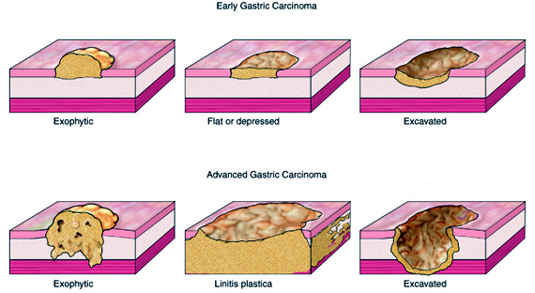

Slide 37
Therapy
Current therapies for PUD are aimed at
H. pylori eradication : Antibiotic
Acid suppression
Proton pump inhibitors
H2 blockers

Slide 39
Case scenario: A woman with intermittent severe epigastric pain
A 49-year-old secretary presents to medical outpatients with a 7-month history of epigastric pain. She had been widowed in the last year, her husband having died of cancer. The patient had been left to support two children . She had recently become a vegetarian to cut down on meat costs. She smokes five cigarettes per day but does not drink alcohol. She has been treated with antacids by her GP, but this has not controlled the symptoms. In the clinic, she complains of epigastric pains which are sharp and burning and radiate her subcostal margin to the right. The pain is worse at night and is relieved by food. On examination, there is epigastric tenderness and clinical signs of anaemia.

Slide 40
1. What are the possible causes of this clinical presentation?
This patient would appear to have a stress-related duodenal ulcer that is not responding to existing treatment. Ulcer repair is compromised by the high levels of stress and poor diet, due to financial constraints. Cigarette smoking will also
be contributory. The differential diagnosis includes gastric ulceration with or without reflux
esophagitis and, although atypical, biliary disease should be considered.

Slide 41
2. What are the predisposing causes?
Gastric and duodenal ulcers have many similarities but differ in epidemiology, natural history, outcome and management. Duodenal ulceration is thought to be a consequence of an imbalance between damaging effects of acid and pepsin attack on the mucosal defenses of the duodenum. The pH of the duodenal lumen is decreased more frequently and for longer periods in patients with duodenal ulceration, and these patients also empty food from their stomachs at a greater rate, so that after a meal there is less food available to buffer the secreted acid as it passes
into the lumen of the duodenum. Taking NSAIDs and stress have also been associated with duodenal mucosal ulceration. There are also strong links with smoking and alcohol intake. There are four major factors that account for the tendency of duodenal ulcer patients to hypersecrete acid and pepsin:
Increased parietal cell mass.
Increased stimulation of acid secretion
Increased parietal cell sensitivity to stimulants.
Loss of inhibitory control of acid secretion.

Slide 42
3. What are the major complications?
The major complication is perforation of a vessel with subsequent gastro-intestinal haemorrhage. This can present as either hematemesis, melena or iron deficiency anemia. Depending upon the direction of rupture, perforation can cause severe pain, collapse and peritonitis. Posterior perforation may cause mid-back pain. Other complications include fibrosis and adhesions

Slide 43
4. What investigations should be performed?
Fiberoptic endoscopy is the investigation of choice as it allows any ulcer observed to be
biopsied to exclude neoplastic disease and to confirm or refute the presence of Helicobacter
pylori. Blood counts should be performed to exclude anemia from previous bleeding.

Slide 44
5. What changes might an endoscopic biopsy show if there was ulceration of the gastric or duodenal mucosa?
The histological features include an acute and/or chronic inflammatory cell infiltrate within the glandular or surface epithelium and lamina propria, often with lymphoid aggregate formation.
Regenerative changes are sometimes observed in the surface epithelium.
In the stomach, small intestinal metaplasia may be observed and goblet cells are also frequently located in these metaplastic areas.
Gland atrophy, often quite marked, is also a feature of chronic gastritis, especially when H. pylori infection is identified.
The presence of dysplasia should be sought and carefully excluded.
Finally, special stains may reveal the presence of H. pylori in the
surface mucosa.

Slide 45
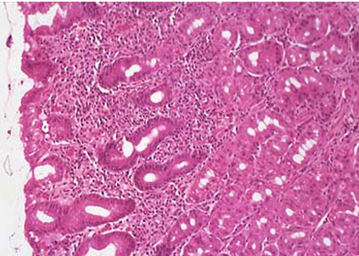
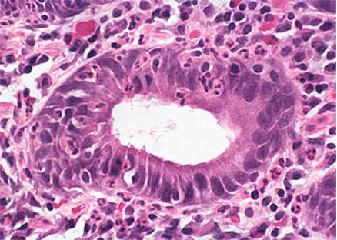
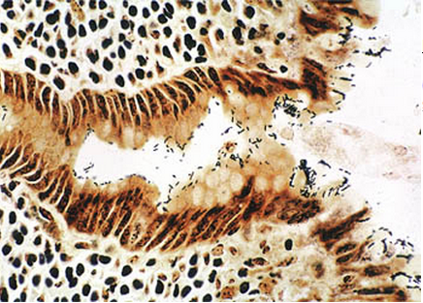
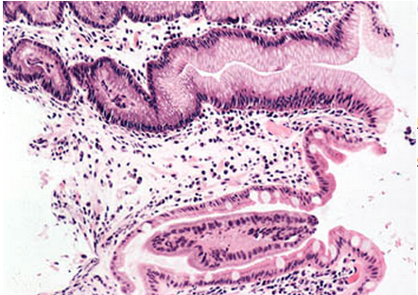
Helicobacter pylori gastritis
Goblet cells
Helicobacter pylori gastritis

Slide 46
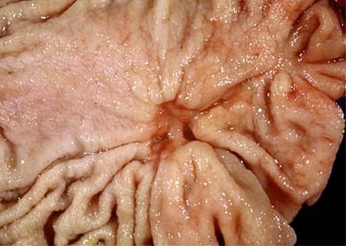
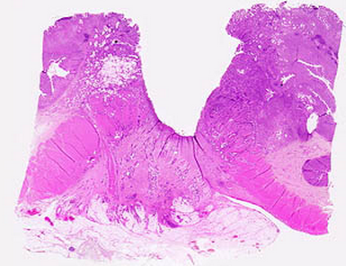
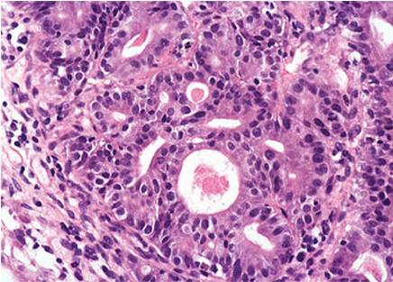
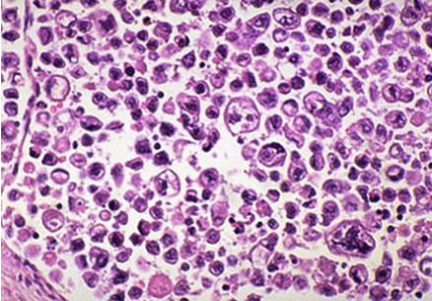
Gastric Carcinoma

Slide 47
Do chronic peptic ulcers of duodenum undergo malignant transformation?
No

Slide 48
What is the relationship between chronic gastritis, Helicobacter pylori, chronic peptic ulcer, gastric carcinoma and a low-grade gastric lymphoma?
Chronic infection, especially with H pylori, represents the most common form of chronic gastritis. The mucosa shows an intense acute and chronic inflammatory infiltrate and progressive atrophy of the mucosal glands. Patients secrete excess acid and have a low intragastric pH. H pylori is also associated with gastric and duodenal ulcer disease and with gastric cancer. H pylori infection of gastric mucosa is present in 100% of patients with duodenal ulcer and 70% of those with gastric ulcer. H pylori infection is a major factor in the pathogenesis of peptic ulcer.
H pylori induces an intense inflammatory and immune response and increased production of proinflammatory cytokines. H pylori secretes a urease that breaks down urea to form toxic compounds such as ammonium chloride and monochloramine. Thrombotic occulsion of surface capillaries is promoted by a bacterial platelet-activating factor.
Other antigens, including lipopolysaccharides, recruit inflammatory cells to the mucosa. The chronically inflamed mucosa is more susceptible to acid-peptic injury and peptic ulceration. In addition, chronic inflammation of the mucosa is possibly important in the pathogenesis of gastric carcinoma and a low-grade gastric lymphoma, also known as MALToma (MALT = Mucosa-Associated Lymphoid Tissue).

Slide 49
What are the complications of chronic peptic ulcers? The complications of peptic ulcer disease are (1) bleeding; (2) perforation; (3) penetration into an adjacent viscus; (4) obstruction from edema or from scarring of the pylorus or duodenum; (5) intractable pain. Malignant transformation does not occur in duodenal ulcers and is extremely rare in gastric ulcers.

Slide 50
Describe acute gastric ulcers
Acute ulcers are multiple, small, circular mucosal defects that typically measure less than 1 cm. The ulcer base is stained dark brown by acid digestion of extravasated blood. In an ulcer, necrosis involves the entire thickness of the mucosa. When the necrosis involves only the superficial mucosa, the lesion is an erosion. Acute gastric ulcers are usually not associated with fibrosis, which characterizes a chronic peptic ulcer. Acute, or stress, ulcers are most commonly encountered in patients with shock, burns, sepsis, intracranial conditions, and aspirin. About 1% to 4% of patients admitted to hospital intensive care units acutely develop superficial gastric erosion or ulcers, which may be associated with lethal bleeding. The most important determinant of clinical outcome is the ability to correct the underlying condition(s).
Are acute gastric ulcers associated with Helicobacter pylori? No

