Slide 1
Gastrointestinal Block
Pathology lecture
2013
Diarrhea
Dr. Maha Arafah
Dr. Ahmed Al Humaidi

Slide 2
DIARREAHA
Objectives
Define diarrhea
Describe the pathogenesis of different types of diarrhea
3. List the causes of chronic diarrhea

Slide 3
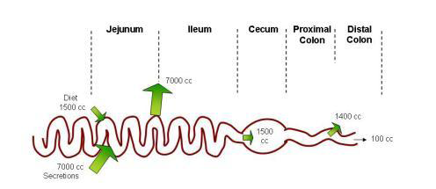
Physiology of Fluid and small intestine

Slide 4
DIARREAHA
DEFINITION
World Health Organization
3 or more loose or liquid stools per day
Abnormally high fluid content of stool
  200-300 gm/day

Slide 5
Why important?
The loss of fluids through diarrhea can cause dehydration and electrolyte imbalances
Easy to treat but if untreated, may lead to death especially in children

Slide 6
Why important?
More than 70 % of almost 11 million child deaths every year are attributable to 6 causes:
Diarrhea
Malaria
neonatal infection
Pneumonia
preterm delivery
lack of oxygen at birth.
UNICEF

Slide 7
CLASSIFICATION
Acute …………….if 2 weeks,
Persistent ……. if 2 to 4 weeks,
Chronic ………..if 4 weeks in duration.

Slide 8
Pathophysiology
Categories of diarrhea
Secretory
Osmotic
Exudative (inflammatory )
Motility-related

Slide 9
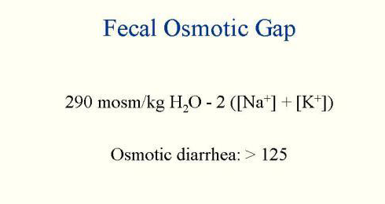
Fecal osmolarity
As stool leaves the colon, fecal osmolality is equal to the serum osmolality i.e. 290 mosm/kg.
Under normal circumstances, the major osmoles are Na⁺, K⁺, Cl–, and HCO₃–
Stool osmotic gap =
Stool osmolality - 2 x (stool Na + stool K)
Normal fecal fluid values:
Osmolality: ~290 mOsm/kg
Na+: ~30 mmol/L
K+: ~75 mmol/L

Slide 10
Osmotic
Excess amount of poorly absorbed substances that exert osmotic effect………water is drawn into the bowels……diarrhea
Stool output is usually not massive
Fasting improve the condition
Stool osmotic gap is high, > 125 mOsm/kg (loss of hypotonic fluid)
Can be the result of
Malabsorption in which the nutrients are left in the lumen to pull in water e.g. lactose intolerance
osmotic laxatives.
Hexitols (poorly absorbed): sorbitol, mannitol, xylitol).

Slide 11
Secretory
There is an increase in the active secretion of water
High stool output
Lack of response to fasting
Stool osmotic gap < 100 mOsm/kg
The most common cause of this type of diarrhea is a bacterial toxin ( E. coli , cholera) that stimulates the secretion of anions.
Other causes:
  Enteropathogenic virus e.g. rotavirus and norwalk virus
      Also seen in neuroendocrine tumours ( carcinoid tumor, gastrinomas)
      Rectal villous adenoma

Slide 12
Exudative (inflammatory)
Results from the outpouring of blood protein, or mucus from an inflamed or ulcerated mucosa
Presence of blood and pus in the stool.
Persists on fasting
Occurs with inflammatory bowel diseases, and invasive infections e.g. E. coli, Clostridium difficile and Shigella

Slide 13
Exudative (inflammatory)
Some bacterial infections cause damage by invasion of the mucosa. Many cause diarrhea with blood and pus in the stool (bacterial dysentery).
  The main organisms are:
    Campylobacter invades mucosa in the jejunum, ileum and colon, causing ulceration and acute inflammation.
    Salmonella typhi, S. paratyphi A, B, and C
    Shigella infections are mainly seen in young children.
    Enteroinvasive and enterohemorrhagic E. coli

Slide 14
Motility-related
Caused by the rapid movement of food through the intestines (hypermotility).
Irritable bowel syndrome (IBS) – a motor disorder that causes abdominal pain and altered bowel habits with diarrhea predominating

Slide 15
SUMMARY: TYPES OF DIARRHEA
SCREENING TESTS | CAUSES | CHARACTERISTICS | TYPE
Fecal smear for leukocytes: positive in most cases | Shigella spp. Campylobacter jejuni | Pathogens invade enterocytes Low-volume diarrhea | Invasive
Order stool culture & for O&P | Entamoeba histolytica | Diarrhea with blood and leukocytes (i.e., dysentery)
Stool osmotic gap < 50 mOsm/kg Fecal smear for leukocytes: negative Increased 5-HIAA: carcinoid syndrome | Laxatives: melanosis coli with use of phenanthracene laxatives Production of enterotoxins: Vibrio cholerae Enterotoxigenic E. coli Increased serotonin: carcinoid syndrome | Loss of isotonic fluid High-volume diarrhea Mechanisms: Laxatives Enterotoxins stimulate Cl⁻ channels regulated by cAMP and cGMP Serotonin increases bowel motility No inflammation in bowel mucosa | Secretory
Fecal smear for leukocytes: negative Stool osmotic gap > 100 mOsm/kg | Disaccharidase def. Giardiasis, Celiac Dis. Ingestion of poorly absorbable solutes | Osmotically active substance is drawing hypotonic salt solution out of bowel High-volume diarrhea No inflammation in bowel mucosa | Osmotic
 | Irritable bowel syndrome (IBS) – a motor disorder | Rapid movement of food through the intestines | Motility-related

Slide 16
Entamoeba histolytica

Slide 17
Acute diarrhea

Slide 18
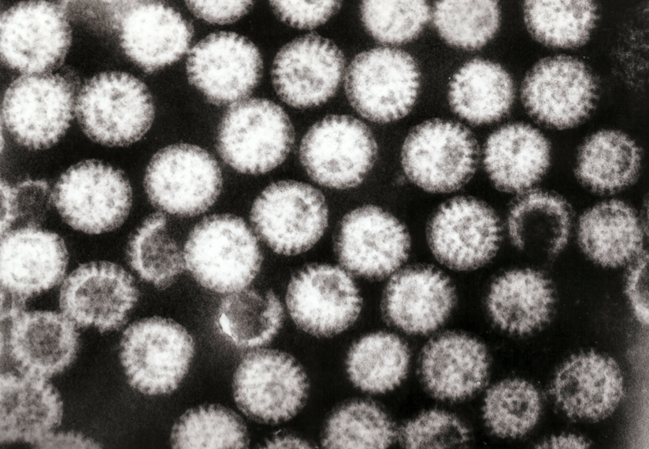
Aetiology
Acute diarrhea?
Approximately 80% of acute diarrheas are due to infections (viruses, bacteria, helminths, and protozoa).
Viral gastroenteritis (viral infection of the stomach and the small intestine) is the most common cause of acute diarrhea worldwide.
Food poisoning
Drugs
Others
Rotavirus
The cause of nearly 40% of hospitalizations from diarrhea in children under 5
Rotaviruses cause 50% of infantile diarrhea

Slide 19
Antibiotic-Associated Diarrheas
Diarrhea occurs in 20% of patients receiving broad-spectrum antibiotics; about 20% of these diarrheas are due to Clostridium difficile
Leading to pseudomembranous colitis

Slide 20
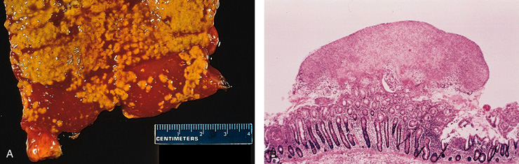
Pseudomembranous colitis
patients received broad-spectrum antibiotics
Caused by Clostridium difficile

Slide 21
Clostridium species. Gram-positive rods

Slide 22
Chronic diarrhea

Slide 23
Chronic diarrhea
Aetiology
Infection e.g. Giardia lamblia . AIDS often have chronic infections of their intestines that cause diarrhea.
Post-infectious Following acute viral, bacterial or parasitic infections
Malabsorption
Inflammatory bowel disease (IBD)
Endocrine diseases
Colon cancer
Irritable bowel syndrome

Slide 24
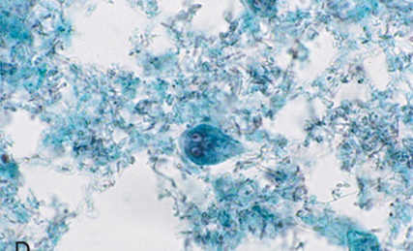
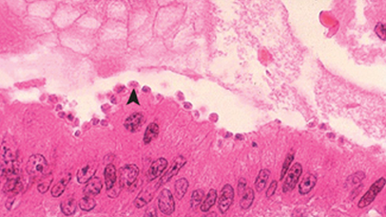
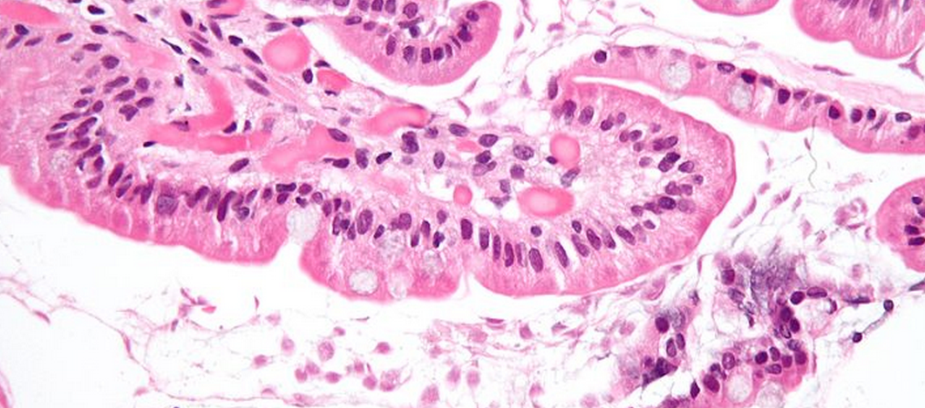
Causes of Chronic Diarrhea
Giardia lamblia
Cryptosporidiosis in AIDS
Parasitic and protozoal infections affect over half of the world's population on a chronic or recurrent basis.

Slide 25
Complications
Fluids ………………Dehydration
Electrolytes …………….. Electrolytes imbalance
Sodium bicarbonate……. Metabolic acidosis
If persistent ……Malnutrition

Slide 26
Tests useful in the evaluation of diarrhea
Acute diarrhea
Fecal leukocytes
present
not present
Inflammatory Diarrhea
Noninflammatory Diarrhea
Suggests colonic mucosa damage caused by invasion
shigellosis, salmonellosis, Campylobacter or Yersinia infection, amebiasis)
toxin (C difficile, E coli O157:H7).
Inflammatory bowel diseases
Suggests a small bowel source
Or colon but without mucosal injury

Slide 27
Chronic diarrhea
Infection
+
Stool analysis
Ova, parasites
-
Secretory or
Noninfectious
inflammatory diarrhea
-
Stool fat test
(normal <20%)
+
Malabsorption
Quantitative stool for fat
  (1) Best screening test
  (2) 72-hour collection of stool
  (3) Positive test > 7 g of fat/24 hours.
Do serum Anti-tissue transglutaminase antibodies
Anti-endomysial IgA antibodies
Antigliadin antibodies to check for celiac disease
Duodenal biopsy

Slide 28
