Slide 1
Gastrointestinal Block Pathology lecture 2013
Benign Tumors of Intestine
Dr. Maha Arafah
Dr. Ahmed Al Humaidi

Slide 2
Tumors of the small and large intestines
Polyps
Carcinoma
Carcinoid tumor
Lymphoma

Slide 3
Polyps
Non-neoplastic polyps 90%
Hyperplastic polyps
Hamartomatous polyps (Juvenile & Peutz-Jeghers polyps)
Inflammatory polyps
Lymphoid polyps
Neoplastic polyps 10%
Adenoma

Slide 5
Polyps
Hyperplastic Polyp
Asymtomatic
> 50% are located in the rectosigmoid
Sawtooth surface
Star shaped crypts
Composed of well-formed glands and crypts lined by differentiated goblet or absorptive cells.

Slide 6
Hamartomatous polyps
Juvenile polyps Peutz-Jeghers polyps

Slide 7
Non-Neoplastic Polyp
Hamartomatous polyp
Juvenile Polyps (retention polyp)
Developmental malformations affecting the glands and lamina propria
Commonly occur in children under 5 years old in the rectum.
In adult called retention polyp.
Notes:
4

Slide 8
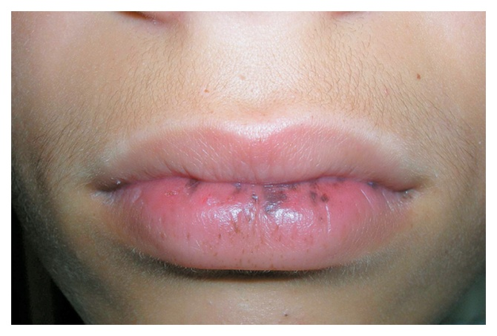
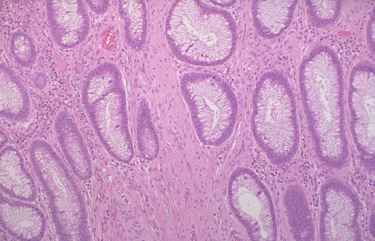
Non-Neoplatic Polyps
Hamartomatous Polyps
Peutz-Jehgers syndrome
Rare, autosomal dominant
hamartomatous polyps accompanied by mucosal and cutaneous pigmentation around the lips, oral mucosa, face and genitalia, present with red blood in stool.
Polyps tend to be large and pedunculated.
Increased risk of developing carcinoma of the pancreas, breast, lung, ovary and uterus.
Notes:
5

Slide 9
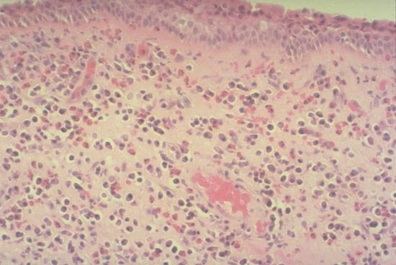
Non-Neoplastic Polyps
Inflammatory Polyps
longstanding IBD, especially in chronic ulcerative colitis.
Represent an exuberant reparative response to longstanding mucosal injury called pseudopolyps
Notes:
6

Slide 10
4] Lymphoid polyps

Slide 11
Neoplastic Polyps (Adenomas)
Adenomatous Polyp ( adenoma )
Occur mainly in large bowel.
Sporadic and familial
Vary from small pedunculated to large sessile
Epithelium proliferation and dysplasia
Notes:
7

Slide 12
Neoplastic Polyps (Adenomas)
Adenomatous Polyp ( adenoma )
Divided into:
Tubular adenoma: less than 25% villous architecture
Villous adenoma: villous architecture over 50%
Tubulovillous adenoma: villous architecture between 25 and 50%.
Notes:
7

Slide 13
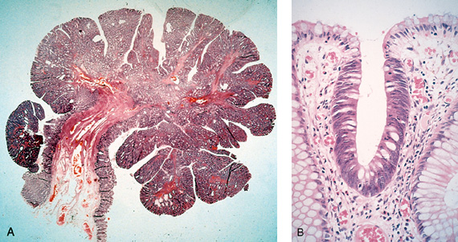
Neoplastic Polyps
1] Tubular adenoma
Represents 75% of all neoplastic polyps.
75 % occur in the distal colon and rectum.
Notes:
8

Slide 14
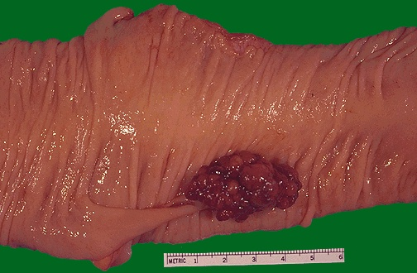
Neoplastic Polyps
Villous Adenoma
The least common, largest and most ominous of epithelial polyps (most likely to undergo malignant transformation).
Age: 60 to 65 years,
Present with rectal bleeding or anemia, large ones may secrete copious amounts of mucoid material rich in protein.
75% located in rectosigmoid area.
Notes:
10

Slide 15
3] Tubulovillous adenoma
Intermmediate in size, degree of dysplasia and malignant potential between tubular and villous adenomas.

Slide 17
Relationship of Neoplastic Polyps to Carcinoma
Adenoma to carcinoma sequence is documented by several genetic alterations.
Notes:
12

Slide 18
Adenoma to Carcinoma Pathway
Normal
Adenoma
Cancer
APC
loss
K-ras
mutation
Chrom 18
loss
p53
loss
Normal
Epithelium
Hyper-
proliferation
Early
Adenoma
Intermediate
Adenoma
Late
Adenoma
Cancer
Notes:
Polyp removal leads to CRC prevention
Polyp is surrogate marker

Slide 19
Relationship of Neoplastic Polyps to Carcinoma
The probability of carcinoma occuring in a neoplastic polyp is related to:
1. The size of the polyp.
2. The relative proportion of its villous features.
3. The presence of significant cytologic atypia (dysplasia) in the neoplastic cells.
Notes:
12

Slide 20
Familial Polyposis Syndrome
Patients have genetic tendencies to develop neoplastic polyps.
Familial polyposis coli (FPC)
Gardener’s syndrome
Turcot syndrome
Notes:
13

Slide 21
Familial Polyposis Syndrome
Familial polyposis coli (FPC)
Genetic defect of Adenomatous polyposis coli (APC).
APC gene located on the long arm of chromosome 5 (5q21).
APC gene is a tumor suppressor gene
Innumerable neoplastic polyps in the colon (500 to 2500)
Polyps are also found elsewhere in alimentary tract
The risk of colorectal cancer is 100% by midlife.
Gardener’s syndrome
Turcot syndrome
Notes:
13

Slide 22
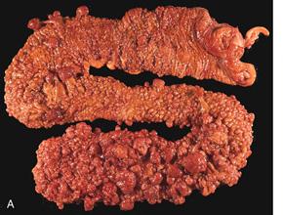
Familial polyposis coli (FPC)

Slide 23
Familial Polyposis Syndrome
Gardener’s syndrome
Polyposis coli, multiple osteomas, epidermal cysts, and fibromatosis.
Turcot syndrome
Polyposis coli, glioma and fibromatosis
Notes:
13

Slide 26
Gastrointestinal Block Pathology lecture 2013
Malignant Tumors of Intestine
Dr. Maha Arafah
Dr. Ahmed Al Humaidi

Slide 27
Malignant Tumors of Large Intestine
Adenocarcinoma
Adenocarcinoma of the colon is the most common malignancy of the GI tract and is a major cause of morbidity and mortality worldwide.
Constitutes 98% of all cancers in the large intestine.
incidence peaks at 60 to 70 years of age
Notes:
14

Slide 28
Malignant Tumors of Large Intestine
Adenocarcinoma
Predisposing factors
IBD, adenomas, polyposis syndrome.
Diet appears to play an important role in the risk for colon cancer:
- Low fibre diet.
High fat content.
Alcohol
- Reduced intake of vit A, C & E.
Notes:
14

Slide 29
Adenocarcinoma of Large Intestine
Carcinogenesis
Two pathogenetically distinct pathways for the development of colon cancer, both seem to result from accumulation of multiple mutations:
1- The APC/B-catenin pathway ( 85 % )
2- The DNA mismatch repair genes pathway

Slide 30
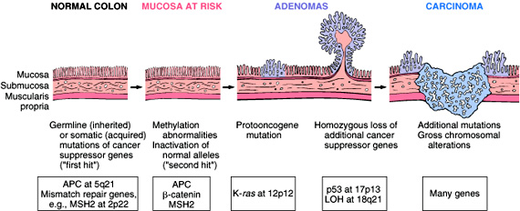
Adenocarcinoma of Large Intestine
Carcinogenesis
1- The APC/B-catenin pathway ( 85 % )
chromosomal instability that results in stepwise accumulation of mutations in a series of oncogenes and tumor suppressor genes.
adenoma-carcinoma sequence

Slide 31
Familial Adenomatous Polyposis
Hereditary mutation of the APC gene is the cause of familial adenomatous polyposis (FAP), where affected individuals carry an almost 100% risk of developing colon cancer by age 40 years.

Slide 32
Malignant Tumors of Large Intestine Adenocarcinoma
Carcinogenesis
2- The DNA mismatch repair genes pathway:
10% to 15% of sporadic cases.
There is accumulation of mutations (as in the APC/B-catenin schema)
Five DNA mismatch repair genes (MSH2, MSH6, MLH1, PMS1, AND PMS2)
give rise to the hereditary non polyposis colon carcinoma (HNPCC) syndrome.

Slide 33
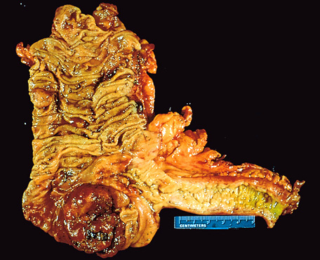
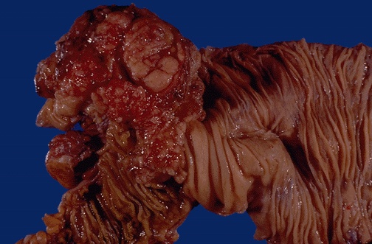
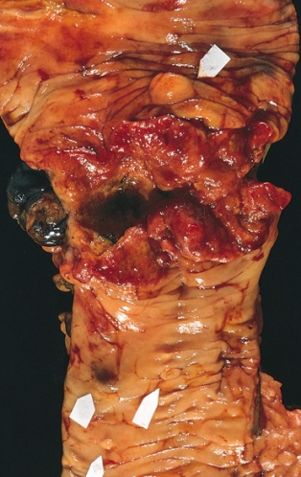
Colorectal Carcinoma
Morphology
70% are in the rectum, rectosigmoid and sigmoid colon.
Left-sided carcinomas tend to be annular, encircling lesions with early symptoms of obstruction.
Right-sided carcinomas tend to grow as polypoid, fungating masses, obstruction is uncommon.
Right-sided
Left-sided
Notes:
16

Slide 34
Colorectal Carcinoma Morphology
Adenocarcinoma
Mucinous adenocarcinoma secret abundant mucin that may dissect through cleavage planes in the wall.

Slide 36
Signs and symptoms
If located closer to the anus: change in bowel habit, feeling of incomplete defecation, PR bleeding
A tumor that is large enough to fill the entire lumen of the bowel may cause bowel obstruction
Right-sided lesions are more likely to bleed while left-sided tumors are usually detected later and could present with bowel obstruction.

Slide 37
Colorectal Carcinoma
Serum levels of carcinoembryonic antigen (CEA) are related to tumor size and extent of spread. They are helpful in monitoring for recurrence of tumor after resection.
TNM Staging of Colon Cancers is used for staging
Ref: Robbins Basic Pathology:

Slide 40
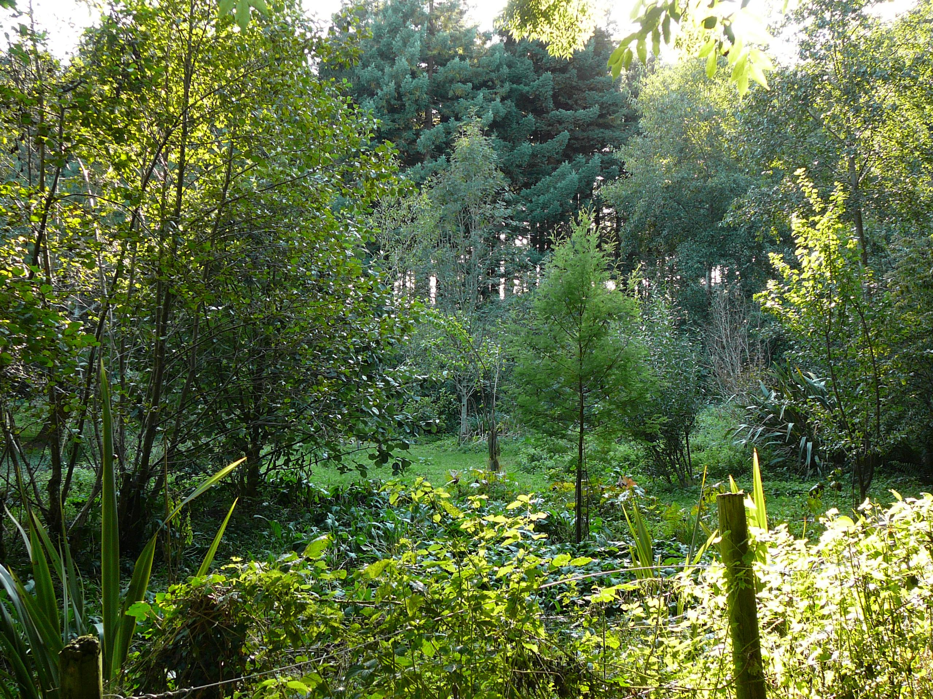

Slide 41
Malignant Small Intestinal Neoplasms
In descending order of frequency:
Carcinoid
Adenocarcinomas
Lymphomas
Leiomyosarcomas.
Notes:
20

Slide 42
Small Intestinal Neoplasms
Carcinoid Tumors
Neoplasms arising from endocrine cells found along the length of GIT mucosa.
The peak incidence: sixth decade, but they may appear at any age.
They compose less than 2% of colorectal malignancies
almost half of small intestinal malignant tumors:
60 to 80% appendix and terminal ileum
10 to 20% rectum.
Notes:
21

Slide 43
Carcinoid Tumors Behavior
Aggressive behavior correlates with:
Site of origin:
Appendiceal and rectal carcinoids infrequently metastasize, even though they may show extensive local spread
90% of ileal, gastric, and colonic carcinoids that have penetrated halfway through the muscle wall have spread to lymph nodes and distant sites at the time of diagnosis, especially those larger than 2 cm in diameter.
Depth of local penetration
Size of the tumor

Slide 44
Small Intestinal Neoplasms
Carcinoid Tumors
Morphology
A solid, yellow-tan appearance
The cells are monotonously similar, having a scant, pink granular cytoplasm and a round-to-oval stippled nucleus.
Ultrastructral features: neurosecretory electron dense bodies in the cytoplasm
Notes:
21

Slide 45
Small Intestinal Neoplasms
Carcinoid Tumor
Clinical features
Asymptomatic
May cause obstruction, intussusception or bleeding.
May elaborate hormones: Zollinger-Ellison, Cushing’s carcinoid or other syndromes.
Notes:
22

Slide 46
Small Intestinal Neoplasms
Carcinoid tumor
Carcinoid syndrome
1% of carcinoid tumor & in 20% of those of widespread metastasis
Paroxymal flushing, episodes of asthma-like wheezing, right-sided heart failure, attacks of watery diarrhea, abdominal pain,
The principal chemical mediator is serotonin
The syndrome is classically associated with ileal carcinoids with hepatic metastases.
Notes:
23

Slide 47
Serotonin and diarrhea
Patients with carcinoid syndrome often suffer from diarrhea, which has both a secretory and a motor component. The secretory component of carcinoid diarrhea is attributable to excessive serotonergic stimulation of submucosal secretomotor neurons; the motor component includes faster small bowel and colon transit and an exaggerated tonic response of the colon to ingestion of a meal
Gastroenterology Volume 132, Issue 1 , Pages 397-414, January 2007

Slide 48
Small Intestinal Neoplasms
Lymphoma
Most often low-grade lymphomas arising in mucosal-associated lymphoid tissue (MALT) lymphoma or high-grade non-Hodgkin's lymphomas of B cell type.
May occur in any part of the intestine;
The ileocecal region is a favored site for Burkitt's lymphoma.

Slide 51
Diverticulosis

