Slide 1
Normal anatomy and histology

Slide 2
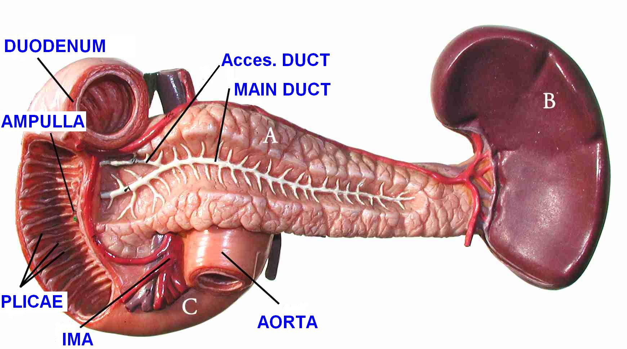
PANCREAS

Slide 3
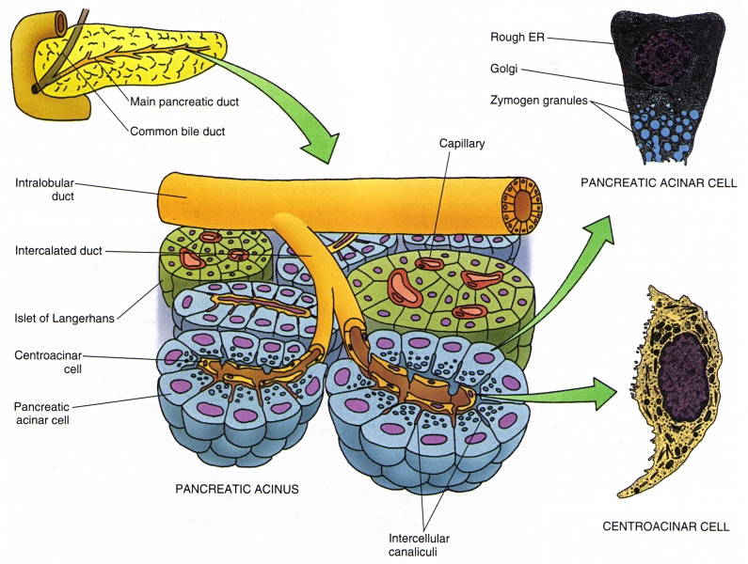
Notes:
Histology concepts.

Slide 4
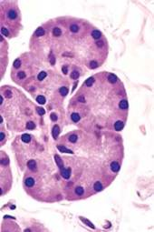
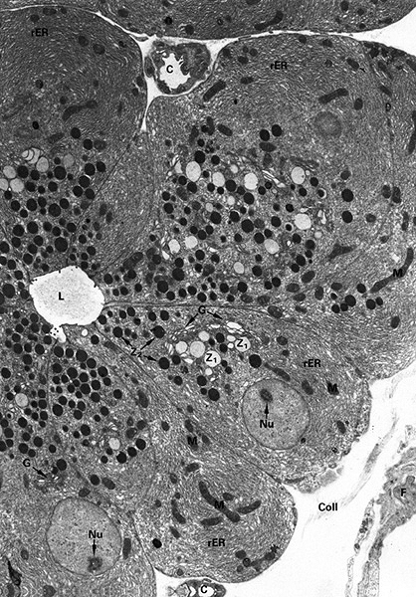
Notes:
H&E, e.m.

Slide 5
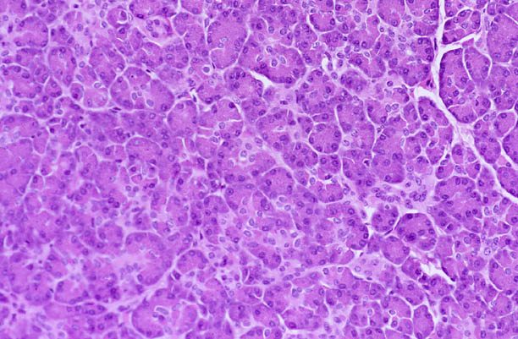
Notes:
Histology, H&E

Slide 6
PANCREATITIS
ACUTE (VERY SERIOUS)
CHRONIC

Slide 7
Common causes of pancreatitis

Slide 8
CONSEQUENCES of ACUTE and CHRONIC pancreatitis

Slide 9
ACUTE PANCREATITIS
ALCOHOLISM
Bile reflux
Medications (thiazides)
Hypertriglyceridemia, hypercalcemia
Acute ischemia
Trauma, blunt, iatrogenic
Genes: PRSS1, SPINK1
Idiopathic, 10-20%

Slide 10
Mnemonic for Causes
I GET SMASHED
I - Idiopathic
G - Gall stones
E - Ethanol
T - Traumas
S - Steroids
M - Mumps, Malignancy
A - Auto-immune
S - Scorpion bite
H - Hypercalcemia, Hyperlipidemia
E - ERCP
D - Drugs

Slide 11
CLINICAL FEATURES
ABDOMINAL PAIN
EXTREME emergency situation
HIGH mortality
…but MOST important lab test is……….????? →

Slide 12
AMYLASE
!!!!!!!

Slide 13
Pathophysiology
Central cause appears to be activation of the digestive zymogens →subsequent autodigestion of the pancreas.
Activated proteolytic enzymes eg trypsin digest cellular membranes within pancreas & cause edema, interstitial hemorrhage, vascular damage, coagulation & cellular necrosis.
This can lead to extension of localized process into generalized systemic inflammatory response
Can lead to shock, ARDS, Multi-organ system failure

Slide 14
MORPHOLOGY
EDEMA
FAT NECROSIS
ACUTE INFLAMMATORY INFILTRATE
PANCREAS AUTODIGESTION
BLOOD VESSEL DESTRUCTION
“SAPONIFICATION”

Slide 15
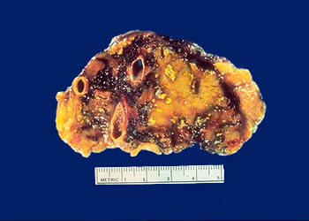
Pancreas
In severe acute pancreatitis, black areas of hemorrhage are present within the pancreas as well as chalky, yellow-white areas of fat necrosis. Pancreatic parenchyma is soft and gray-white due to necrosis

Slide 16
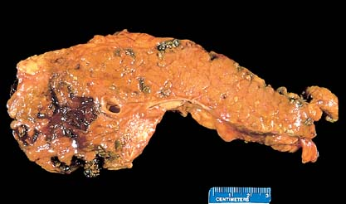
Notes:
Does this look like a partly digested piece of meat? It is.

Slide 17
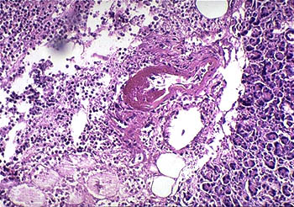
This image of severe acute pancreatitis shows an area of acute inflammation with necrosis. Within the necrotic area is a blood vessel showing fibrinoid necrosis of the vessel wall. Damage such as this leads to severe, hemorrhagic, acute pancreatitis.

Slide 18
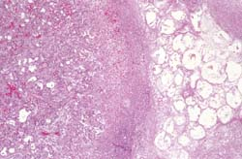
Notes:
Why the blurr? Microscope out of focus. What is autolysis?

Slide 19
Chronic pancreatitis

Slide 20
Chronic Pancreatitis
Defined as chronic inflammatory condition that causes irreversible damage to pancreatic structure and function
Causes: Alcohol abuse, malnutrition, hyperPTH, ampullary stenosis, cystic fibrosis, hereditary (mutations) , trauma, idiopathic.
Chronic pancreatitis goes hand in hand with chronic alcoholism.

Slide 21
Chronic Pancreatitis
Chronic pancreatitis results in interstitial inflammation w/duct obstruction and dilation leading to parenchymal loss and fibrosis.
Loss of both exocrine and endocrine
Clinicically significant malabsorption occurs when 90% of pancreas is lost.

Slide 22
Chronic Pancreatitis
Presents as mid-epigastric abdominal pain, nausea, vomiting
Pts. may appear chronically ill, with sign of pancreatic insufficiency such as weight loss, steatorrhea, clubbing, polyuria
Differentiating acute vs chronic pancreatitis is difficult and primary distinction is based on disease reversibility

Slide 23
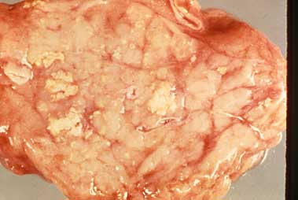
CHRONIC PANCREATITIS
Pancreatic cut surface shows areas of pale whitish necrosis

Slide 24
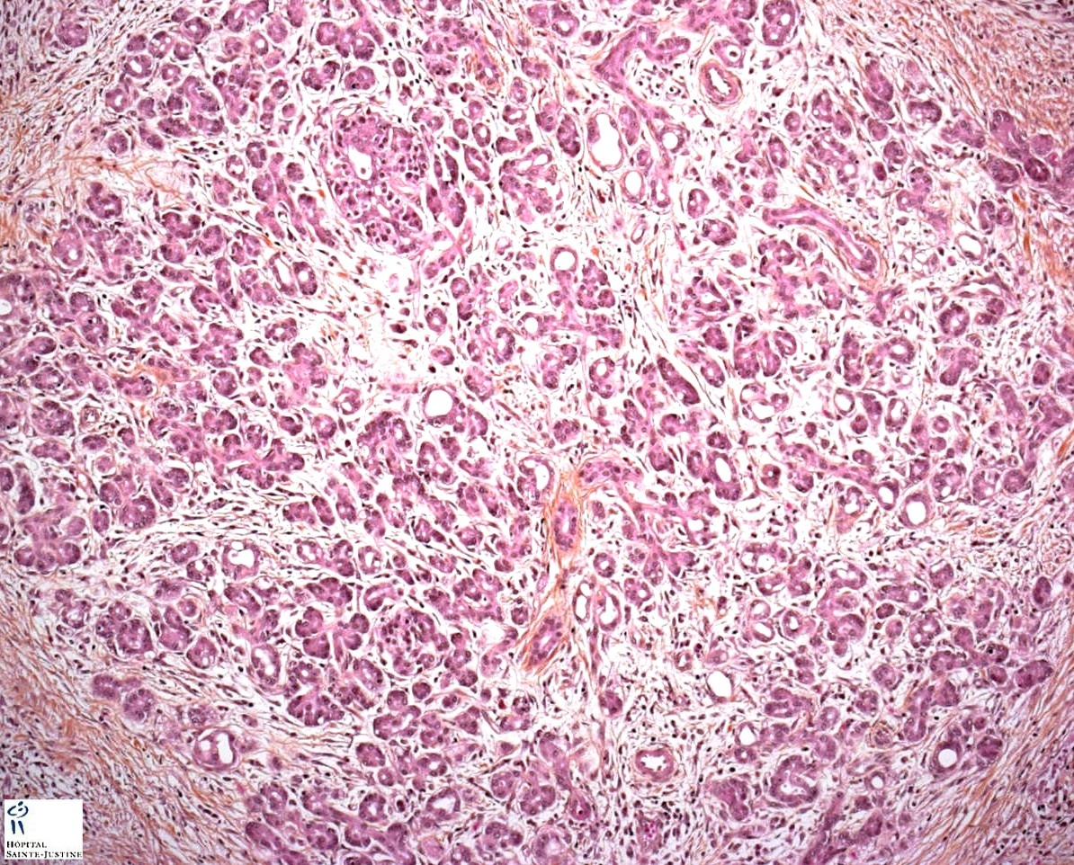
Notes:
Unfortunately dense fibrosis is a feature BOTH of chronic pancreatitis as well as adenocarcinoma.

Slide 25
CHRONIC PANCREATITIS
Notes:
What is every pathologist’s nightmare? Ans: Getting a small needle biopsy of sclerosing pancreatitis and calling it it cancer, getting the “Whipple” specimen the next day, and realizing you were WRONG! The patient has now undergone an operation which has a 10% mortality rate, for no reason, and the malpractice attorneys at at your door like jackals.

Slide 26
Hyperplastic pancreatic Islets of Langerhans.
Chronic inflammation. Distorted pancreatic acinii.
Stromal fibrosis.

Slide 27
CLINICAL FEATURES of chronic pancreatitis
Abdominal Pain
Vague abdominal symptoms
Nothing
CT-- calcifications ,
Amylase elevated
Complications of chronic pancreatitis:
Pancreatic pseudocyst.
Steatorrhea (fat malabsorption leading to vitamin deficiencies)

