Slide 1
ANATOMY OF THE SMALL INTESTINE
Prof. Ahmed Fathalla Ibrahim
Professor of Anatomy
College of Medicine
King Saud University
E-mail: ahmedfathala@hotmail.com

Slide 2
OBJECTIVES
At the end of the lecture, students should:
List the different parts of small intestine.
Describe the anatomy of duodenum, jejunum & ileum regarding: the shape, length, site of beginning & termination, peritoneal covering, arterial supply & lymphatic drainage.
Differentiate between each part of duodenum regarding the length, level & relations.
Differentiate between the jejunum & ileum regarding the characteristic anatomical features of each of them.

Slide 3
SMALL INTESTINE
FIXED PART
(NO MESENTERY)
DUODENUM
FREE (MOVABLE) PART
(WITH MESENTERY)
JEJUNUM & ILEUM

Slide 4
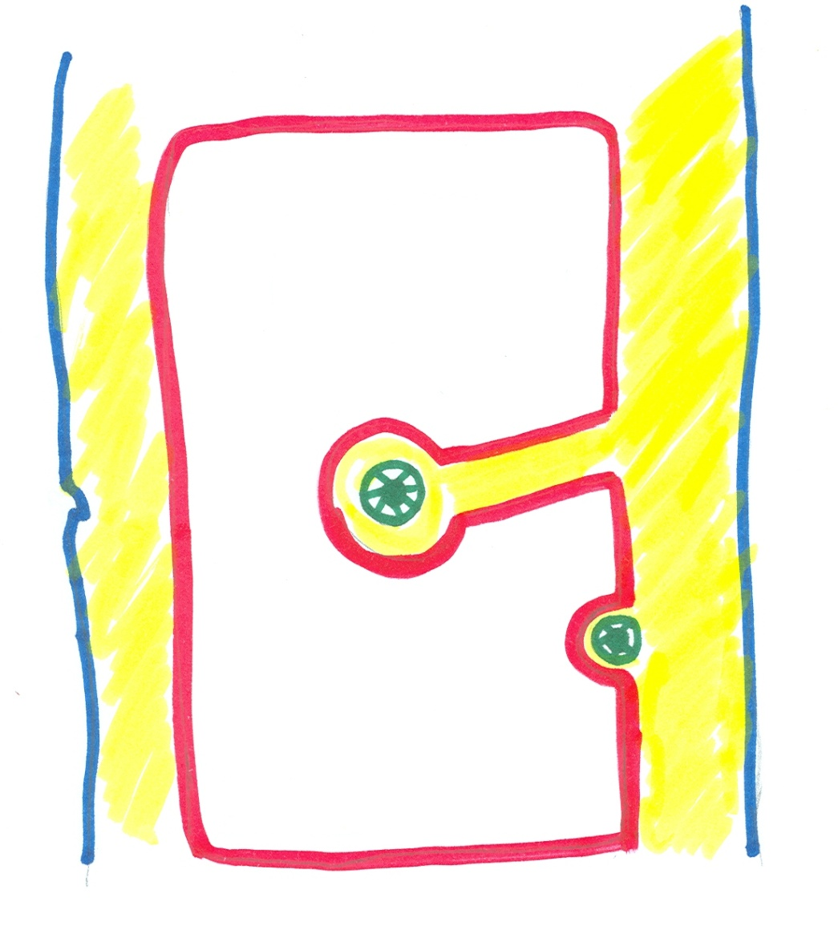
ABDOMEN
Peritoneal cavity
Posterior abdominal wall
Anterior abdominal wall
Peritoneal fold
(Mesentery OR
Omentum)
Retroperitoneal
structure

Slide 5
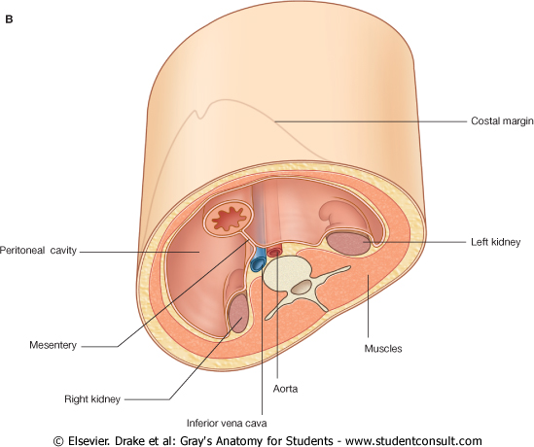
ABDOMEN

Slide 6
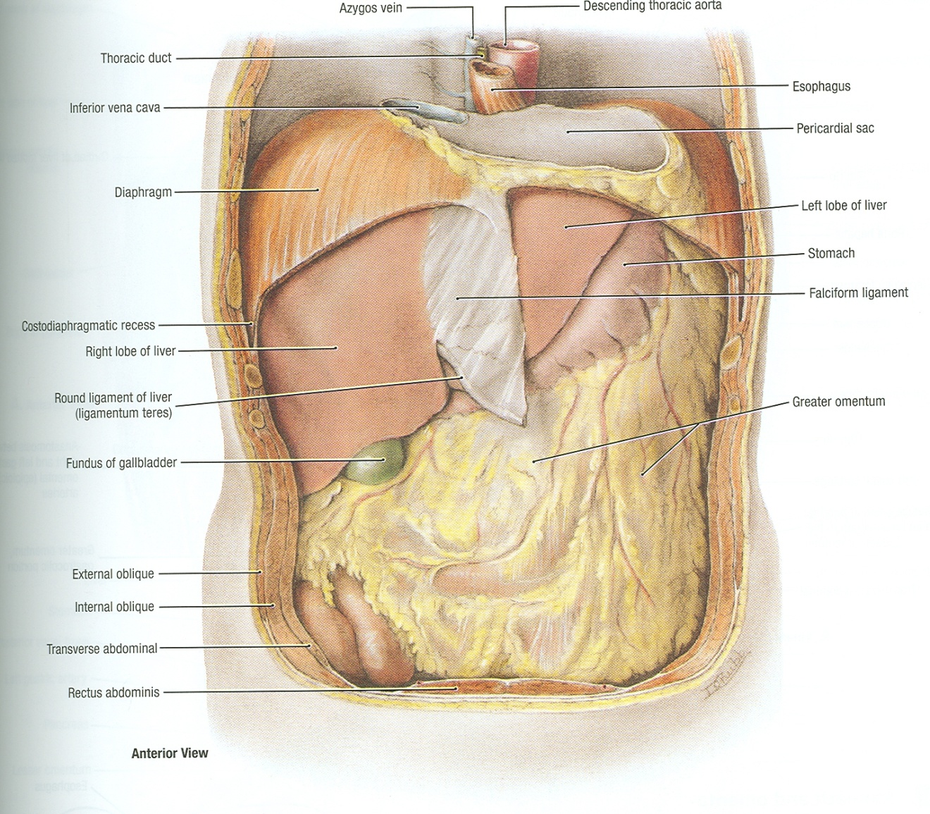
ABDOMEN
L
s
L
OMENTUM
SI

Slide 7
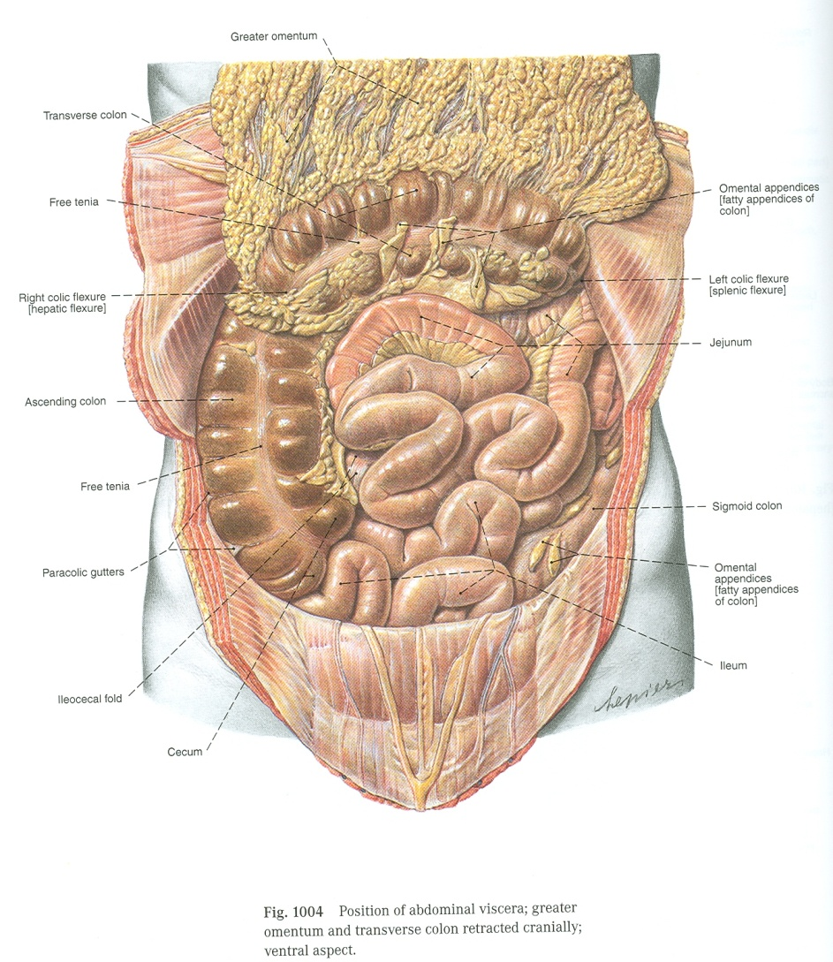
JEJUNUM & ILEUM
OMENTUM
TC
AC

Slide 8
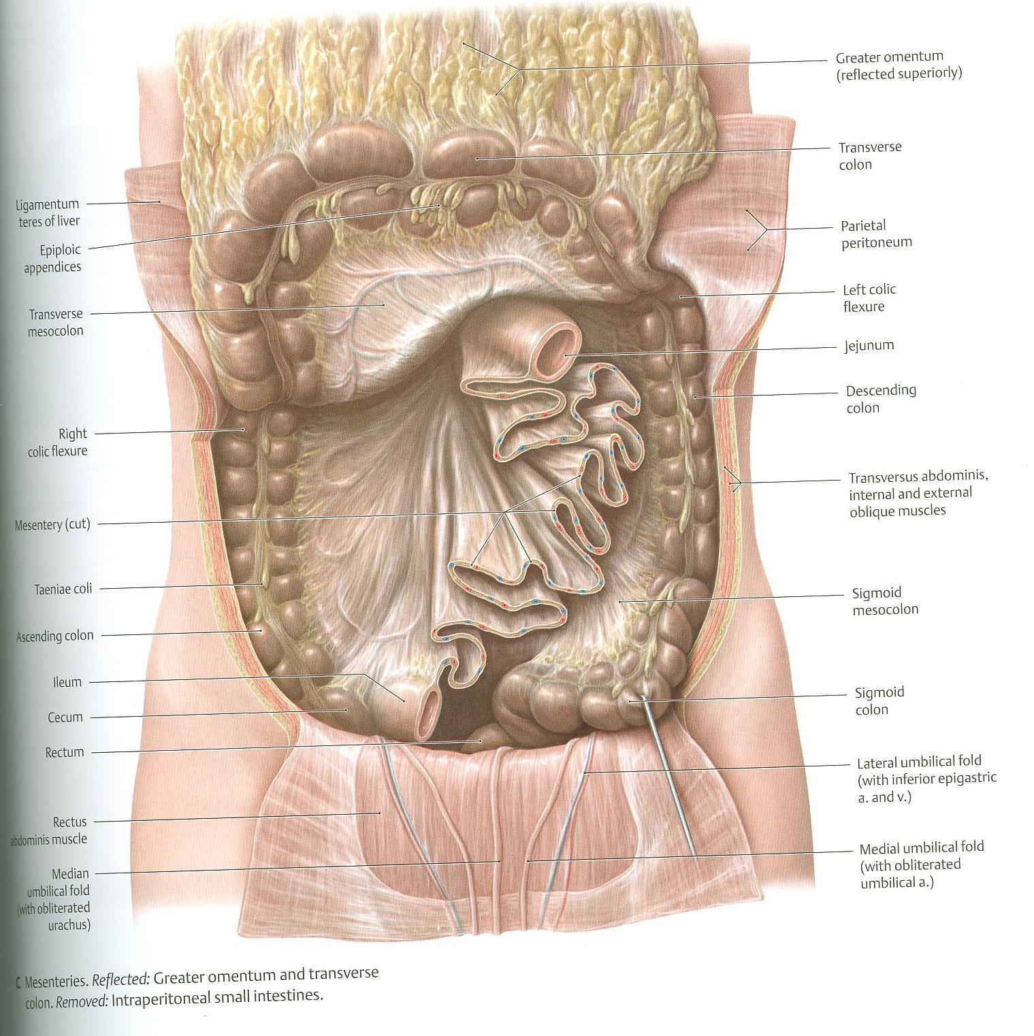
MESENTERY OF SMALL INTESTINE

Slide 9
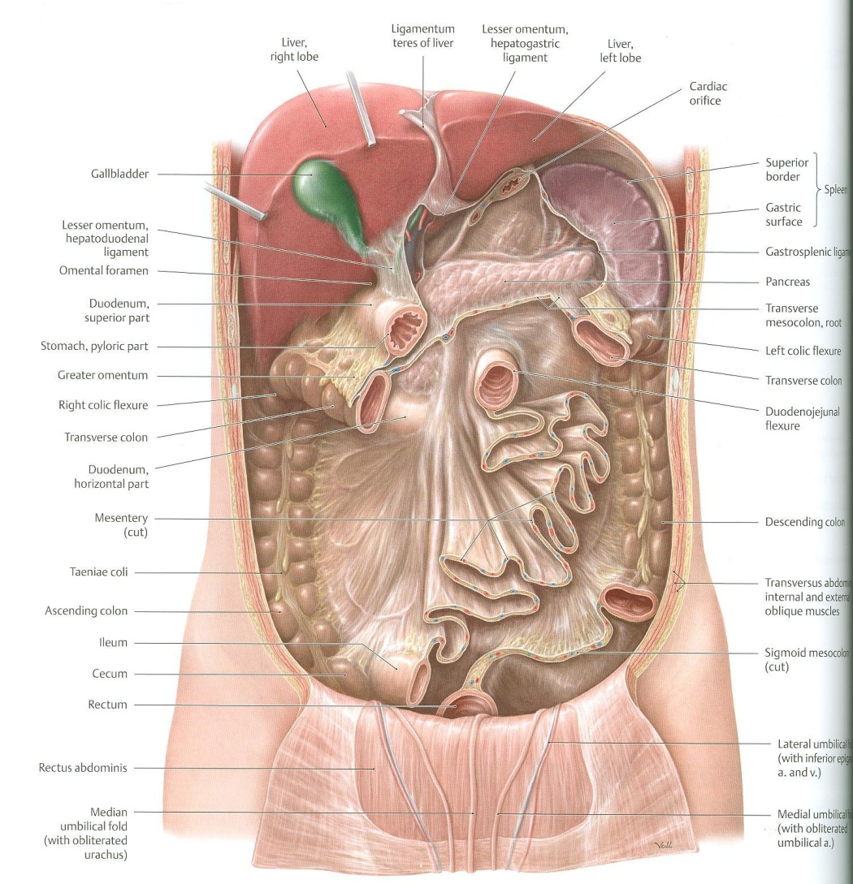
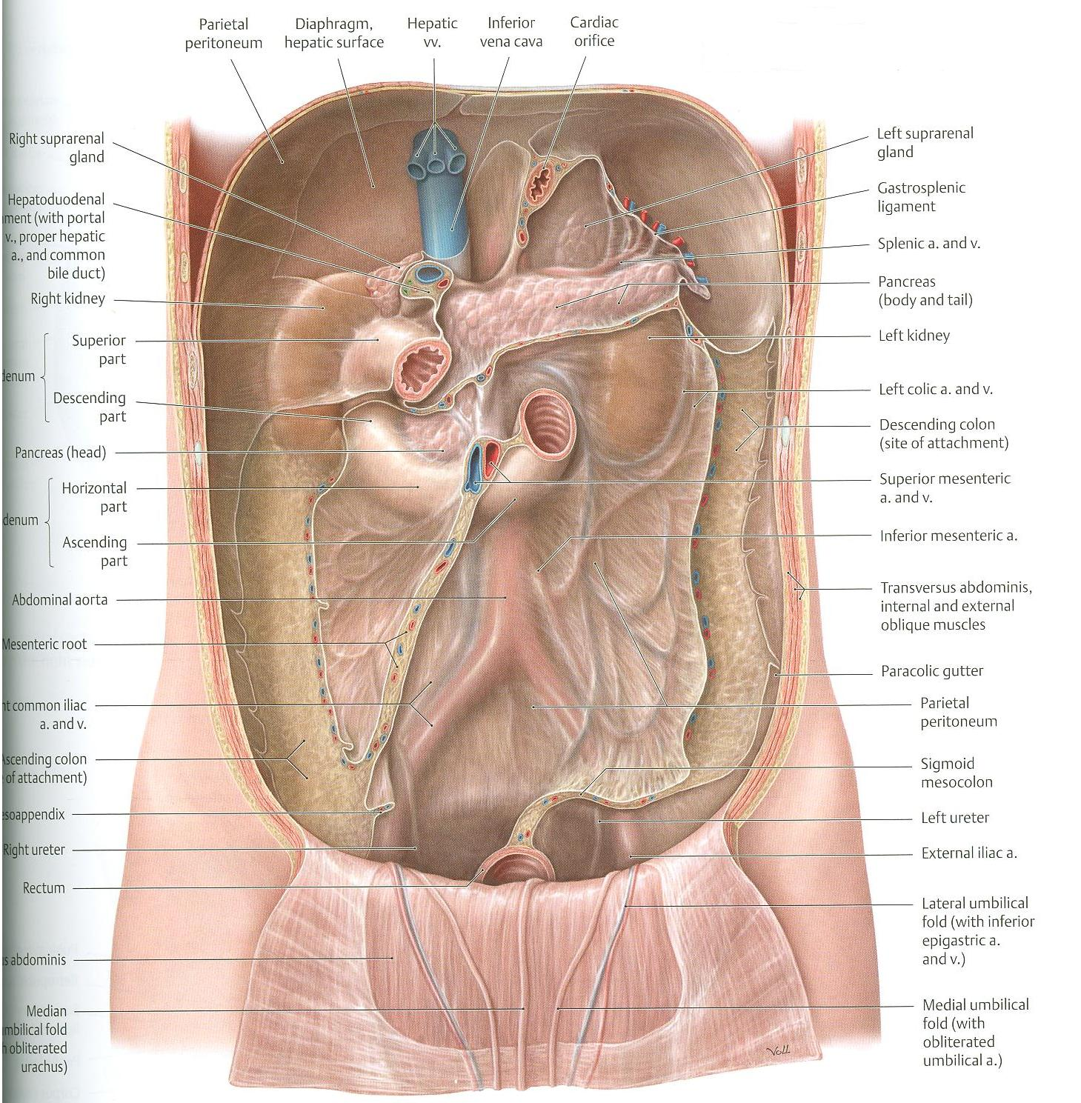
1
2

Slide 10
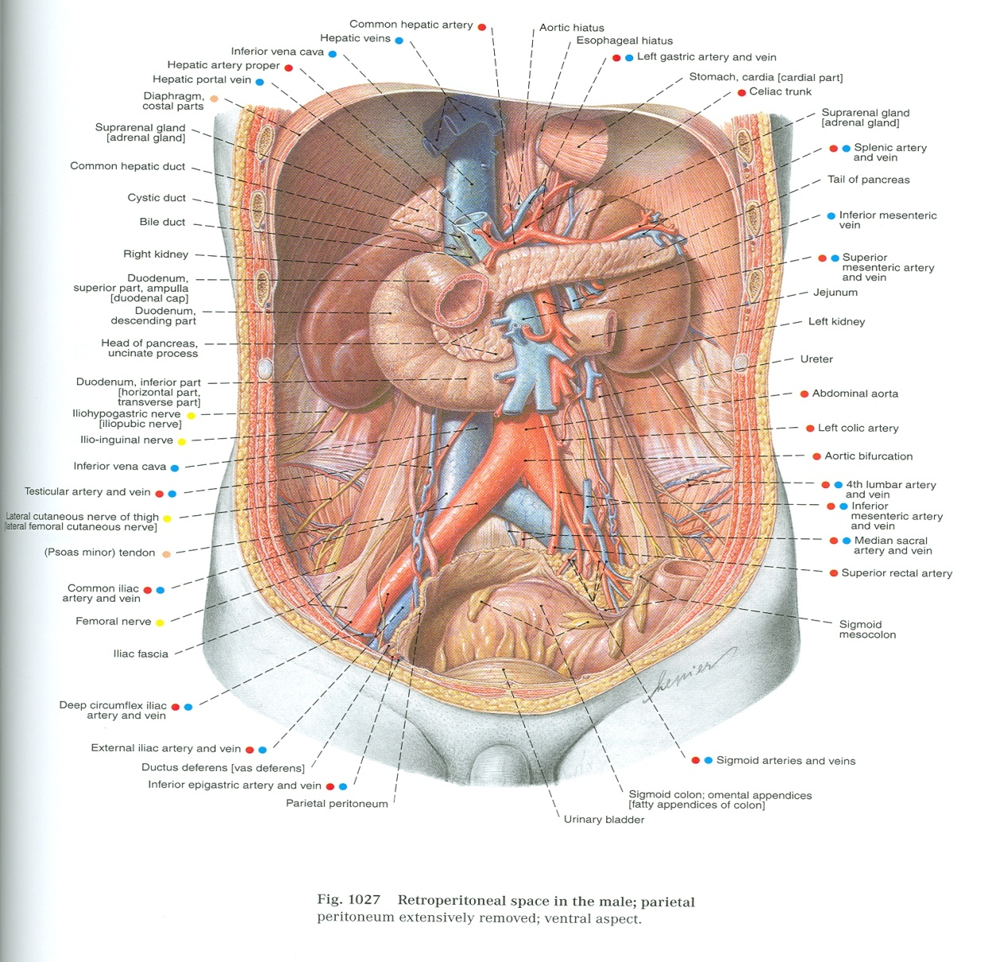
DUODENUM
Pancreas
Left kidney
Right kidney
Abdominal aorta
Inferior vena cava
Right psoas major
Left psoas major

Slide 11
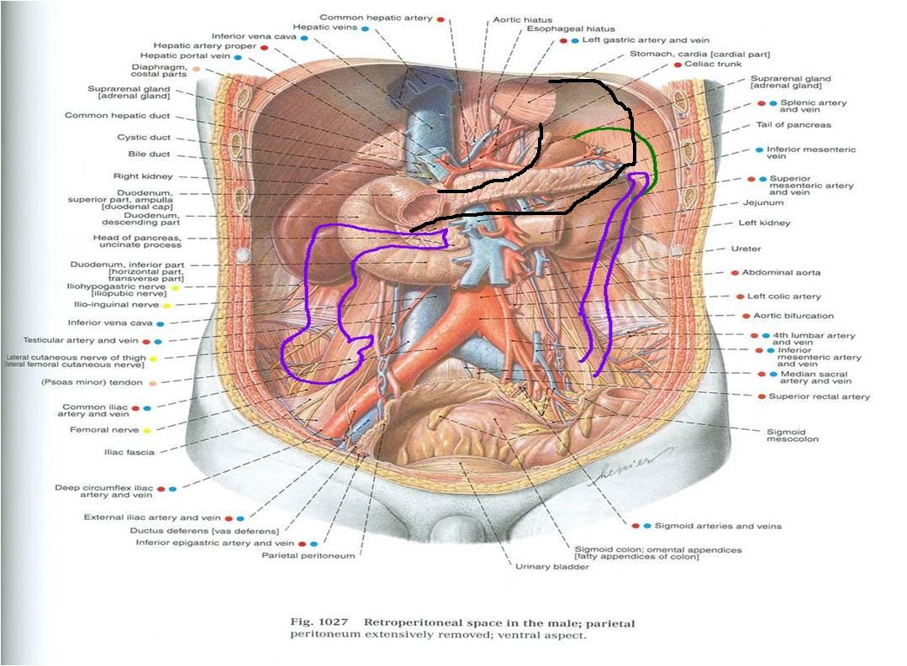

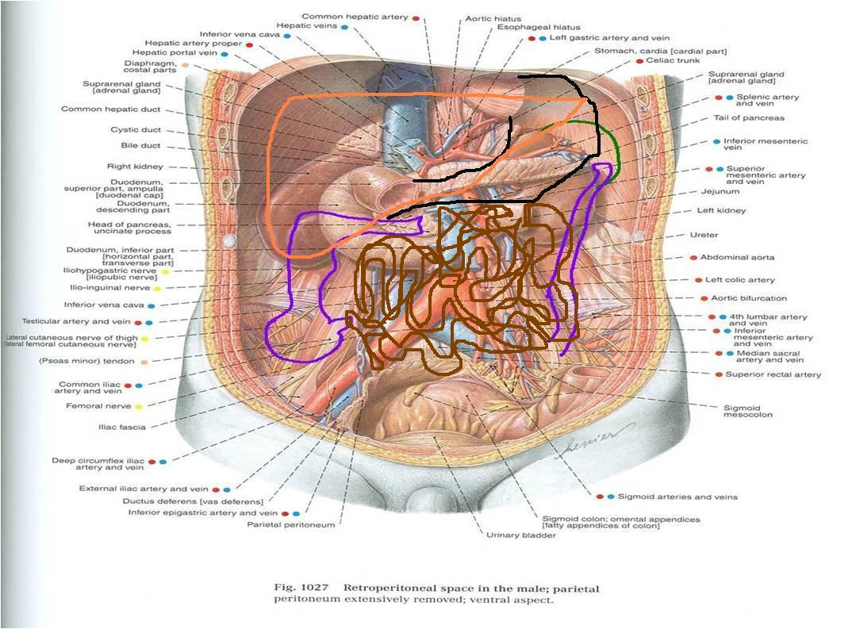

Slide 13
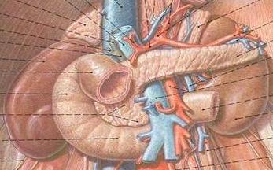
RELATION BETWEEN
EMBRYOLOGICAL ORIGIN & ARTERIAL SUPPLY
DUODENUM:
Origin: Foregut & Midgut
Arterial supply:
Coeliac trunk (artery of foregut)
Superior mesenteric: (artery of midgut)
JEJUNUM & ILEUM:
Origin: Midgut
Arterial supply:
Superior mesenteric: (artery of midgut)

Slide 14
DUODENUM
SHAPE: C-shaped loop
LENGTH: 10 inches
BEGINNING: at pyloro-duodenal junction
TERMINATION: at duodeno-jejunal flexure
PERITONEAL COVERING: retroperitoneal
DIVISIONS: 4 parts
EMBRYOLOGICAL ORIGIN: foregut & midgut
ARTERIAL SUPPLY: coeliac & superior mesenteric
LYMPHATIC DRAINAGE: coeliac & superior mesenteric

Slide 15
DUODENUM
LENGTH – SURFACE ANATOMY
PART | LENGTH | LEVEL
FIRST PART (HORIZONTAL) | 2 INCHES | L1 (TRANSPYLORIC PLANE)
SECOND PART (DESCENDING) | 3 INCHES | DESCENDS FROM L1 TO L3
THIRD PART (HORIZONTAL) | 4 INCHES | L3 (SUBCOTAL PLANE)
FOURTH PART (ASCENDING) | 1 INCHES | ASCENDS FROM L3 TO L2

Slide 16
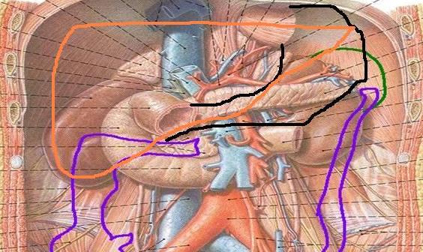
RELATIONS OF FIRST PART
3)
2)
1)
X
X
Anterior
Liver
Posterior
1)Bile duct
2) Gastroduodenal artery
3)Portal vein

Slide 17
RELATIONS OF SECOND PART
Anterior
1)Liver
2)TC
3)SI
Posterior
Right kidney
X
Lateral
RCF
Medial
Pancreas

Slide 18
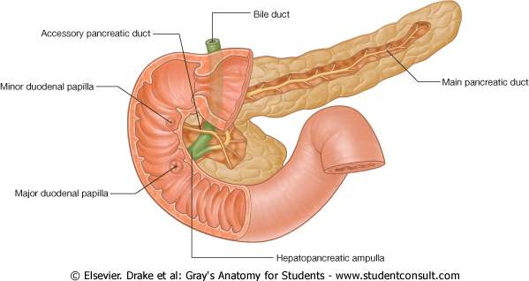
OPENINGS IN
SECOND PART OF DUODENUM
Common opening of bile duct & main pancreatic duct: on summit of major duodenal papilla.
Opening of accessory pancreatic duct (one inch higher): on summit of minor duodenal papilla.

Slide 19
RELATIONS OF THIRD PART
Anterior:
a)Small intestine
b) Superior mesenteric vessels
Posterior:
1) Right psoas major
2) Inferior vena cava
3) Abdominal aorta
4) Inferior mesenteric vessels
X
b
1
2
3
4

Slide 20
RELATIONS OF FOURTH PART
Anterior:
Small intestine
Posterior:
Left psoas major

Slide 21
JEJUNUM & ILEUM
SHAPE: coiled tube
LENGTH: 6 meters (20 feet)
BEGINNING: at duodeno-jejunal flexure
TERMINATION: at ilieo-caecal junction
PERITONEAL FOLD: mesentery of small intestine
EMBRYOLOGICAL ORIGIN: midgut
ARTERIAL SUPPLY: superior mesenteric
LYMPHATIC DRAINAGE: superior mesenteric

Slide 22
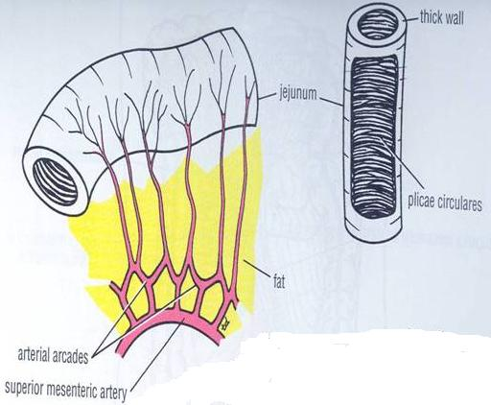
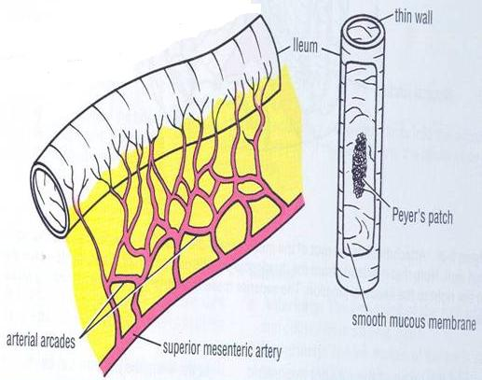
 | JEJUNUM | ILEUM
LENGTH | Shorter (proximal 2/5) | Longer (distal 3/5)
DIAMETER | Wider | Narrower
WALL | Thicker (more plicae circulares) | Thinner (less plica circulares)
APPEARANCE | Dark red (more vascular) | Light red (less vascular)
VESSELS | Less arcades (long terminal branches) | More arcades (short terminal branches)
MESENTERIC FAT | Small amount near intestinal border | Large amount near intestinal border
LYMPHOID TISSUE | Few aggregations | Numerous aggregations (Peyer’s patches)

Slide 23
QUESTION 1
Which one of the following is anterior to the third part of duodenum?
Superior mesenteric vessels
Right kidney
Right posas major muscle
Abdominal aorta

Slide 24
QUESTION 2
Which one of the following structures could be injured in case of perforated duodenal ulcer?
Right kidney
Right colic flexure
Gastroduodenal artery
Inferior mesenteric vessels

Slide 25
THANK YOU

