Slide 1
Pancreas
&
Biliary System

Slide 2
Objectives
At the end of the lecture, the student should be able to describe the:
Location, surface anatomy, parts, relations & peritoneal reflection of the pancreas and gall bladder.
Blood supply, nerve supply and lymphatic drainage of pancreas and gall bladder.
Course of each of common hepatic, cystic and common bile duct and pancreatic ducts

Slide 3
PANCREAS: LOCATION
A soft, lobulated elongated gland with both exocrine and endocrine functions.
6-10 inch in length and 60-100 gram in weight.
Location:
Located in epigastrium & Left upper quadrant of abdomen.
Retro-peritoneal in position
Lies across the posterior abdominal wall in an transverse /oblique direction at transpyloric plane .

Slide 4
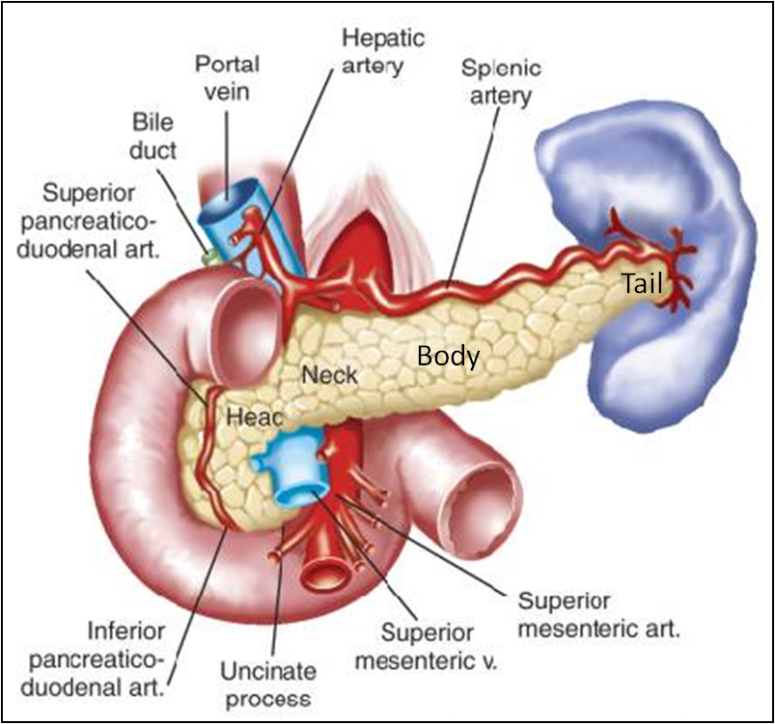
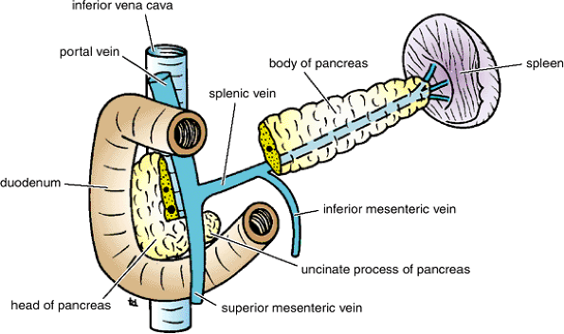
PANCREAS: PARTS
It is divided into:
Head
Neck
Body
Tail.
Head
Disc shaped, lies within the concavity of the duodenum
Related to the 2nd and 3rd portions of the duodenum on the right & continues with the neck on the left
Includes uncinate process (part extending to the left behind the superior mesenteric vessels)

Slide 5
Neck
Lies in front of origin of superior mesenteric artery and the confluence of the portal vein
The superior mesenteric vessels emerge from its inferior border
Body
Triangular in cross section, runs upward and to the left.
The splenic vein is embedded in its posterior surface
Tail
Narrow, short segment, ending at the splenic hilum
Lies in the splenicorenal ligament (may get injured during splenectomy), at the level of the T12 vertebra
Anteriorly, related to splenic flexure of colon

Slide 6
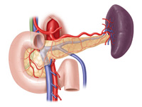
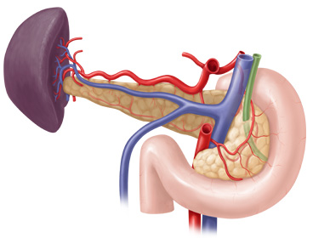
Relations
Anterior
Stomach separated from it by lesser sac
Transverse colon & transverse mesocolon
Posterior
Bile duct, portal & splenic veins, inferior vena cava, aorta & origin of superior mesenteric artery
Left psoas muscle, left adrenal gland, left renal vessels & upper 1/3rd of left kidney
Hilum of the spleen.

Slide 7
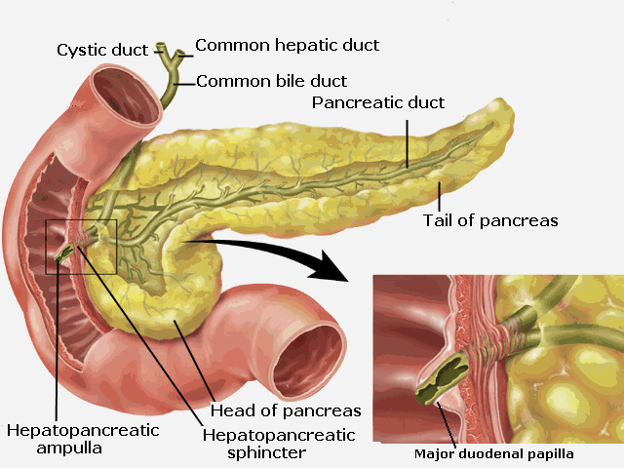
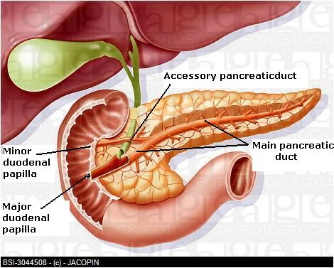
Pancreatic Ducts
Main duct (of Wirsung)
Runs the entire length of pancreas beginning from the tail.
Receives many tributaries from tail, body, neck, inferior portion of head & uncinate process.
Joins common bile duct & together they open into a small hepatopancreatic ampulla (Ampulla of Vater) in the duodenal wall
The ampulla opens into the lumen of the duodenum by means of a small Papilla, (Major duodenal papilla).
The terminal parts of both ducts and the ampulla are surrounded by circular muscle, known as the sphincter of the hepatopancreatic ampulla (sphincter of Oddi).
Accessory duct (of Santorini)
Drains superior portion of the head
Empties separately into 2nd portion of duodenum at (minor duodenal papilla)

Slide 8
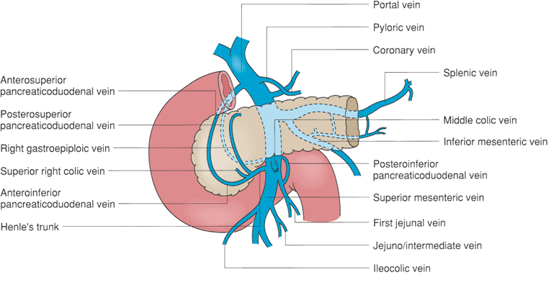
Blood Supply of Pancreas
Arteries
Head & neck: Supplied by branches from:
Celiac trunk through Superior pancreatico-duodenal artery
Superior mesenteric artery through Inferior pancreatico-duodenal artery
Body and tail: Supplied by Splenic artery through 8-10 branches
Veins
Head & neck: Drained by anterior and posterior venous arcades that form the superior & inferior pancreaticoduodenal veins which follow the corresponding arteries.
Body and tail: Drained by splenic vein, which is a tributary of portal vein

Slide 9
Lymphatic Drainage
Rich network that drains into pyloric, hepatic and splenic nodes
Ultimately the efferent vessels drain into the celiac & superior mesenteric lymph nodes.
Innervation
Sympathetic fibers (with predominantly inhibitory effect) from the thoracic splanchnic nerves.
Parasympathetic fibers (stimulate both exocrine and endocrine secretions) from the vagus.

Slide 10
Biliary System
The biliary system consists liver, gall bladder & bile ducts, that are involved in the production, storage & transportation of bile.
Bile is secreted by the liver cells at a constant rate of about 40 ml per hour. When digestion is not taking place, the bile is stored and concentrated in the gallbladder; when needed, it is delivered to the duodenum via bile ducts.
The bile ducts consist of:
Bile canaliculi
Interlobular ducts
Intrahepatic ducts
Right and left hepatic ducts
Common hepatic duct
Cystic duct
Common bile duct (Bile duct)

Slide 11
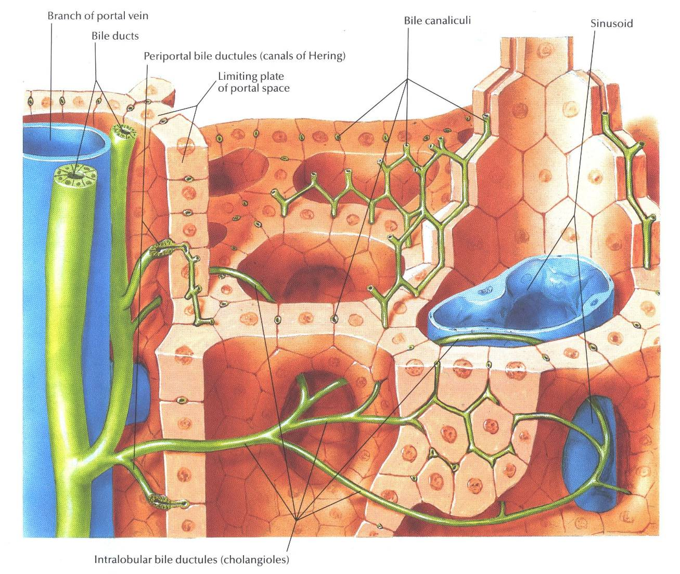
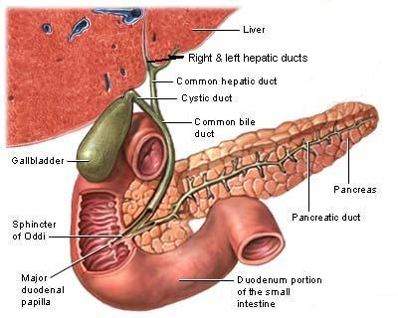
The Bile Ducts
The smallest vessels the bile canaliculi open into the interlobular ducts situated in the portal canals of the liver
The interlobular ducts join one another to form progressively larger ducts and, eventually, at the porta hepatis form the right and left hepatic ducts.
The right hepatic duct drains the right lobe of the liver and the left duct drains the left lobe, caudate lobe, & quadrate lobe. After a short course, the hepatic ducts unite to form the common hepatic duct

Slide 12
The common hepatic duct, about 1.5 in. (4 cm) long, descends within the free margin of the lesser omentum. It is joined on the right side by the cystic duct from the gallbladder to form the common bile duct (bile duct)
The common bile duct is about 3 inches long.
In its course:
First it lies in the right free margin of the lesser omentum.
Then it runs behind the first part of the duodenum.
Then it lies in a groove on the posterior surface of the head of the pancreas. Here, the bile joins the main pancreatic duct and opens into 2nd part of duodenum

Slide 13
Gallbladder
A pear-shaped sac, with a capacity of 30 to 50 ml, lies on the undersurface of the liver.
Divided into the fundus, body, neck.
Fundus: rounded and projects below the inferior margin of the liver, where it comes in contact with the anterior abdominal wall at the level of the tip of the ninth right costal cartilage.
Body: lies in contact with the visceral surface of the liver
Neck becomes continuous with the cystic duct
The peritoneum completely surrounds the fundus of the gallbladder and binds the body and neck to the visceral surface of the liver.

Slide 14
Gallbladder
Relations
Anterior
Anterior abdominal wall
Inferior surface of the liver
Posterior
Transverse colon
1st & 2nd parts of the duodenum
Functions
Stores bile
Concentrates bile
Selectively absorbs bile salts, keeps the bile acid
Excretes cholesterol
Secretes mucus.

Slide 15
Blood Supply
The cystic artery, usually a branch of the right hepatic artery.
The cystic vein drains directly into the portal vein.
Several very small arteries and veins also run between the liver and gallbladder.
Nerve Supply
Sympathetic and parasympathetic vagal fibers form the celiac plexus.
Lymph Drainage
Cystic node hepatic nodes celiac nodes.

Slide 16
Cystic Duct
S-shaped duct, about 1.5 in. (3.8 cm) long and connects the neck of the gallbladder to the common hepatic duct to form the bile duct
Descends in the free margin of the lesser omentum.
The mucous is raised to form a spiral fold that is continuous with a similar fold in the neck of the gallbladder. The fold is commonly known as the “spiral valve.” The function of the spiral valve is to keep the lumen constantly open.

Slide 17
Thank You

