Slide 1
A
B
Fasting improve the condition
inflammatory bowel diseases
High stool output
Presence of WBC in stool
Irritable bowel syndrome
bacterial toxin
Malabsorption
High fecal osmotic gap
Secretory
Osmotic
Exudative (inflammatory )
Motility-related

Slide 2
A
B
Irritable bowel syndrome
Giardia lamblia
Viral gastroenteritis
Inflammatory bowel disease
Food poisoning
Antibiotic-Associated Diarrheas
Malabsorption
Acute diarrhea
Chronic diarrhea

Slide 3
CLASSIFICATION diarrhea
Acute
Persistent
Chronic

Slide 4
What are complications of diarrhea?
What are complications of malabsorption?

Slide 5
Pathophysiology of malabsorption ?

Slide 6
Clinical presentation of malabsorption ?

Slide 7
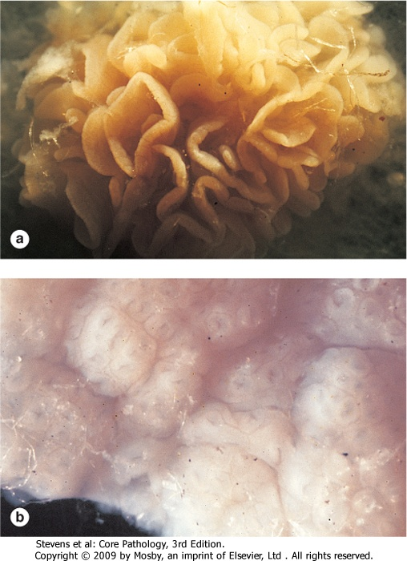
Endoscopy what is the finding?
normal

Slide 8
What is Celiac disease?

Slide 10
A 10-month-old, previously healthy male infant develops a severe, watery diarrhea 2 days after visiting the pediatrician for a routine checkup. The most likely diagnosis is
a. Rotavirus infection
b. Enterotoxigenic E. coli infection
c. Entamoeba histolytica infection
d. Lactase deficiency
e. Ulcerative colitis

Slide 11
Scenario
A 44-year-old white male presented with a seven-month history of diarrhea. The frequency of his bowel movements had increased to 5-7 per day, and his stools were yellow and floated at the top of the water in the toilet. He had occasional abdominal cramping, but no tenesmus, melena, or bleeding. His appetite was good, but he had experienced gradual weight loss. His bowel movement frequency would decrease upon fasting and would increase with food intake.
Stool tests revealed a stool output of 4128 g/d (nl 100-200 g/d) with fat excretion of 17 g/d (nl <5 g/d).
Microscopic examination for ova and parasites and cultures for bacterial pathogens and acid-fast bacilli were negative.
Blood testing showed mild anemia , hypoproteinemia (4.9 mg/dL), and hypoalbuminemia (3.4 mg/dL).

Slide 12
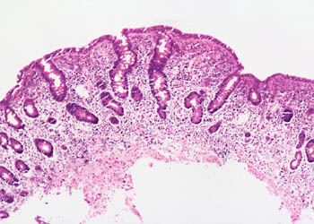
Duodenal biopsy

Slide 13
Exposure to what dietary antigen is thought to be the cause of these changes?
What food components contain this antigen?
Would these histologic changes resolve with dietary modification?
Exposure to gluten (specifically, the gliadin constituent of this protein)
Wheat, barley, flour, and possibly oats contain gluten.
yes

Slide 14
A 6-year-old boy has been brought to outpatients by his mother because he has abdominal pain after some meals. This has been getting increasingly frequent and it sounds, from his description, somewhat colicky in nature. You discover that he has always had very smelly, loose, pale bulky stools, which his parents have put down to the fact that he likes milk. On examination, he is pale, underweight, and of short stature.

Slide 15
1. What are the important differential diagnoses on presentation?
Celiac disease is the most likely diagnosis. Parasitic infection (e.g. giardiasis) and pancreatic insufficiency (e.g. due to chronic pancreatitis or cystic fibrosis) may give rise to a similar presentation, but these are not supported by the results of the investigations.

Slide 16
2. Blood tests reveal a mild macrocytic anemia. There is a low level of vitamin B12, and folate is at the lower end of normal. Autoantibody screens reveal a positive reaction to antigliadin antibodies. Do these tests help to narrow down the diagnosis?
These results are very suggestive of celiac disease due to the low levels of vitamin B¹² and the hypersensitivity reaction to α-gliadin, a component of gluten. The finding of villous atrophy would support the diagnosis, and this is achieved by endoscopic biopsy of the first part of the duodenum.

Slide 17
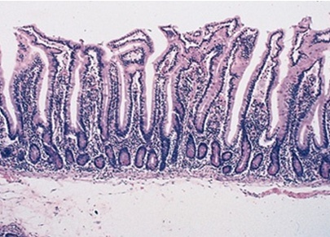
3. A duodenal biopsy shows
Normal

Slide 18
The final diagnosis is celiac disease, provided the patient’s symptoms respond to a gluten-free diet and the histological changes relapse on re-challenge. Such criteria are necessary before confining a patient to a lifelong gluten-free diet.

Slide 19
4. What treatment options are available?
Treatment is by adhering to a strict gluten-free diet.

Slide 20
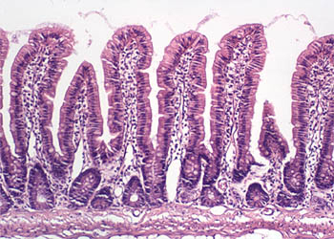

Slide 21
Lactose Intolerance Pathophysiology
lactase
Lactose
glucose + galactose
At the brush border of enterocytes
Lactose Intolerance
Low or absent activity of the enzyme lactase

Slide 22
Lactose Intolerance causes
Inherited lactase deficiency
Congenital lactase deficiency
Childhood-onset and adult-onset lactase deficiency
extremely rare
common
Genetically programmed progressive loss of the activity of the small intestinal enzyme lactase.
Gastroenteritis: Infectious diarrhea, particularly viral gastroenteritis in younger children, may damage the intestinal mucosa enough to reduce the quantity of the lactase enzyme.
Acquired lactase deficiency
Transient
Secondary lactase deficiency due to intestinal mucosal injury by an infectious, allergic, or inflammatory process

Slide 24
How to diagnose lactose intorelence ?
How to treat lactose intorelence ?
Empirical treatment with a lactose-free diet, which results in resolution of symptoms;
Hydrogen breath test
lactose-free diet

