Slide 1
Antiemetics
Prof. Alhaider
1433 H
Pharmacology Department
College of Medicine

Slide 2
Vomiting
Is a complex series of integrated events culminating in the forceful expulsion of gastric contents through the mouth.
Such events are coordinated by the emetic (vomiting) center (VC), lying in reticular formation in medulla.
Stimulation of this center occurs from peripheral sites, cortex, or chemoreceptor trigger zone (CTZ).
Vomiting can be a valuable, life-saving physiol-ogical response ‼‼ to rid stomach & intestine of toxins & prevent their further ingestion
If severe cause dehydration, acid-base imbalance, electrolyte depletion & aspiration pneumonia

Slide 3
Causes of Nausea and Vomiting
Nausea and vomiting may be manifestations of many conditions . However, a useful abbreviation for remembering causes of nausea and vomiting is VOMIT.
Vestibular
Obstruction or drugs like opiates)
Mind (dysmotility)
Infection (irritation of gut)
Toxins (taste and other senses)

Slide 4
Causes of Vomiting
As from previous slide nausea and vomiting may be manifestations of many conditions and may occur due to stimulation of vomiting center that respond to inputs from:
Chemoreceptor trigger zone (CTZ) stimulation
Disturbance of vestibular system
Higher cortical centers stimulation (CNS)
The periphery via sensory nerves

Slide 5
1. CTZ stimulation
CTZ is an area of medulla that communicate with vomiting center to initiate vomiting.
CTZ is physiologically outside BBB
CTZ Contains D₂ & 5 HT₃ receptors.
CTZ can be stimulated by
Drugs such as morphine, apomorphine, L-dopa, bromocryptine, digitalis, estrogen, emetine.
Chemicals
Radiation.
Uremia.

Slide 6
2. The periphery via sensory nerves
GIT irritation, myocardial infarction, renal or biliay stones.
3. Disturbance of vestibular system
4. Higher cortical centers stimulation: emotional factors, nauseating smells or sights.

Slide 7
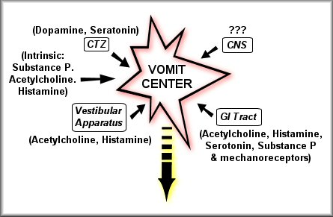
Receptors Associated with Nausea and Vomiting

Slide 8
Pathophysiology of Emesis
Cerebral cortex
Cancer chemotherapy
Opioids
Smell
Sight
Thought
Anticipatory emesis
Chemoreceptor Trigger Zone (CTZ)
Vestibular nuclei
Vomiting Centre (medulla)
Motion sickness
Muscarinic, 5 HT₃ & Histaminic H₁
Muscarinic Histaminic H₁
(Outside BBB)
Dopamine D₂
5 HT_{3,},Opioid Receptors
Chemo & radio therapy Gastroenteritis
Pharynx & GIT
5 HT₃ receptors

Slide 9
What are neurotransmitters & receptors involved in vomiting include?
Histamine (Histaminergic receptors H 1)
Serotonin (5 -HT3)
Ach (Muscarinic)
Dopamine (D2)
Substance P (Neurokinin receptors)
Opioid Receptors

Slide 10
Classification of Antiemetic Drugs:
Which group of drugs can be used as
antiemetics?
5-HT3 antagonists
D2 receptor antagonists
NK1 antagonists
H1-receptor antagonists
Muscarinic receptor antagonists
Cannabinoids
Glucocorticoids

Slide 11
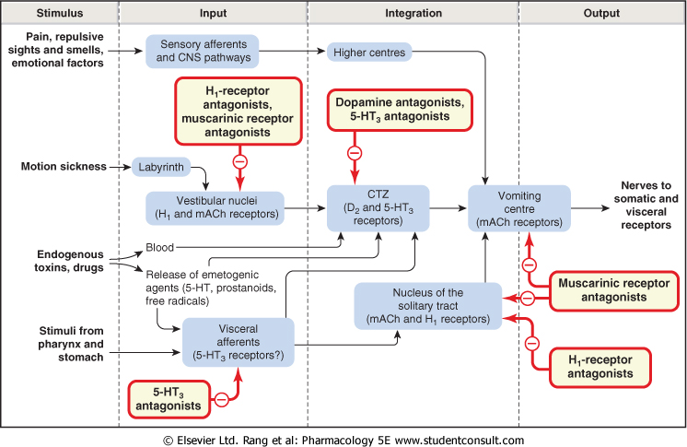

Slide 12
ANTIEMETICS
General rules on use of antiemetics
Should only be used when the cause of nausea or vomiting is known i.e cause of vomiting should be diagnosed.
Otherwise, the symptomatic relief produced could delay diagnosis of a remediable and serious cause.
Treat the cause (e.g. diabetic ketoacidosis, intestinal obstruction, intracerebral space-occupying lesion) usually cures the vomiting.
The choice of drug depends on the aetiology
Indications of antiemetics
1- Chemotherapy-induced
vomiting
2- Post-irradiation vomiting
3- Postoperative vomiting
4- Vomiting of pregnancy
5- Motion (travel) sickness

Slide 13
Antiemetics
5-HT3 antagonists
e.g. Ondansetron, Granisetron
The most Potent antiemetic, mediated through central (vomiting center, chemoreceptor trigger zone) and peripheral (intestinal and spinal) act by 5-HT3 receptor blockade
Orally or i.v., long duration of action.
Has high first pass metabolism
Very effective in nausea & vomiting due to :
Cytotoxic drugs (cisplatin)
Post-radiation and Post-operative (second line).

Slide 14
D2 receptor antagonists
Antagonize D2 receptors in CTZ
Drugs such as metoclopramide Plasil^{R}, domperidone (Motilium^{R} )
Both drugs are also prokinetic agents due to their 5 HT4 agonist activity
Domperidone- oral; Metoclopramide-oral, i.v.
Metoclopramide crosses BBB but domperidone cannot.
Effective against vomiting due to drugs, gastroenteritis, surgery, toxins, uremia, radiation
Can be used in reflux esophagitis .

Slide 15
Which is a better antiemetic, metoclopramide or
domperidone ?
As CTZ is outside BBB both have antiemetic effects.
But as metoclopramide crosses BBB it has adverse effects like extrapyramidal side effects.
Side effects dyskinesia , galactorrhea, menstruation disorders, sedation (only for metoclopramide).

Slide 16
Other uses of Metoclopramide
Facilitate duodenal intubation & endoscopy
◉ Regurgitation & reflux oesophagitis
Diagnostic radiology of gut   time required for barium to reach caecum   No. of films required
Clears gastric contents in emergency anaesthesia

Slide 17
Other D2 receptor antagonists
Neuroleptics:
Antipsychotics with potent antiemetic property due to D2 antagonism
Chlorpromazine, droperidol
orally, parentrally, suppository
used for vomiting due to chemotherapy- induced emesis
Side effects: extrapyramidal symptoms hypotension, sedation, restlessness

Slide 18
Neurokinin1 (NK1) receptor antagonists
Aprepitant
Is a substance P antagonists that acts by blocking neurokinin 1 receptors.
Used in prevention of acute and delayed chemotherapy-induced nausea and vomiting (CINV) and for prevention of postoperative nausea and vomiting (Third line).

Slide 19
H1-receptor antagonists
Effective for motion sickness, morning sickness in pregnancy, Vestibular Disturbances and to combat opioid nausea.
Drugs as
Diphenhydramine
Cyclizine
Meclizine
Promethazine: severe morning sickness of pregnancy (if only essential).
Not in chemotherapy-induced vomiting.

Slide 20
Muscarinic receptor antagonists
Hyoscine (scopolamine)
Used as trans-dermal patches in motion sickness (applied behind the external ear).
Not in chemotherapy-induced vomiting
Cannabinoids
Nabilone, dronabinol (psychoactive drugs)
Used as adjuvant in chemotherapy induced vomiting.
Side effects: Sedation, hallucination and dysphoria.

Slide 21
Glucocorticoids
Dexamethasone and methylprednisolone
Highly effective in acute emesis alone or combined with ondansetron.
Used for vomiting by cytotoxic drugs.
Side effects:?????????????
Hyperglycemia
Hypertension
Cataract
Osteoporosis
Increased intraocular pressure
Increased susceptibility to infection
Increased appetite & obesity

Slide 22
Summary for
Therapeutic Choice of Antiemetics
Motion sickness
Hyoscine: For short Journey.
Diphenhydramine: For Long Journey.
Vomiting with pregnancy (morning sickness)
avoid all drugs in the first trimester
Pyridoxine (B6)
Promethazine ( late pregnancy).

Slide 23
Drug- induced vomiting (CTZ)
domperidone & metoclopramide
Vomiting due to cytotoxic drugs.
Ondansetron
D2- antagonists.
Dexamethazone
Nabilone .
Post operative vomiting
Dopamine antagonists (Metoclopromide or Domperidone)

Slide 24
Thank you Questions ? aqahaider@hotmail.com
Notes:
24

