Slide 1
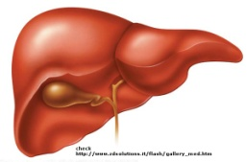
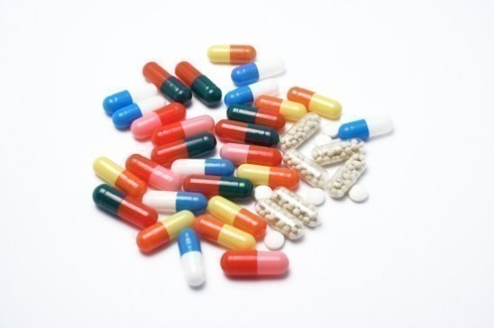
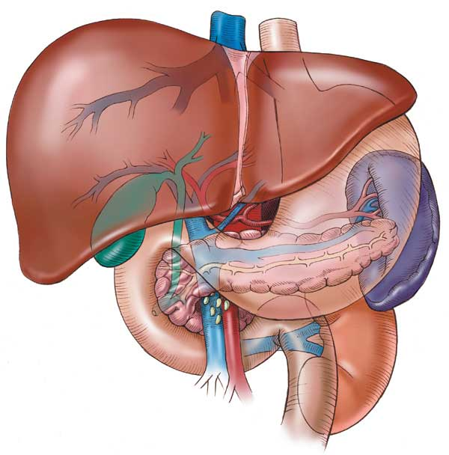
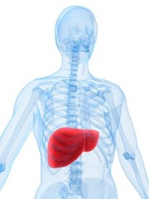
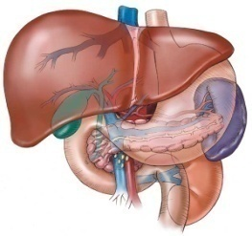
HEPATOTOXIC DRUGS

Slide 2
HEPATOTOXIC DRUGS
ILOs
Clarify the role of liver in drug detoxification
Elaborate types (patterns) of hepatotoxicity
Classify hepatotoxins
Explain how a drug can inflict hepatotoxicity
State the pathological consequences of hepatic injury
Contrast the varied clinical presentation of hepatotoxicity
Discuss possibilities of diagnosis
Enlist the possible treatment

Slide 3
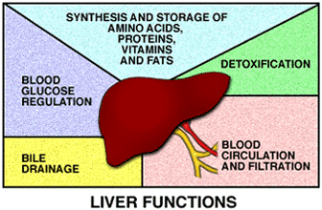
PHYSIOLOGICAL
has multiple functions (>5000) ➔ can be categorized into: 1. Regulation, synthesis & secretion. ➔utilization of glucose, lipids & proteins + bile for digesting fats. 2. Storage. ➔ Glucose (as glycogen), fat soluble vitamins (A, D, E & K) & minerals 3. Purification, transformation & clearance ➔ of endogenous (steroid hormones, cholestrol, FA, & proteins..) & exogenous (drugs, toxins, herbs…etc ) chemicals.
Human body identifies almost all drugs as foreign substances i.e. XENOBIOTIC
Has to get rid of them
"METABOLIC CLEARING HOUSE"
PHARMACOLOGICAL

Slide 4
HEPATOTOXIC DRUGS
Subjects drugs to chemical transformation (METABOLISM) ➔ to become inactive & easily excreted. Since most drugs are lipophilic ➔ they are changed into hydrophilic water soluble products ➔ suitable for elimination through the bile or urine
Such metabolic transformation usually occur in 2 PHASES:
Phase 1 reactions
Oxidation, Reduction, Hydrolysis, Hydration
Catalyzed by CYT P-450
Yields intermediates ➔
polar, transient, usually highly reactive ➔
far more toxic than parent substrates ➔
may result in liver injury
Drug Induced Liver Injury (DILI)
Phase 2 reactions
Conjugation with a moiety
(acetate, a.a., glutathione, glucuronic a., sulfate )
Yields products of increased solubility
If of high molecular weight ➔
excreted in bile
If of low molecular weight ➔ to blood ➔
excreted in urine

Slide 5
Hepatotoxicity ➔ Is the Leading cause of ADRs
HEPATOTOXIC DRUGS
DRUG INDUCED LIVER INJURY
Injury / damage of the liver ➔
Caused by exposure to a drug ➔
Inflict varying impairment in liver functions ➔
Manifests clinically a long range ➔ hepatitis ⇨failure
Inflammation ⇨Apoptosis ⇨ Necrosis

Slide 6
HEPATOTOXIC DRUGS
Why the liver is the major site of ADRs ?
It is the first organ to come in contact with the drug after absorption from the GIT.
Being the metabolic clearing house of the body ➔ it expresses the highest levels of drug metabolizing enzymes that converts some drugs( PROTOXINS) into intermediate (TOXINS) before being conjugated for elimination
Drug (Pro-toxin) Toxin Injury
Paracetamol CYT P450  NABQI centrilobular
(NAPBQI) : N-acetyl-p-benzoquinone imine

Slide 7
HEPATOTOXIC DRUGS
Can any drug cause liver-related ADRs ?
Not all drugs do so.
Drugs that can cause ADRs in the liver (hepatotoxicity)  are called  HEPATOTOXIN
TOXICITY POTENTIAL OF THE DRUG
Chemical composition of the drug itself
Nature of its reactive metabolite
Conjugation reactions linked to it & their availability
Mitochondrial effects of the drug
Drug formulation
…etc

Slide 8
HEPATOTOXIC DRUGS
Types=(PATTERNS) of drug-induced hepatotoxic ADRs ?
If the toxicity of HEPATOTOXIN is inflicted by:
Supertherapeutic or cumulative dose of the drug
INTRINSIC HEPATOTOXIN
The hepatotoxicity it inflicts is  DIRECT HEPATOTOXICITY  belong to TYPE A ADRs: PREDICTABLE / DIRECT
If the toxicity is inflicted by normal dose of the drug 
IDIOSYNCRATIC HEPATOTOXIN
The hepatotoxicity it inflicts is  INDIRECT HEPATOTOXICITY belong to TYPE B ADRs: UNPREDICTABLE / BIZZAR / IDIOSYNCRATIC

Slide 9
Types of drug-induced hepatotoxic ADRs ?
1. DIRECT HEPATOTOXICITY caused by INTRINSIC HEPATOTOXIN
Type A
Dose-dependent hepatotoxicity
Direct increased dose dependent hepatotoxicity
Acetaminophen Increased Dose
Salicylates Increased Dose
Statins Increased Dose
Amiodarone Cumulative Dose/effect
Methotrexate Increased & Cumulative
Oral contraceptives Cumulative Dose/effect
Alcohol Increased & Cumulative Doses/effect
Direct cumulative hepatotoxicity

Slide 10
2. INDIRECT HEPATOTOXICITY caused by IDIOSYNCRATIC HEPATOTOXIN
TypeB
Dose-independent hepatotoxicity  divided into:
Hypersensitivity or immunoallergic reactions
Metabolic-idiosyncratic reactions
2.a. Immunoallergic Idiosyncratic Hepatotoxicity
TypeB
A drug or its metabolite binds to hepatic membranes or proteins act as hapten to induce a variety of immune reactions
Viral hepatitis-like pattern | Inflammatory cholestasis
Halothane. Isoniazid. Phenytoin. Valproic acid. Methyldopa. Acetaminophen. Aspirin. Nitrofurantoin. | Chlorpromazine. Chlorpropamide. Erythromycin. Propylthiouracil. Thiazide

Slide 11
2. INDIRECT HEPATOTOXICITY caused by IDIOSYNCRATIC HEPATOTOXIN
2.b. Metabolic Idiosyncratic Hepatotoxicity
TypeB
The metabolite of the offending drug interferes with hepatic metabolism as that of bilirubin or protein synthesis….etc
Interfere with bilirubin metabolism
Chlorpromazine
Estrogen & Androgen
Erythromycin
Rifampicin
Interfere with protein synthesis
Corticosteroids
Tetracycline
N.B. Not all drugs fall neatly into one of these categories, and overlapping mechanisms may occur with some drugs

Slide 12
HOW CAN A DRUG INDUCE HEPATOTOXICITY ?
Drug or its reactive metabolites can form covalent bonds with target molecules or alter the target molecule by non-covalent interactions or both
COVALENT INTERACTIONS
It is adduct formation between the metabolite of the drug & cellular macromolecules
If covalent binding to protein ➔ immunogenic reaction
If binding to DNA ➔ carcinogenesis
NON-COVALENT INTERACTIONS
- Lipid peroxidation ➔ generation of cytotoxic oxygen radicals - Impairment of mitochondrial respiration
- Depletion of GSH reactions ➔ 'oxidative stress'
- Modification of sulfhydryl groups ➔ impair Ca²⁺homostasis
- Protein synthesis inhibition
…..etc

Slide 13
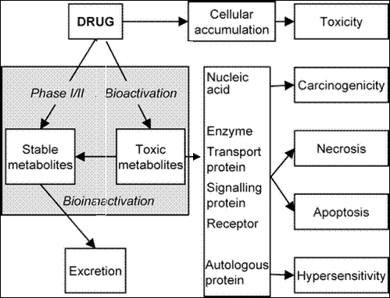
Phase I: Bio-activation
Phase II
Bio-inactivation

Slide 14
Do hepatotoxins cause liver disease in all persons ?
Most hepatotoxins cause liver disease only in certain persons.
The reasons for this are not completely understood.
It is believed that the underlying metabolic state of the liver plays a pivotal role.
This metabolic state is a reflection of a person's
ENVIRONMENTAL
HOST FACTORS
Race / Age / Sex /
Nutritional status
Concomitant habits /
drugs / diseases
HOST
GENETIC MAKEUP Metabolizing Enzymes
Detoxifying System
Drug Transport

Slide 15
Hepatotoxicity ➔ Is the Leading cause of ADRs
HEPATOTOXIC DRUGS
DRUG INDUCED LIVER INJURY
Injury / damage of the liver ➔
Caused by exposure to a drug ➔
Inflict varying impairment in liver functions ➔
Manifests clinically along a range ➔ hepatitis ⇨failure
Inflammation ⇨Apoptosis ⇨ Necrosis

Slide 16
DRUG INDUCED HEPATIC INJURY
Is DIHI common ?
INCIDENCE of DILI
Drugs produce about 10% of all cases of hepatitis in young adults and 40% of cases in patients older than 50.
Are certain persons or population more susceptible ?
Upon exposure to hepatotoxins people are categorized as;
Tolerators  No injury
Adaptors  Mild transient injury but adapt
Susceptibles Develop overt symptoms depending on existing predisposing factors
In Threat ; DILI accelerates beyond initial targets due to loss of synthetic & clearance function of hepatocyte with recruitment of inflammatory cells provoke apoptotic & necrotic signals
TOXICITY
POTENTIAL
OF THE DRUG
HOST
GENETIC
MAKEUP
ENVIRONMENTAL
HOST
FACTORS

Slide 17
What are the presenting manifestations?
Individual drugs tend to have ➔ CHARACTERISTIC SIGNATURE ➔ composed of: A particular latency period
A clinical pattern
A pathological pattern
Yet, they can still show more than one signature
LATENCY PERIOD  short (hrs/dys), intermediate (1-8ws), long (1-12ms)
In Direct Hepatotoxicity Latency period  short as it occurs after a threshold of toxicity is reached
acetaminophen ( toxic dose) / amiodarone (cumulative doses)
In Indirect Immunoallergic Idiosyncratic Hepatotoxicity Latency period  intermediate but may continue to evoke even after drug withdrawal  phenytoin, isoniazid, sulfa drugs, halothane
In Indirect Metabolic Idiosyncratic Hepatotoxicity  Latency period usually long  Unpredictable  most problematic
 tetracyclines, chlorpromazine

Slide 18
CLINICAL PATTERNS
The clinical presentation could be of variable intensity, ranging from asymptomatic of liver enzymes ➔ ➔ ➔ fulminant hepatic failure
Methyldopa
Phenytoin
Statins
Sulfonamides
Salicylates
Sulfonylureas
Quinidine
Some drugs just induce ➔ ASYMPTOMATIC
 IN AMINOTRANSFERASES
Other drugs induce ➔ SYMPTOMATIC MANIFESTATIONS
If injury targets hepatocytes  apoptosis or necrosis  HEPATITIS (cytotoxic) develops rapid onset of malaise, severe anorexia and jaundice +  in alanine aminotransferases (ALT)
If injury targets biliary system (canalicular or ductal)  CHOLESTASIS develop  jaundice + severe pruritis predominate   in alkaline phosphatase (ALP ) + hyperbilirubinaemia
If injury targets both hepatocytes & biliary system  MIXED TYPE

Slide 19
Some PATTERNS of SYMPTOMATIC drug-induced liver disease
Hepatic injury | Hepatocellular | Cholestatic | Mixed
 | Flu-like, malaise, m. aches weakness, loss of appetite, GIT symptoms, diarrhea, jaundice, urine discolored, | Yellowish discoloration of skin, dark urine, rash, pruritus, stool may be light
ALT | ≥ 3 fold rise | Normal or slight | ≥ 3 fold rise
ALP | Normal | ≥ 2 fold rise | ≥ 2 fold rise
Examples | Acetaminophen Salicylates & NSAIDs Isoniazid α-methyldopa Griseofulvin Azoles; Fluconazole Amiodarone | Chlorpromazine Chlorpropamide Erythromycin Rifamycin Cimetidine Anabolic steroids Oral contraceptives | Phenytoin Carbamazepine Sulfonamides ACE Inhibitors TCAs; Amitryptyline

Slide 20
A long standing rheumatoid arthritic patient developed tuberculosis 2 month ago. Today she was received in E.R complaining of yellowish discoloration of skin, severe anorexia, vomiting and flue like manifestations since two days. She is very weak and looks toxic.
Her drug history reveals that she has been on cyclosporine to control the arthiritic exacerbations, she was put on isoniazid when she developed T.B. and multivitamins because she is weak. Currently she
is given domperidone for the emesis.
Lab results reveals severe elevation in ALT but no elevation in ALP.
Which one of the following drug is the likely cause of her symptoms?
Cyclosporine b. Multivitamines
c. Isoniazid d. Domperidone
Which type of hepatotoxin it is considered?
What is the likely hepatotoxic pattern inflicted by the drug?
Treatment????

Slide 21
A hypercholestrolemic patient was received in E.R complaining of yellowish discoloration of skin, change in color of urine & stools, and severe itching
He has been for long receiving statins for the hypercholestrolemia. Three month ago he was diagnosed as being diabetic and hypertensive and since then he is receiving Chlorpropamide for the diabetes and nadolol for the hypertension. The last couple of days he had a flue; for which he was given acetaminophen for muscle aches and nasal drops for his nasal stuffiness.
Lab investigations shows severe elevation in ALP and no significant elevation in ALT
Which one of the following drug is the likely cause of his symptoms?
a. Nadolol b. Chlorpropamide c. Acetaminophen d. Statins
Which type of hepatotoxin it is considered?
What is the hepatotoxic pattern inflicted by the drug?
Treatment????

Slide 22
HISTOPATHOLOGICAL PATTERNS
No universal histo-pathological pattern of DIHI exist.
The commonest are; Hepatocellular necrosis
Cholestasis
Steatosis
More than one type of injury may occur in the same patient
Any one agent may produce different types of injury in different patients

Slide 23
How is DIHI diagnosed?
DILI is most often diagnosis by
A] Thorough history
B] Exclusion of;
Viral hepatitis
Autoimmune disorders
Alcohol intake
Metabolic and genetic disorders
Hemodynamic dysfunction
Billiary abnormalities.
C] Perform of relevant investigations as;
Liver enzymes; ALT, ALP
Ultrasonography, CT scan, MRI
Biopsy……etc
N.B. Early recognition is essential to minimize injury

Slide 24
What are the lines of treatment?
Immediate withdrawal  of any suspected drug
No specific treatment  largely symptomatic & supportive
Symptomatic;
If a severe allergic reaction is observed  Corticosteroids
If pruritus  enhance bile acid excretion  Cholestyramine
If cholestatic liver injury  Ursodeoxycholic acid (Ursodiol)
If coagulopathy or encephalopathy develop treat accordingly
Supportive;
High carbohydrate, moderate protein diet adequate in calories
Specific antidotes
N-acetylcysteine  acetaminophen toxicity
L-carnitine valproate toxicity
Emergency liver transplantation for drug induced fulminant hepatic failure

Slide 25
HEPATOTOXIC DRUGS
GOOD LUCK

