Slide 1
Platelet Structure & Function
Dr. Nervana Bayoumy
MD, PhD (Aberdeen – UK))
Associate Professor of Physiology,
College of Medicine

Slide 2
Objectives
At the end of this lecture you are
expected to:
- Understand platelet normal ultrastructure.
- Understand the functions of different platelets
organelles and surface receptors.
- Understand the mechanisms of platelet functions.
- Relate membrane receptors and granule content to
normal function in hemostasis and bleeding
(platelet) disorders.

Slide 3
Contents
- Platelet normal ultrastructure
- Functions of different platelets organelles and
surface receptors
- The mechanisms of platelet functions
- Platelet membrane receptors and bleeding
(platelet) disorders

Slide 4
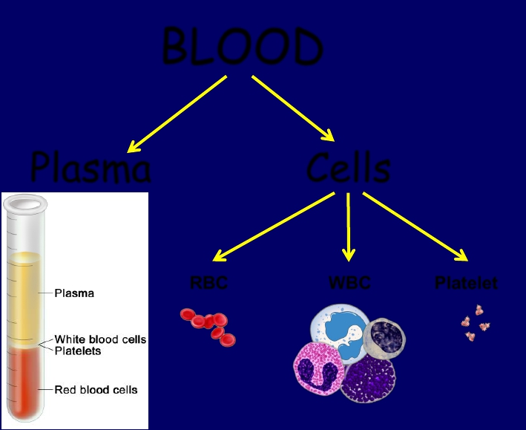
What are platelets?
BLOOD
Plasma
Cells
RBC
WBC
Platelet

Slide 5
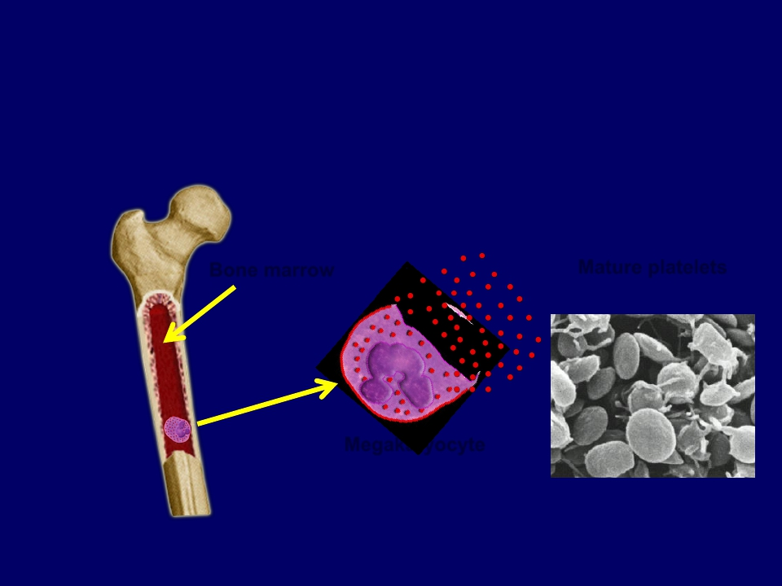
What are platelets?
Bone marrow
Mature platelets
Megakaryocyte

Slide 6
Platelets
Cont.
• Site of formation:
Bone marrow
• Steps:
Stem cell
Megakaryoblast
Megakaryocyte
Platelets

Slide 7
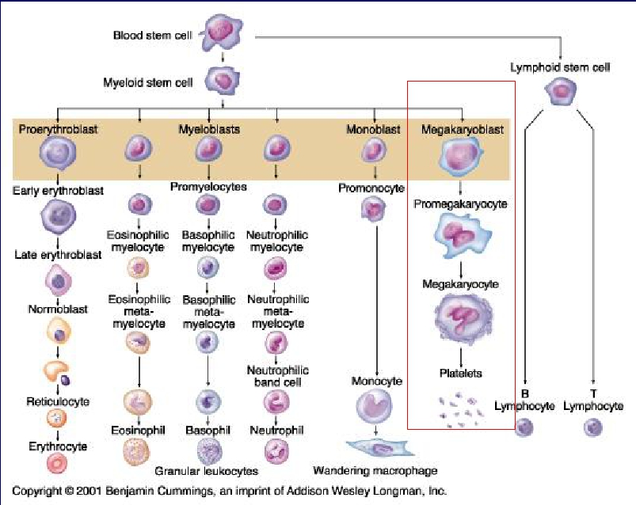
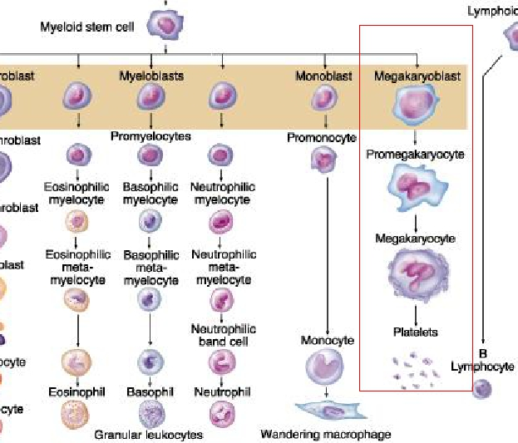
Megakayocyte and platelet formation

Slide 8
Platelets Formation
(Thrombopoiesis)
Regulation of thrombopoiesis
by
Thrombombopoietin

Slide 9
Platelet ultra-structure
(Electron microscope - EM)

Slide 10
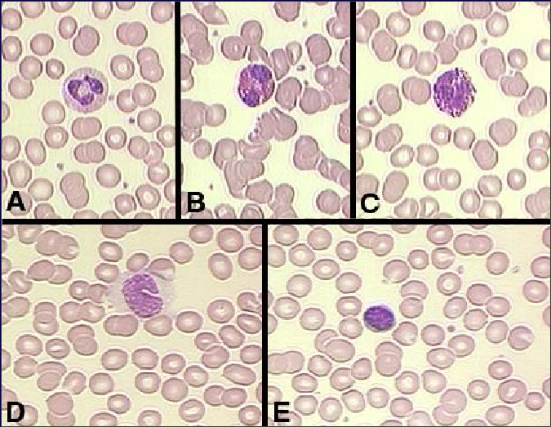

Slide 11
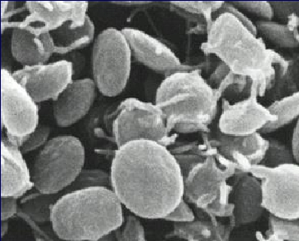
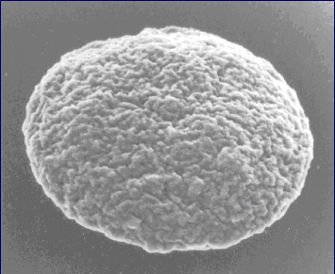

Slide 12
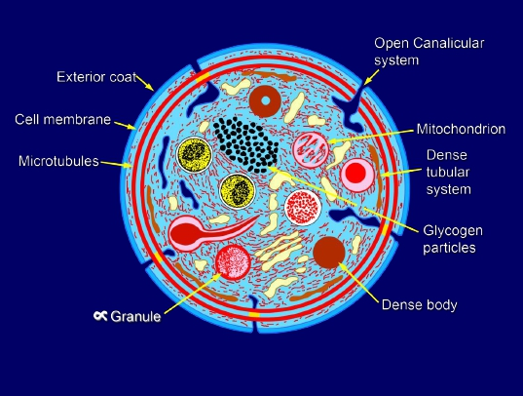
(Thrombocytes)
• Anuclear and discoid cell → spherical when
activated
• Size: 1.5–3.0 µm
• Life span: 7–10 days
• Sequestered in the spleen; hypersplenism
may lead to low platelet counts.

Slide 13
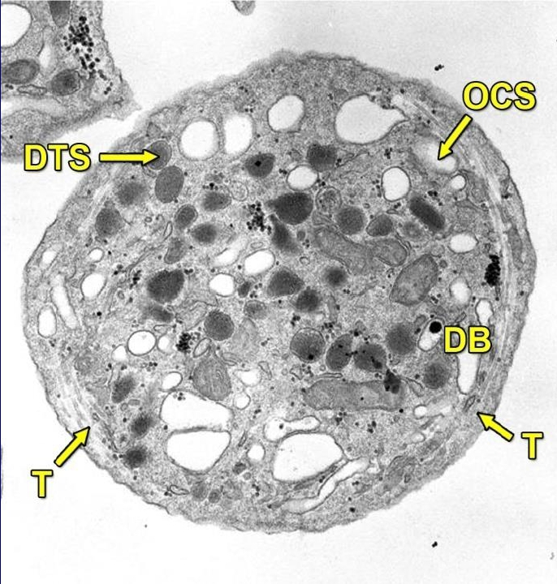
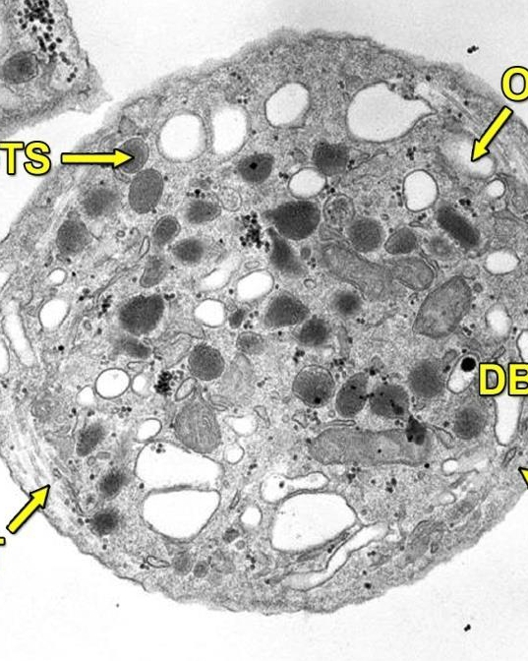

Slide 14
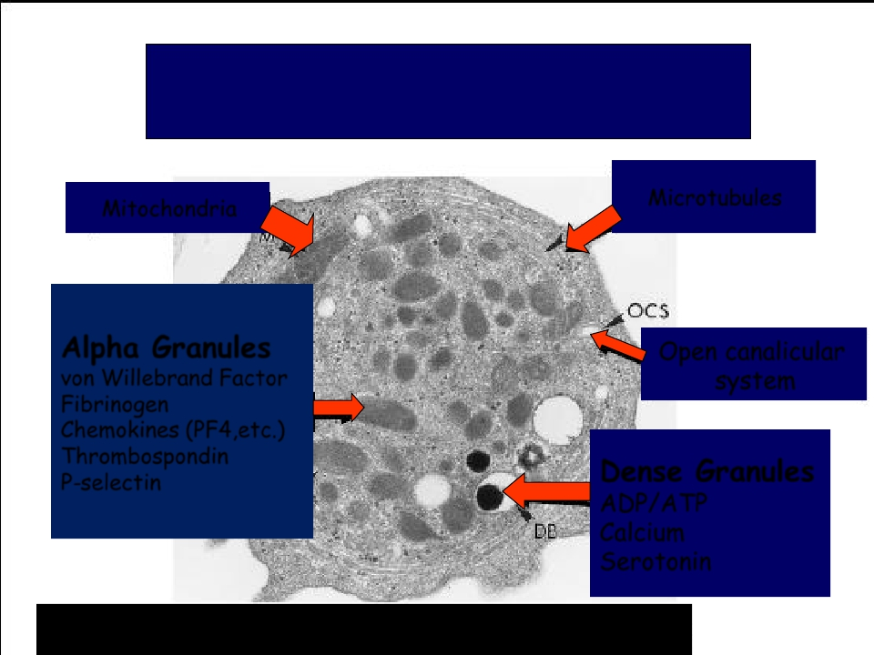
Platelet Ultrastructure
Mitochondria
Alpha Granules
von Willebrand Factor
Fibrinogen
Chemokines (PF4,etc.)
Thrombospondin
P-selectin
Microtubules
Open canalicular
system
Dense Granules
ADP/ATP
Calcium
Serotonin

Slide 15
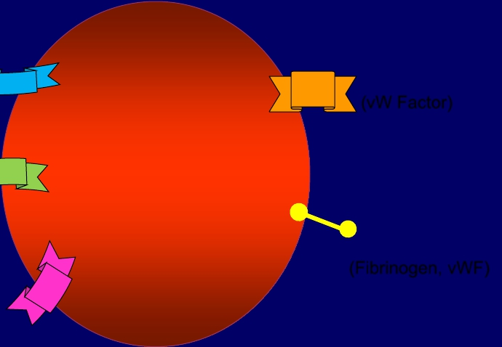
Platelet Receptors
Platelet
(GP Ia, GP VI)
Collagen
(TPα)
TXA2
(P2Y12)
ADP
GP Ib-IX-V
(vW Factor)
GP IIb-IIIa
(Fibrinogen, vWF)

Slide 16
General functions of
the platelets

Slide 17
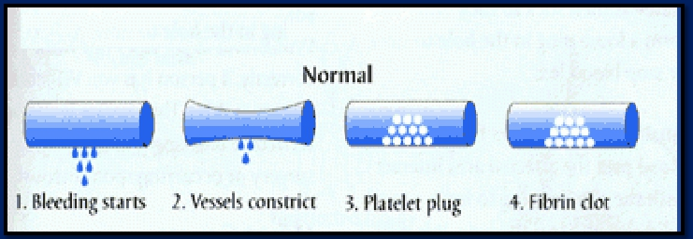
HEMOSTASIS
1. VASCULAR PHASE
2. PLATELET PHASE
3. COAGULATION PHASE
4. FIBRINOLYTIC
PHASE

Slide 18
Platelet Activation
• Adhesion
• Shape change
• Aggregation
• Release
• Clot Retraction

Slide 19
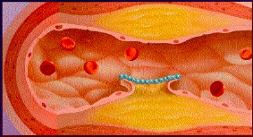
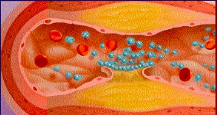
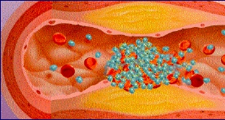
Platelet function
Adhesion
Activation
Aggregation
Secretion

Slide 20
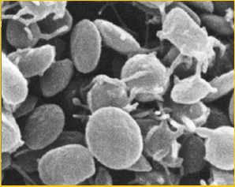
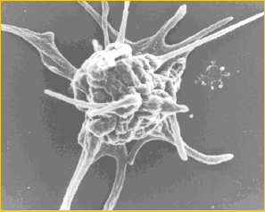
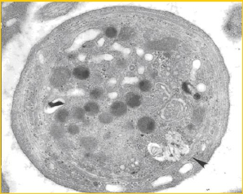
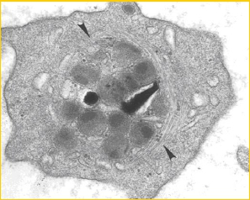
Resting platelet
Activated platelet

Slide 21
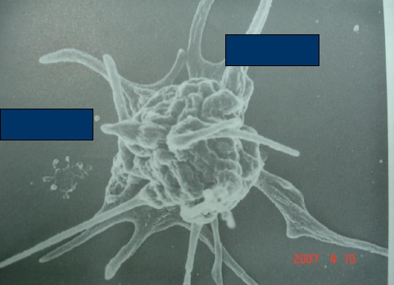
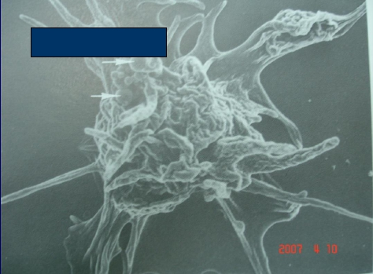
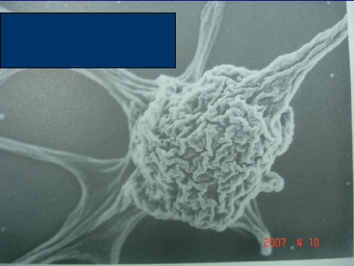
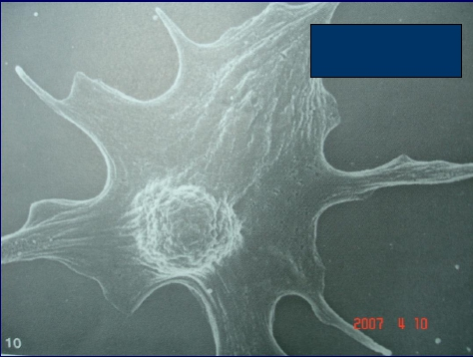
Convolutions
Spread to psuedopods
Smooth surface
psuedipods
Convolutions
In body
Further Spread of
Convolutions to psuedopods
Early
Spread platelet

Slide 22
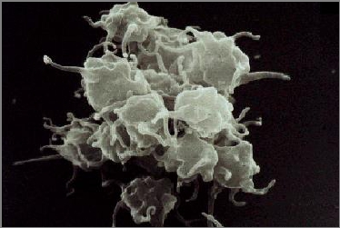
Platelet Aggregation
• Aggregation:
Fibrinogen is needed to join
platelets to each other via platelet
fibrinogen receptors

Slide 23
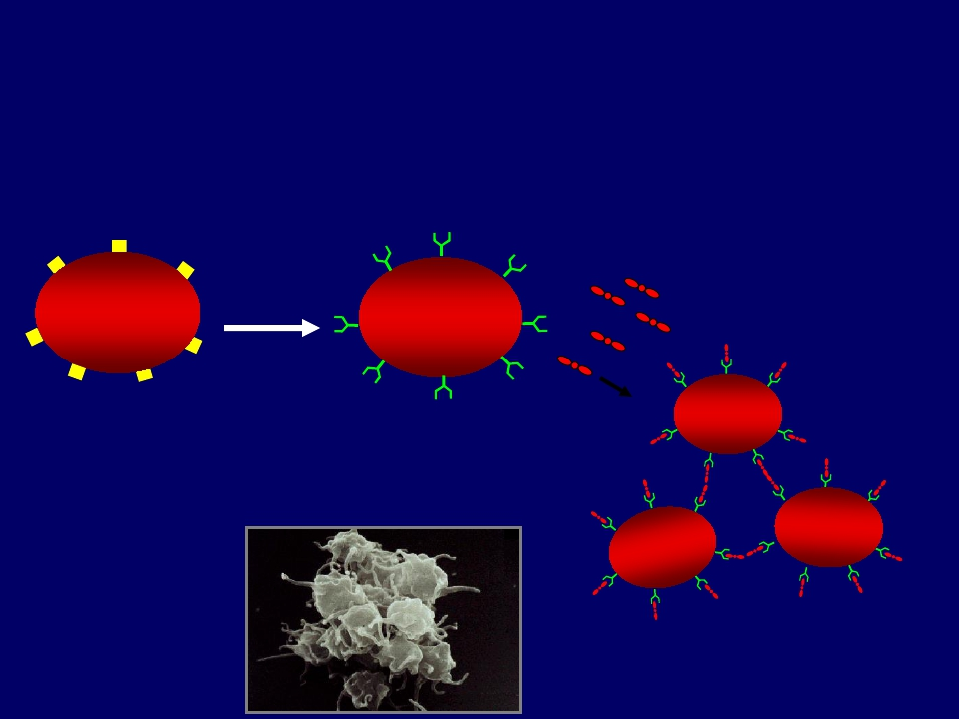
Platelet Aggregation
Activated platelet
Fibrinogen
Agonist
Resting platelet
GP IIb/IIIa
receptors
(unreceptive state)
Aggregating platelets

Slide 24
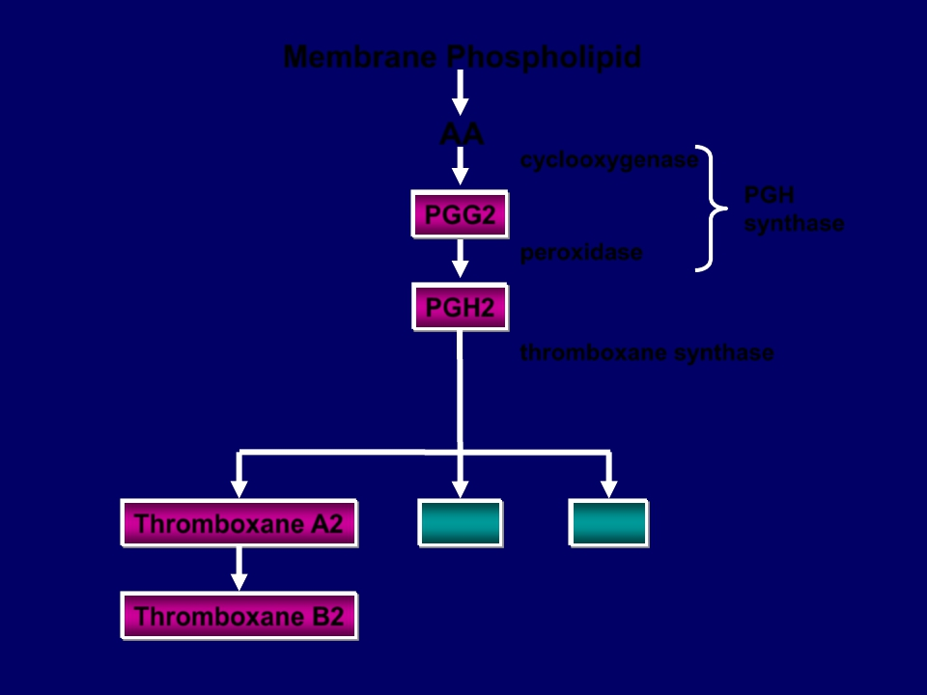
Membrane Phospholipid
AA
cyclooxygenase
PGG2
peroxidase
PGH2
PGH
synthase
thromboxane synthase
Thromboxane A2
Thromboxane B2
MDA
HHT

Slide 25
Activated Platelets
Secrete:
1. 5HT → vasoconstriction
2. Platelet phospholipid (PF3) → clot
formation
3. Thromboxane A2 (TXA2) is a
prostaglandin formed from
arachidonic acid
Function:
– vasoconstriction
– Platelet aggregation
(TXA2 inhibited by aspirin)

Slide 26
Clot Retraction
Myosin and actin filaments in
platelets are stimulated to
contract during aggregation
further reinforcing the plug
and help release of
granule contents

Slide 27
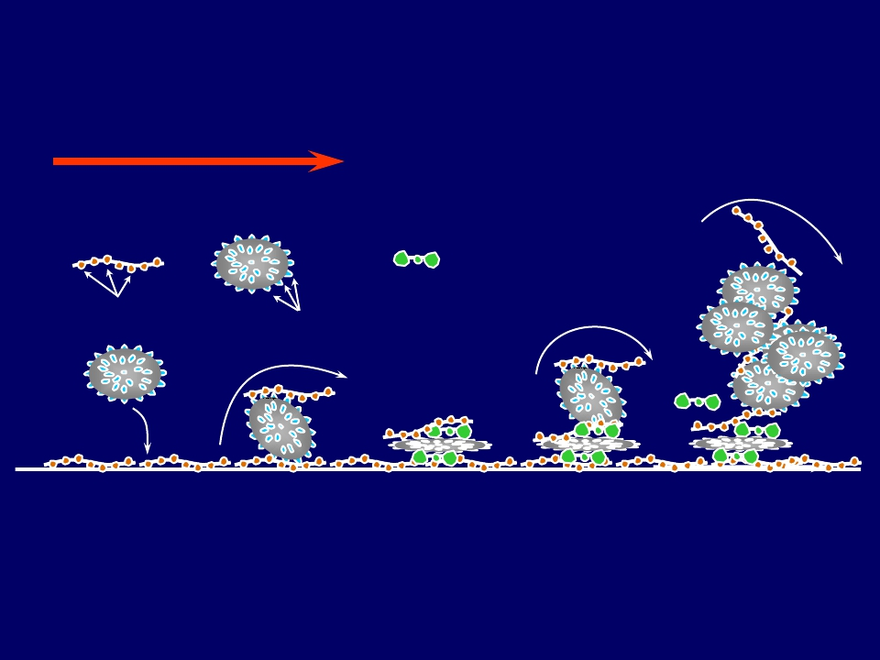
von Willebrand factor (vWF)
and Platelet Adhesion
Blood Flow
vWF
Platelet
Fibrinogen
A1 domains
GPIb
Recruitment
Plug
Formation
Adhesion
Rolling
Activation

Slide 28
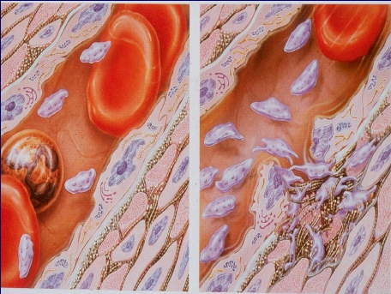
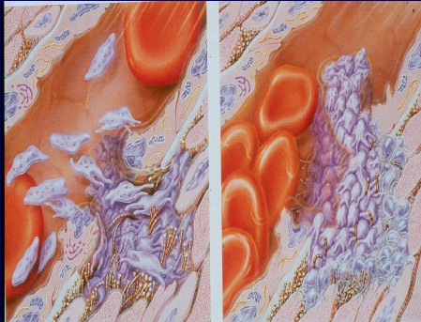
Platelet Function Tests
Platelet haemostatic plug formation
Platelets activated by adhesion
Extend projections to make contact with each other
Release thromboxane A2, serotonin & ADP activating other platelets
Serotonin & thromboxane A2 are vasoconstrictors decreasing blood flow
through the injured vessel. ADP causes stickiness and enhances
aggregation

Slide 29
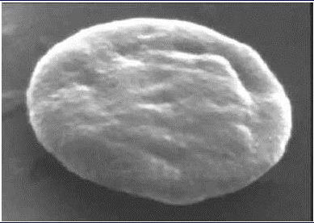
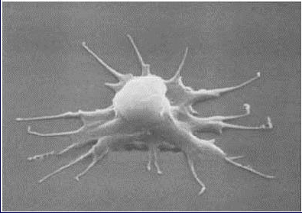
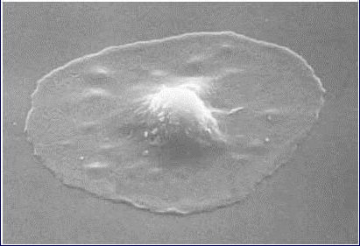

Slide 30
Platelet haemostatic plug formation
Platelets activated by adhesion
Extend projections to make contact with each
other
Release:
thromboxane A2, serotonin & ADP >>> activating
other platelets
Serotonin & thromboxane A2 are vasoconstrictors
decreasing blood flow through the injured vessel.
ADP causes stickiness and enhances aggregation

Slide 31
General functions of
the platelets

Slide 32
General functions of the platelets:
• Platelet plug formation
• Platelets and blood coagulation

Slide 33
Role of platelet in
blood coagulation
(The cell-based model of blood coagulation)

Slide 34
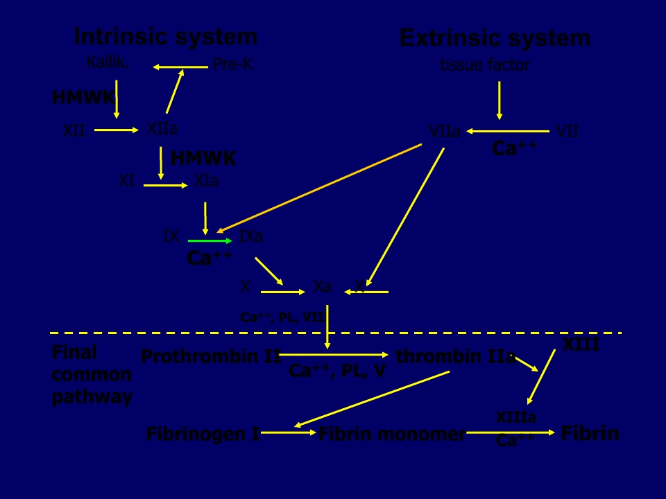
Intrinsic system
Extrinsic system
Kallik.
HMWK
Pre-K
tissue factor
XII
XIIa
HMWK
VIIa
VII
Ca++
XI
XIa
IX
IXa
Ca++
X
Xa
X
Ca++, PL, VIII
Final
common
pathway
XIII
Prothrombin II
thrombin IIa
Ca
++, PL, V
XIIIa
Ca++
Fibrinogen I
Fibrin monomer
Fibrin

Slide 35
Initiation
Cell based model
Fibroblast
TF
VIIa
IXa
Propagation
Xa
Prothrombin
Thrombin
Thrombin
Prothrombin
Xa
IXa
XIa
VIIIa
XIa
Platelet
Activated platelets
Amplification

Slide 36
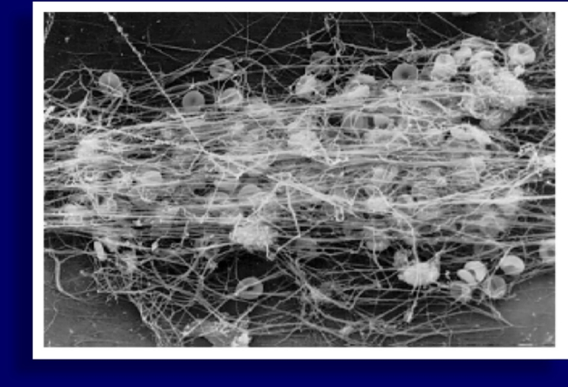

Slide 37
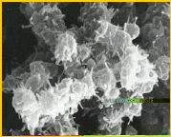
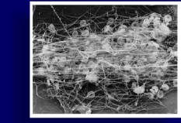
Platelet function
Maintenance of vascular integrity
Adequate number
and function of platelet
is essential to participate
optimally in
haemostasis
Initial arrest of bleeding by
Stabilization of hemostatic plug
platelet plug formation
by contributing to fibrin formation

Slide 38
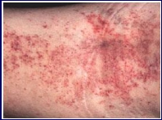
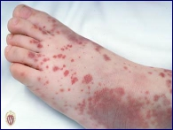
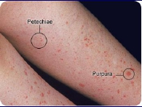
Platelet function
Bleeding disorders
abnormal number
or function of platelet

Slide 39
Platelet Activation- summary
Platelets are activated when brought into contact with collagen
exposed when the endothelial blood vessel lining is damaged
Activated platelets release a number of different coagulation and
platelet activating factors
Transport of negatively charged phospholipids to the platelet surface;
provide a catalytic surface for coagulation cascade to occur
Platelets adhesion receptors (integrins): Platelets adhere to each
other via adhesion receptors forming a hemostatic plug with fibrin
Myosin and actin filaments in platelets are stimulated to contract
during aggregation further reinforcing the plug and help release of
granule contents
GPIIb/IIIa: the most common platelet adhesion receptor for fibrinogen
and von Willebrand factor (vWF)
•
•
•
•
•
•

Slide 40
Platelet function tests

Slide 41
Laboratory Testing of Platelet Functions
Platelet count (& shape)
Bleeding time
Platelet Aggregation
Platelet Function Analyzer
Flow-cytometry
Electron-microscopy
Granule release products
(PFA-100)
White GC et al. Approach to the Bleeding Patient. In Colman, RW et al. Hemostasis and thrombosis 2nd ed. 1987

Slide 42
Bleeding Time

Slide 43
Laboratory Testing of Platelet Functions
Platelet Aggregation (in PRP):
Provides information on time course of plat.
activation.
Agonists:
ADP
Adrenaline
Collagen
Arachidonic acid
Ristocetin
Thrombin
Reference ranges need to be determined for
each agonist (+ Dose responses)

Slide 44
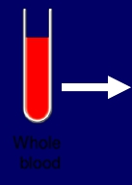
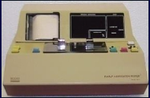
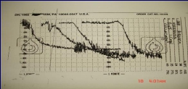
Platelet Aggregation
Agonists:
•ADP
•Adrenaline
•Collagen
•Arachidonic acid
•Ristocetin
•Thrombin
Whole
blood
RBC
PRP

Slide 45
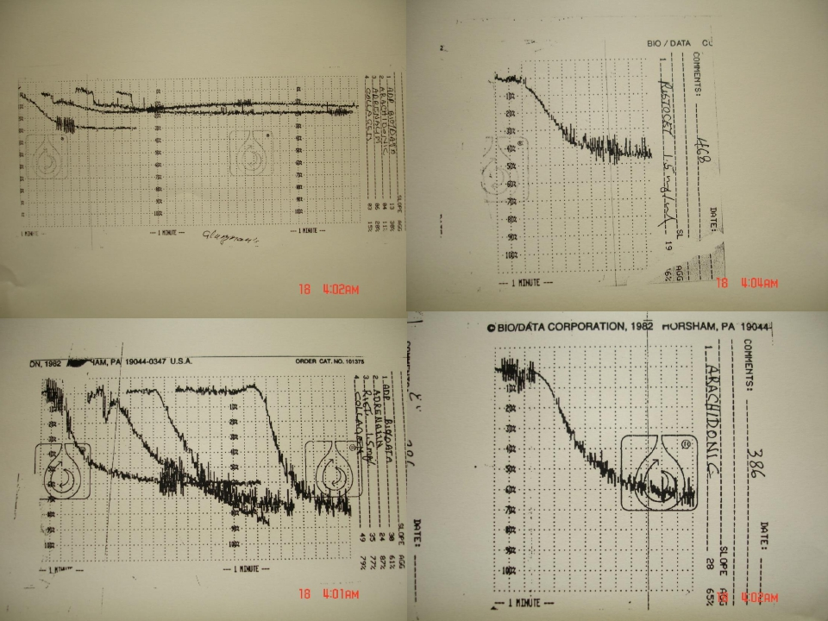

Slide 46
Congenital Platelet Disorders
Disorders of Adhesion:
. Bernard-Soulier Syndrome
Disorder of Aggregation:
. Glanzmann thrombosthenia
Disorders of Granules:
. Grey Platelet Syndrome
. Storage Pool deficiency
. Hermansky-Pudlak syndrome
.Chediak-Higashi syndrome

Slide 47
Platelet Ultrastructure
Mitochondria
Alpha Granules
von Willebrand Factor
Fibrinogen
Chemokines (PF4,etc.)
Thrombospondin
P-selectin
Microtubules
Open canalicular
system
Dense Granules
ADP/ATP
Calcium
Serotonin

Slide 48
Platelet Activation
• Adhesion:
Bernard-Soulier Syndrome (BSS)
•
•
•
•
Shape change
Aggregation
Release
Clot Retraction

Slide 49
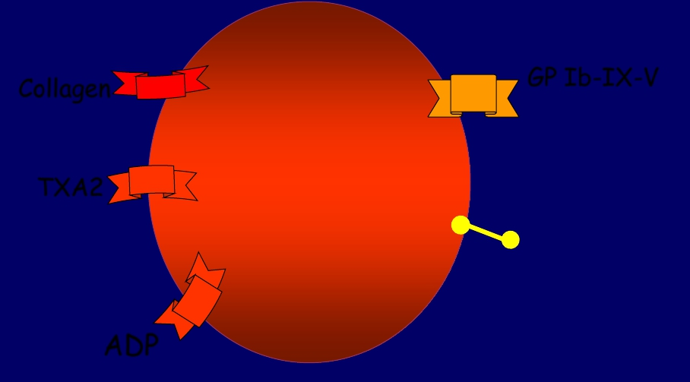
Bernard-Soulier Syndrome
Platelet
GP Ib-IX-V
(vW Factor)
GP IIb-IIIa
(Fibrinogen, vWF)
Collagen
(GP Ia, GP VI)
TXA2
ADP

Slide 50
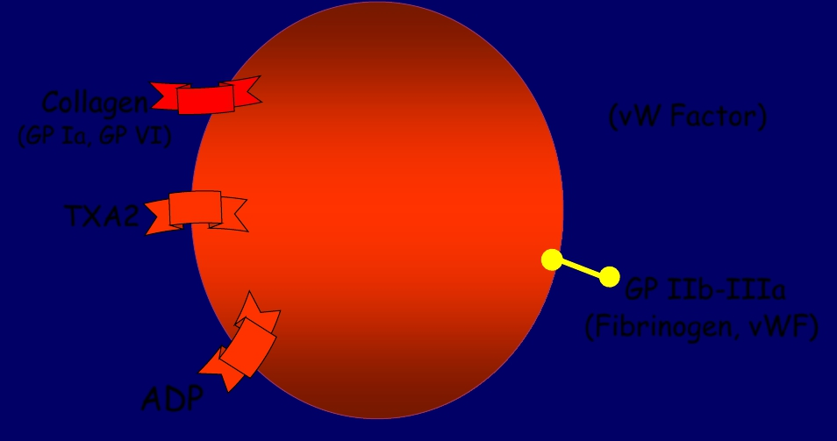
Bernard-Soulier Syndrome
Platelet
Collagen
(GP Ia, GP VI)
TXA2
ADP
(vW Factor)
GP IIb-IIIa
(Fibrinogen, vWF)

Slide 51
Platelet Activation
• Adhesion:
Bernard-Soulier Syndrome (BSS)
•
•
Shape change
Aggregation
Glanzmann
Thrombashenia
•
•
Release
Clot Retraction

Slide 52
Glanzmann Thromasthenia
Platelet
GP Ib-IX-V
(vW Factor)
GP IIb-IIIa
(Fibrinogen, vWF)
Collagen
(GP Ia, GP VI)
TXA2
ADP

Slide 53
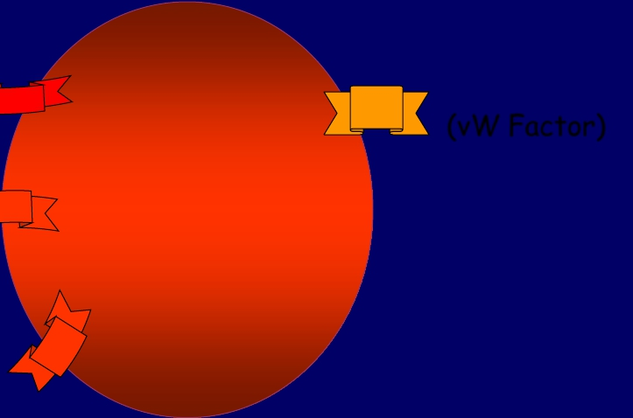
Glanzmann Thromasthenia
Platelet
GP Ib-IX-V
(vW Factor)
Collagen
(GP Ia, GP VI)
TXA2
ADP

Slide 54
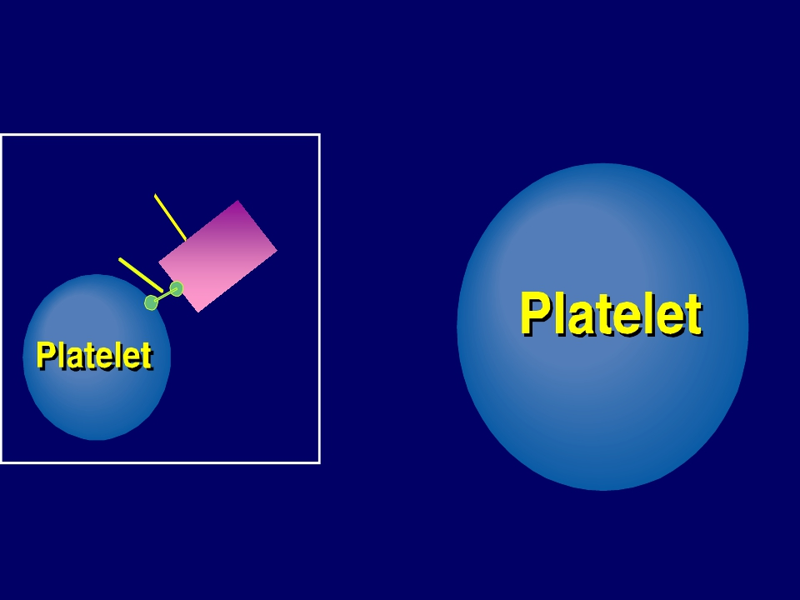
Glanzmann Thrombasthenia
Fibrinogen
IIb-IIIa
Normal
No Gp IIb-IIIa Receptors

Slide 55
Objectives
At the end of this lecture the student
is expected to:
- Understand platelet normal ultrastructure
- Understand the functions of different platelets
organelles and surface receptors
- Understand the mechanisms of platelet functions
- Relate membrane receptors and granule content to
normal function in hemostasis and bleeding
(platelet) disorders

Slide 56
وفقن الله

