Slide 1
Practical Haemaglobinopathy
DR. SHIHAB AL-MASHHADANI
Consultant Haematologist

Slide 3
EFFECTS OF HAEMOGLOBIN VARIANTS
Variant | Clinical and haematological abnormalities
HbS | Recurrent painful crises (in adults) and chronic haemolytic anaemia; both related to sickling of red cells on deoxygenation*
HbC | Chronic haemolytic anaemia due to reduced red cell deformability on deoxygenation, * deoxygenated HbC is less soluble than deoxygenated HbA.
Hb Köln, Hb Hammersmith | Spontaneous or drug-induced haemolytic anaemia due to instability of the Hb and consequent intracellular precipitation.
HbM Boston, HbM Saskatoon | Cyanosis due to congenital methaemoglobinaemia as a consequence of a substitution near or in the haem pocket.
Hb Chesapeake | Hereditary polycythaemia due to increased O₂ affinity.
Hb Constant Spring, Hb Lepore, HbE | Thalassaemia-like syndrome due to decreased rate of synthesis of normal chains.
Hb Indianapolis | Thalassaemia-like syndrome due to marked instability of Hb
* Only in homozygotes
.

Slide 4
Abnormal Haemoglobin Variants
Hb C:-
* Is due to replacement of glutamic acid in position 6 of the beta chain by lysine (α₂β₂ 6-GLU→ LYS).
* About 7-22% of people of West Africa ar hetrozygotes especially Nigeria and North Ghana
* Homozygotes are rare and have mild to moderate hemolytic anaemia with many thick target RBCs in the blood film and mild to moderate splenomegaly.
* The chronic hemolytic anaemia is due to reduced red cell deformability on deoxygenation.
Deoxygenated HbC is less soluble than deoxygenated HbA.
* Double heterozygotes with sickle Hb S/C give moderate to sever anaemia with symptoms of sickle cell disease.

Slide 5
Hb D Punjab
(α₂β₂-121 GLU → GLN)
Prevalent in Indian and Pakistani in every 100 persons about 1 trait (1% of the population).
Trait are usually health.
Homozygous D/D have mild to moderate anaemia.
Combined double heterozygotes Hb S/D can give rise to moderate to a severe anaemia and symptoms of sickle cell disease.

Slide 6
Hb E:
* (α₂β₂ 26 GLU → LYS) is one of the most common beta-chain variants.
* It is very prevalent in South East Asia (50%) of the population are heterozygotes.
* Patients who are homozygous generally have mild haemolytic anaemia, microcytic hypochromic red cells and mild enlargement of the spleen.
* Carriers are symptomless unless they have combined other mutations such as the one for alpha thalassemia, or beta-thalassemia trait.

Slide 7
Hb O Arab
(α₂β₂-121 GLU → LYS)
Heterozygotes are not symptomatic.
Double heterozygous with sickle S/O are clinically severe.
Hb O- Arab enhance the polymerization of HbS.

Slide 8
High Oxygen affinity haemoglobins
Hb Chesapeake:
* (α₂-92 ARG → LEU β₂).
* Carriers are without clinical symptoms.
* Homozygous of erythrocytosis (polychemia) due to increased O₂ affinity.
* The patients have no splenomegaly. (except for patient’s with concomitant β-thalassemia).
* They have normal WBC, and normal platelets.
* High Hb, High RBCs count and high haematocrit. (HCT).

Slide 9
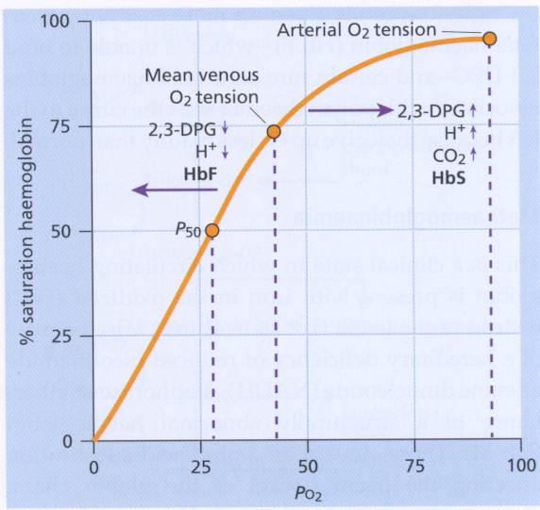
.
The haemoglobin oxygen (O₂) dissociation cruve. 2,3-DPG, 2,3-diphosphoglycerate.

Slide 10
Unstable Haemoglobins
Hb koln (α₂β₂-98 VAL → MET)
Hb Hammersmith (α₂β₂ 42 PHE → SER)
Hb Hasharon (α₂-47 ASP → HIS β₂).
These abnormal haemoglobin cause haemolysis in the newborn (congenital non-spherocytic haemolytic anaemia).
Heinz body hemolytic anaemia with sensitivity to oxidant drugs, such as sulfonamides.
Reticulocytosis out of proportion to the level of Hb.
Increased formation of methemoglobin.
Spontaneous or drug induced haemolytic anaemia due to instability of the haemoglobin and consequent intracellular precipitation.
Thalassaemia – like peripheral blood picture.
Clinically: The patient have anemia, jaundice, splenomegaly / hepatomegaly and gall stones.

Slide 11
Low oxygen affinity haemoglobins
More than 50 variants with reduced oxygen affinity have been identified.
Hb kansas (α₂β₂102 ASN → THR)
Hb Aukland (α₂β₂ 25 GLY → ASP)
Rare as homozygotes.
Patients have anaemia and congenital cynosis due to reduced oxygen affinity.

Slide 12
Congenital methaemoglobinaemia
Hb M Boston (α₂ 58 HIS → TYR - β₂)
Hb M Saskatoon (α₂₋β₂-63 HIS → TYR)
Hb M Hyde park (α₂β₂ 92 HIS → TYR)
Hb M IWATE (α₂87 HIS → TYR-β₂)
Cynosis in homozygotes due to congenital methaemoglobinaemia as a consequences of substitution of amonoacids near or in haem pocket.

Slide 13
Hb iIndianapolis
(α₂-β₂112 CYS – ARG)
Is a rare and slightly unstable beta-globin variant.
Carriers are clinically normal with only mild reticulocytosis.
Homozygons have haemolytic anaemia and renal failure in severe cases.
Thalassaemia-like syndrome due to marked instability of the Hb.

Slide 14
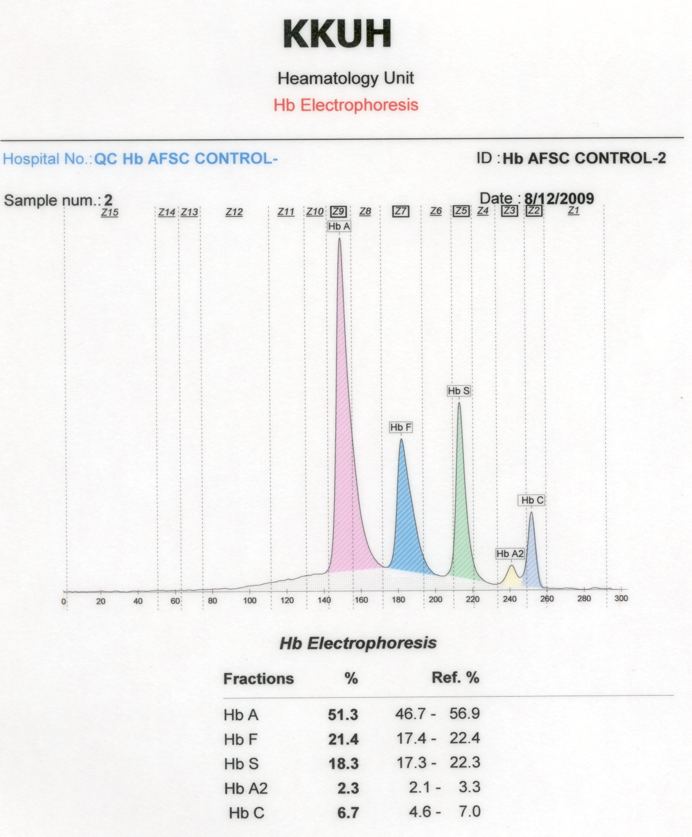

Slide 16
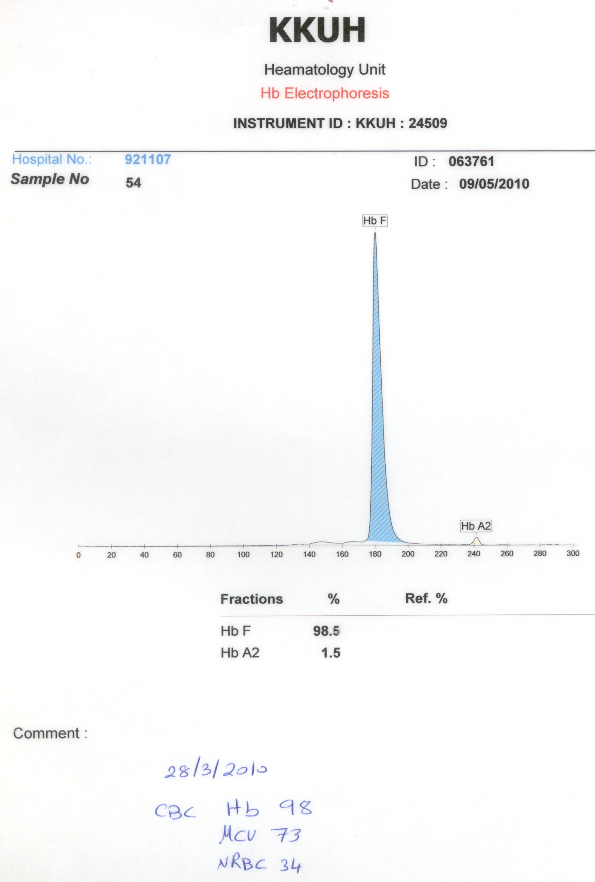

Slide 17
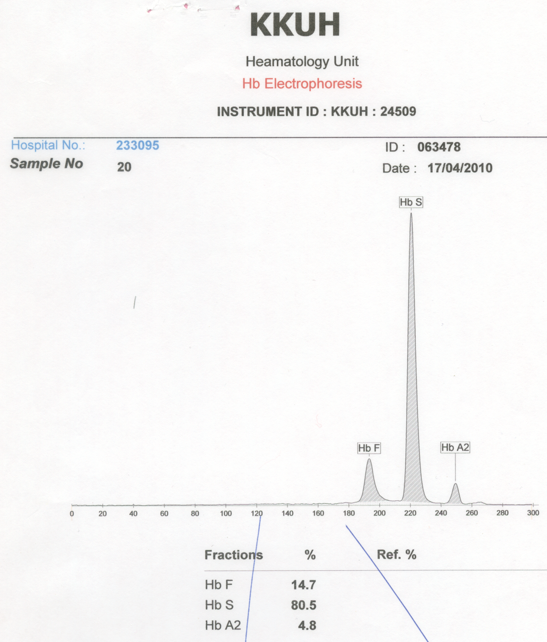

Slide 18
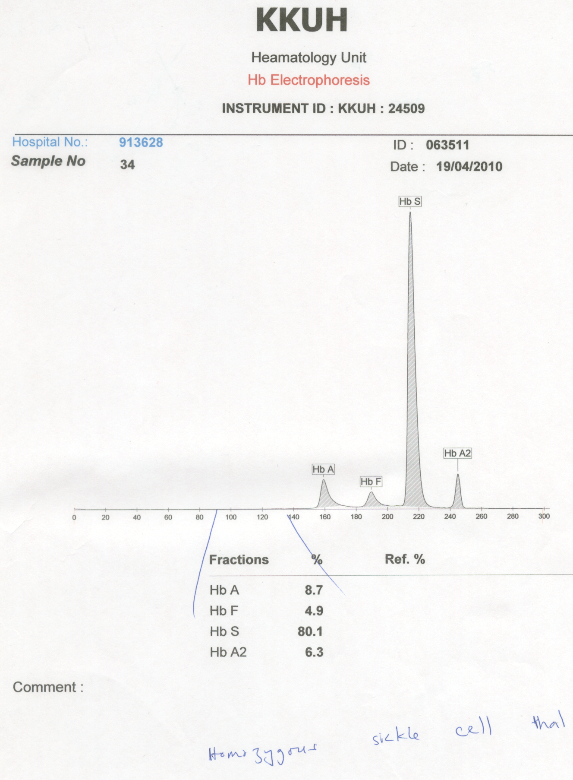

Slide 21
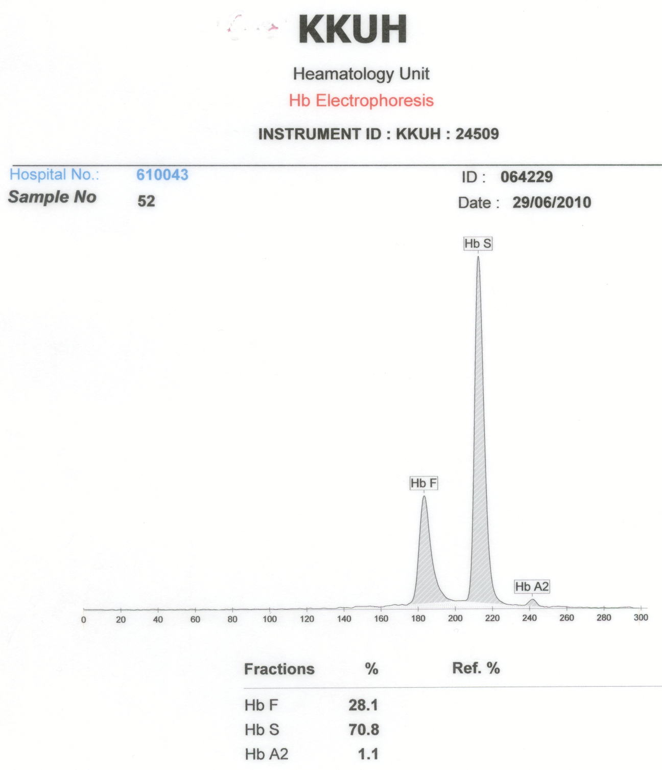

Slide 22
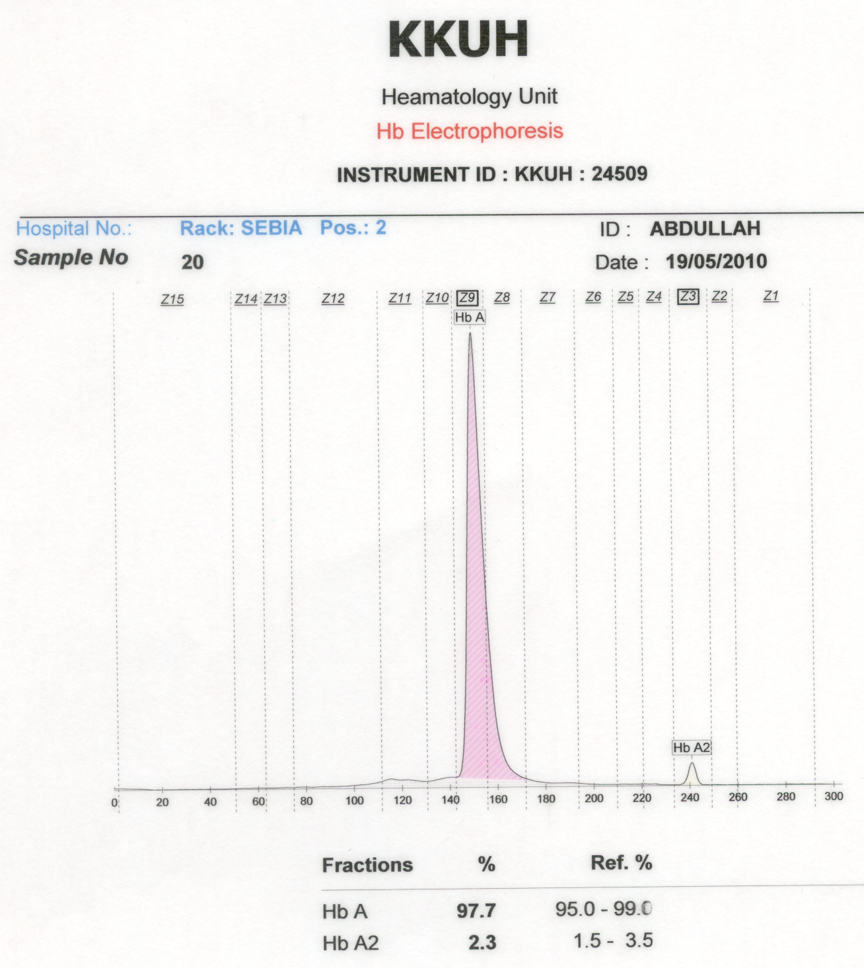

Slide 25
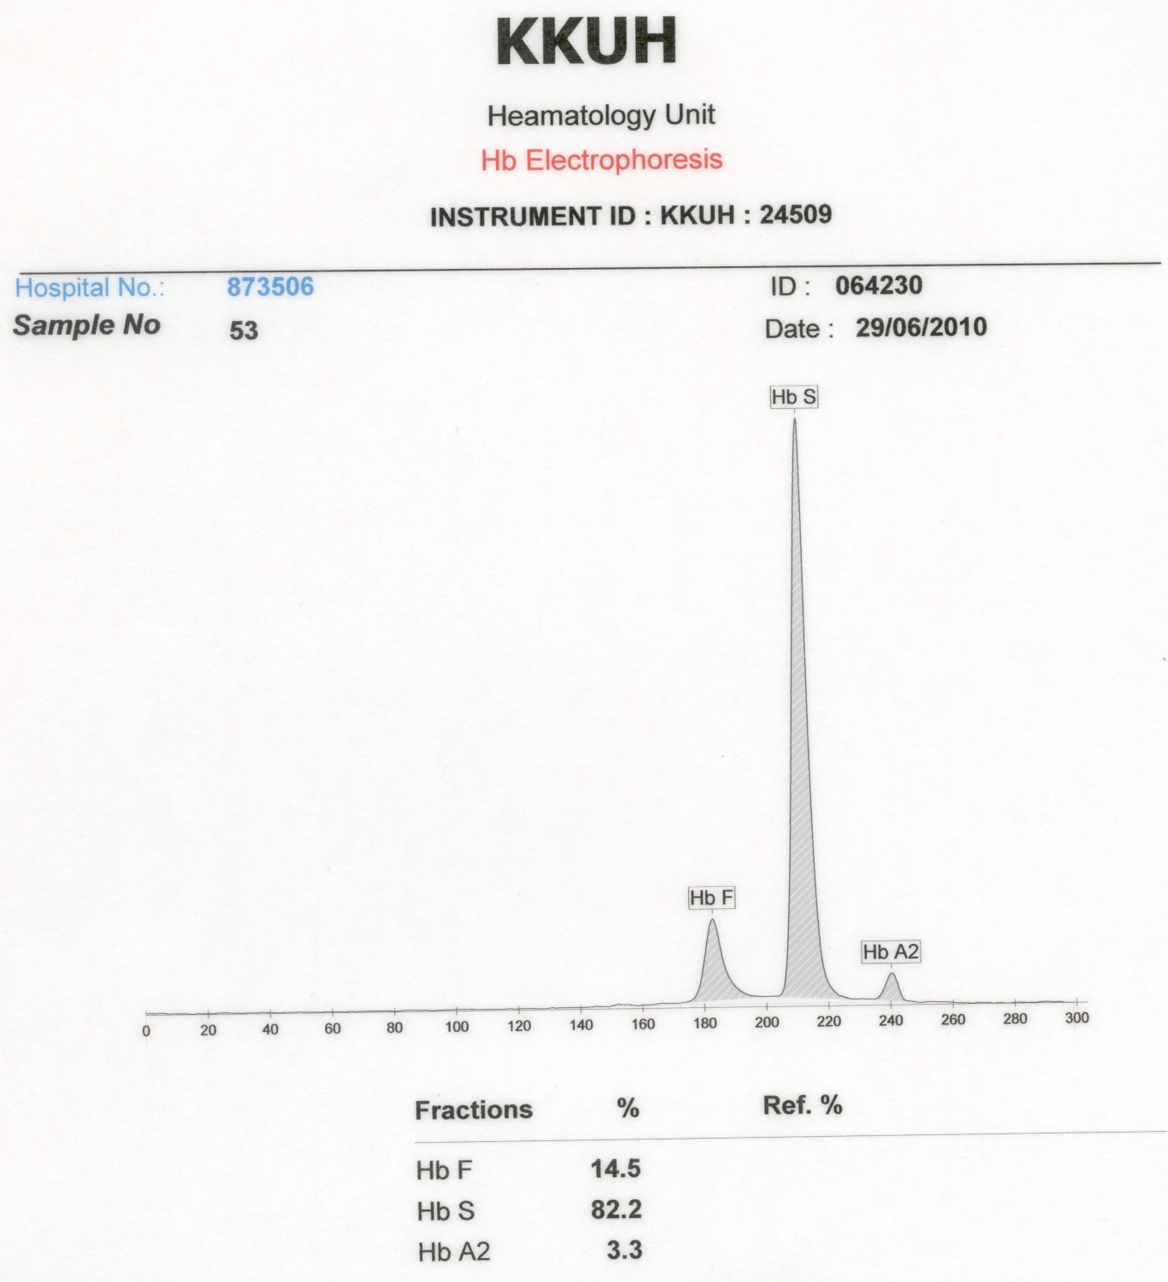

Slide 26
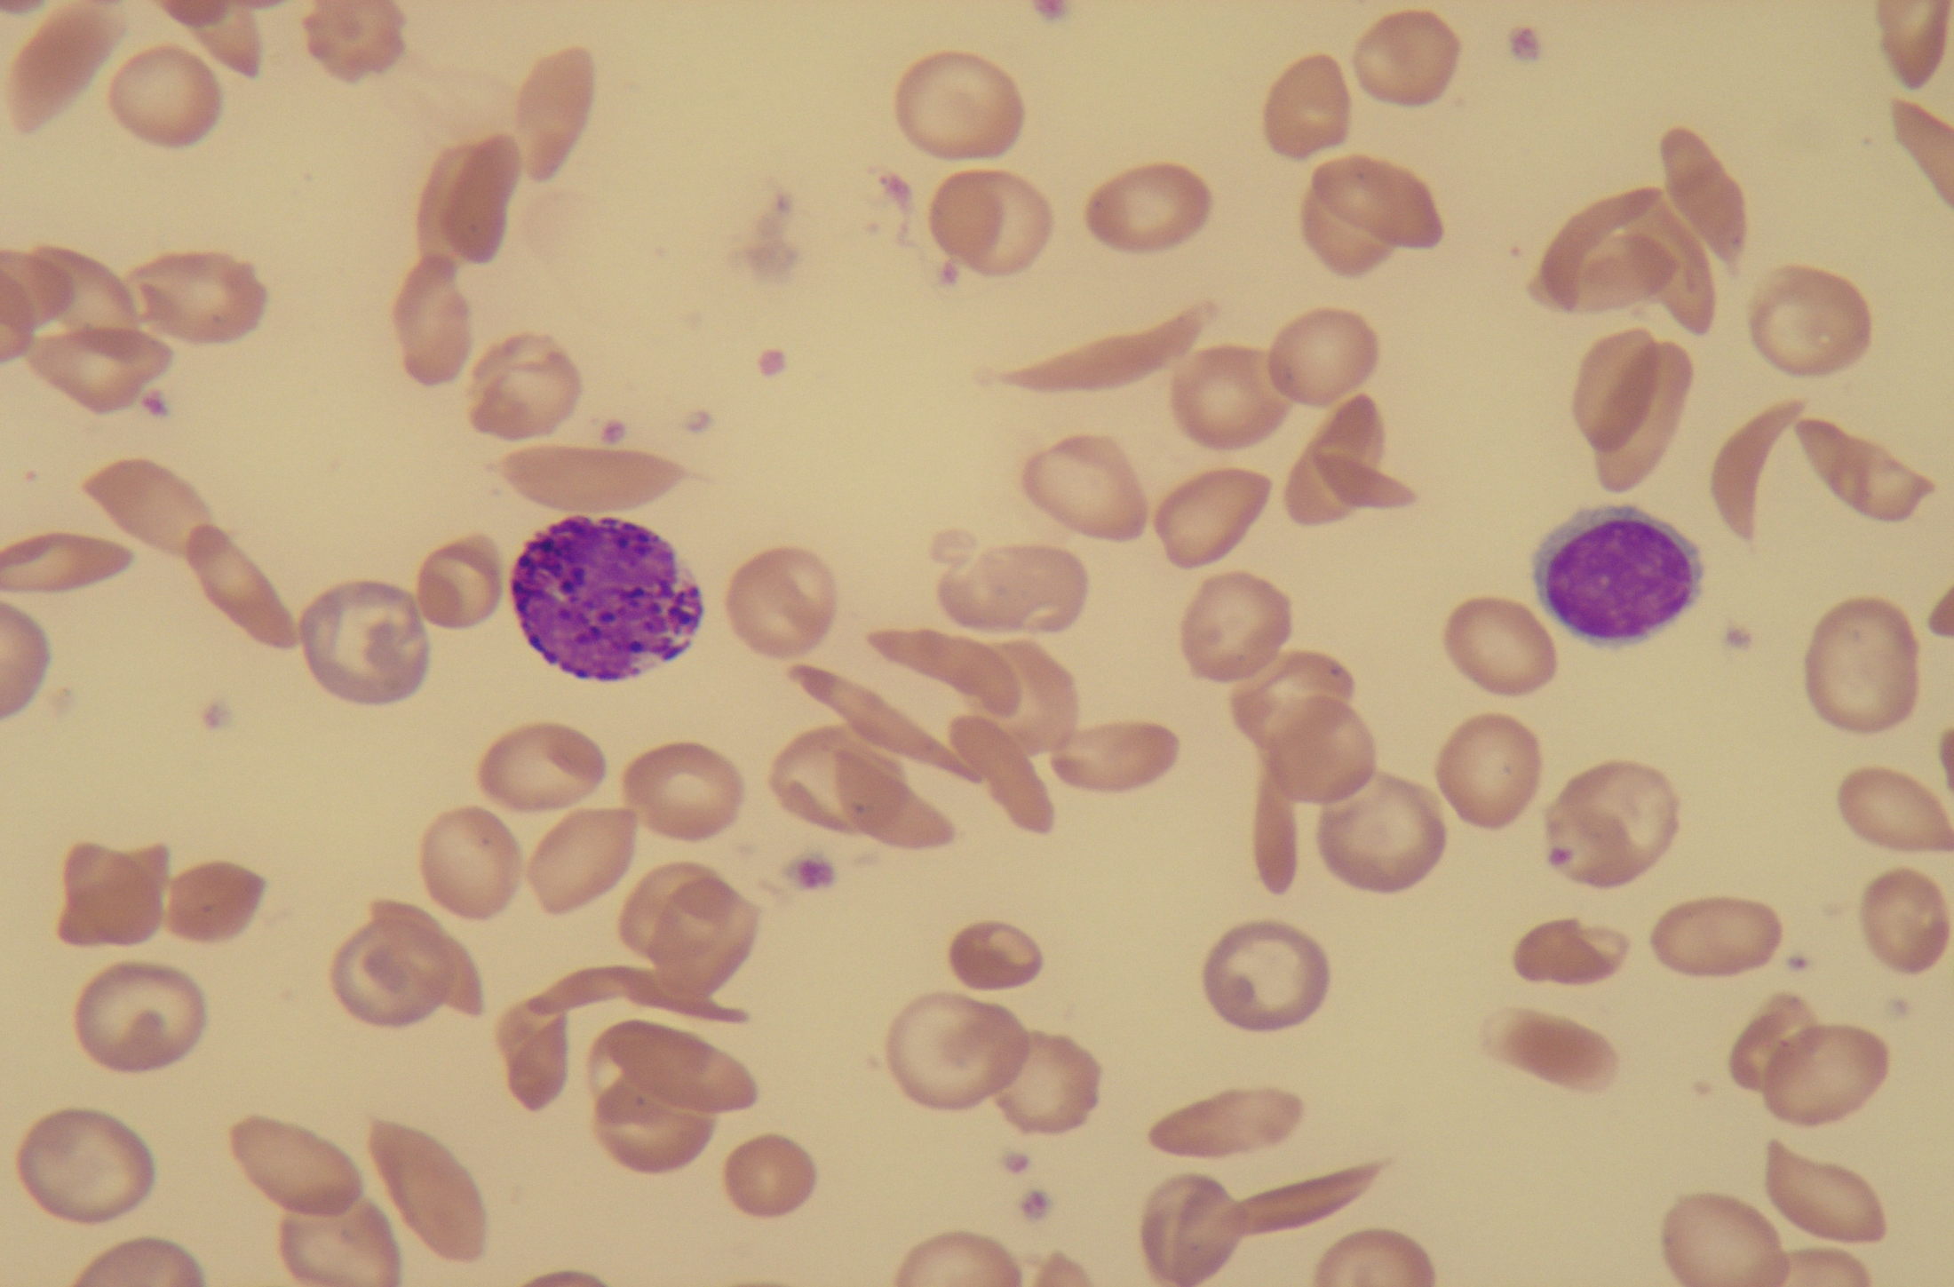

Slide 27
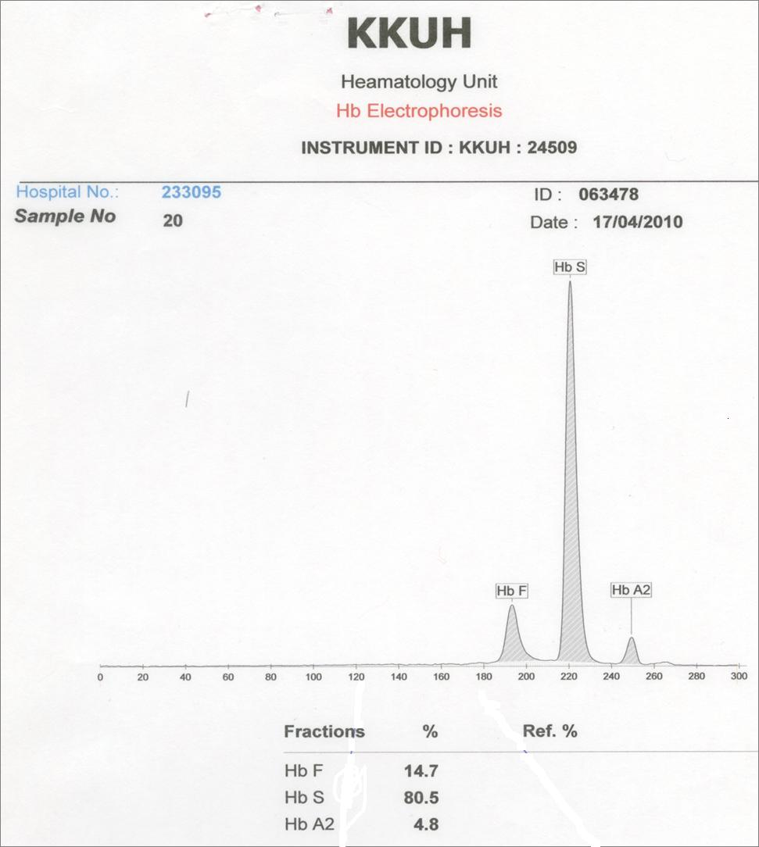

Slide 34
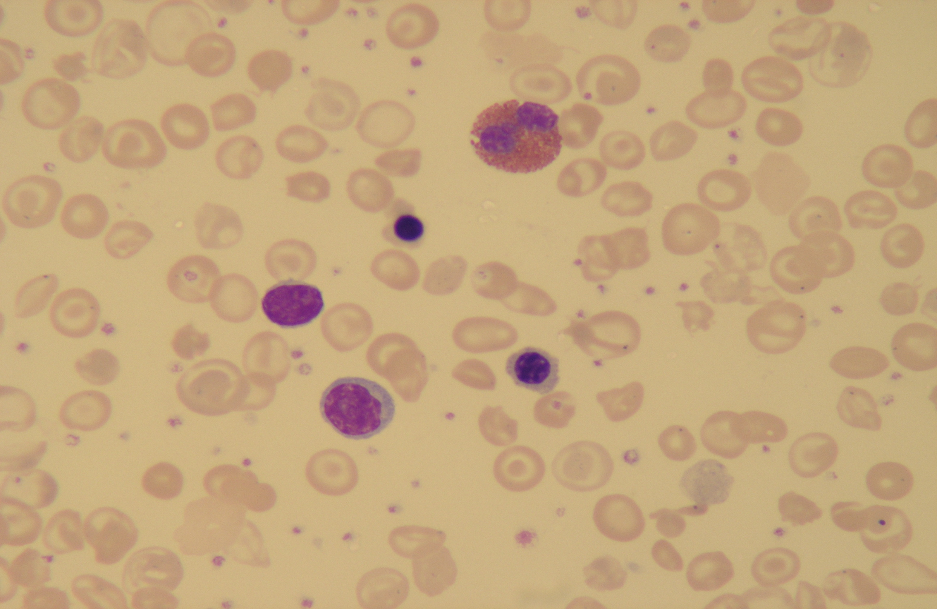
Beta Thalassaemia Major

Slide 35
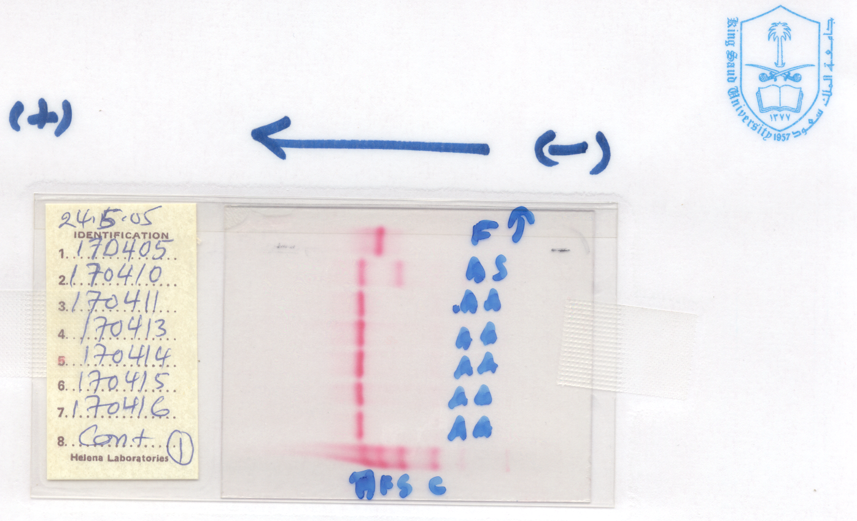

Slide 36
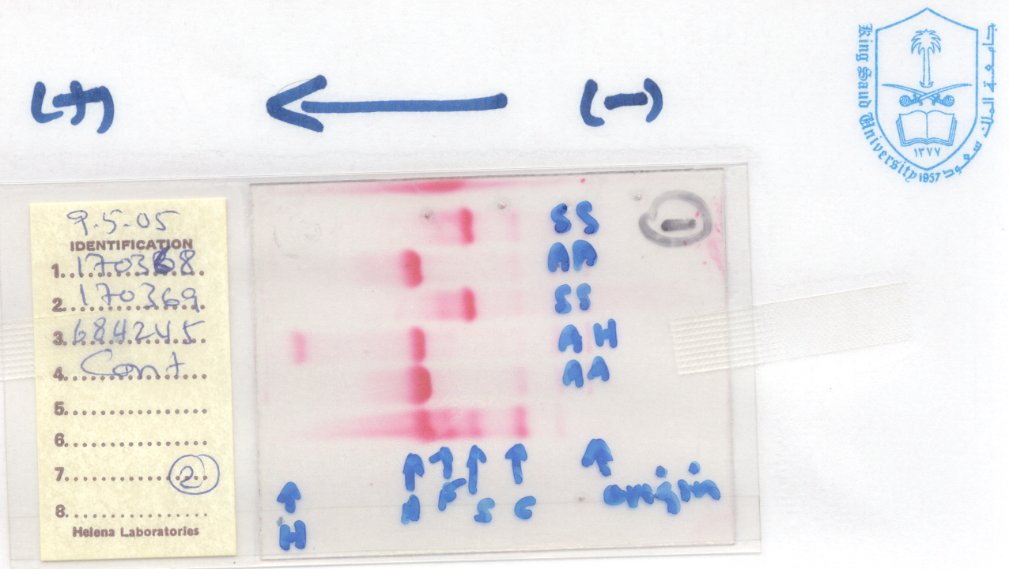

Slide 37
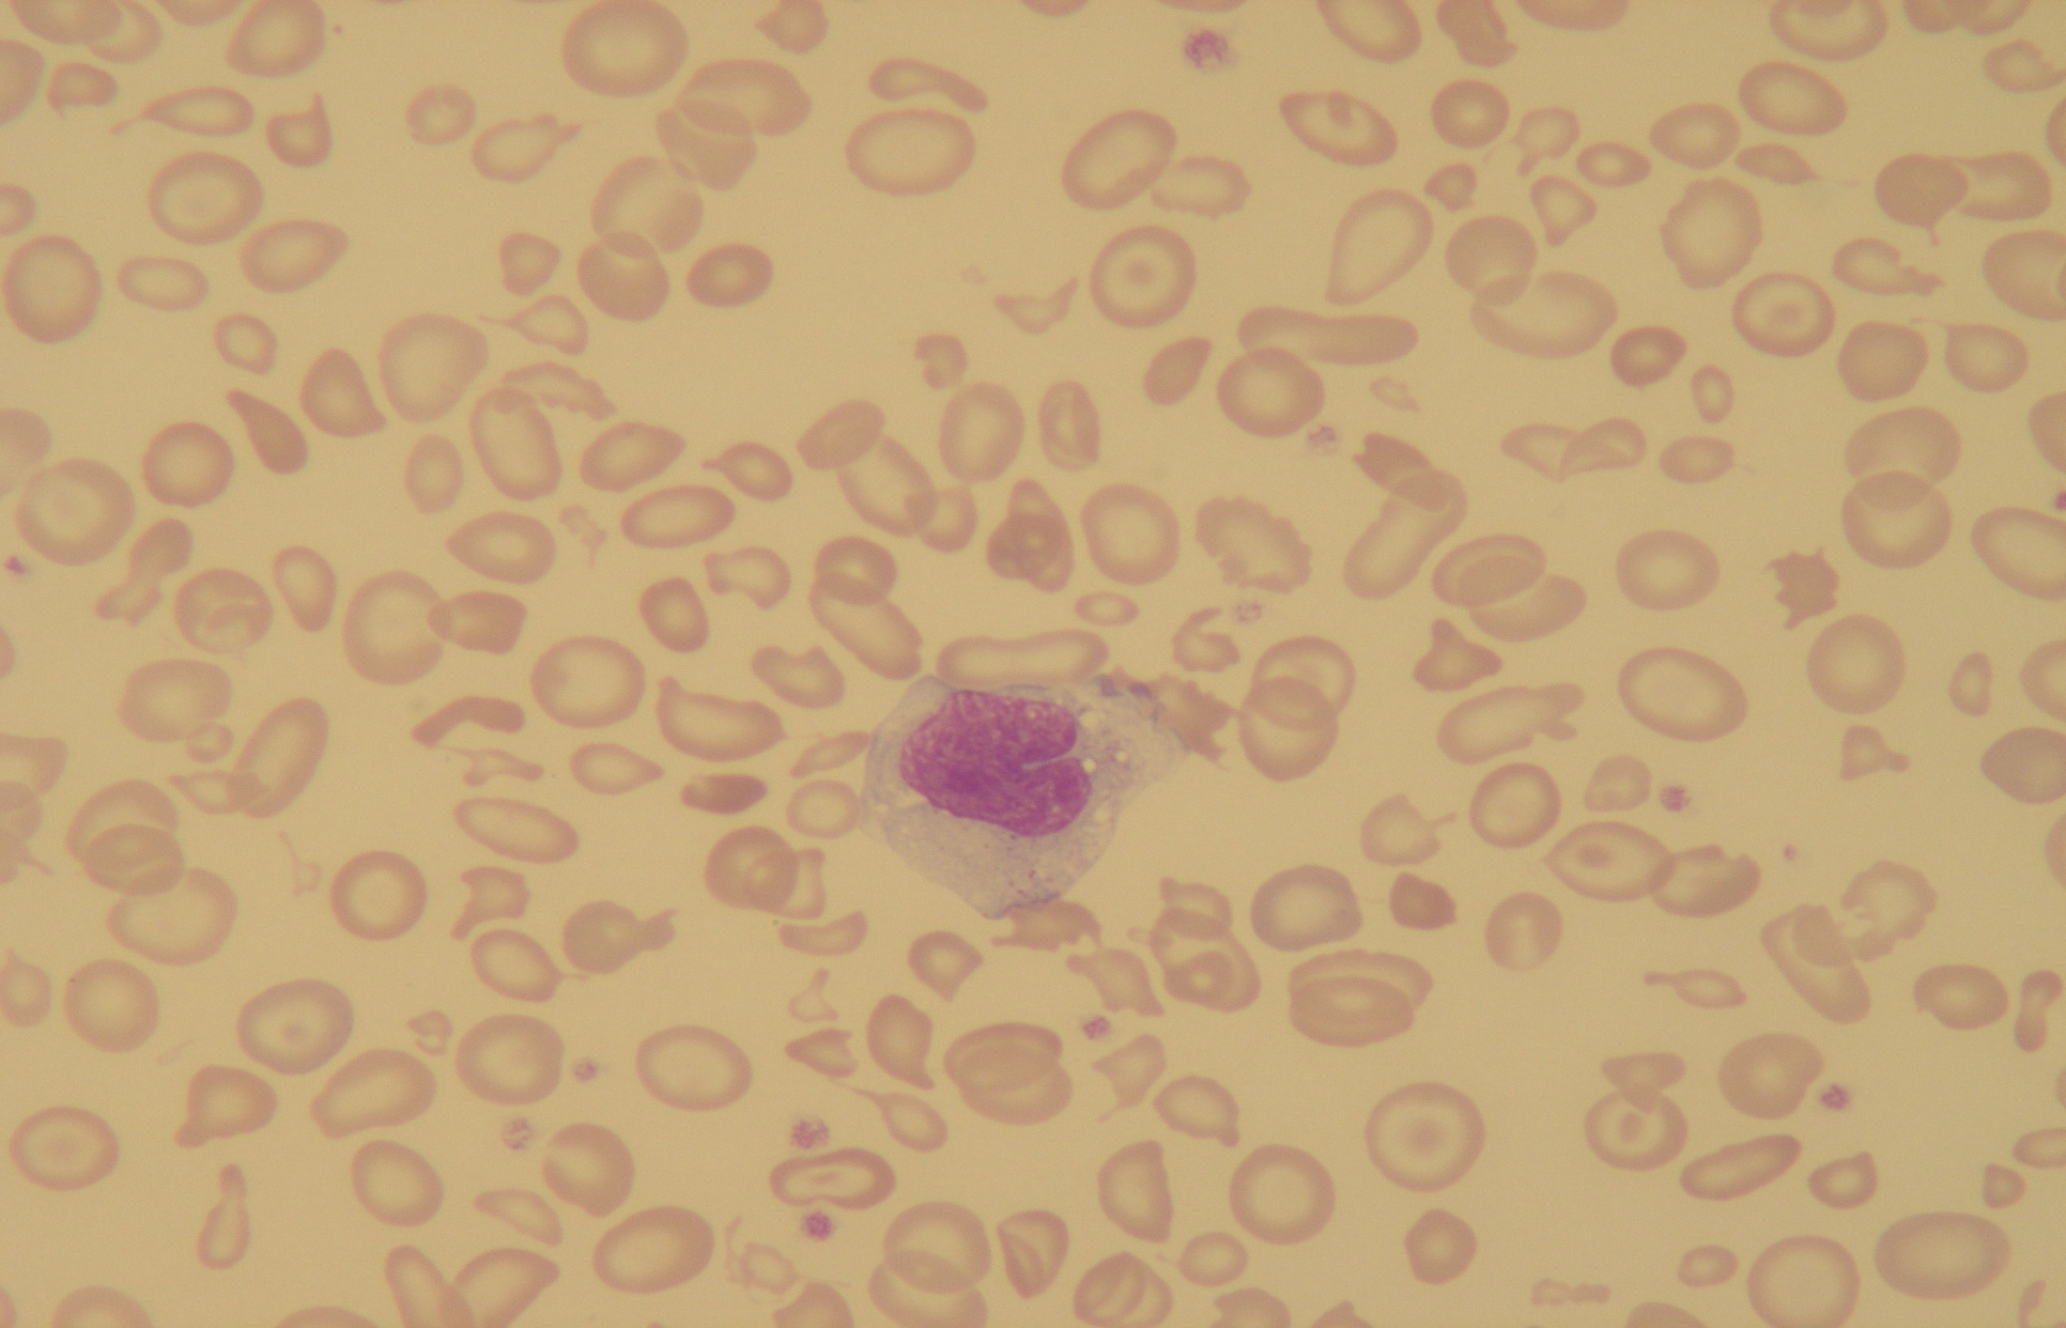
Alpha Thalassaemia

Slide 38
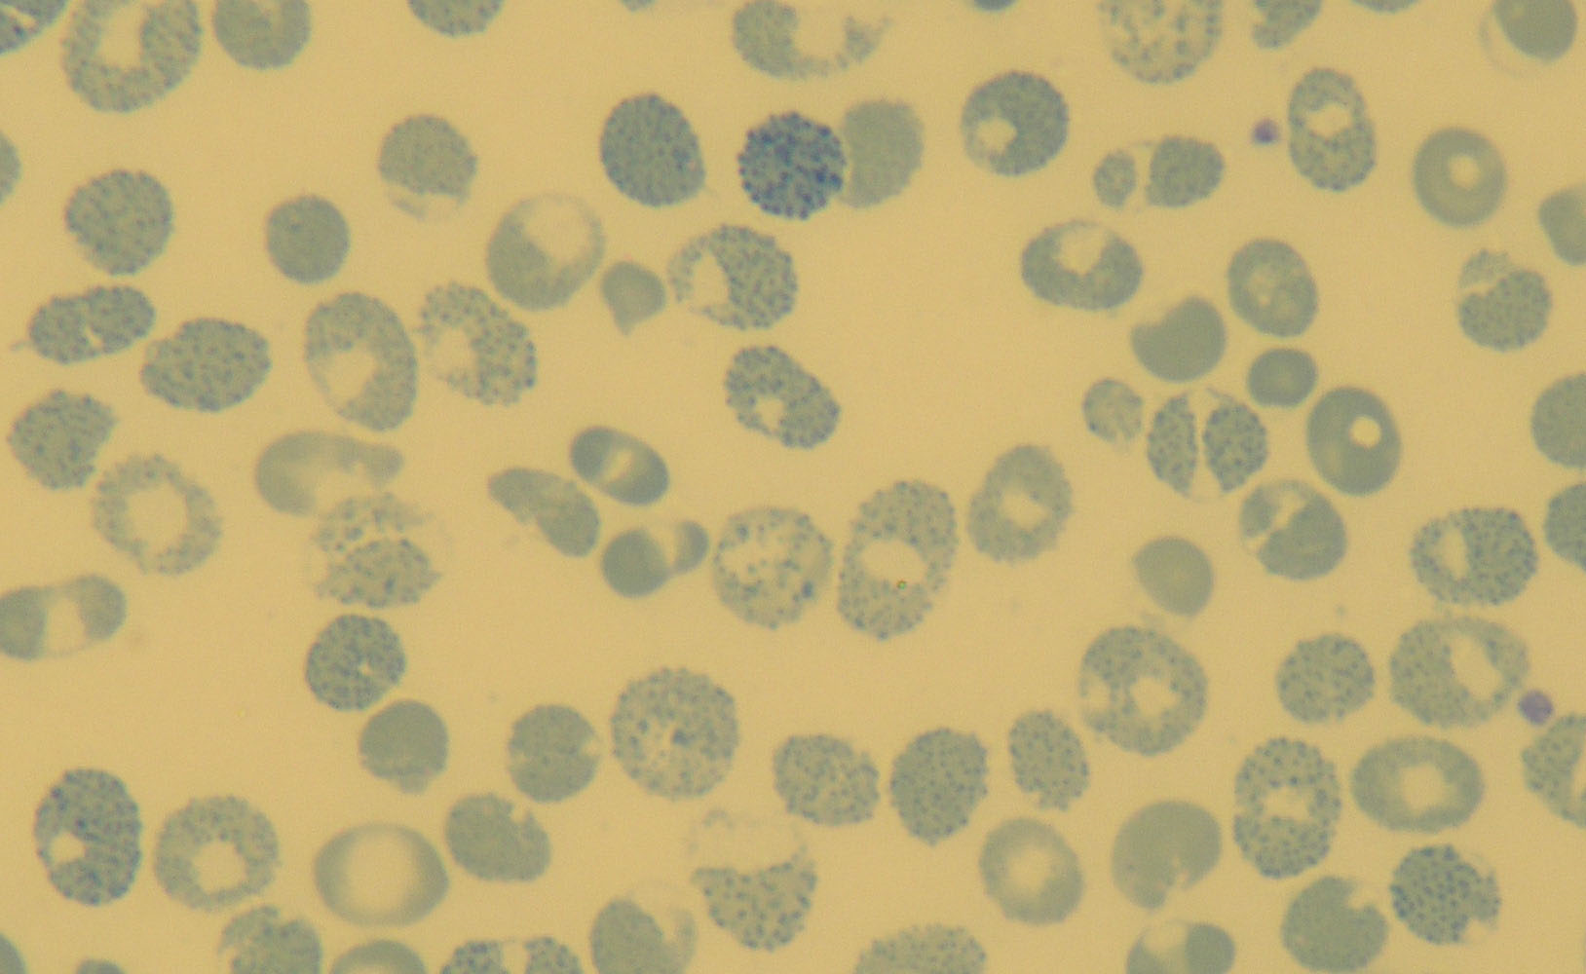
Haemoglobin H Disease

Slide 39
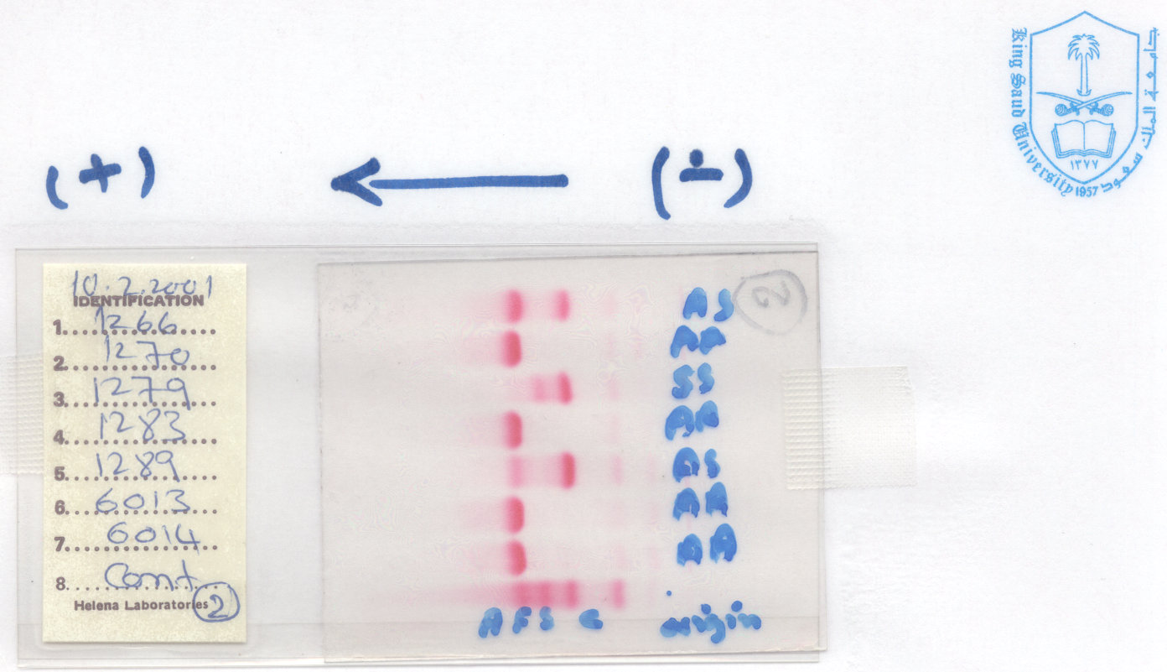

Slide 40
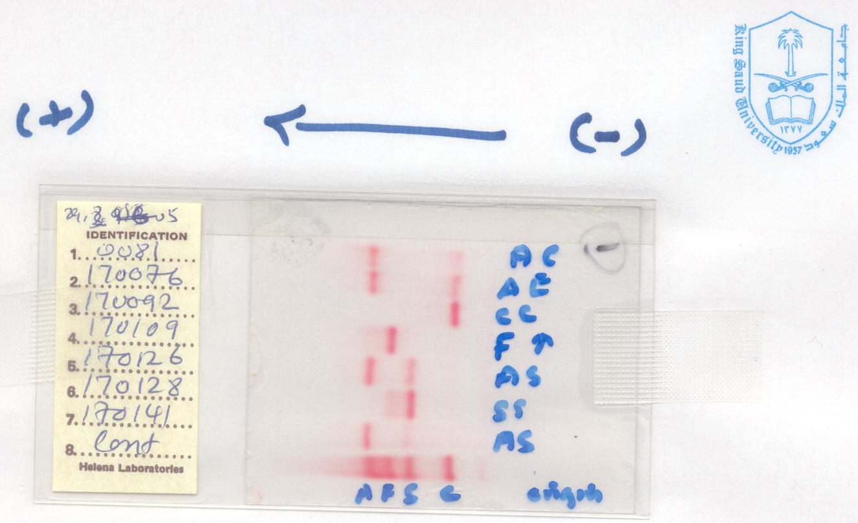

Slide 41
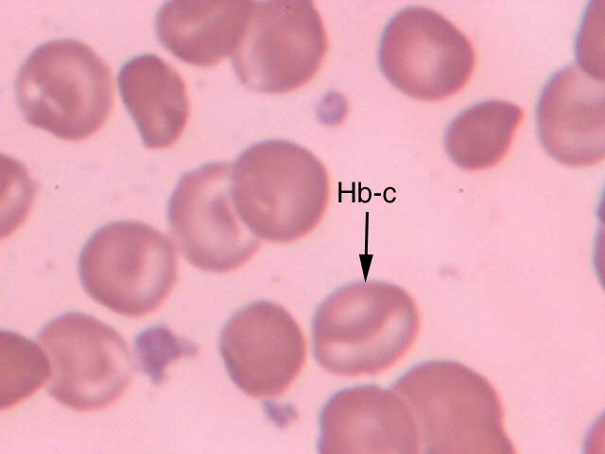
HAEMOGLOBIN C DISEASE

Slide 42
Thank you

