Slide 1
Nutrition Education
Prof. Ashry Gad Mohamed
Prof. of Epidemiology
College of Medicine, KSU

Slide 2
Objectives
At the end of the lecture you should gain the ability to:
Define nutrition.
Know of aims of nutrition education.
Understand factors affecting food consumption.
Understand of channels and techniques of nutrition education.

Slide 3
Definition of nutrition education
It is the science of teaching the individual how to practice proper and correct nutrition in terms of:
1-Knowing the proper nutrition rules.
2-Knowing benefit of each nutrient.
3-To give more attention to quality and quantity of foods.
Nutrition: The process by which the human intakes food for growth, energy, and replacement of tissues; its successive stages include digestion, absorption, metabolism, and excretion.

Slide 4
Food: Any substance taken into the body that will help to meet the body needs for energy, maintenance and growth.
Nutrition requirements: The quantities of each nutrient which met the human body needs to prevent nutrients deficiency diseases.

Slide 5
Contribution differs between countries
Ignorance
Diseases
Poverty
Malnutrition

Slide 6
Importance of nutrition education
Man doesn’t have instinct nor inherit knowledge that leads him to know the effect of different foods on health.
there is consensus that people’s food choices, dietary practices, and physical activities behaviors influence health.
increased risk of chronic diseases.
nutrition education can increase the motivation, skills, and opportunities for people to engage in health promoting actions.

Slide 7
Aims of nutrition education
To increase people’s ability to know the following facts:
The relationship between the body growth, qualities of and appearance, and the types of food they eat.
Increased diversification in the food they eat, and enjoy its taste.
Planning and preparing of meals rich in nutrients.

Slide 8
The natural resources of food.
Assessment of their nutritional behaviors and beliefs.
Appreciating the importance of the standard of living improving programs.

Slide 9
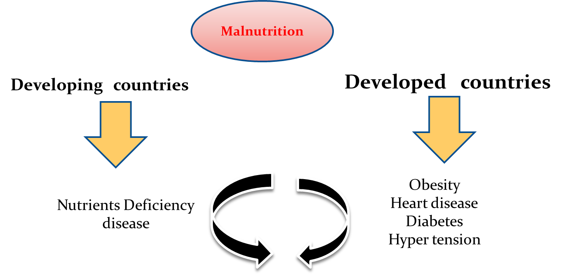

Slide 10
Factors affected on human's food consumptions:
1-The health and disease.
2-Psychological factors.
3-Food habits.
4-Economic levels.
5-Education level.
6-Religious beliefs.
7-Political conditions.

Slide 11
8-Social conditions
9-Form and offering way of food
10-Media
11-Travel & Tourism
12-Labor Migration
13-Geographical characteristics
15-Religious occasions

Slide 12
Nutrition Education strategy
Encouraging the targeted population to consume Balanced diets according to the:
available sources
Renew the dishes
Local food and eating habits
The presenting ways
The best preparing Methods
Suitable food
To Meet the needs

Slide 13
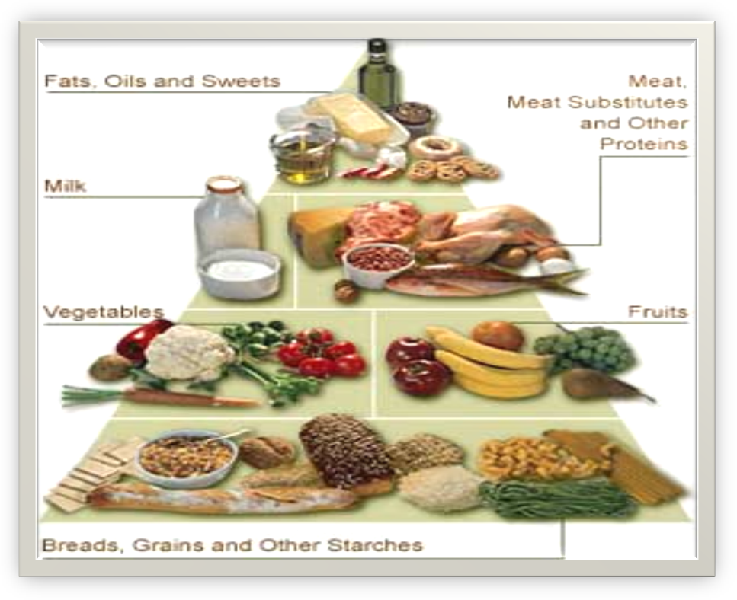

Slide 14
Changing the eating habits through nutrition education
Food habits affect food consumption pattern.
Requirements:
Diffusion Of Innovations : Spread of innovations / (new ideas).
Communication process: Methods of conveying thought and
feeling, it describes interactions between individuals and
groups as well on between various media and people.
Source : nutrition educator

Slide 15
Channel: presentations, lectures………….media
Message: simple (eat more vegetables and fruits)
complex (how to get your child to eat healthful)
Audience : individual, group or public.

Slide 16
Adoption of Idea
Steps
Awareness.
Recognizing innovative for the first time
Interest.
Collection of information available about the idea as much as possible, and more knowledge about characteristic , as a result of generating motivation to learn more about this new idea.

Slide 17
Decision & evaluation.
The adopter take decision continuing to collect more information about the idea or to quit , as well as begin to assess the information which obtained according to the present situation and future prospects for decision to adopt it , or leave it.
Trial.
In this stage the individual try to apply the new ideas in small area , to esteem the benefits of this new ideas.
Adoption
After recognizing and after convicting the benefits of the new ideas , the person will adopt these new ideas

Slide 18
Classes of adopters
Innovators
Early adopters
Early majority
late majority
laggards

Slide 20
Choosing the channels of nutrition education
1.Newspapers and publications. 2. The radio. 3. Television. 4. Space stations. 5. Telephone and fax. 6. Internet

Slide 21
Techniques
ways that the educator will delivering the massages to the reserve (target groups)
1.lecture
2. seminars. 3. symposium .
4. role play
5. Discussion groups

Slide 22
References:
El-Shafi M. Nutrition education. Educational course. CHS456. KSU.
Park K. Nutrition and health. In: Preventive and social Medicine. Editor. 21th edition. 2011 pages 561-617.

