Slide 1
Anti-platelet drugs
Dr. Ishfaq Bukhari

Slide 2
Platelets and vessels
In healthy vasculature, circulating platelets are maintained in an inactive state by nitric oxide (NO) and prostacyclinre (PGI2)leased by endothelial cells lining the blood vessels.
An injury to vascular system leads to interaction between Platelets, Endothelial system and Coagulation factors which lead to formation of the CLOT

Slide 3
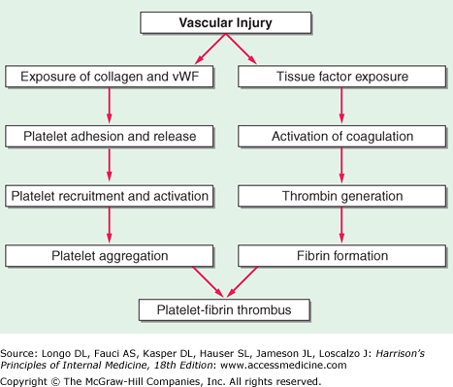

Slide 4
Activation of platelets after vascular injury
Injury exposes reactive subendothelial matrix proteins, platelet adherence & activation, + secretion & synthesis of vasoconstrictors & platelet activating molecules.
Thus, thromboxane A₂ (TXA₂) is synthesized from arachidonic acid within platelets & is platelet activator & potent vasoconstrictor.
Adenosine diphosphate (ADP), secreted from platelet, a powerful inducer of platelet aggregation
Serotonin (5HT), which stimulates aggregation & vasoconstriction.

Slide 5
Activation of platelets, aggregation & conformational change in the GP11b/111a, enabling it to bind fibrinogen, which cross-links adjacent platelets, aggregation & formation of a platelet plug.
Simultaneously, the coagulation system cascade is activated, thrombin generation & a fibrin clot, which stabilizes the platelet plug.

Slide 6
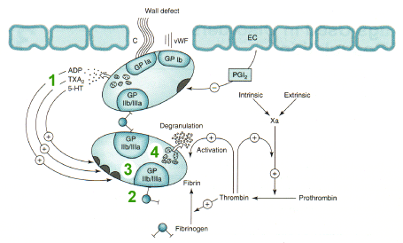
Damage to endothelium and Platelets aggregation (formation of clot)
vWF=Von Willebrand factor

Slide 7
Clot
THROMBUS: is the CLOT that adheres to vessel wall
EMBOLUS: is the CLOT that floats in the blood
THROMBOSIS: is the formation of unwanted clot with in the blood vessel, producing life threatening condition.
Acute myocardial infarction
Acute ischemic stroke
Deep vein thrombosis
Pulmonary embolism

Slide 8
DRUGS
Antiplatelets (drugs which prevent and inhibit
platelet aggression)
Anticoagulants (drugs which prevent clotting by inhibiting clotting factors)
Thrombolytics (Fibrinolytics)(drugs which reduce or lysis the clot.

Slide 9
Antiplatelet drugs target
Ticlopidine &clopidogrel
TXA2: Aspirin
Abciximab
Tirofiban Eptifibatide

Slide 10
Drugs targets for platelet inhibition:
 | Mechanism of action | Drug | ROA
(1) | Inhibition of thromboxane A2 synthesis via inhibiting COX-1 | Aspirin | Oral
(2) | Inhibition of ADP-induced platelet aggregation (Antagonist of ADP receptors) | Clopidogrel Ticlopidine | Oral
(3) | GP IIb / IIIa receptor antagonists (Inhibitors) | Abciximab Tirofiban Eptifibatide | I / V
(4) | Phosphodiestrase 3 (PDE) inhibitors / adenosine uptake inhibitors | Dipyridamol Cilostazol | Oral Oral

Slide 11
Aspirin
Mechanism of action: (Low dose)
irreversible inhibition (acetylation) of
cyclooxygenase enzyme-1 (COX-1)
thus inhibits the synthesis of thromboxane A ₂
(thromboxane A 2 ---- causes platelet aggregation)
Aspirin with a low dose (75-160 mg per selectively inhibits COX-1 , decreasing synthesis of platelet TxA2 and inhibit platelet aggregation.
,low dose spares the protective PGI2 synthesis.

Slide 12
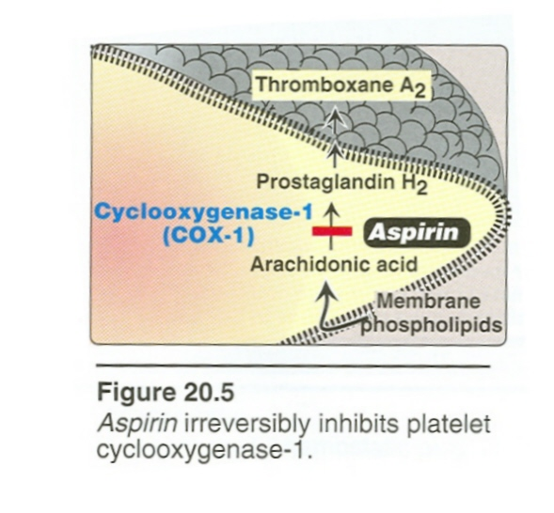

Slide 13
Targets of Aspirin in low doses drugs
Aspirin in low dose does not inhibits PGI2 synthesis by endothelium)
Good Guy!!!!
Aspirin inhibits COX-1 present in platelets thus decreasing TXA2 synthesis.

Slide 14
Aspirin
Uses:
Prophylaxis of thromboembolism e.g.
unstable angina / myocardial infarction,
ischemic stroke, can also be used in combination with other antiplatelet aggregating (Clopidogrel) and anticoagulant drugs (Heparin )
Adverse effects:
Hyperacidity
Contraindication:
Peptic ulcer

Slide 15
Clopidogrel & Ticlopidine
Mechanism of action:
irreversibly block ADP receptors on platelets
This action inhibits ADP-induced expression of platelet membrane GPIIb/IIIa and fibrinogen binding to activated platelets.
Uses:
To prevent thrombosis
(Prevention of vascular events in pts with):
- transient ischemic attacks
- unstable angina pectoris
- placement of a coronary stent
.

Slide 16
Target of clopidogrel and ticlopidine
Ticlopidine
&clopidogrel

Slide 17
Ticlopidine
Adverse effects:
- nausea , dyspepsia , diarrhea
- hemorrhage
- leucopenia
- TTP (thrombotic thrombocytopenic purpura)
Precaution:
Regular monitoring of WBC count during
first three months
(Therapy with ticlopidine requires regular monitoring for neutropenia)

Slide 18
Clopidogrel
Adverse effects:
- same but fewer than ticlopidine
- long duration of action
(once daily dosing, ticlopidine given twice daily)
clopidogrel is more potent than ticlopidine and has a better safety profile, clopidogrel has replaced ticlopidine.

Slide 19
Clopidogrel & Ticlopidine
Ticlopidine and clopidogrel are prodrugs that require metabolism by the hepatic cytochrome P450 (CYP) enzyme system to active form.

Slide 20
Abciximab , Tirofiban , Eptifibatide (monoclonal antibodies)
Mechanism of action:
- GP IIb / IIIa receptor Blockers (antagonists)
GPIIb/IIIa is found on the surface of platelets and is the most abundant receptor.
activated, GPIIb/IIIa binds adhesive molecules, such as fibrinogen and vWF to promote clotting.
Abciximab binds to GPIIb/IIIa and stops the clot fromation.
Tirofiban and eptifibatide inhbit platelets binding to fibronogen

Slide 21
Mechanism of action of Abciximab , tirofiban & eptifibatide
Abciximab
Tirofiban & Eptifibatide

Slide 22
(Abciximab)
Abciximab is monoclonal antibody directed against glycoprotein GPIIb/IIIa.
Clinical Efficacy: In acute MI patients,
Abciximab is administered iv as an adjuvant to angioplasty surgery for the prevention of ischemic complications of angioplasty.
Heparin or aspirin is given with abciximab
Abciximab is non-competitive and has long duration of action , while Tirofiban & Eptifibatide are competive and have short duration.
Given parenteraly only

Slide 23
Abciximab , Tirofiban , Eptifibatide
Uses:
To prevent thrombosis
(Prevention of vascular events in pts with):
- Acute coronary syndrome
- Percutaneous coronary intervention
Adv effects: Bleeding
Thrombocytopenia (immune reaction)
.

Slide 24
Cilostazole
- phosphodiestrase inhibitor(on PDE3) increases cAMP
---- promotes ----- vasodilation & inhibition of platelet aggregation
Uses:
-To prevent intermittent claudication
Claudication refers to the pain, aching or fatigue of the muscles of the buttocks, thigh and/or calf that occurs with exertion. This pain or cramping is caused by poor circulation due to blockage of the arteries of the lower extremity.

Slide 25
Antiplatelet drugs
Prevent blood clots from forming in the arteries.
Aspirin is the most commonly prescribed antiplatelet drug.
Clopidogrel works by reducing the “stickiness” of platelets in a similar way to aspirin & is often recommended as an alternative for people who cannot take aspirin.
Aspirin and clopidogrel are given together in high risk patients

Slide 26
clopidogrel & aspirin may be recommended for people who have had a heart attack, a severe attack of angina, or who have undergone a coronary angioplasty & stenting.
Monitoring:
- Bleeding time
(Antiplatelet drugs increase bleeding time)

Slide 27
Aspirin Resistance:
The reported incidence of resistance varies greatly, from 5 % to 75%.
Resistance: recurrent thrombosis while on antiplatelet therapy.
Although aspirin reduces the production of TX_{A2}, it may fail to inhibit platelet aggregation because platelets continue to respond strongly to other agonists.
TX_{A2}-induced platelet aggregation is only ONE of many factors leading to thrombus formation, which is the most common, but not the only, mechanism leading to ischemic events.

Slide 28
Antiplatelet drugs
Monitoring:
- Bleeding time
(Antiplatelet drugs increase bleeding time)

