Slide 1
Reticuloendothelial System
& Spleen
DR.MOHAMMED ALOTAIBI Assist. Professor of Physiology, College of Medicine
King Khalid University Hospital King Saud University

Slide 2
Objectives
At the end of this lecture the student is expected to be able to:
Define the term Reticuloendothelial system (RES)
Describe the cellular components of RES
Describe the functions of the RES
Define the structural function of the spleen
Describe the functions of the spleen
Understand the basic concept of the indication and risks of splenectomy

Slide 3
The Reticuloendothelial system (RES)
It is a network of connective tissue fibers inhabited (dwelled) by phagocytic cells such as macrophages ready to attack and ingest microbes and particles
RES is an essential component
of the immune system

Slide 4
Reticuloendothelial system (RES) (Mononuclear phagocyte system)
Reticuloendothelial system is an older term for the mononuclear phagocyte system (MPS)
Most endothelial cells are not macrophages.

Slide 5
Cellular Components of RES
Monocytes
Macrophage Located in all tissues, such as skin, liver (kupffer), spleen, bone marrow, lymph nodes, lung.
Endothelial cells: bone marrow, spleen, lymph node

Slide 6
Macrophages
Often remain fixed to their organs. They filter and destroy objects which are foreign to the body, such as bacteria, viruses.
Some macrophages are mobile, and they can group together to become one big phagocytic cell in order to ingest larger foreign particles.

Slide 7
Types of Macrophages
Macrophages differ depending on the organs in which they reside in.
Kupffer cells …………..in the liver.
Microglia…..................in the CNS
Reticular cells ………..in the lymph nodes, bone marrow, spleen.
Tissue histiocytes (fixed macrophages)
………..…...in subcutaneous connective tissues
Alveolar cells………….in the lungs

Slide 8
Formation of Macrophages
Begin by Stem cell in Bone Marrow:
monoblast maturing to promonocyte and mature monocytes released into blood
Stay for 10-20 hours in circulation
Then leave blood to tissues transforming into larger cells macrophage
Macrophage life span is longer up to few months in tissues

Slide 9
Transformation of monocytes to macrophages
Characterized by an increase in:
Cell size
Number and complexity of intracellular organelles Golgi, mitochondria, lysosomes
Intracellular digestive enzymes

Slide 10
General Functions of RES
Phagocytosis: Bacterial, dead cells, foreign particles (direct)
Immune function: processing antigen and antibodies production (indirect)
Destruction of aging RBCs
Storage and circulation of iron

Slide 11
Phagocytosis
Phagocytosis is a part of the natural, or innate immune process
Macrophages are the powerful phagocytic cells:
Ingest up to 100 bacteria
Ingest larger particles such as old RBCs
Get rid of waste products

Slide 12
Direct anti Inflammatory

Slide 13
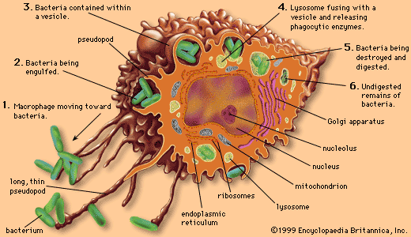

Slide 14
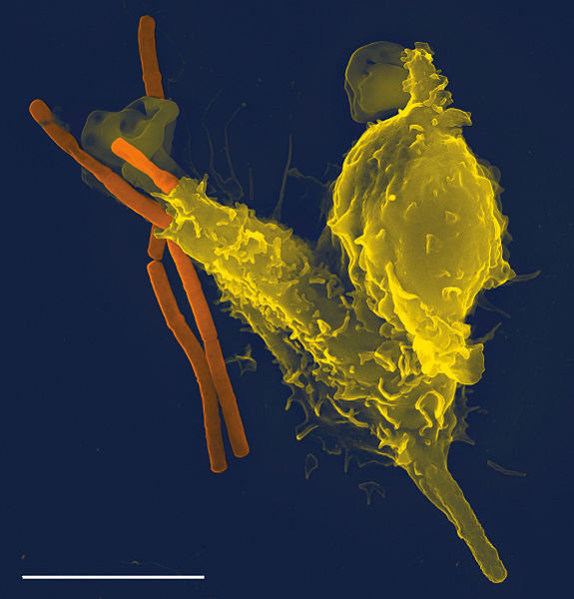
A scanning electron microscope image of a single neutrophil (yellow), engulfing anthrax bacteria (orange).

Slide 15
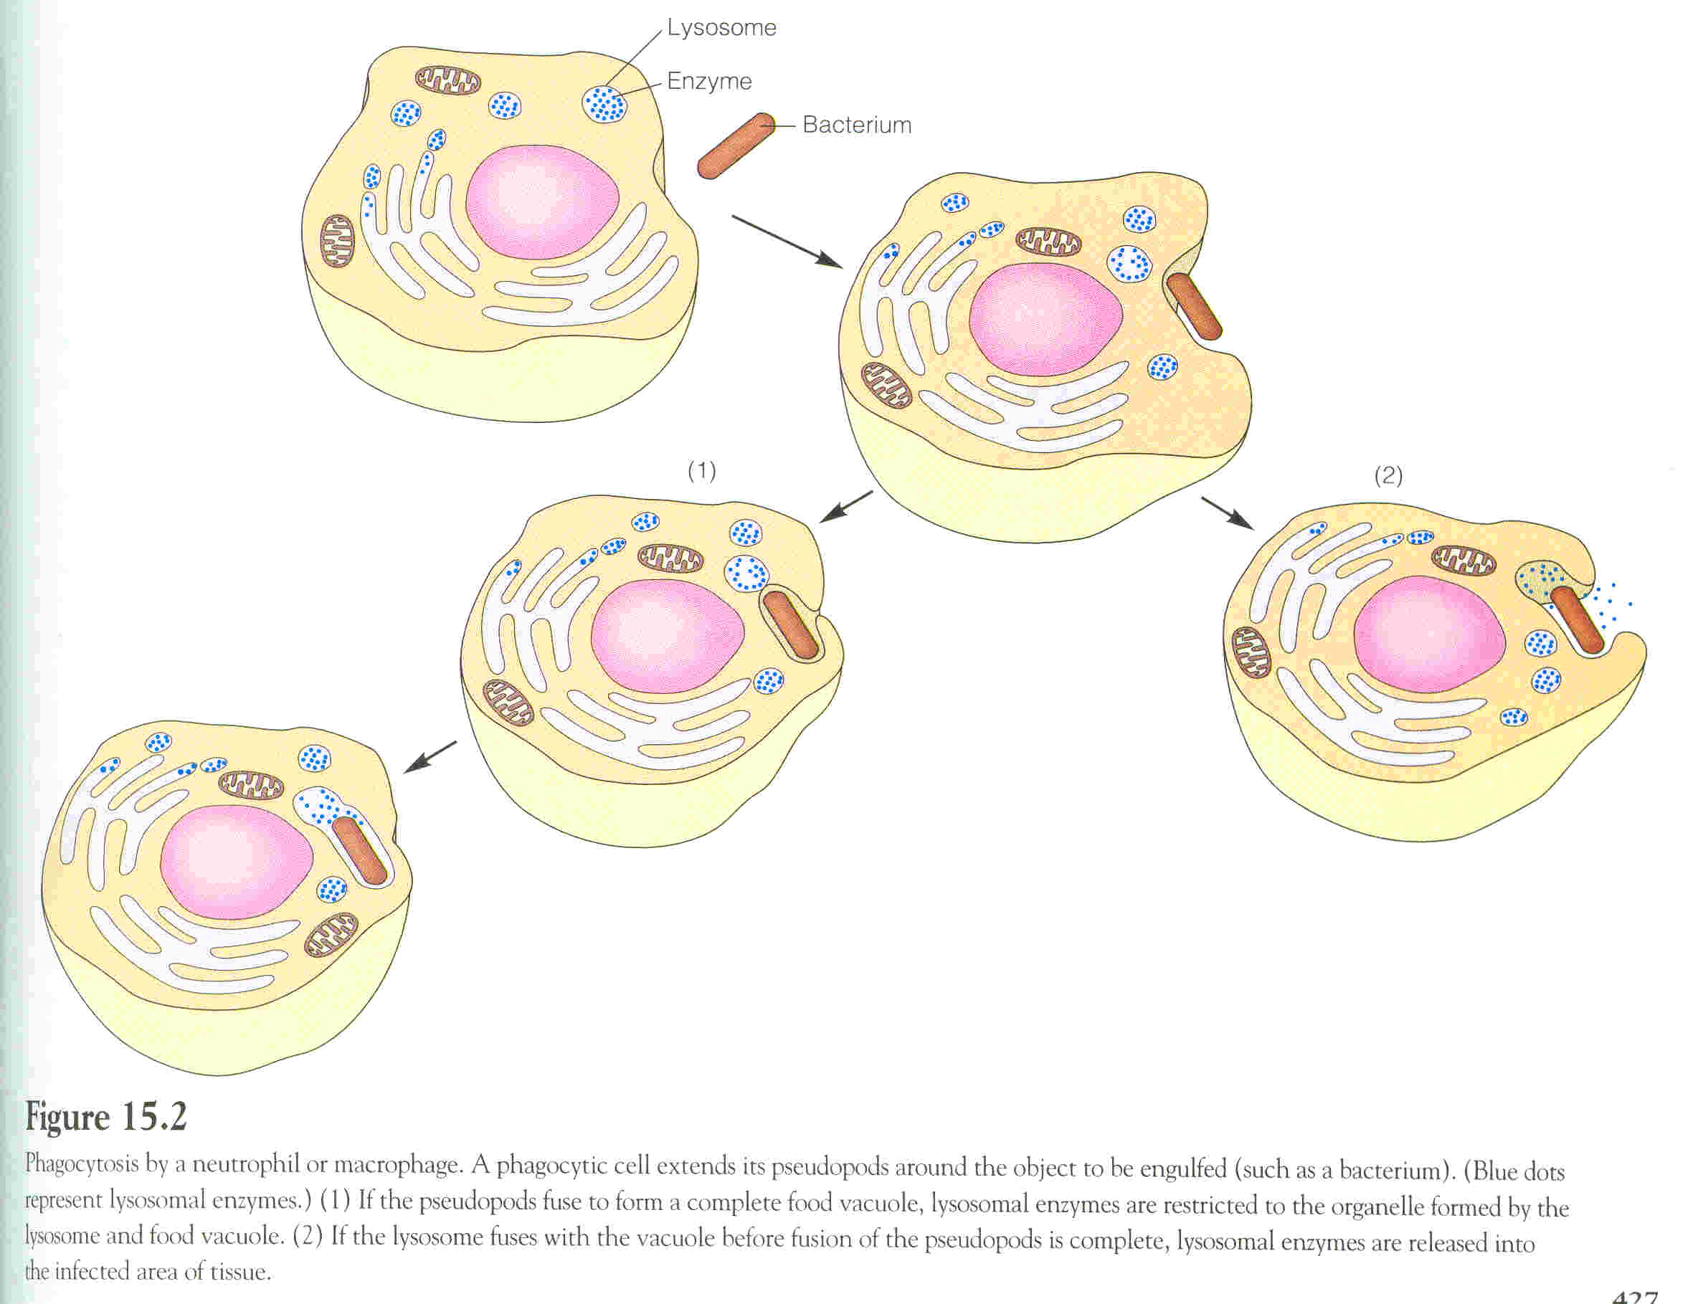
Phagocytosis

Slide 16
Microbial killing

Slide 17
Indirect Immune function Of RES
Indirectly immune function of RES:
Ingest foreign body, process it, and present it to lymphocytes

Slide 18
Lymphoid Organs
Thymus: high rate of growth and activity until puberty, then begins to shrink; site of T-cell maturation
Lymph nodes: small, encapsulated, bean-shaped organs stationed along lymphatic channels and large blood vessels of the thoracic and abdominal cavities
Spleen: structurally similar to lymph node it filters circulating blood to remove worn out RBCs and pathogens. It is the largest system of the MPS.

Slide 19
Spleen
Is soft purple gray in color located in the left upper quadrant of the abdomen.
It is a highly vascular lymphoid organ
It plays important roles in: red blood cells integrity and has immune function.
It holds a reserve of blood in case of hemorrhagic shock.
It is one of the centers of activity of the RES and its absence leads to a predisposition toward certain infections
Despite its importance, there are no tests specific to splenic function

Slide 20
Spleen

Slide 21
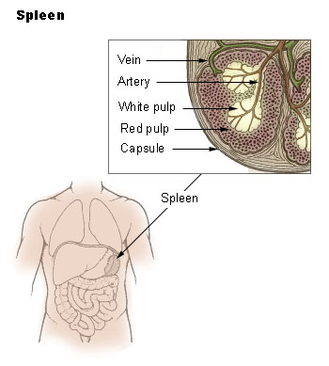
Structural Function of Spleen
White pulp: Thick sleeves of lymphoid tissue, that provides the immune function of the spleen
Red pulp: surrounds white pulp, composed of Venous sinuses filled with whole blood and Splenic cords of reticular connective tissue rich in macrophages

Slide 22
Functions of Spleen
Haematopoiesis (Hemopoiesis) (fetal life)
Spleen is a main site for destruction of RBCs specially old and abnormal e.g. spherocytosis
Blood is filtered through the spleen.
Reservoir of thrombocytes and immature erythrocytes
Recycles of iron

Slide 23
Immune Functions of Spleen
Because the organ is directly connected to blood circulation, it responds faster than other lymph nodes to blood-borne antigens
Reservoir of lymphocytes in white pulp
Destruction and processing of antigens
Site for Phagocytosis of bacteria and worn-out blood cells (Slow blood flow in the red pulp cords allows foreign particles to be phagocytosed )

Slide 24
Immune Functions of Spleen
Site of B cell maturation into plasma cells, which synthesize antibodies in its white pulp and initiates humoral response
Removes antibody-coated bacteria along with antibody-coated blood cells.
It contains (in its blood reserve) half of the body monocytes within the red pulp, upon moving to injured tissue (such as the heart), they turn into dendritic cells and macrophages that promote tissue healing.

Slide 25
Spleenectomy
Indications:
Hypersplenism: enlargement of the spleen (splenomegaly) with defects in the blood cells count.
primary spleen cancers
Sickle cell anaemia, Thalassemia,hereditary spherocytosis (HS) and elliptocytosis,
Idiopathic thrombocytopenic purpura (ITP).
Trauma.
Hodgkin's disease (lymphoma).
Autoimmune hemolytic disorders.

Slide 26
Risks of Spleenectomy
Overwhelming bacterial infection or post splenectomy sepsis.
Patient prone to malaria
Inflammation of the pancreas and collapse of the lungs.
Excessive post-operative bleeding (surgical)
Post-operative thrombocytosis and thrombosis

Slide 27
The End

