Slide 1
Platelet Structure & Function
DR.MOHAMMED ALOTAIBI
MRes, PhD (Liverpool, England)
Assist. Professor of Physiology, College of Medicine
King Khalid University Hospital
King Saud University

Slide 2
Objectives
At the end of this lecture the student is expected to:
- Understand platelet normal ultrastructure
- Understand the functions of different platelets organelles and surface receptors
- Understand the mechanisms of platelet functions
- Relate membrane receptors and granule content to normal function in hemostasis and bleeding (platelet) disorders

Slide 3
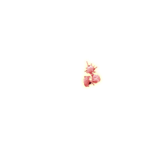
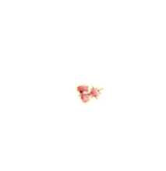
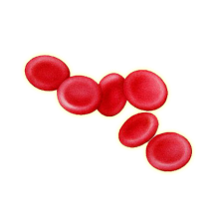

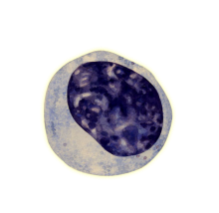
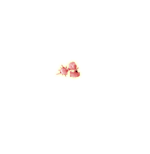
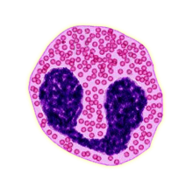
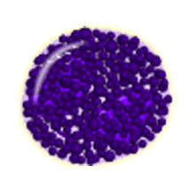
What are platelets?
BLOOD
Plasma
Cells
RBC
WBC
Platelet

Slide 4
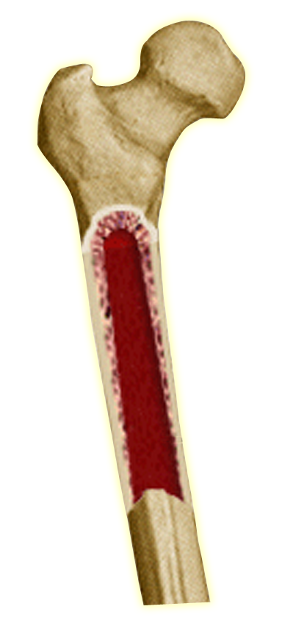
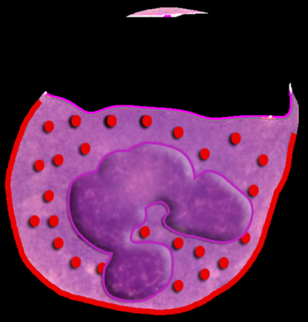
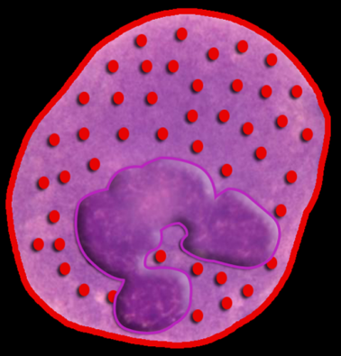
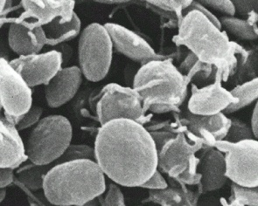

What are platelets?
Bone marrow
Mature platelets
Megakaryocyte

Slide 5
Platelets – cont.
Site of formation: Bone marrow
Steps: Stem cell
Megakaryoblast
Megakaryocyte
Platelets

Slide 6
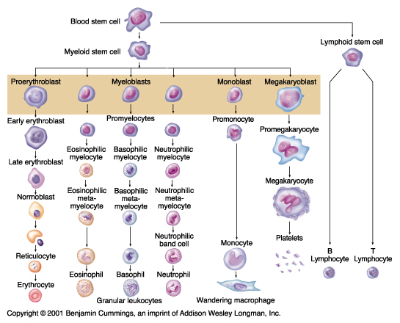
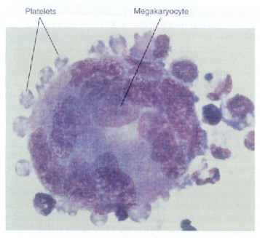
Megakayocyte and platelet formation

Slide 7
Platelets Formation
(Thrombopoiesis)
Regulation of thrombopoiesis
by
Thrombopoietin

Slide 8
Platelet ultra-structure
(Electron-microscope -EM)

Slide 9
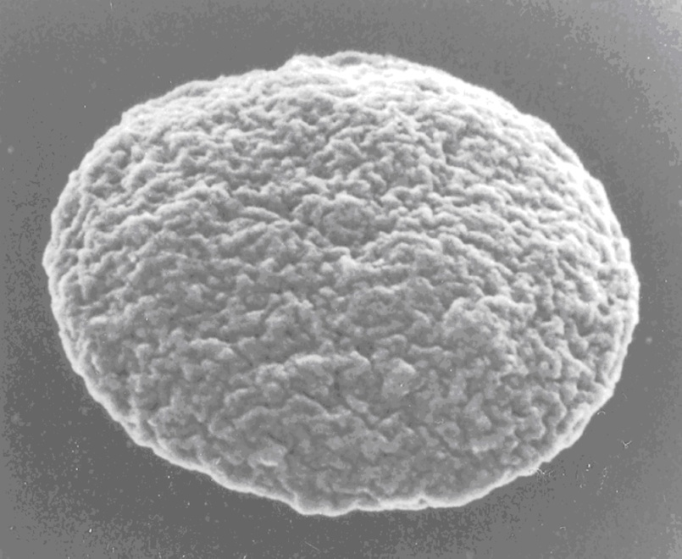
Platelets
(Thrombocytes)
- Discs ~ 1-4 μM in diameter
- Their normal concentration in the blood is between 150,000 and 300,000 /μl

Slide 10
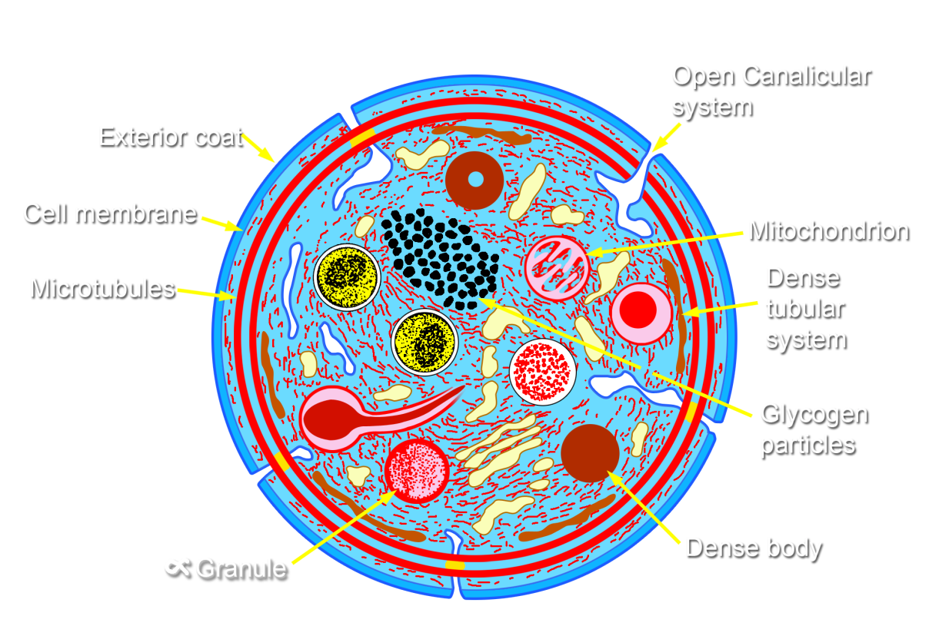
(Thrombocytes)
Anuclear and discoid cell → spherical when activated
Life span: 7–10 days
Sequestered in the spleen; hypersplenism may lead to low platelet counts.

Slide 11
Platelet Ultrastructure
Microtubules
Mitochondria
α Granules
von Willebrand Factor
Fibrinogen
Chemokines (PF4,etc.)
Thrombospondin
P-selectin
Open canalicular
system
Dense Granules
ADP/ATP
Calcium
Serotonin
Notes:
11

Slide 12
Platelet Receptors
Platelet
(GP Ia, GP VI)
Collagen
GP Ib-IX-V
(vW Factor)
(TPα)
TXA2
GP IIb-IIIa
(Fibrinogen, vWF)
(P2Y₁₂)
ADP
Notes:
12

Slide 13
General functions of the platelets

Slide 14
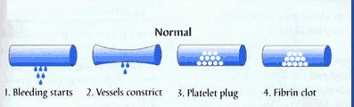
HEMOSTASIS
1. VASCULAR PHASE
2. PLATELET PHASE
3. COAGULATION PHASE
4. FIBRINOLYTIC PHASE
Notes:
14

Slide 15
Platelet Activation
Adhesion
Shape change
Aggregation
Secretion (Release reaction)
Clot Retraction

Slide 16
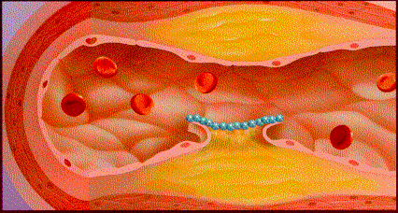
Platelet function
Adhesion
Platelet
(vWF)
(GP Ia, GP VI)
Collagen
GP Ib-IX-V
(vW Factor)
GP IIb-IIIa
(Fibrinogen, vWF)

Slide 17
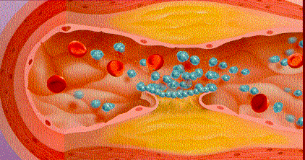
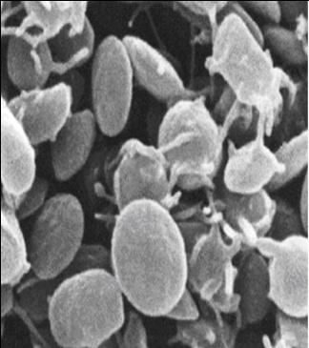
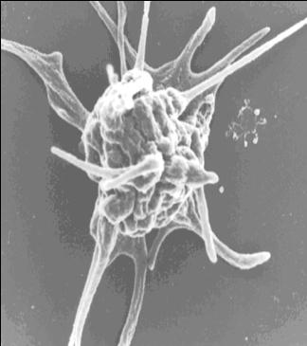
Platelet function
Activation

Slide 18
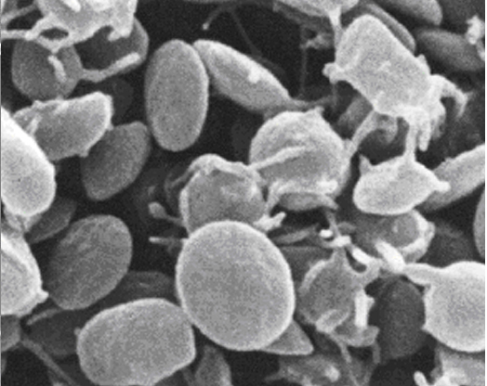
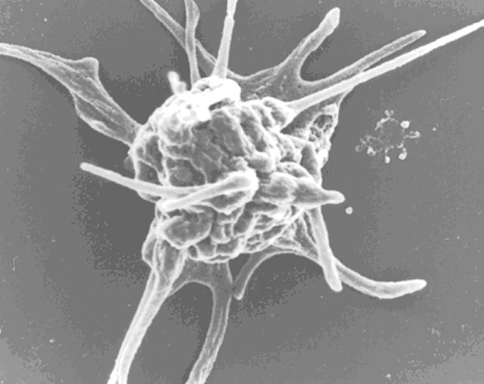
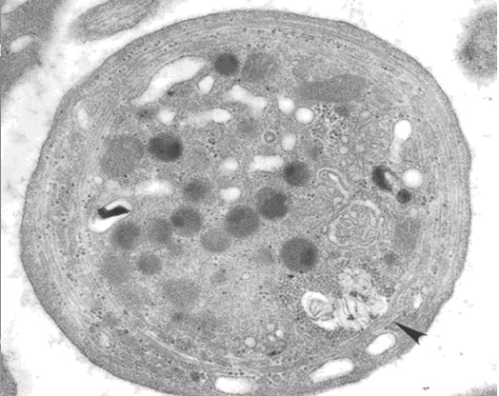
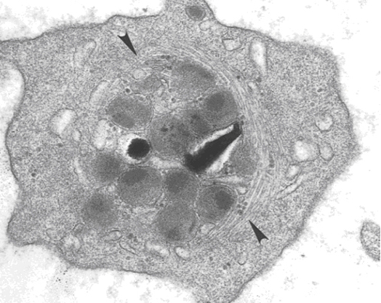
Resting platelet
Activated platelet

Slide 19
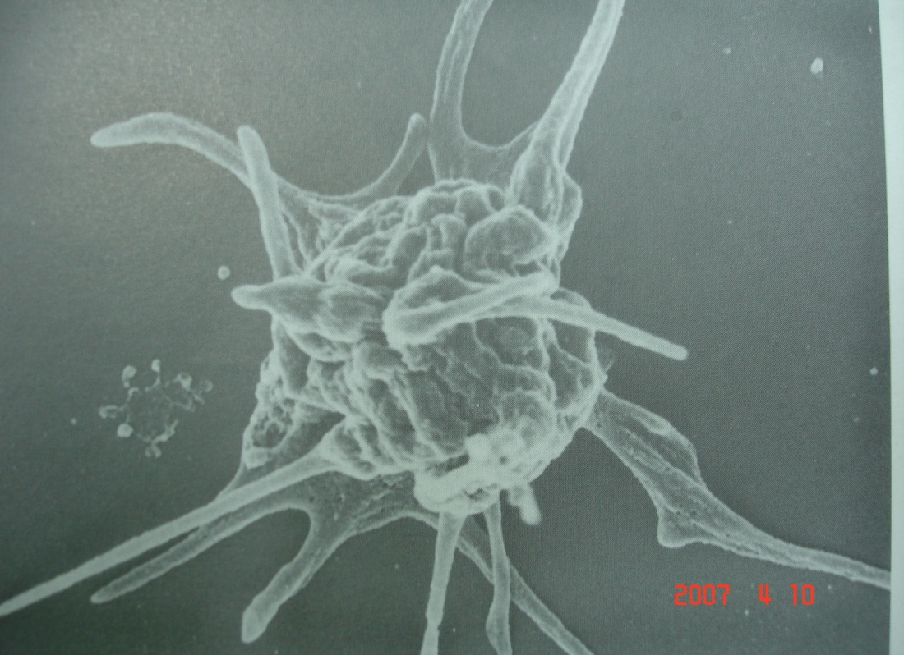
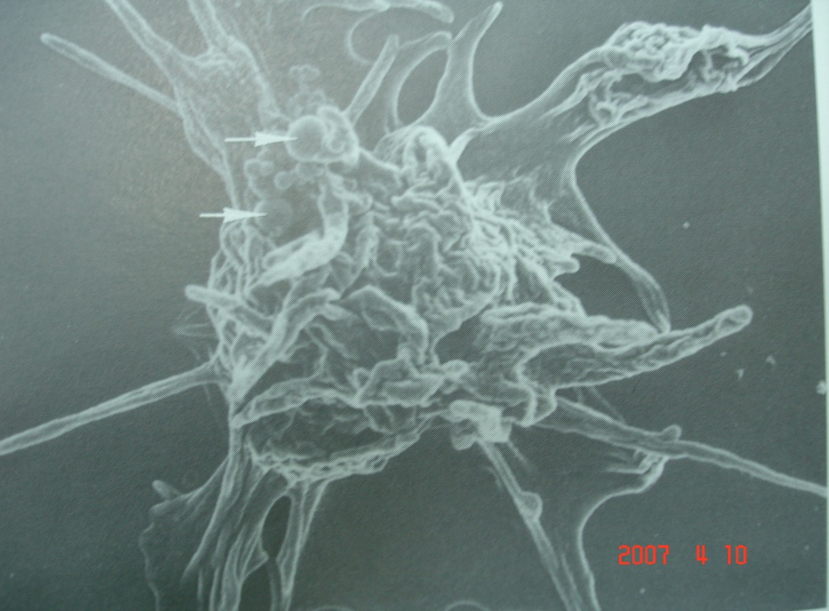
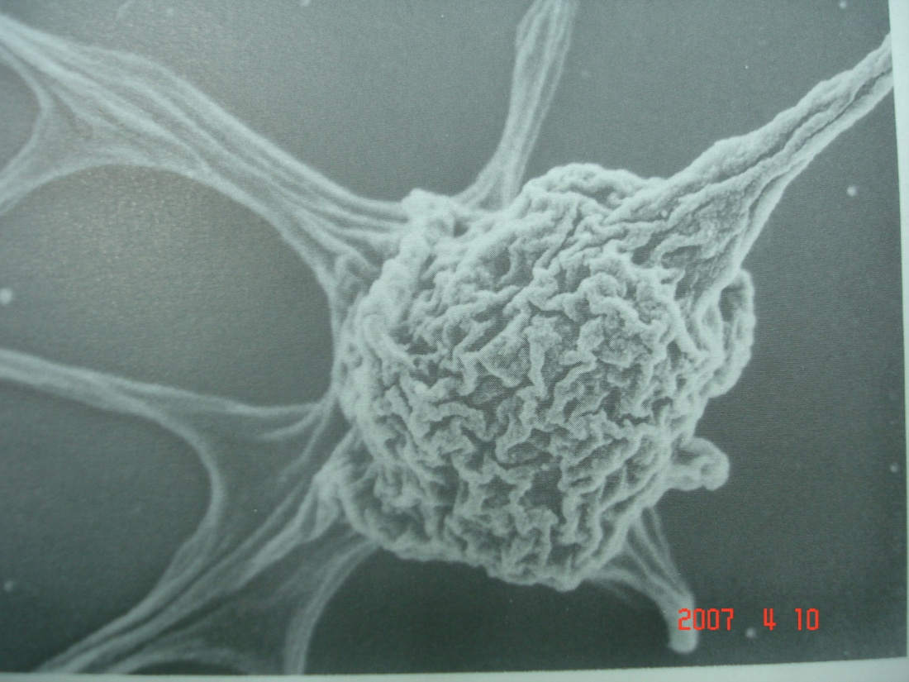
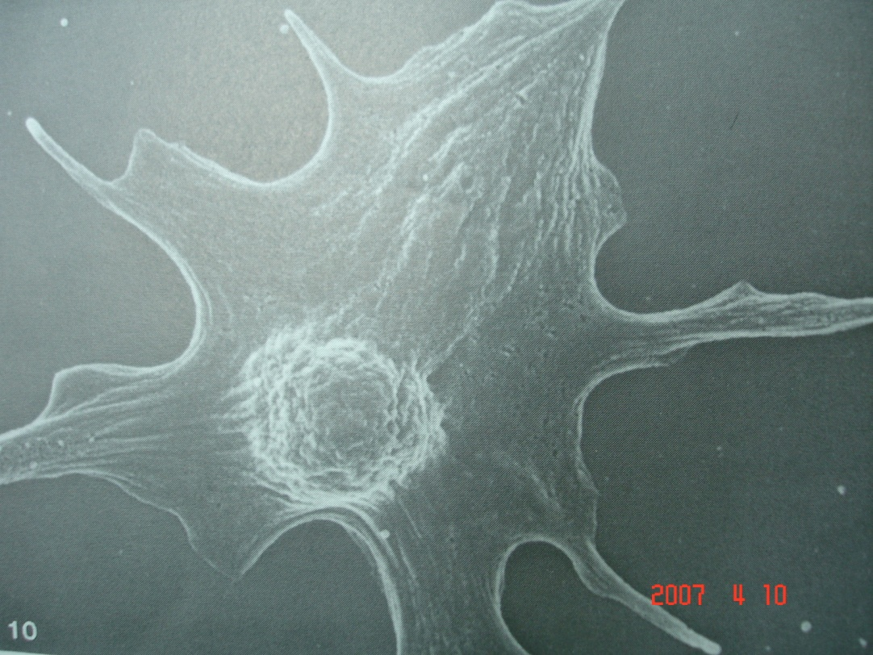
Smooth surface
psuedopods
Convolutions
Spread to psuedopods
Convolutions
In body
Further Spread of
Convolutions to psuedopods
Early
Spread platelet
Notes:
19

Slide 20
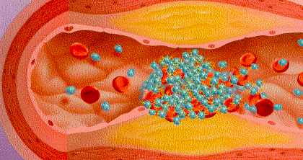
Platelet function
Platelet
(GP Ia, GP VI)
Collagen
GP Ib-IX-V
(vW Factor)
(TPα)
TXA2
GP IIb-IIIa
(Fibrinogen, vWF)
Aggregation
(P2Y₁₂)
ADP
Aggregation:
Fibrinogen is needed to join platelets to each other via platelet fibrinogen receptors

Slide 21
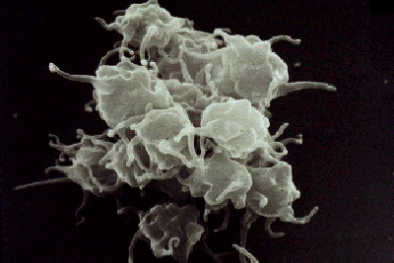
Platelet Aggregation
Resting platelet
Activated platelet
Fibrinogen
Agonist
GP IIb/IIIa receptors
(unreceptive state)
Aggregating platelets

Slide 22
von Willebrand factor (vWF) and Platelet Adhesion
Blood Flow
vWF
Platelet
Fibrinogen
A1 domains
GPIb- IX-V
Plug
Formation
Adhesion
Rolling
Activation
Recruitment
Notes:
22

Slide 23
Platelet function
TXA2
ADP
Secretion

Slide 24
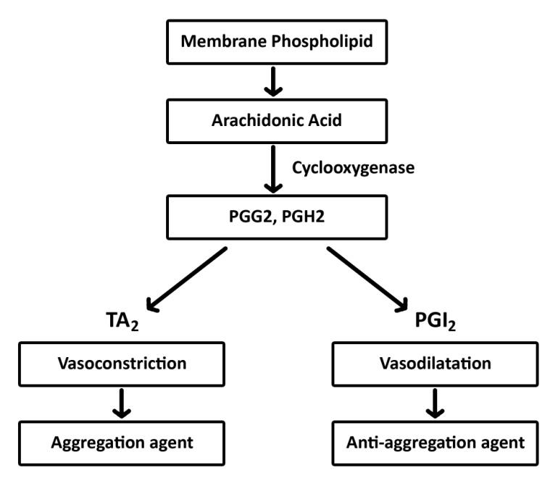

Slide 25
Activated Platelets
Secrete:
  5HT (serotonin)→ vasoconstriction
  Platelet phospholipid (PF3) → clot formation
  Thromboxane A2 (TXA2) is a prostaglandin formed from arachidonic acid
  Function:
  Vasoconstriction
  Platelet aggregation
  (TXA2 inhibited by aspirin)

Slide 26
Clot Retraction
Myosin, actin filaments and thrombosthenin in platelets are stimulated to
contract during aggregation
further reinforcing the plug
and help release of
granule contents

Slide 27
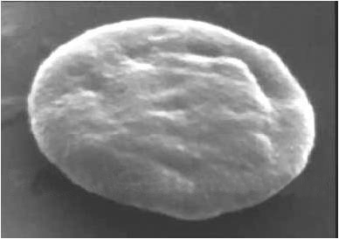
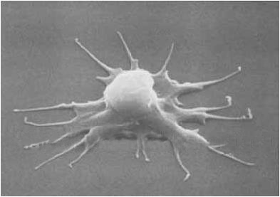
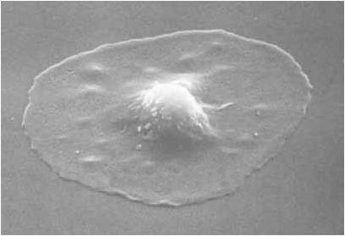

Slide 28
Platelet haemostatic plug formation
Platelets activated by adhesion
Extend projections to make contact with each other
Release:
thromboxane A2, serotonin & ADP >>> activating other platelets
Serotonin & thromboxane A2 are vasoconstrictors decreasing blood flow through the injured vessel.
ADP causes stickiness and enhances aggregation

Slide 29
Platelet Activation- summary
Platelets are activated when brought into contact with collagen exposed when the endothelial blood vessel lining is damaged
Activated platelets release a number of different coagulation and platelet activating factors
Transport of negatively charged phospholipids to the platelet surface; provide a catalytic surface for coagulation cascade to occur
Platelets adhesion receptors (integrins): Platelets adhere to each other via adhesion receptors forming a hemostatic plug with fibrin
Myosin and actin filaments in platelets are stimulated to contract during aggregation further reinforcing the plug and help release of granule contents
GPIIb/IIIa: the most common platelet adhesion receptor for fibrinogen and von Willebrand factor (vWF)

Slide 30
General functions of the platelets:
Platelet plug formation
Platelets and blood coagulation

Slide 31
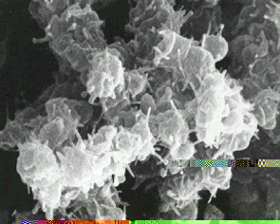
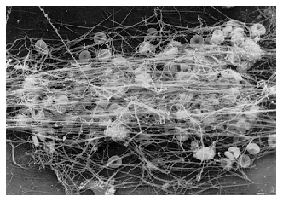
Maintenance of vascular integrity
Adequate number
and function of platelet
is essential to participate
optimally in
hemostasis
Initial arrest of bleeding by
platelet plug formation
Stabilization of hemostatic plug
by contributing to fibrin formation

Slide 32
Bleeding Disorders
• Bleeding can result from:
– Platelet defects:
Deficiency in number (thrombocytopenia)
Defeciency in function (acquired or congenital)

Slide 33
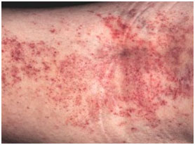
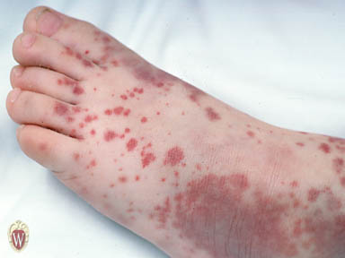
Platelet function
Bleeding disorders
abnormal number
or function of platelet

Slide 34
Congenital Platelet Disorders
Disorders of Adhesion:
. Bernard-Soulier Syndrome
Disorder of Aggregation:
. Glanzmann thrombosthenia
Disorders of Granules:
. Grey Platelet Syndrome
. Storage Pool deficiency
. Hermansky-Pudlak syndrome
.Chediak-Higashi syndrome

Slide 35
Bernard-Soulier Syndrome
Platelet
Collagen
(GP Ia, GP VI)
GP Ib-IX-V
(vW Factor)
TXA2
GP IIb-IIIa
(Fibrinogen, vWF)
ADP

Slide 36
Bernard-Soulier Syndrome
Platelet
(vW Factor)
Collagen
(GP Ia, GP VI)
TXA2
GP IIb-IIIa
(Fibrinogen, vWF)
ADP

Slide 37
Glanzmann Thromasthenia
Platelet
Collagen
(GP Ia, GP VI)
GP Ib-IX-V
(vW Factor)
TXA2
GP IIb-IIIa
(Fibrinogen, vWF)
ADP

Slide 38
Glanzmann Thromasthenia
Platelet
Collagen
(GP Ia, GP VI)
GP Ib-IX-V
(vW Factor)
TXA2
ADP

Slide 39
Glanzmann Thrombasthenia
Fibrinogen
IIb-IIIa
Normal
No Gp IIb-IIIa Receptors
Notes:
39

Slide 40
How to investigate for platelet disorders?
Platelet function tests

Slide 41
Laboratory Testing of Platelet Functions
Platelet count (& shape)
Bleeding time
Platelet Aggregation
Platelet Function Analyzer (PFA-100)
Flow-cytometry
Electron-microscopy
Granule release products
White GC et al. Approach to the Bleeding Patient. In Colman, RW et al. Hemostasis and thrombosis 2nd ed. 1987

Slide 42
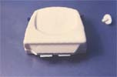
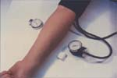

Bleeding Time

Slide 43
Laboratory Testing of Platelet Functions
Platelet Aggregometer (in PRP):
  Provides information on time course of plat. activation.
  Agonists:
    ADP
    Adrenaline
    Collagen
    Arachidonic acid
    Ristocetin
    Thrombin
  Reference ranges need to be determined for each agonist (+ Dose responses)

Slide 44



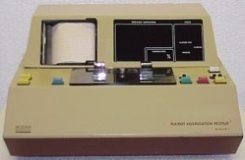
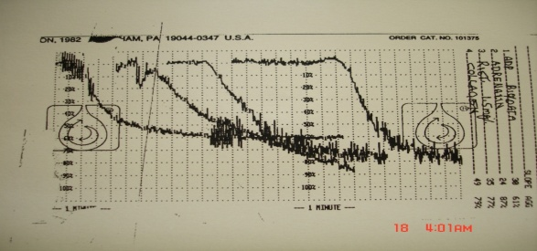
Platelet Aggregation
  Agonists:
    ADP
    Adrenaline
    Collagen
    Arachidonic acid
    Ristocetin
    Thrombin
Whole
blood
RBC
PRP

Slide 45
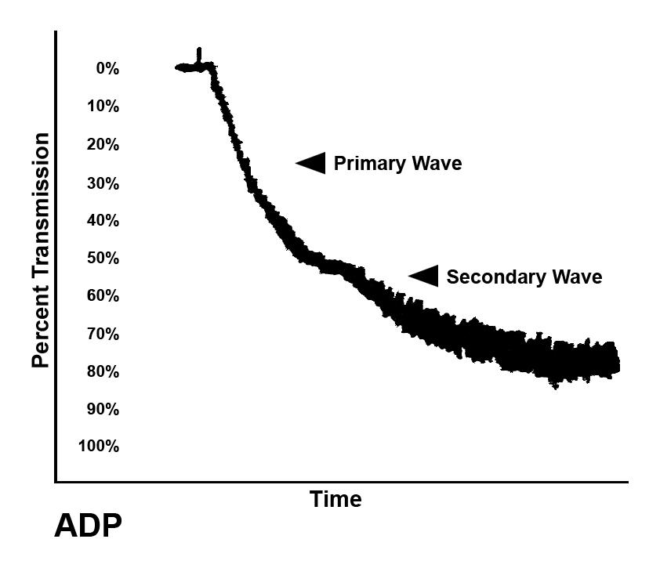
Normal Platelet Aggregation

Slide 46
Summary
Platelets are cell fragments derived from megakaryocyte in the bone marrow
Platelets play a pivotal role in hemostasis by arresting bleeding from injured blood
Vessels
Bleeding can result from: Platelet defects
acquired or congenital

Slide 47

THE END

