Slide 1
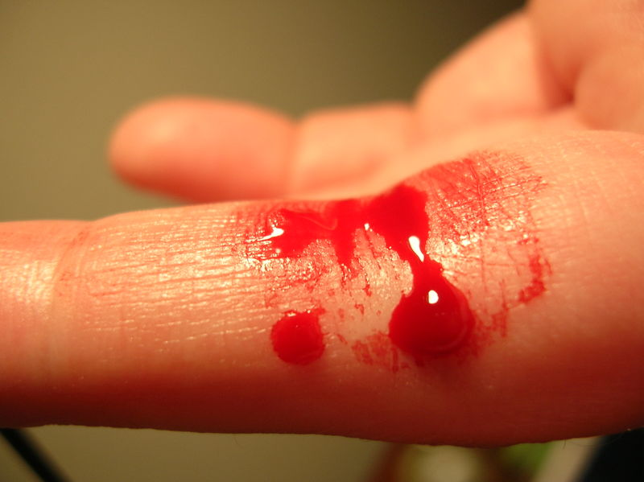
Coagulation Mechanisms
TEXTBOOK OF MEDICAL PHYSIOLOGY
GUYTON & HALL 11TH EDITION
UNIT VI CHAPTER 36
Dr Mohammed Alotaibi
MRes, PhD (Liverpool, England)
Assist. Professor
Department of Physiology
College of Medicine
King Saud University

Slide 2
Objectives
At the end of this lecture student should be able to:
Recognize the different clotting factors
Understand the role of calcium ions during clotting cascades.
Describe the cascades of intrinsic and extrinsic pathways for clotting.
Recognize process of fibrinolysis and function of plasmin
Recognize some conditions causing excessive bleeding
Understand some important anticoagulants and their mechanism of action

Slide 3
Mechanism of Blood Coagulation
• A crucial physiological balance exists between factors promoting coagulation (procoagulants) and factors inhibiting coagulation (anticoagulants).
• Coagulation of blood depends on the balance between these two factors.
• Disturbances in this balance could lead to thrombosis or bleeding

Slide 5
Hemostasis:
prevention or stoppage of blood loss.
Hemostatic Mechanisms:
Vessel wall (Vasoconstriction)
Platelets (Production and activation, Platelets Plug formation)
Blood coagulation
Clot formation (intrinsic & extrinsic pathways)
4. Fibrinolysis

Slide 6
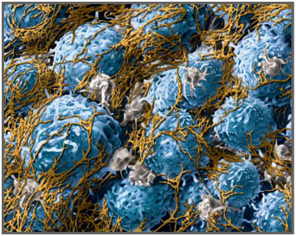
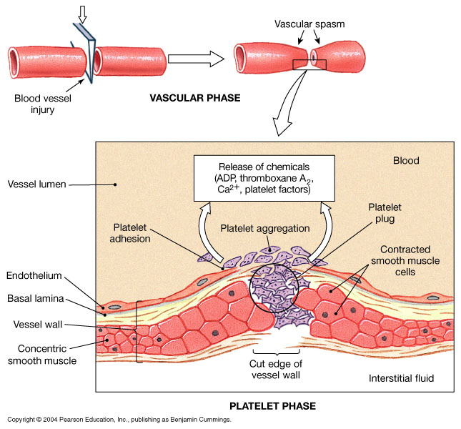
Coagulation: Formation of fibrin meshwork (Threads) to form a
CLOT

Slide 7
Clotting Factors
Names | Factors
Fibrinogen Prothrombin Thromboplastin (tissue factor) Calcium Labile factor Stable factor Antihemophilic factor A Antihemophilic factor B Stuart-Prower factor Plasma thromboplastin antecedent (PTA) Hageman factor Fibrin stablizing factors | I II III IV V VII VIII IX X XI XII XIII

Slide 8
Activated Factor X
Prothrombin activator
Prothrombin Thrombin
Fibrinogen
Fibrin

Slide 9
The Coagulation Cascades
Intrinsic pathway
Extrinsic pathway
Activators:
Collagen and damaged endothelium
Common pathway
Activator:
Tissue factor (III) (Thromboplastin)
XII XII activated
X X activated
V, Ca,
Phospholipids
VII VII activated
XI XI activated
III,
Ca,
Phospholipids
Prothrombin activator
Ca
IX IX activated
Prothrombin Thrombin
VIII, Ca,
Phospholipids
Fibrinogen Fibrin monomer
12-16 seconds
XIII
Ca
3-6 minutes
Fibrin fibers polymers (Insoluble)

Slide 10
Thrombin
Thrombin changes fibrinogen to fibrin
Thrombin is essential in platelet morphological changes to form primary plug
Thrombin stimulates platelets to release ADP & thromboxane A2; both stimulate further platelets aggregation
Activates factor V, VIII, XIII

Slide 11
Blood coagulation (clot formation)
A series of biochemical reactions leading to the formation of a blood clot within few seconds after injury
Prothrombin (inactive thrombin) is activated by a long intrinsic or short extrinsic pathways
This reaction leads to the activation of thrombin enzyme from inactive form prothrombin
Thrombin will change fibrinogen (plasma protein) into fibrin (insoluble protein)

Slide 12
Intrinsic pathway
The trigger is the activation of factor XII by contact with foreign surface, injured blood vessel, and glass.
Activated factor XII will activate factor XI
Activated factor Xl will activate IX
Activated factor IX + factor VIII + platelet phospholipid factor (PF3)+ Ca activate factor X
Following this step the pathway is common for both intrinsic and extrinsic

Slide 13
Extrinsic pathway
Triggered by material released from damaged tissues (tissue thromboplastin)
Tissue thromboplastin + VII + Ca → activate X
Common pathway
Activated factor X + factor V +PF3 + Ca activate prothrombin activator; a proteolytic enzyme which activates prothrombin.
Activated prothrombin activates thrombin
Thrombin acts on fibrinogen and change it into insoluble thread like fibrin.
Factor XIII + Ca → strong fibrin (strong clot)

Slide 14
Activation of Blood Coagulation
Intrinsic Pathway: all clotting factors present in the blood
Extrinsic Pathway: triggered by tissue factor (thromboplastin)
Common Pathway

Slide 15
Fibrinolysis
Formed blood clot can either become fibrous or dissolved.
Fibrinolysis (dissolving) = Break down of fibrin by naturally occurring enzyme plasmin therefore prevent intravascular blocking.
There is a balance between clotting and fibrinolysis
Excess clotting → blocking of Blood Vessels
Excess fibrinolysis → tendency for bleeding

Slide 16
Streptokinase
Released from healed tissues and vascular endothelium
Urokinase
Fibrinolysis
Tissue Plasminogen Activator (t-PA)
Plasminogen
Plasmin
(Protein in the blood)
Fibrinolysis
Fibrinogen
Fibrin
Thrombin
FDP*
FDP*: Fibrin Degradation Products

Slide 17
Plasmin
Plasmin is present in the blood in an inactive form plasminogen
Plasmin is activated by tissue plasminogen activators (t-PA) in blood.
Plasmin digests intra & extra vascular deposit of Fibrin → fibrin degradation products (FDP)
Unwanted effect of plasmin is the digestion of clotting factors
(α₂-antiplasmin or plasmin inhibitor) is responsible for inactivating plasmin

Slide 18
Prevention of blood clotting in the normal vascular system
Endothelial surface factors
Smoothness of the ECs.
Glycocalyx layer
Thrombomodulin protein
Fibrin fibers, adsorbs ~ 90% of thrombin to removes it from circulating blood
Antithrombin III, combines the remaining thrombin and removes it from blood
Heparin, combines with Antithrombin III and quickly removes thrombin from blood
- Liver, lungs, mast cells, basophils

Slide 19
Anticoagulants
Anticoagulants for clinical use:
Heparin
- Commercial, extracted from animals
Coumarins
- Warfarin, competitive with vitamin K
- decrease Factors II, VII, IX, X
Prevention of blood coagulation outside the body:
(decrease calcium ion concentration)
Oxalate (precipitation, toxic )
Citrate (deionizer)
EDTA (Chelating agent)

Slide 20
Conditions that cause excessive bleeding
Vitamin K Deficiency
Factor II, Factor VII, Factor IX, Factor X require vitamin K for their synthesis
Hepatitis, Cirrhosis, acute yellow atrophy AND GI disease
Hemophilia
↑ bleeding tendency.
Affects males.
85% due to Factor VIII deficiency (hemophilia A), and 15% due to Factor IX deficiency (hemophilia B).
Thrombocytopenia
Very low number of platelets in blood (< 50,000/μl)
Thrombocytopenia purpura, hemorrhages throughout all the body tissues
Idiopathic Thrombocytopenia, unknown cause.

Slide 21
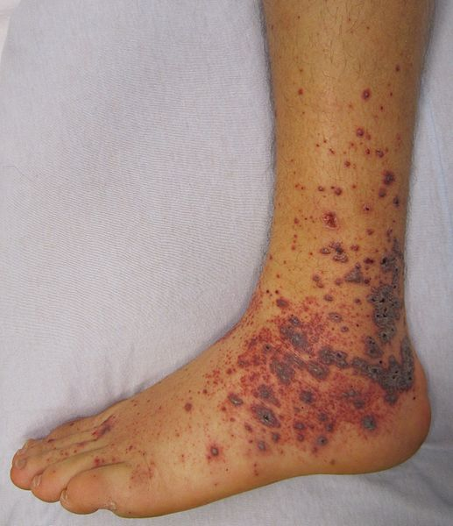
The END
Thrombocytopenia purpura

