Slide 1
The Immune System and Endocrine Disorders
Immunology Unit
College of Medicine
King Saud University

Slide 2
Objectives
To understand the mechanisms involved in immunological damage to the endocrine glands.
To know about various endocrine disorders such as Graves’ disease, hashimoto’s thyroiditis, type I diabetes and Addison’s disease resulting from autoimmunity.
To describe the association of certain auto-antibodies with regards to their pathogenic and diagnostic importance.

Slide 3
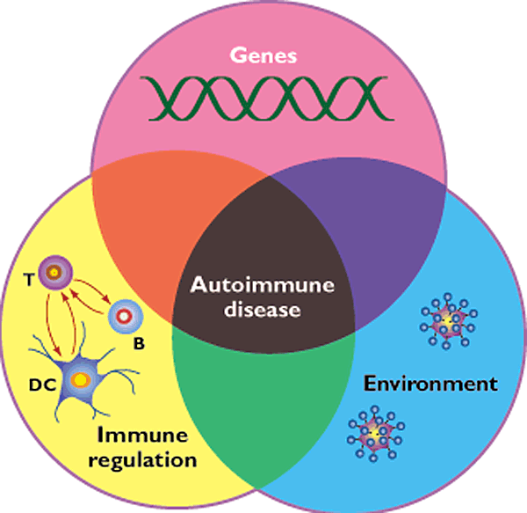

Slide 4
Thyroid Gland
Graves’ Disease
Hashimoto’sThyroiditis

Slide 5
Central Nervous System
Hypothalamus
Pituitary Gland
Target Tissues
Thyroid Gland
Autoantibodies
Thyroid Releasing Hormone (TRH)
Thyroid Stimulating Hormone (TSH)
Thyroid Hormones (T3 and T4)

Slide 6
Apoptosis of Thyrocyte
Thyroid
Thyroid
Thyrocyte
Insult
Radicals, cytokines
Cytotoxicity
Autoantibodies
Presentation of thyroid-specific antigens by the insulted thyrocytes to APCs and processing of these antigens by APCs
B cells
Macrophages
T cells
Infiltration and accumulation of cells
Draining Lymph node
Infiltration
Antigen presentation
Induction of anti-thyroid antibody production
APC
Environmental Triggers such as viruses, toxins etc.
Auto-reactive T cell
B-cell
Breakdown of immune tolerance

Slide 7
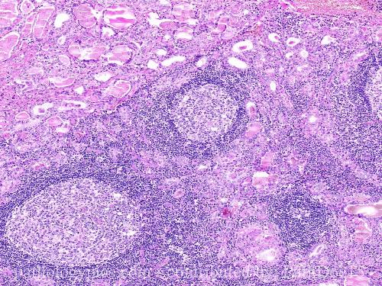
Hashimoto’s Thyroiditis

Slide 8
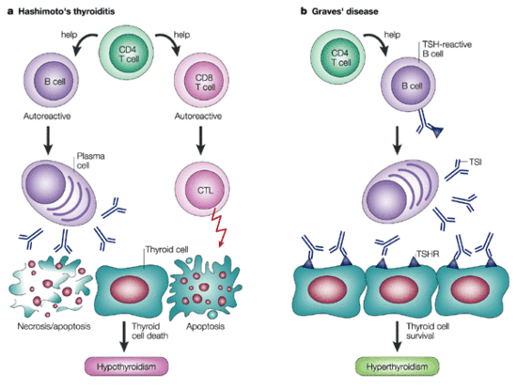

Slide 9
Anti Thyroid Antibodies
Graves’ Disease (Hyperthyroidism)
Thyroid Stimulating Immunoglobulin (TSH receptor antibodies)
Binds and activates TSH receptor in Thyroid
Seen in Hyperthyroidism: Grave's Disease

Slide 10
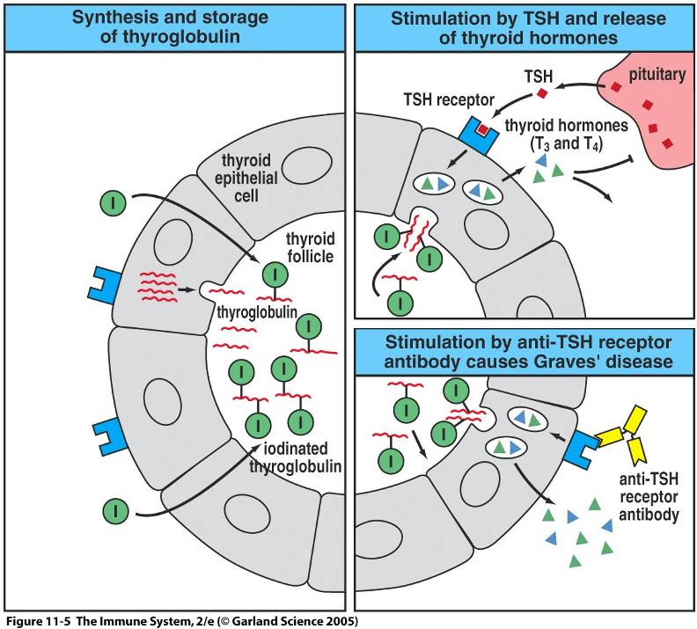

Slide 11
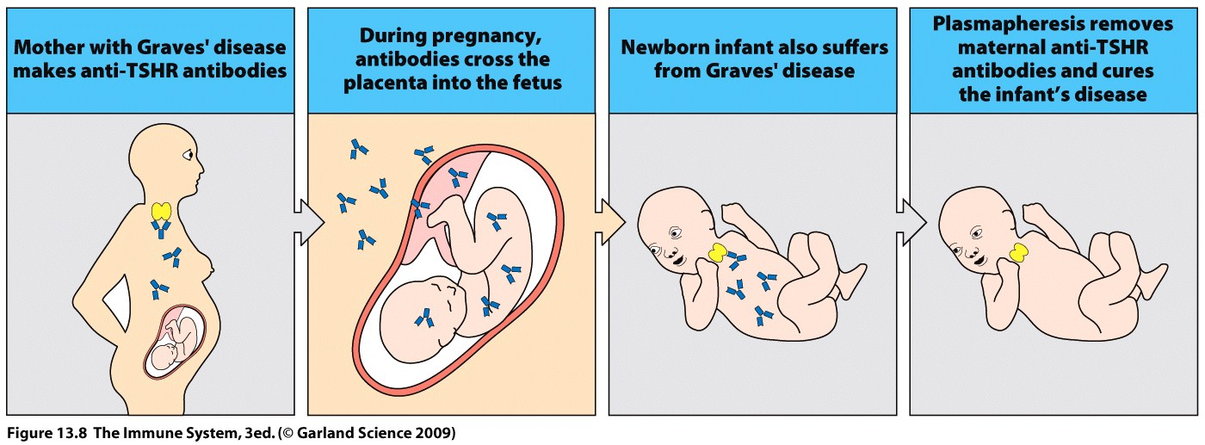
Mother with Graves’ disease makes thyroid stimulating hormone receptor antibodies

Slide 12
Hashimoto’s thyroiditis
Anti-thyroid Microsomal Antibody
(Tissue destruction and blocking antibodies)
Present in Hypothyroidism
Hashimoto's thyroiditis
Anti-thyroglobulin Antibody
Seen in Hashimoto's Thyroiditis
Less commonly elevated compared with thyroid microsomal antibody

Slide 13
Anti Microsomal Antibodies
Microsomes are found inside thyroid cells
The body produces antibodies to microsomes when there has been damage to thyroid cells
Alternative Names
Thyroid anti-microsomal antibody
Anti-microsomal antibody
Microsomal antibody
Thyroid peroxidase antibody (TPOAb)

Slide 14
Anti Microsomal Antibodies
The thyroid microsomal antigen has been shown to be the enzyme thyroid peroxidase (TPO)
TPO is a membrane-bound enzyme and plays a significant role in the biosynthesis of thyroid hormones
Autoantibodies produced against TPO are capable of inhibiting the enzyme activity

Slide 15
Anti Microsomal Antibodies
Antibodies to TPO have also been found in:
- More than 90% patients with autoimmune thyroiditis (Hashimoto's thyroiditis)
- 50% of patients with Graves' disease
- Less frequently in patients with other thyroid disorders
Low titers may also be found in 5-10 percent of normal individuals

Slide 16
Anti Thyroglobulin Antibodies
Thyroglobulin Antibodies are directed against the glycoprotein thyroglobulin located in the thyroid follicles
90 percent of patients with Hashimoto's thyroiditis have thyroglobulin or thyroid microsomal antibodies

Slide 17
Pancreas
Type I Diabetes mellitus

Slide 18
Type 1 Diabetes mellitus
Autoimmune destruction of the beta cells in the pancreas which produce insulin
Requires insulin administration for controlling high blood sugar levels

Slide 19
Type 1 Diabetes mellitus
Predisposition
Genetic (HLA DRB, DQA, DQB)
Viral infections
Stress
Environmental exposure - exposure to certain chemicals or drugs
Immunological destruction of beta cells of pancreas
10% chance of inheriting if first degree relative has diabetes
Most likely to inherit from father

Slide 20
Viruses
Infection introduces a viral protein that resembles a beta cell protein
Cross-reacting T-cells and antibodies because of molecular mimicry attack beta cell proteins and virus
Cow’s milk
Certain protein which may trigger attack on beta cells (molecular mimicry)

Slide 21
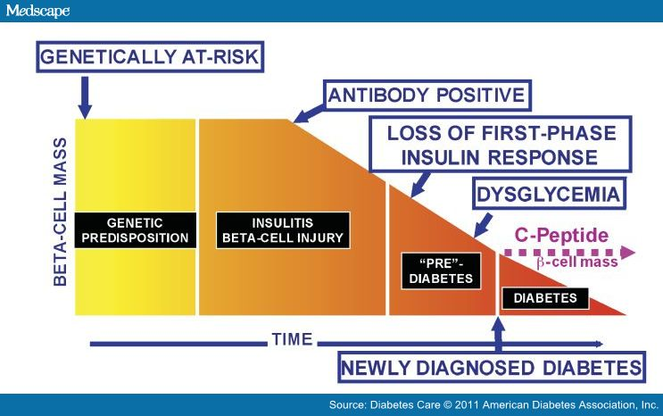
Development of Type I diabetes mellitus

Slide 22
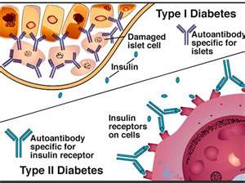
Immunological damage in diabetes

Slide 23
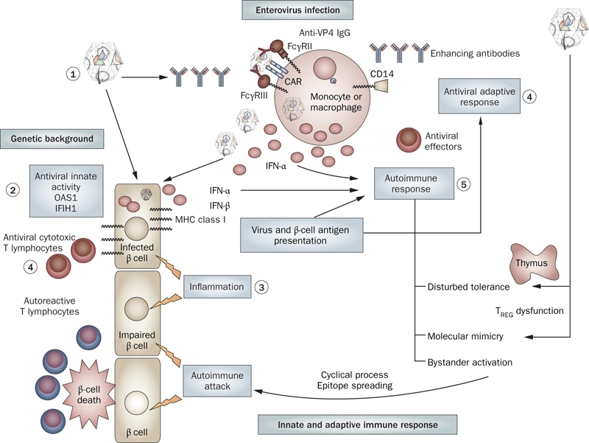
Innate antiviral activity

Slide 24
Diabetes
Four auto-antibodies are markers of beta cell autoimmunity in type 1 diabetes :
Islet Cell Antibodies (ICA), against cytoplasmic proteins in the beta cell found in 75-90% patients
Antibodies to Glutamic Acid Decarboxylase 65 (GAD65) in 80% of patients
Insulin Auto-antibodies (IAA) is the first marker found in 70% of children at the time of diagnosis
IA-2A, to protein tyrosine phosphatase found in 54-75% of patients

Slide 25
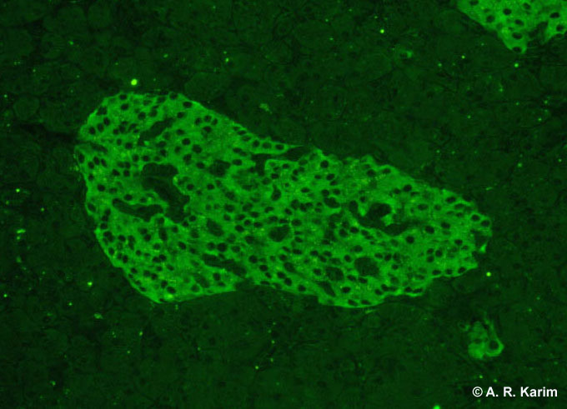
Islet cell antibody (Immunofluorescence)

Slide 26
Differential Diagnosis
Type 1 diabetes may be diagnosed by the presence of one or more auto-antibodies
People who screen positive for one or more auto-antibodies may not necessarily develop diabetes
Risk of having type 1 diabetes is proportional to titer of antibodies

Slide 27
Interpretation
Antibodies may be present several years before a patient develops hyperglycemia
Presence of auto-antibodies impair insulin response

Slide 28
Limitations
Auto-antibodies may disappear months or years later without the development of diabetes
Since insulin-treated patients develop insulin antibodies, analysis of IAA is not useful in insulin-treated patients
Antibodies may be transferred trans-placentally to infants of type 1 diabetic mothers so caution must be used for interpretation

Slide 29
Anti-insulin antibodies
Anti-insulin antibodies either of IgG and/or IgM class against insulin are elevated and this may make insulin less effective or neutralize it IgG: is the most common type of anti-insulin antibody IgM: may cause insulin resistance IgE: may be responsible for allergic reactions

Slide 30
Disease associations
About 10% patients with Type 1 diabetes are prone to other autoimmune disorders such as:
Graves’ disease
Hashimoto’s thyroiditis
Addison’s disease
Pernicious anemia

Slide 31
Autoimmune adrenocortical failure or Addison's disease
It develops as a consequence of autoimmune destruction of steroid-producing cells in the adrenal gland
75 to 80% of all cases of adrenal insufficiency or Addison’s disease are of autoimmune origin with circulating anti-adrenal antibodies
The damage is probably mediated by T cells and the role of antibodies is unclear

Slide 32
Adrenal antibodies
Adrenal antibodies are also known as adrenocorticol antibodies (ACA)
Antibody to 21-Hydroxylase an enzyme involved in biosynthesis of cortisol and aldosteron is the best marker of autoimmune Addison's disease,
Other antibodies rarely tested are:
17 alpha hydroxylase
Cytochrome P450

Slide 33
Take home message
Graves’ disease is caused by stimulating antibodies
Hashimotos thyroiditis is associated with tissue damage mediated by proinflammatory cells and antibodies directed to self antigens in thyroid gland
Type I diabetes mellitus results from immune mediated destruction of beta cells in pancreas and a number of auto-antibodies can be detected in patients
In majority of patients with Addison’s disease evidence of auto-immunity can be detected by the presence of anti-adrenal antibodies

