Slide 1
Endocrine practical block
Dr Shaesta Naseem
12-2-14

Slide 2
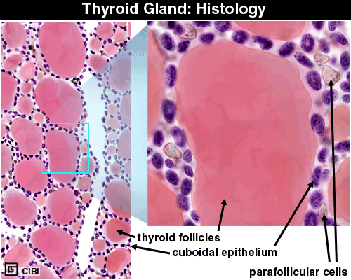
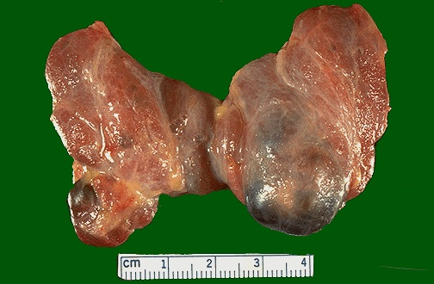
Normal anatomy of thyroid gland
15-25 grams
Notes:
The normal weight of the thyroid, in grams, is also the same as its 24 hour radioactive iodine uptake percentage. Why? Ans: Because it take up 1% per gram.

Slide 3
Gross and histopathology
1- Multinodular goiter

Slide 4
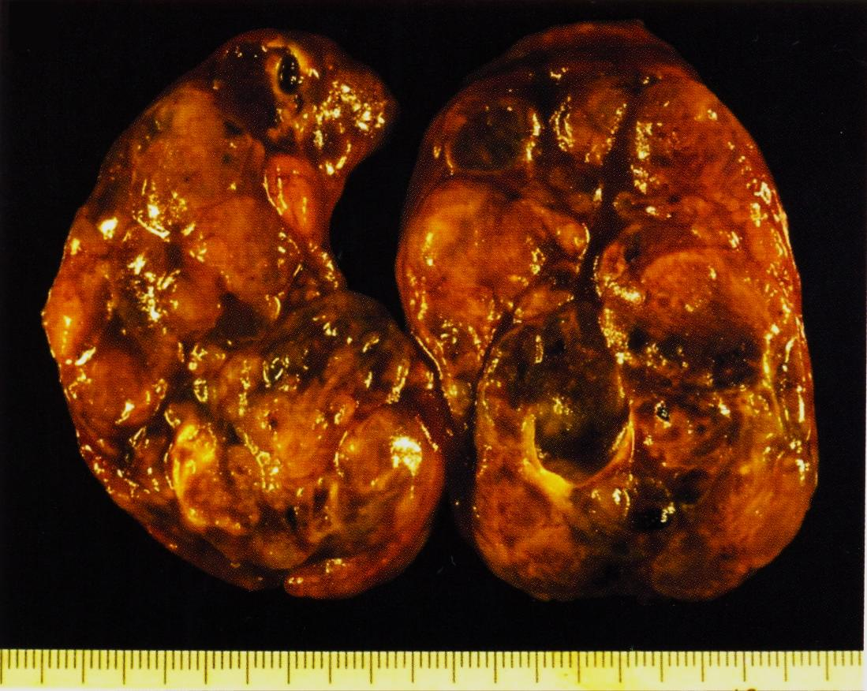
Multinodular Goiter
Asymmetric enlargement
Multinodular
Haemorrhage
Cystic degeneration
Goiter is the clinical term of thyroid enlargement, mostly caused by lack of iodine in water and food supply

Slide 5
Multinodular Goiter
Numerous follicles varying in size filled with colloid.
We can also see
Recent haemorrhage
Haemosiderin laden macrophages
Cystic degeneration
Calcification

Slide 6
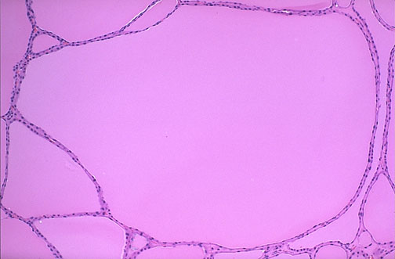
Multinodular Goiter
The follicles are irregularly enlarged, with flattened lining epithelium and filled with increased colloid

Slide 7
2- Thyrotoxicosis

Slide 8
HYPER-THYROIDISM
HYPERMETABOLISM
Tachycardia, palpitations
Decreased or low TSH and Increased T3, T4
Exophthalmos
Tremor
GI hypermotility
Thyroid “storm”, life threatening

Slide 9
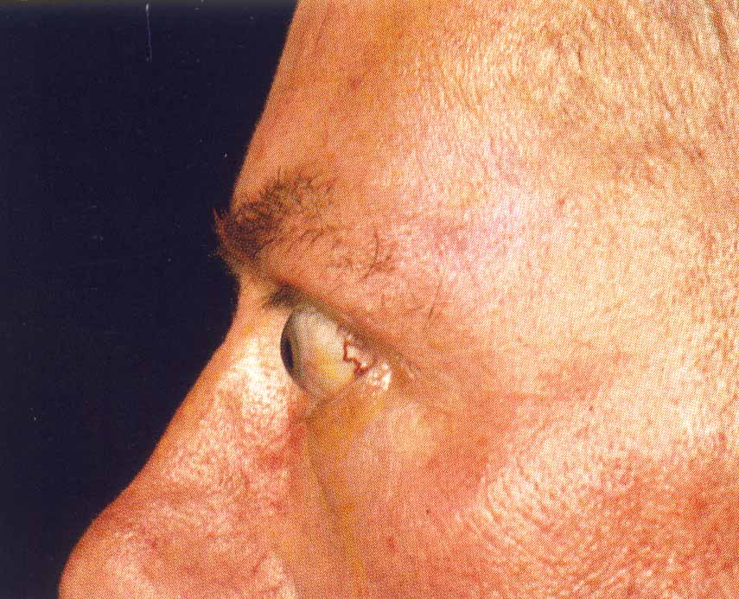
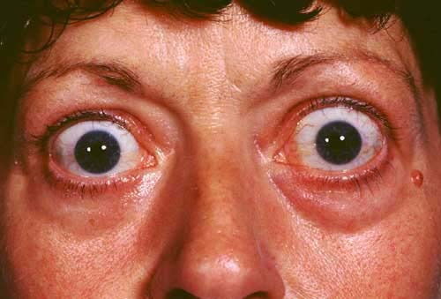
“Exophthalmos”
Protrusion of the eye globes with retraction of the eyelids caused by increased retro-orbital connective tissue

Slide 10
Graves Disease/ Thyrotoxicosis
It is an auto immune disease.
The patient can have elevated T3 and T4 with depressed TSH
Grossly, there is symmetrical enlargement of thyroid gland
Cut-surface is homogenous, soft and appear meaty

Slide 11
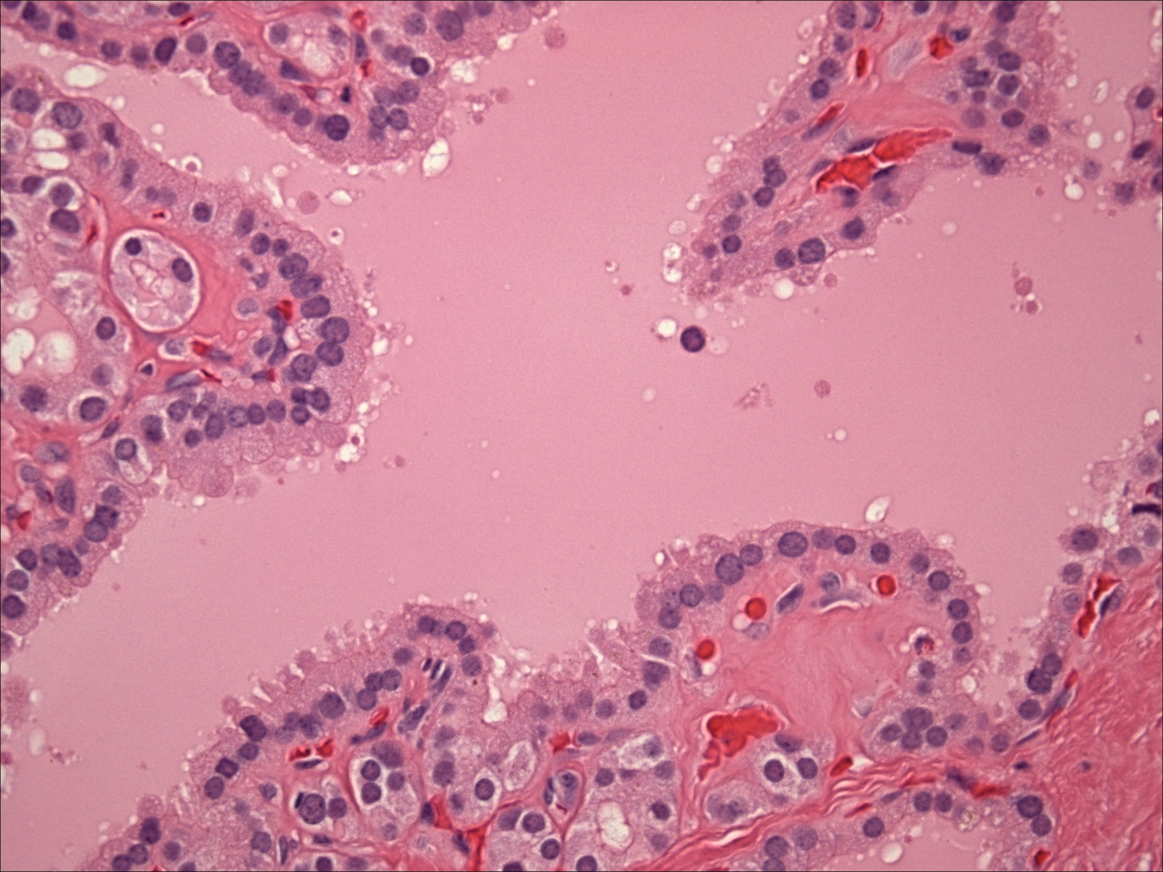
Section shows thyroid follicles lined by columnar and high cuboidal cells with evidence of peripheral vacuoles and intrafollicular colloid material. Lymphocytic infiltration of the thyroid gland is sometimes seen in thyrotoxicosis
Notes:
Note the presence of peripheral smaller thyroid follicles devoid of colloid but lined by similar cells .

Slide 12
3- Hashimotos thyroiditis

Slide 13
Hashimoto Thyroiditis
Diffuse enlargement.
Firm or rubbery.
Pale, yellow-tan, firm & somewhat nodular cut surface

Slide 14
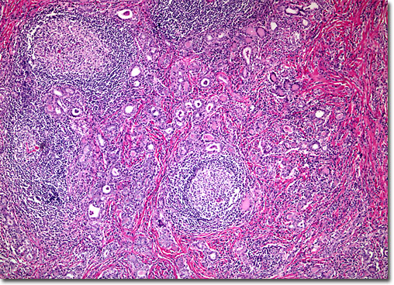
Notes:
The diagnosis of Hashimoto thyroiditis requires not only lymphoid follicles in the thyroid, but SECONDARY (i.e., germinal centers) follicles should be present. If the thyroid gland looks like a lymph node, the diagnosis is Hashimoto thyroiditis, Hashimoto = auto-immune

Slide 15
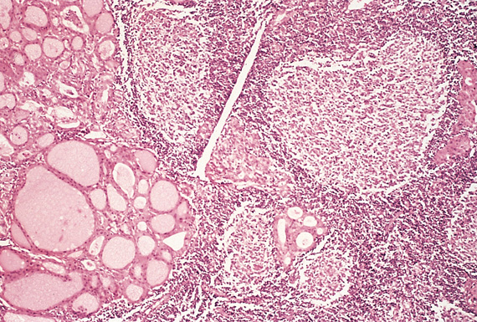
Hashimoto Thyroiditis
Massive lympho-plasmcytic infiltration with lymphoid follicles formation
Destruction of thyroid follicles
Remaining follicles are small and many are lined by Hurthle cells
Increased interstitial connective tissue

Slide 16
4- Follicular adenoma

Slide 17
Follicular Adenoma
Solitary
Variably sized
Encapsulated
Well-circumscribed
With homogenous gray-white to red-brown cut-surface
+/- degenerative changes

Slide 18
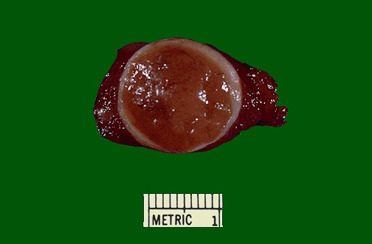
There is a well circumscribed light brown and circular tumor nodule which is surrounded by a thick and whitish capsule . The surrounding thyroid tissue is unremarkable . The features are consistent with a follicular adenoma of thyroid gland .
Notes:
EXTREMELY well encapsulated tumor. Benign. It is sometimes difficult to tell a well-differentiated follicular carcinoma from a follicular adenoma. Thus, patients with follicular neoplasm are treated with subtotal thyroidectomy just to be on the safe side.

Slide 19
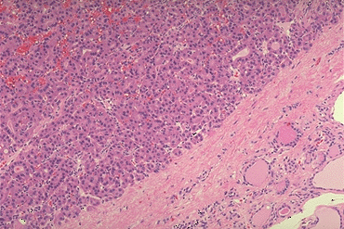
Proliferating small thyroid follicles containing colloid and showing benign features . It is surrounded by a fibrous capsule and compressed normal thyroid tissue
Notes:
EXTREMELY well encapsulated benign tumor. Excision is curative
This adenoma is a well- differentiated neoplasm because it closely resemble normal tissue. The follicles of the adenoma contain colloid, but there is greater variability in size than normal.

Slide 20
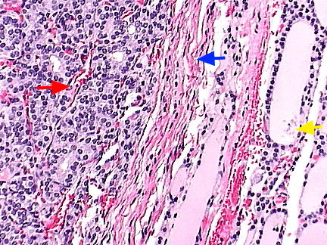

Slide 21
5- Papillary thyroid carcinoma

Slide 22
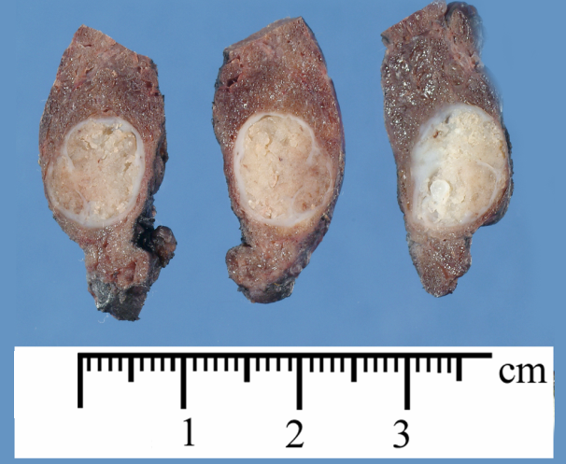
A well circumscribed pale and firm nodule showing a whitish cut surface with vague scattered papillary areas .
Notes:
This neoplasm can be multifocal, because of the propensity to invade lymphatics within thyroid, and lymph node metastases are common.

Slide 23
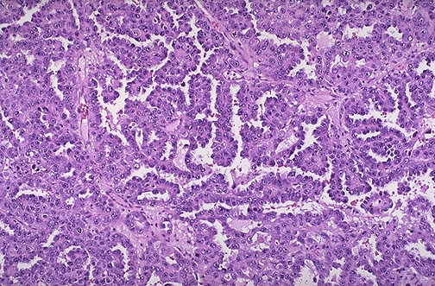
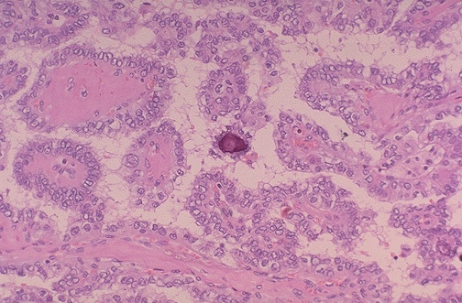
papillary neoplasm consisting of papillary fronds lined by overlapping clear nuclei ( Orphan Annie nuclei ). Calcified Psammoma bodies are also seen .
Notes:
Orphan Annie cells are seen in papillary carcinoma in which considerably cytoplasm has invaginated into the nucleus.

Slide 24
Papillary carcinoma of the thyroid gland.
Papillary structures.
Clear and overlapping nuclei lining the papillary areas.
Psammoma bodies
Serum calcitonin is normal in papillary thyroid carcinoma but is increased in cases of medullary carcinoma.

Slide 25
6--Pheochromocytoma

Slide 26
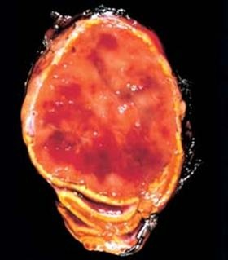
Pheochromocytoma
Well circumsribed medullary adrenal mass.
Tumour has a haemorrhagic cut surface.
Compressed adrenal cortex
Adrenal Gland
Notes:
The tumor is enclosed within an attenuated cortex and shows areas of haemorrhage. Arrow shows residual adrenal gland

Slide 27
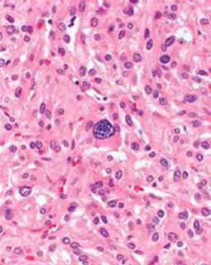
Pheochromocytoma
Nests of cells (Zellballen)
Pleomorphic cells with abundant eosinophilic cytoplasm and “salt and pepper” chromatin in some cells

Slide 28
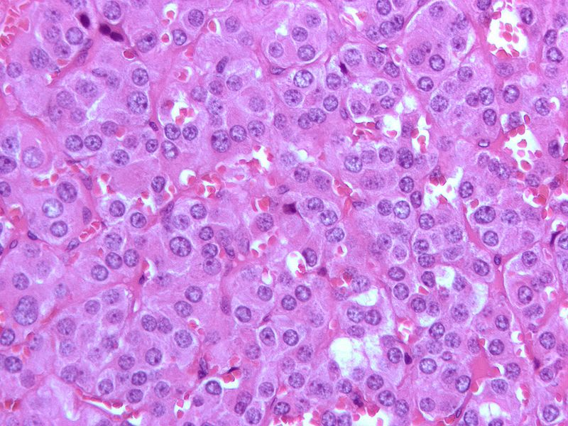
Characteristic nests of cells “Zellballen” seen.
The cells are polygonal to spindle shaped with abundant finely granular cytoplasm and nuclei with stippled ‘salt and pepper’ chromatin.

Slide 29
Laboratory test that help to confirm the diagnosis of pheochromocytoma:-
Increased urinary excretion of
Catecholamines,
Metanephrines and
VMA (Vanillyl mandelic acid ).

