Slide 1
THE THYROID GLAND
DR. Nervana Bayoumy

Slide 2
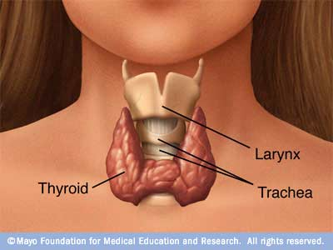

Slide 3
It is located below the larynx on either sides and anterior to the trachea.
The first recognized endocrine gland.
20g in adult.

Slide 4
HORMONES
T4 (tetraiodothyronine) (thyroxine) 90%.
T3 (Triiodothyronine)10%.
Reverse T3
Calcitonin.

Slide 5
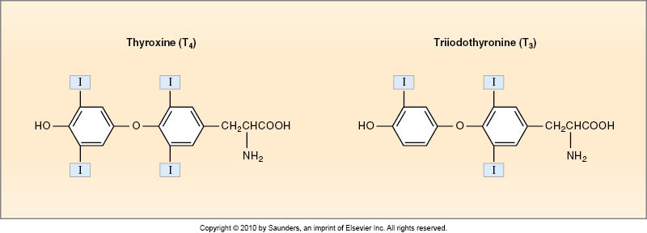

Slide 6
SYNTHESIS

Slide 7
THREE UNIQUE FEATURES
1- Contains a large amount of iodine.
- supplied in diet.
- 1mg/week.

Slide 9
2- Synthesis is partially intracellular and partially extracellular.
3- T4 is the major product.

Slide 10
STEPS of BIOSYNTHESIS

Slide 11
Thyroid Hormones [T3 - T4]
Biosynthesis: by the follicular cells
1- Iodide pump.
2- Thyroglobulin synthesis.
3- Oxidation of iodide to iodine.
4- Iodination of tyrosine, to form mono-iodotyrosine (MIT)
& di-iodotyrosine (DIT).
5- Coupling; MIT + DIT = Tri-iodothyronine, ( T3).
DIT + DIT = Tetra-iodothyronine, (T4)/ Thyroxine.
6- Release.
Notes:
(by protease enzyme & concentration gradient).

Slide 12
STEPS IN BIOSYNTHESIS
1- THYROGLOBULIN FORMATION AND TRANSPORT:
- Glycoprotein.
- Tyrosine.
- Rough endoplasmic reticulum and Golgi apparatus.

Slide 13
2- IODIDE PUMP OR IODIDE TRAP:
- Active transport.
It is stimulated by TSH.
- Wolff-chaikoff effect
- Ratio of concentration from 30-250 times.
(A reduction in thyroid hormone levels caused by administration of a large amount of iodine).

Slide 14
3- OXIDATION OF IODIDE TO IODINE:
Thyroid peroxidase.
- It is located in or attached to the apical membrane.

Slide 15
4- ORGANIFICATION OF THYROGLOBULIN
Binding of iodine with thyroglobulin.
- Catalyzed by thyroid peroxidase, to form MIT/DIT
- Remain attached to thyroglobulin until the gland stimulated to secret.

Slide 16
5- COUPLING REACTION:
DIT + DIT T4 (faster)
DIT + MIT T3
- Catalyzed by thyroid peroxidase.
- It is stored as colloid.
- Is sufficient for 2-3 months.

Slide 17
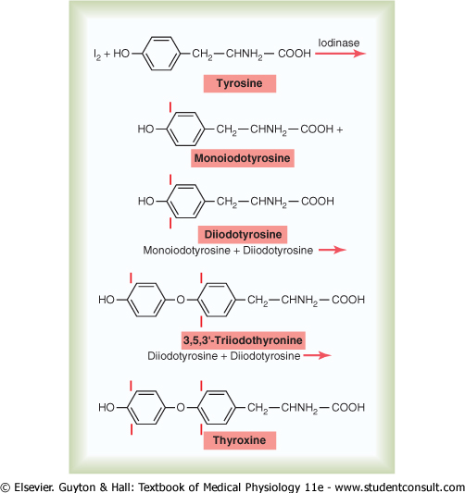

Slide 18
6- Endocytosis of thyroglobulin.
7- Fusion of lysosomes immediately with the vesicles.
8- Hydrolysis of the peptide bond to release DIT+MIT+T4+T3 from the thyroglobulin.

Slide 19
9- Delivery of T4 and T3 to the systemic circulation.
10- Deiodination of DIT and MIT by thyroid deiodinase (recycling).

Slide 20
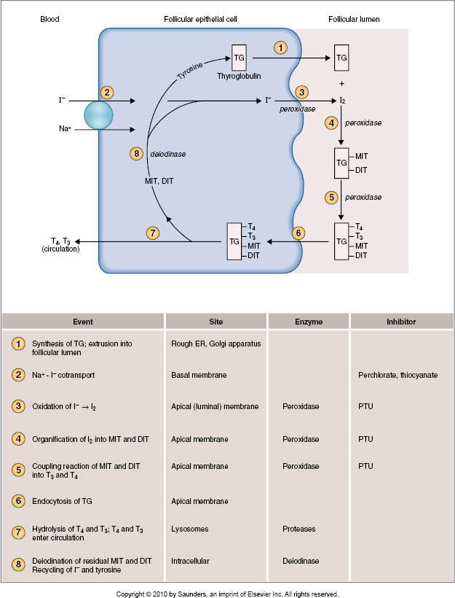

Slide 21
Notes:
Propylthiouracil (PTU): A drug that blocks the production of thyroid hormone by the thyroid gland. PTU is used to treat hyperthyroidism

Slide 22
THYROID HORMONES IN THE CIRCULATION
1- Bound:
70- 80% bound to thyroxine-binding globulin (TBG) synthesized in the liver.
The reminder is bound to albumin.
2- Unbound (Free):
0.03% of T4
0.3% of T3.

Slide 23
In hepatic failure:
TBG free T3/T4 inhibition of thyroid secretion.
In pregnancy:
estrogen TBG freeT3/T4 stimulation of thyroid secretion.

Slide 24
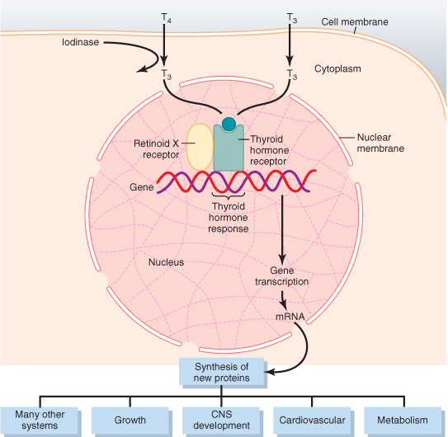
RELEASE OF T4 AND T3 TO THE TISSUES

Slide 25
RELEASE OF T4 AND T3 TO THE TISSUES
The release is slow because of the high affinity of the plasma binding proteins.
- ½ of T4 in the blood is released every 6 days.
- ½ of T3 in the blood is released every one day.

Slide 26
2- T4 & T3 readily diffuse through the cell membrane.
3- Stored in the targeted tissues (days to weeks).
5- Most of T4 is deionized to T3 by iodinase enzyme.
6- In the nucleus, T3 mainly binds to “thyroid hormone receptor” and influence transcription of genes.

Slide 27
ACTION OF THYROID HORMONES
- Before binding to the nuclear receptors 90% of T4 is converted to T3.
[T3 + nuclear receptor activation of thyroid regulating element on DNA DNA transcription formation of mRNA translation of mRNA specific protein synthesis (target tissue specific)]

Slide 28
ACTION OF THYROID HORMONES cont.
1- Basal Metabolic Rate (BMR):
- Is the energy requirement under basal condition (mental and physical rest 12-18 hours after a meal).
- Complete lake of thyroid hormones 40-50% in BMR.
- Extreme increase of thyroid hormones 60-100% in BMR.

Slide 29
2- Metabolism
A) Effect on carbohydrate metabolism:
1- increase glucose uptake by the cells.
2- increase glycogenolysis.
3- increase gluconeogenesis.
4- increase absorption from the GIT.

Slide 30
B) Effects on fat metabolism:
1- increase lipolysis.
2- decrease plasma cholesterol by increase loss in feces.
3- increase oxidation of free fatty acids.
C) Effect on protein metabolism:
overall effect is catabolic leading to decrease in muscle mass.

Slide 31
The metabolic effects are due to the induction of metabolic enzymes:
1- cytochrome oxidase.
2- NAPDH cytochrome C reductase.
3- alpha- glycerophosphate dehydrogenase.
4- malic enzymes.
5- several proteolytic enzymes

Slide 32
3- Effects on the Cardiovascular system:
- increase heart rate.
- increase stroke volume.
- decrease peripheral resistance.
*end result is increase delivery of oxygenated blood to the tissues.
Cardiac output
up to 60%

Slide 33
The cardiovascular effects are due to:
1- Thyroid hormones potentiate the effect of catecholamine in the circulation activation of β-adrenergic receptors.
2- Direct induction of:
a) myocardial β-adrenergic receptors.
b) sarcoplasmic reticulum.
c) Ca⁺² ATPase.
d) myosine.

Slide 34
6- Effects on the CNS:
A) Peri-natal period:
Thyroid hormones are essential for maturation of the CNS.
decrease of hormones secretion
irreversible mental retardation
- Screening is necessary to introduce hormone replacement .

Slide 35
6- Effects on the CNS: cont.
B) In adult:
Increase in thyroid hormone secretion:
1-hyperexcitability.
2- irritability.
Decrease in thyroid hormones secretion:
1- slow movement.
2- impaired memory.
3- mental capacity.

Slide 36
7- Effects on bone:
a) promote bone formation.
b) promote ossification.
c) promote fusion of bone plate.
d) promote bone maturation.

Slide 37
8- Effects on Respiration:
1- increase ventilation rate.
2- increase dissociation of oxygen from Hb by increasing RBC 2,3-DPG (2,3 diphosphoglycerate).
Notes:
2,3 Diphosphoglycerate
A highly anionic organic phosphate which is present in human red blood cells at about the same molar ratio as hemoglobin. It binds to deoxyhemoglobin but not the oxygenated form, therefore diminishing the oxygen affinity of hemoglobin.

Slide 38
9- Effects on the GIT:
1- increase appetite and food intake.
2- increase of digestive juices secretion.
3- increase of G.I tract motility.
excess secretion diarrhea.
lake of secretion constipation.

Slide 39
10- Effects on Autonomic nervous system:
Produced the same action as catecholamines via
β-adrenergic receptors including:
a) increase BMR.
b) increase heat production.
c) increase heart rate.
d) increase stroke volume.
i.e. β-blocker (propranolol) is used in treatment of hyperthyroidism.

Slide 40
Summary

Slide 41
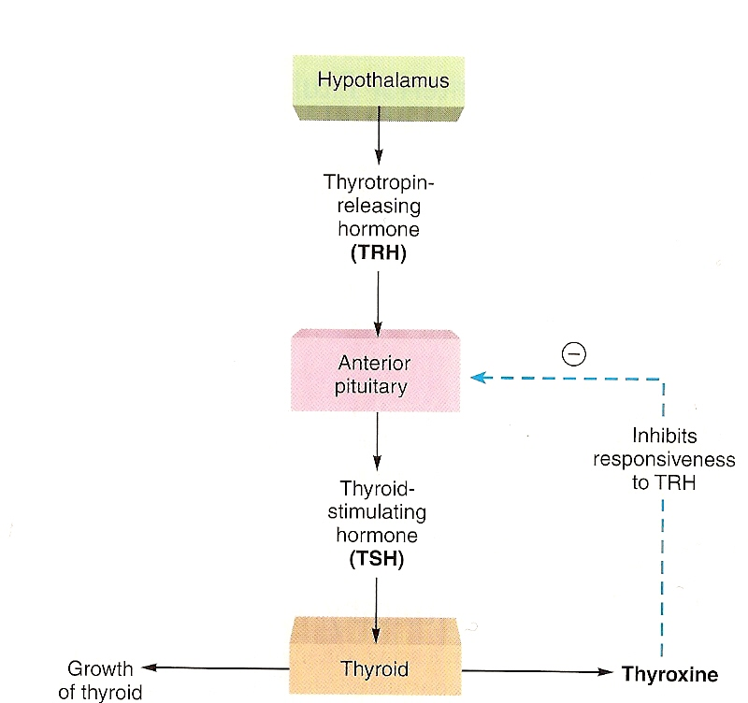
REGULATION OF HORMONES SECRETION
It is regulated by the hypothalamic-pituitary axis.

Slide 43
1- Thyrotropin-releasing hormone (TRH):
-Tripeptide.
- Paraventricular nuclei of the hypothalamus.
- Act on the thyrotrophs of the anterior pituitary
- Transcription and secretion of TSH.
- Phospholipid second messenger system.

Slide 44
2- Thyroid-stimulating hormone (TSH):
- Glycoprotein.
- Anterior pituitary.
Regulate metabolism , secretion and growth of thyroid gland (trophic effect).

Slide 45
Action of TSH
1- Increase proteolysis of the thyroglobulin.
2- Increase pump activity.
3- Increase iodination of tyrosine.
4- Increase coupling reaction.
5- Trophic effect.

Slide 46
TSH secretion started at 11-12 of gestational weeks.
TSH + receptor activation of adenylyl cyclase via Gs protein cAMP activation of protein kinase multiple phosphorylation secretion and thyroid growth.

Slide 47
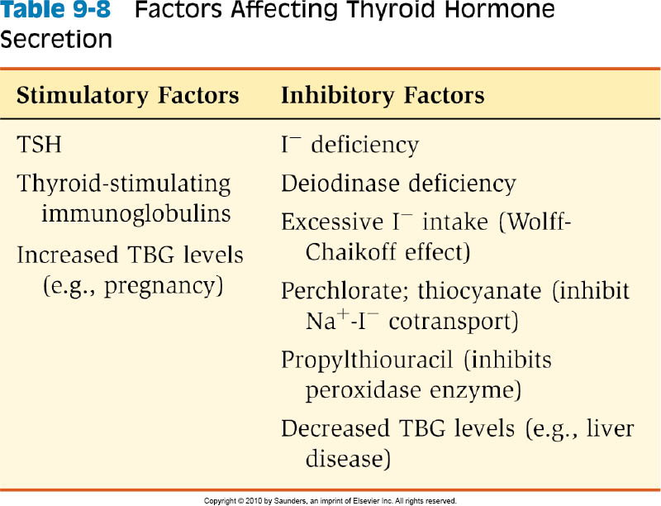

Slide 48
DISEASES OF THE THYROID GLAND
DR ABDULMAJEED AL-DREES

Slide 49
HYPERTHYROIDISM
- Over activity of the thyroid gland.
- Women : men ratio (8:1).
- activity of gland :
a)- 5- 10 times increase in secretion.
b)- 2-3 times increase in size.

Slide 50
CAUSES
1- Graves’ disease :
- an autoimmune disorder.
- increased circulating level of thyroid- stimulating immunoglobulins ( TSI).
- 95%.
- 4 – 8 times more common in women than men.

Slide 51
2- Thyroid gland tumor:
- 95% is benign.
- 5% is malignant.
- history of head and neck irradiation and family history.
3- Exogenous T3 and T4:
( rarely cause)

Slide 52
4- Excess TSH secretion:
- diseases of the hypothalamus ( TRH).
- diseases of the pituitary ( TSH).

Slide 53
DIAGNOSIS
Symptoms:
1- Goiter in 95%.
2- skin:
- smooth, warm and moist.
- heat intolerance, night sweating.

Slide 54
3- musculo skeletal:
-Muscle atrophy.
4- Neurological:
- tremor.
- enhanced reflexes.
- irritability.

Slide 55
5- Cardiovascular:
- increase heart rate.
- increase stroke volume.
- arrhythmias.
- hypertension.
6- G.I tract:
- weight loss.
- diarrhea.

Slide 56
7- Renal function:
- glomerular filtration rate.
8- Exophthalmos:
- anxious staring expression.
- protrusion of eye balls.
9- Others:
- menstrual cycle disturbance.

Slide 58
INVESTIGATIONS
1- Serum T3, T4 measurement.
In primary hyperthyroidism:
high T3, T4 and low TSH .
In secondary hyperthyroidism:
high T3, T4 and high TSH.

Slide 59
TREATMENT
1- Medical therapy:
e.g. propylthiourcal
- usually for 12-18 months course.
- with 3-4 monthly monitoring.

Slide 60
2- Surgery:
- Subtotal thyroidectomy.
- Indication for surgery:
a)- Relapse after medical treatment.
b)- Drug intolerance.
c)- Cosmetic.
d)- Suspected malignancy.

Slide 61
HYPOTHYROIDISM
Under activity of the thyroid gland
more in woman ( 30- 60 years).

Slide 62
CAUSES
1- inherited abnormalities of thyroid hormone synthesis :
- peroxidase defect.
- Iodide trapping defect.
- thyroglobulin defect.

Slide 63
2- Endemic Colloid Goiter:
- before table salt.
iodide hormone formation TSH
Thyroglobulin size ( > 10 times)

Slide 65
3- Idiopathic Nontoxic Colloid Goiter:
- I in take is normal.
- thyroiditis?
inflammation cell damage hormone secretion
TSH of activity of normal cells size

Slide 66
4- Gland destruction (surgery).
5- Pituitary diseases or tumor.
6- Hypothalamus diseases or tumor.

Slide 67
DIAGNOSIS
1- skin :
- dry skin.
- cold intolerance.
2- Musculo skeletal:
- muscle bulk.
- in skeletal growth.
- muscle sluggishness
- slow relaxation after contraction.

Slide 68
3- Neurological:
- slow movement.
- impaired memory.
- decrease mental capacity.
4- Cardiovascular:
- blood volume.
- heart rate
- stroke volume.

Slide 69
5- G.I tract:
- constipation
- increase weight.
6- Renal function:
- decrease glomerular filtration rate.

Slide 70
7- Myxoedema:
An edematous appearance through out body.
8- others:
- loss of libido.
- menstrual cycle disturbance.

Slide 71
INVESTIGATIONS
1- Serum T3,T4 are low.
- TSH is elevated in primary.
- TSH is low in secondary hypothyroidism.

Slide 72
TREATMENT
- L- thyroxine
- Starting dose is 25-50 µg.
- Increase to 200 µg.
- At 2-4 weeks period.
The first response seen is the weight loss.

Slide 75
CRETINISM
Extreme hypothyroidism during infancy and child hood (failure of growth).

Slide 76
CAUSES
1- Congenital lake of thyroid gland (congenital cretinism).
2- Genetic deficiency leading to failure to produce hormone.
3- Iodine lake in the diet (endemic cretinism).

Slide 77
SYMPTOMS
1- Infant is normal at birth but abnormality appears within weeks.
2- Protruding tongue.
3- Dwarf with short limbs.
4- Mental retardation.
5- Often umbilical hernia.
6- teeth.

Slide 79
TREATMENT
Changes are irreversible unless treatment is given early.

Slide 81
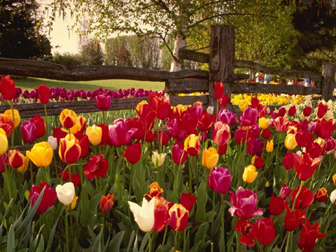

Slide 82
Calculate your BMR:
Men: BMR = 66 + (13.7 X wt in kg) + (5 X ht in cm) - (6.8 X age in years)
Women: BMR = 655 + (9.6 X wt in kg) + (1.8 X ht in cm) - (4.7 X age in years)
Example: You are female You are 30 years old You are 5' 6 " tall (167.6 cm) You weigh 120 lbs. (54.5 kilos) Your BMR = 655 + 523 + 302 - 141 = 1339 calories/day

