Slide 1
Candidiasis
Dr. Ahmed Al-Barrag Asst. Professor of Medical Mycology School of Medicine and the University Hospitals King Saud University
Endocrine block March 2014

Slide 2
Objectives
Students at the end of the lecture will be able to:
Acquire the basic knowledge about Candida as a pathogen
know the main infections caused by Candida species
Identify the clinical settings of such infections
Know the laboratory diagnosis, and treatment of these infections.

Slide 3
The Organism
Candida

Slide 4
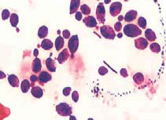
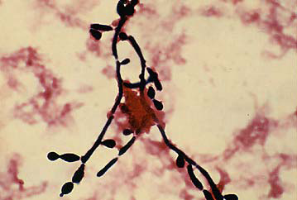
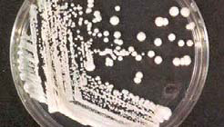
Candida
Candida is a unicellular yeast fungus.
It is imperfect reproducing by budding
Morphology
Microscopy: Budding yeast cells, and Pseudohyphae.
Culture: Creamy colony, fast growing on Sabouraud Dextrose agar (SDA), Blood agar (48 hr)

Slide 5
Candida
There are many species of Candida (>150)
The common species are:
Candida albicans,
C.parapsilosis
C.tropicalis,
C.glabrata,
C.krusei,
Human commensal
Oral cavity
Skin
Gastrointestinal tract
Genitourinary tracts

Slide 6
The disease
Candidiasis

Slide 7
Candidiasis
Definition:
Any infection caused by any species of the yeast fungus Candida.
The most common invasive fungal infections in immunocompromised patients
4th most common cause of nosocomial blood stream infection
It is considered opportunistic infection

Slide 8
Candidiasis Opportunistic Fungal Infections
Alteration in
Immunity
Physiology
Normal flora
Damage in the barriers
ENDOGENOUS
Colonization precedes infection
Antibiotic suppression of normal flora, fungal overgrowth
Clinical – Spectrum of disease?

Slide 9
Candida - Clinical
Mucous membrane infections
Thrush (oropharyngeal)
Esophagitis
Vaginitis
Cutaneous infections
Paronychia (skin around nail bed)
Onychomycosis (nails)
Diaper rash
Balanitis
Chronic mucotaneous candidiasis
children with T-cell abnormality

Slide 10
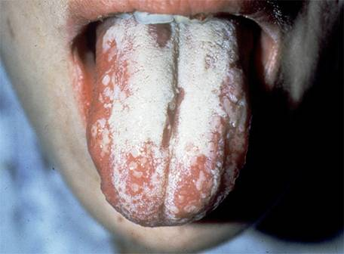
Mucocutaneous infections
Oropharyngeal Candidiasis
Oral thrush:
White or grey Pseudomembranous patches on oral surfaces especially tongue with underlying erythema.
Common in neonates, infants, elderly
In immunocompromised host, e.g. AIDS.
Esophagitis
Vulvovaginitis :
Common in pregnancy, diabetics, use of contraceptives.
Thick discharge, itching irritation . Lesion appear as white patches on vaginal mucosa.

Slide 11
Cutaneous infections
Intertriginous candidiasis:
Infections of skin folds eg. axilla, buttock, toe web, under breast.
Erythematous lesion, dry or moist or whitish accompanied by itching and burning.
Nail infections:
Onychomycosis and paronychia
Diaper rash
Chronic mucocutaneous candidiasis

Slide 12
Candida - Clinical
Urinary tract infection
Candidemia
Disseminated (systemic, invasive) infection
Endophthalmitis (eye)
Liver and spleen
Kidneys
Skin
Brain
Lungs
Bone

Slide 13
Pulmonary Candidiasis
Primary pneumonia is less common and could be a result of Aspiration
Secondary pneumonia commonly seen with hematogenous candisiasis
Immunocompromised patients
Isolation of Candida from sputum is not always significant
Clinical features
Radiology,
Other Lab investigations

Slide 14
Candidemia
Increased colonization (endogenous or exogenous factors)
Damage in host barriers by catheters, trauma, surgery
Immunosuppression
Central venous catheters (CVC)
Disseminated candidiasis (involvement of any organ)
Septic shock
Meningitis
Ocular involvement (retinitis)
Fever could be the only clinical manifestation

Slide 15
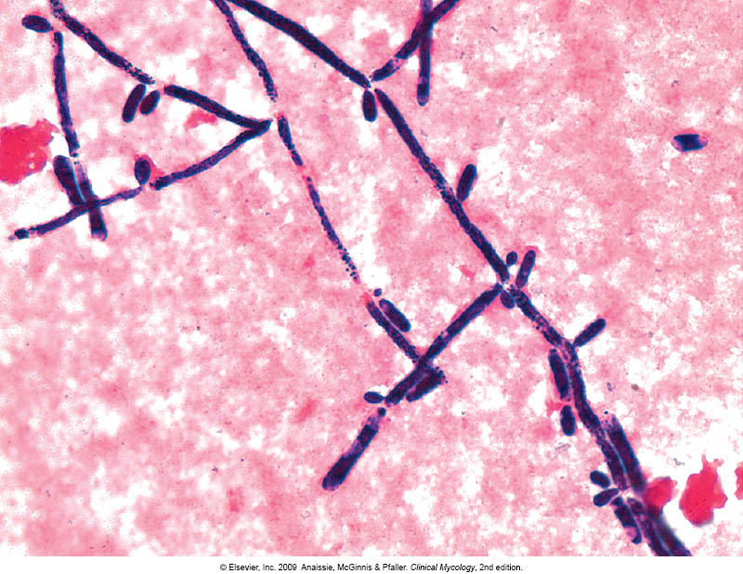
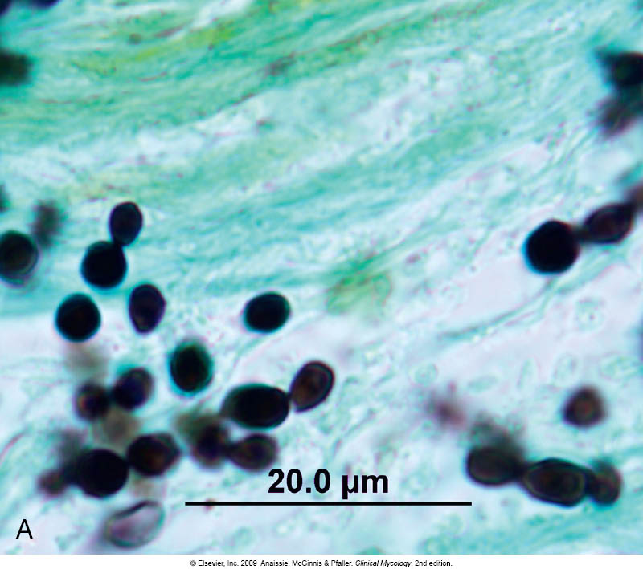
Candidiasis – Laboratory diagnosis
Specimen depend on site of infection.
Swabs, Urine, Blood, Respiratory specimens, CSF, Blood
1. Direct microscopy :
Gram stain, KOH, Giemsa, GMS, or PAS stained smears.
Budding yeast cells and pseudohyphae will be seen in stained smear or KOH.

Slide 16
Candidiasis – Laboratory diagnosis
2. Culture:
Media: SDA & Blood agar at 37ºC,
Creamy moist colonies in 24 - 48 hours.
3. Blood culture

Slide 17
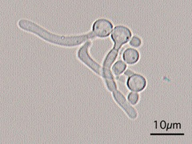
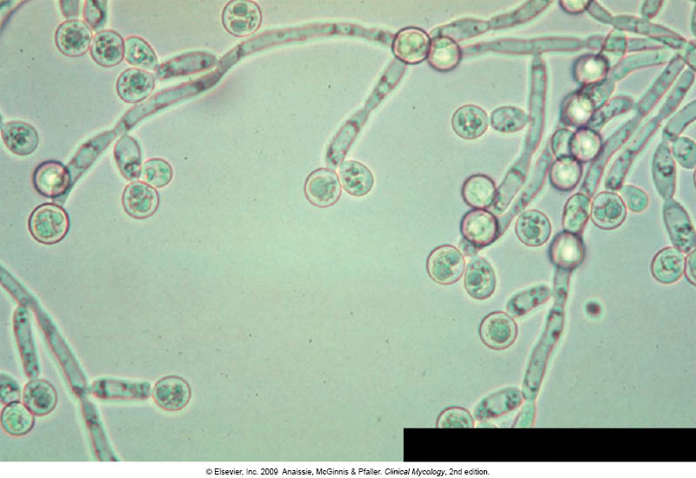
Candidiasis – Laboratory diagnosis Laboratory identification of Yeast
Because C. albicans is the most common species to cause infection
The following tests are used to identify C. albicans:
Germ tube test : Formation of germ tube when cultured in
serum at 37ᵒC
2. Chlamydospore production in corn meal Agar
3. Resistance to 500 μg/ml Cycloheximide
If these 3 are positive this yeast is C.albicans,
If negative, then it could be any other yeast,
Use Carbohydrate assimilations and fermentation.
Commercial kits available for this like: API 20C, API 32C
Culture on Chromogenic Media (CHROMagar™ Candida)
Germ tube test
Chlamydospores of C. albicans in CMA

Slide 18
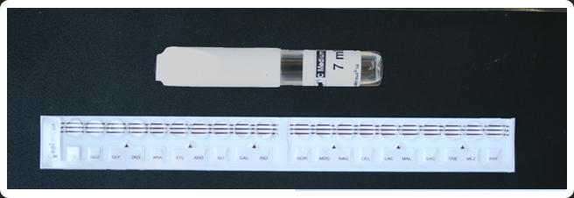
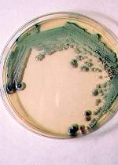
Yeast Identification
Chromagar
Carbohydrates assimilation test , API 20C

Slide 19
Candidiasis – Laboratory diagnosis
4. Serology:
Patient serum
Test for Antigen , e.g. Mannan antigen using ELISA
Test for Antibodies
5. PCR

Slide 20
Candidiasis- Treatment
Oropharyngeal:
Topical Nystatin suspension, Clotrimazole troches ,Miconazole, Fluconazole suspension.
Vaginitis:
Miconazole, Clotrimazole, Fluconazole
Systemic treatment of Candidiasis
Fluconazole
Voriconazole
Caspofungin
Amphotericin
In candidemia :
Treat for 14 days after last positive culture and resolution of signs and symptoms
Remove catheters, if possible
Points to consider:
C. glabrata can be less susceptible or resistant to fluconazole
C. krusei is resistant to fluconazole

Slide 21
THANK YOU

