Slide 1
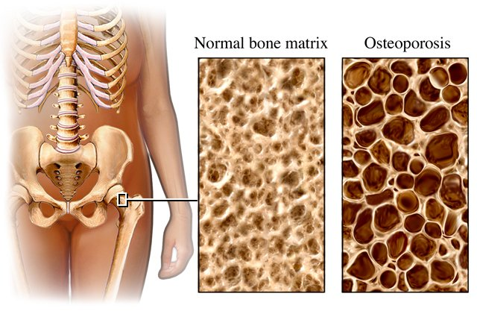
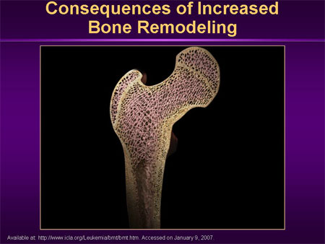
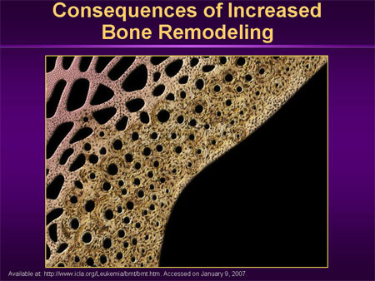
OSTEOPOROSIS and drugs used
Dr. Ishfaq Bukhari
Assistant Professor of Pharmacology
Dept of Medical Pharmacolgy
King Saud Univerity Riyadh

Slide 2
OSTEOPOROSIS
ILOs
By the end of this lecture you will be able to:
Revise the composition, regulation & the remodeling stages
of bone turnover
Recognize the interlinks of osteoblastic & osteoclastic function
Relate changes to the development of osteoporosis
Classify drugs according to their replacement, antiresorptive or
anabolic mechanism of action
Detail the pharmacology of such group of drugs& their clinical
utility in combating osteoporosis

Slide 3
OSTEOPOROSIS ;Key points

Slide 4
OSTEOPOROSIS: “The Silent Disease”
“Osteo” is Latin for “bone”
“Porosis” means “porous or full of holes”
“Osteoporosis” means “bones that are full of holes”
Osteoporosis can develop without symptoms

Slide 5
TYPES OF BONE
(1) Cortical – is hard, compact, dense bone (example: mid-section of larger, long-bones of arms and legs)
(2) Trabecular – is spongy, porous and flexible bone (example: end of the wrist, hip and the spine)
Activity - Understanding Our Bones

Slide 6
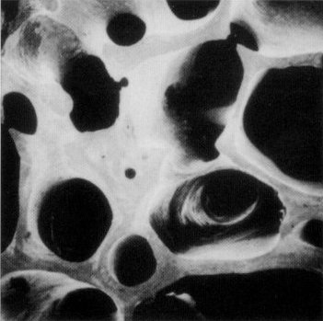
HEALTHY BONE
Bone is living tissue, which is constantly being broken down and rebuilt, a process called remodeling
Bone is renewed like skin, hair and nails

Slide 7
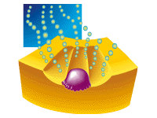
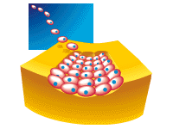
BONE “REMODELING”
Resorption-removes old bone
Formation-replaces old bone with new bone

Slide 8

BONE “REMODELING”
OSTEOCLASTS-PHASE 1
Cells called osteoclasts (think “C” for cutting of bone) seek out old bone or damaged bone tissue and destroy it, leaving small spaces (resorption)

Slide 9
BONE “REMODELING”
OSTEOBLASTS – PHASE 2
Cells called osteoblasts (think “B” for builder) use minerals like calcium, phosphorus, and vitamin D to fill in the spaces with new bone (formation)

Slide 10
BUILD YOUR BONE BANK
You build bone until about age 30
Steps to building healthy bones include:
Calcium & vitamin D
Limit Caffeine & Alcohol
Exercise
Don’t Smoke

Slide 11
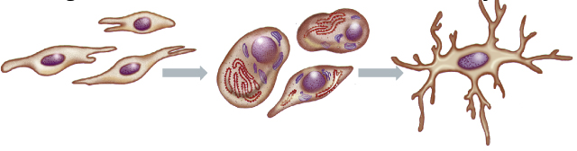
Bone is basically composed of 2 types of tissues
  INORGANIC 65% of mass  Consists of crystaline calcium phosphate salts(hydroxyapatite)
  Organic  35% of mass  Consists of ;osteoblasts, osteoclasts and osteocytes).
• Bone cells are either; Bone Forming or Bone Resorptive
Osteoblasts
Osteocytes
A. Bone Forming Cells:
    Osteogenic cells  mesenchymal in origin  are found on all bone surfaces
    Osteoblasts  forms osteoid framework & help in its mineralization
    Osteocytes  star like cells in the bone matrix, sense mechanical stress  signals to both blasts & clasts

Slide 12
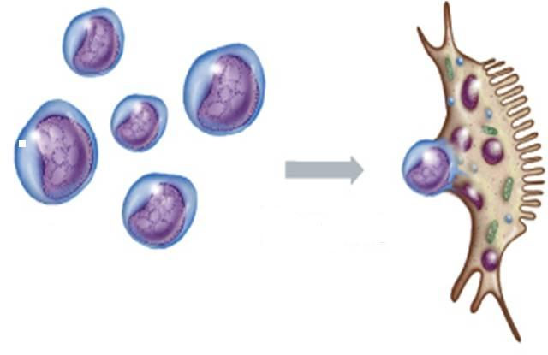
B. Bone Resorptive Cell:
Osteoclastes 
Reside in pits (resorption bays) that form by eaten bone surface. Secretes lysosomal enzymes (collagenase & metalloproteinase) + hydrochloric a.  dissolve bone matrix
Osteoclasts
NORMALLY
bones continuously form & resorb
○ BONE REMODELING
Under control of systemic hormones, body mineral contents
& local autocrine-paracrine secretions (Cytokines, Growth Factors, PGs)
It is meant to maintain calcium homeostasis & to renew bone in repair of microdamage & microcracks

Slide 13
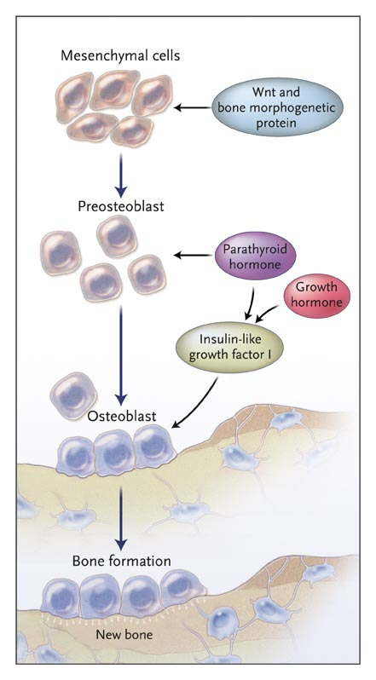
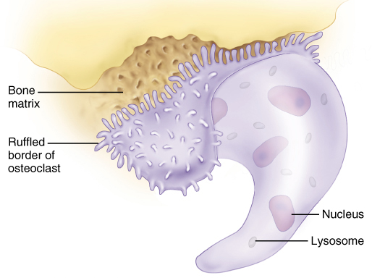
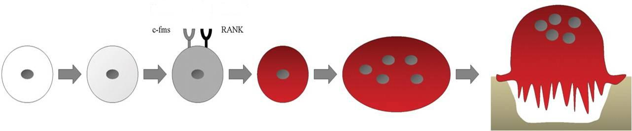
LOCAL FACTORS DRIVING THE REMODELING PROCSS
Osteoprotegerin [OPG]
RANKL
HSC
Myloid Proginator
Monocyte
Pre-Osteoclast
Mature
Osteoclast
Resorbing
Osteoclast

Slide 14
SYSTEMIC HORMONES Controlling Remodeling
1. PARATHORMONE
Maintains calcium homeostasis via
 bone formation ( intermittent) / bone resorption (continuous)
renal tubular calcium reabsorption
 renal calcitriol production
2. CALCITROL (active form of vit D)
 intestinal Ca & phosphorus absorption  bone mineralization
 bone resorption when they are deficient
3. ESTROGEN & ANDROGEN
 rate of bone loss by acting on many local factors
 osteoclast apoptosis & growth factors from osteoblasts
No. & depth of resorption cavities & release of cytokines
4. CALCITONIN
Not much physiological role in man
Pharmacologically   osteoclasts & bone resorption
5. CLUCOCORTICOIDS
 apoptosis of osteoblasts & osteocytes   resorption  differentiation of osteoblasts   formation
6. THYROID HORMONE
 Bone turn-over i.e. resorption & formation
7. Growth hormone & IGFs
 skeletal growth & endochondral bone formation.

Slide 15
BONE BANK DEPOSITS
From birth through adolescence, new bone is built faster than old bone is removed
In mid-life, depending on lifestyle and other factors, bone removal can achieve a balance with bone formation
After menopause, bone removal may accelerate due to a decrease in estrogen

Slide 16
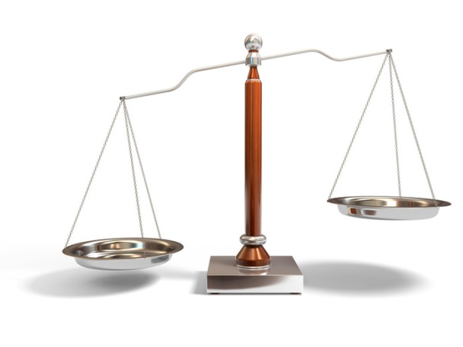
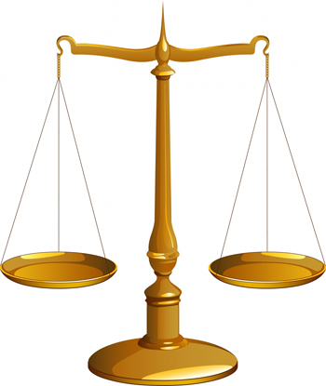
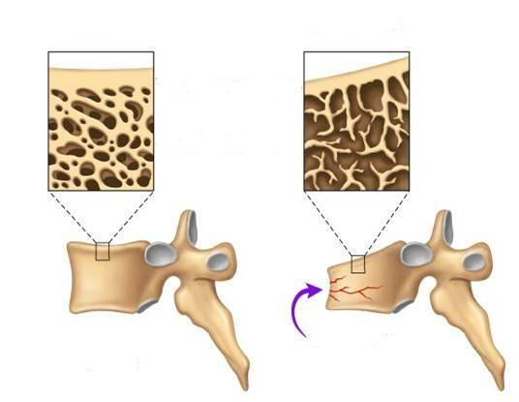
BONE REMODELING
Formation
Resorption
Formation
Resorption
OSTEOPOROSIS
A complex endocrinologic disorder of bone & mineral metabolism
(bone resorption > formation)
Low bone mass
Disruption of bone architecture
Reduced bone strength
Risk of fractures

Slide 17
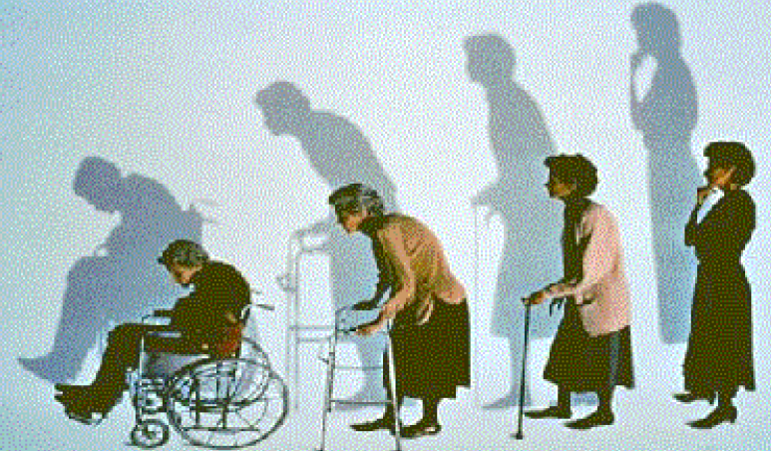
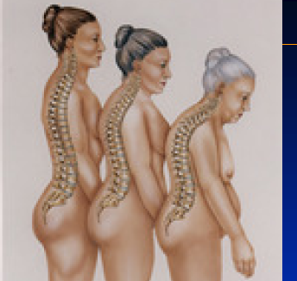
OSTEOPOROSIS
PREVENTION
TREATMENT
Potentially Modifiable | Nonmodifiable
Current cigarette smoking | Personal history of fracture
Diet low in calcium/vitamin D | 1st-degree relative has fracture
Glucocorticoids, anticonvulsants | Race (Caucasian or Asian)
Excessive alcohol intake | Elderly age
Sedentary lifestyle | Poor health
Body weight less than 127 lb | Dementia
Lack of estrogen | Hormonal disorders
Environmental risks | Neoplastic disorders
 | Metabolic abnormalities
 | Connective tissue disorders

Slide 18
BONE LOSS & AGING
The first 5-15 years after menopause a woman can lose approximately 25 - 30 % of trabecular bone & approximately 10 – 15 % of cortical bone
Bone loss often occurs
without symptoms or
warning signs

Slide 19
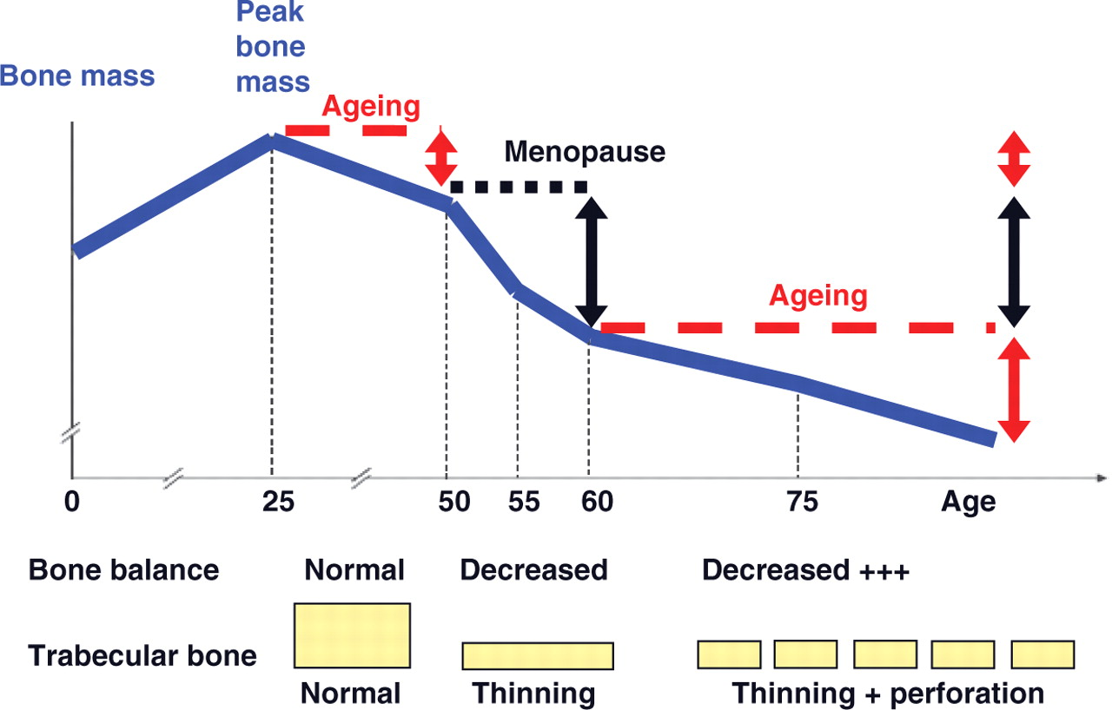

Slide 20
BUILD YOUR BONE BANK
You build bone until about age 30
Steps to building healthy bones include:
  Calcium & vitamin D (milk, cheese, yogurt, sunshine)
Limit Caffeine & Alcohol
Exercise (Walk , run)
Don’t Smoke

Slide 21
TREATMENT OF OSTEOPOROSIS
  Replace what is missing….Ca, Vit D, Na fluoride
  Reset back the balance of remodeling
Used to enhance the strength by the formation of fluorapatite.
Is considered only when trabecular bone is  in presence of normal cortical bones
ANTIRESORPTIVE AGENTS
BONE ANABOLIC (building) AGENTS

BISPHOSPHONATES
ESTROGEN ANALOGES
ANDROGEN ANALOGES
SERMS
CALCITONIN
RANKL INHIBITORS

(Parathyroid hormone; TERIPARATIDE



STRONTIUM


Slide 22
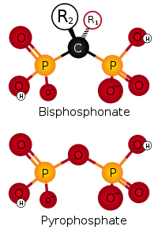
BISPHOSPHONATES
Are compounds that have two phosphonate (PO₃) groups
Non-Nitrogenous
Nitrogenous
Etidronate
Clodronate
Tildronate
Alendronate
Ibandronate
Risedronate
Zoledronate
○ 500
1000
2000
10000
10
10
Mechanism
Are structurally similar to pyrophosphate,
They preferentially "stick" to calcium  concentrate in bones, bound to hydroxapatite, decreasing its solubility and making it more resistant to osteoclastic activity.
They prevent bone resorption by inhibiting osteoclast function.
Their relative potencies for osteoclast inhibition is the most with 3rd generation “Zoledronate”
How do they inhibit osteoclasts???  It is also taken up by osteoclast  blocks steps in cholestrol synthetic pathway within osteoclast  end up by osteoclast apoptosis .

Slide 23
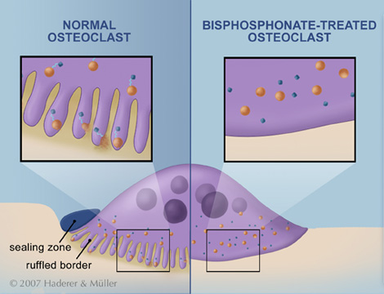
BLOCK STEPS IN CHOLESTROL SYNTHETIC PATHWAY IN OSTEOCLAST
that act as signaling molecules responsible for the osteoclastic hydrolytic & phagocytic activity.
Stop function  apoptosis (increased death of osteoclast)

Slide 24
BISPHOSPHONATES
Kinetics
Poorly abs (< 10%), food impair absorption more  must be given on
an empty stomach. / infused IV.
t_{1/2} 1 hr.
Half of absorbed drug accumulates in bones, remainder  excreted
unchanged in urine.
In bone it is retained for months, depending on bone turnover.
Indications
Osteoporosis, 2ndry to menopause, glucocorticoids, ….
Paget’s Disease
Malignancy- associated hypercalcaemia
Dosing
Once weekly, or on two consecutive days each month
Should be taken in upright position (to avoid esophagitis).
Separate 4 hrs before giving Ca, Mg, Al containing drugs

Slide 25
BISPHOSPHONATES
ADRs
GIT irritation; nausea, vomiting, gastritis , ulceration  to avoid
give large amount of water
Gastro-esophageal reflux + ulcerations  to avoid give on empty
stomach while sitting in upright
Flue like manifestations upon IV infusion
Osteo-necrosis of the jaw [ mandible > jaw ] more upon long use
with IV infusion preparation usually after dental surgical
procedures. It is due to activation of matrix metalloproteinase that
cause lysis
Atrial fibrillation > women with alendronate & zolidronate
Contraindications
Decreased renal function
Peptic ulcer / esophageal reflux

Slide 26
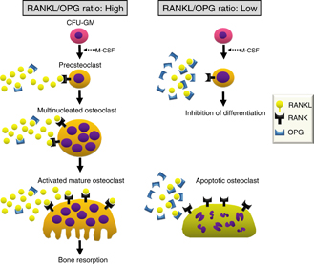
DENOSUMAB (still under investigation)
RANKL INHIBITORS
It is a fully human MOA that mimics the activity of osteoprotegerin.
Mechanism
It binds to RANKL, expressed by osteoblasts 
blocks RANKL from interacting with RANK expressed on preosteoclasts   osteoclastogenesis ( no mature osteoclasts).
It binds also to mature osteoclast  its apoptosis
So net effect   bone resorption .
Administration
Subcutaneous every 6 month
Contraindications
In patients with hypocalcemia. Correct Ca & Vit D levels before starting denosumab

Slide 27
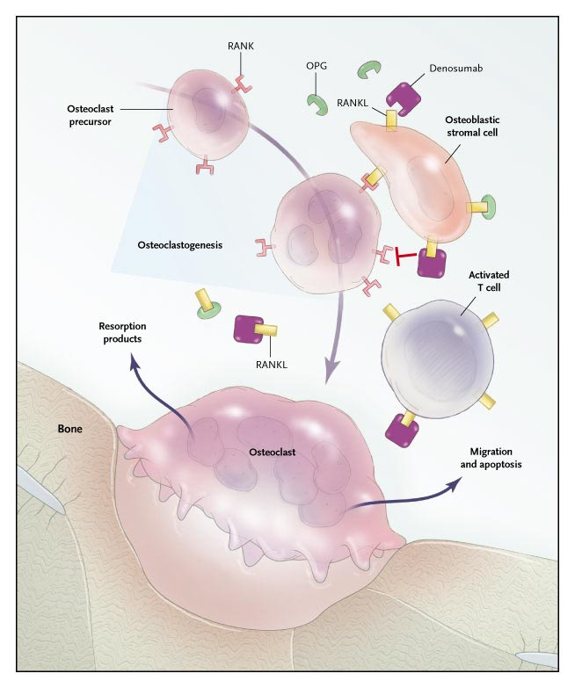
Mechanism
DENOSUMAB
RANKL binds to its receptor RANK on the surface of precursor and mature osteoclasts, and stimulates these cells to mature and resorb bone. OPG, which competes with RANK for binding to RANKL, is the physiological inhibitor of RANKL. Denosumab binds with high affinity to RANKL, mimicking the effect of OPG.
ADRs
Infections;
urinary & respiratory
Eczema & skin rash
Constipation
Cataract
Joint pains

Slide 28
STRONTIUM
Sr²⁺, is a divalent cation, resembling Ca²⁺ in atomic & ionic properties.
It is orally active as distrontium
Mechanism
1st drug to possess “ dual action “ i.e has both anabolic & antiresor-ptive effects resulting in a rebalance of bone turnover in favor of bone formation.
On Osteoblast;
Since it is like Ca, it acts as agonist on Ca Sensing Receptor [CaSR] ; which is a GP coupled receptor that enhances differentiation of preoteoblast to osteoblast  bone formation
It stimulate the expression of OPG RANKL binding  -ve of osteo-clustogenesis  bone resorption
On Osteoclast;
Acts as agonist on Ca Sensing Receptor [CaSP] suppress differentiation of preoteoclast to osteoclast  osteoclast apoptosis  bone resorption

Slide 29
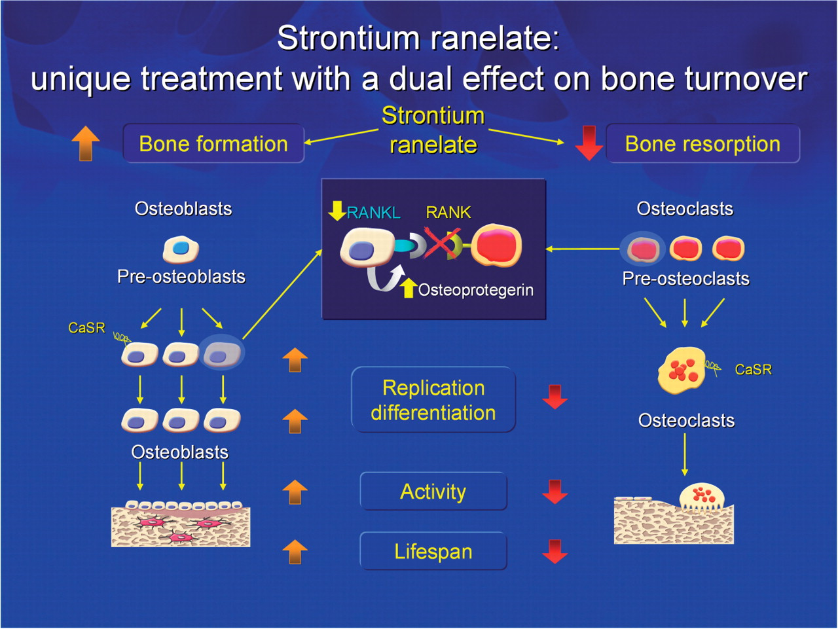

Slide 30
Pharmacokinetics
STRONTIUM
Orally with a modest bioavailability 25%
Binds partially to plasma proteins and strongly to bones
t ½  60 hrs
Excreted mainly by the kidney
Indications
Osteoporosis, 2ndry to menopause, glucocorticoids, ….
Malignancy- associated hypercalcaemia
Contraindications
In severe renal disease.
In hypersensitivity to it
In increased risk of venous thromboembolism
In phenylketonuria
Interactions
Precautions
Food specially containing milk+ its products 
Antacids 
Oral tetracycline & quinolones chelate it
2hrs spacing
ADRs
GIT irritation; nausea, vomiting, headache, eczema
All resolve in 1st 3 months

Slide 31


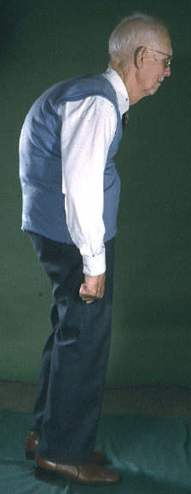
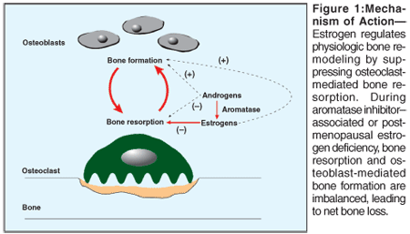
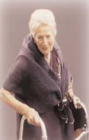
ESTROGENS
If hystrectomy
+ progestins if uterus present
HRT
Menopausal Symptoms
SERMs
Menopause /
Elderly
Estrogen in females & Androgen in males
is essential for normal bone remodeling
ANDROGENS
Elderly men
 osteoclast apoptosis & inhbit osteobalst apoptosis
◉ No. & depth of resorption cavities
 release of growth factors from osteoblasts
◉ release of inflammatory cytokines causing resorption
Adverse effects: HRT (estrogen): vaginal bleeding, risk of breat cancer, and venous thrmboembolism

Slide 32



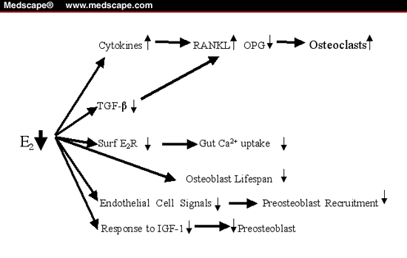
During Hot
Flashes
Post Vasomotor Symptoms
Pre fracture
Post Fracture
ESTROGENS
PTH
Risk
of Fracture
◉ ANDROGENS
Raloxifene
Bisphosphonates
HRT
HRT
Calcitonin
Osteoporosis
AGE
HRT
Raloxifene
Bisphsphonates
PTH
REPLACEMENT THERAPY OR
OTHER THERAPY MODALITIES
?
50 55 60 65 70 75 80 85 90

Slide 33
SERMs
RALOXIFENE
1st selective estrogen Receptor modulator (SERM) for prevention and tteatment of osteoporosis
Mechanism
Antiestrogens that exhibits partial agonistic action; acting as an agonist in bone & an antagonist in some female sex organs
 | Brain | Uterus | Vagina | Breast | Bone | CVS
Estradiol | ++ | ++ | ++ | ++ | ++ | ++
Raloxifene | — | — | — | — | + | +
Advantages
   bone density (2%) &  fracture risk (30%)
  No stimulation of breast or endometrial tissue
  No need for progestin in women with uterus
  ◉ LDL
  Good for women with risk of uterine
  and breast cancer.
  Lower risk of thromboembolism comopared to estrogen
Disadvantages
  May  hot flushes
  No effect on HDL
TIBOLONE
Synthetic steroid  estrogen, androgen & progestin properties
Can be used without CVS risks

Slide 34
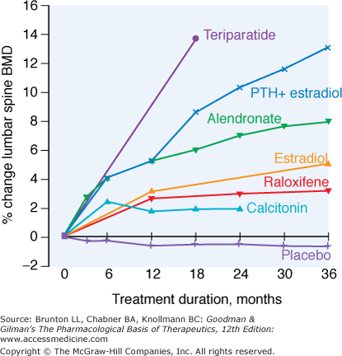
Relative efficacy of different therapeutic interventions on bone mineral density of the lumbar spine

Slide 35
OSTEOPOROSIS
GOOD LUCK

