Slide 1
Adrenal Androgens

Slide 2
Androgens
Androgens are the hormones that exert masculinizing effects. They promote anabolism and growth.
Testosterone from the testis is the major active ,androgen. The adrenal androgens have less than 20% of its activity.

Slide 3
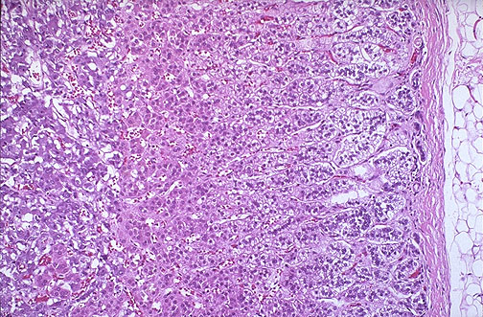
Endocrine activity of the Adrenal Cortex
Zona reticularis
Produces small amounts of androgens, mostly dehydroepiandosterone (DHEA), DHEA may be converted into estrogens
Hormone Control:
Believed to be ACTH
Target tissue:
General body cells

Slide 4
Adrenal Androgens
The adrenal cortex produces both androgens i.e.
“male sex hormones” and estrogens or “female sex hormones.
The adrenal cortex in both sexes produces small amounts of sex hormone of the opposite sex. Additional small amounts of sex hormones come from nonadrenal sources. Some testosterone in males is converted into estrogen by the enzyme aromatase found in adipose tissues.
In females, ovaries produce androgen as an intermediate step in estrogen production. Little of this androgen is released in the blood instead of being converted into estrogen.

Slide 5
Adrenal androgens
A subset of androgens, adrenal androgens, includes :
-dehydroepiandrosterone (DHEA),
-androstenedione.

Slide 6
Adrenal androgens, cont,….
Dehydroepiandrosterone (DHEA):
A steroid hormone produced in the adrenal cortex from cholesterol. It is the primary precursor of natural estrogens.
It is the most abundant adrenal androgen

Slide 7
Adrenal androgens, cont,….
Androstenedione:
An androgenic steroid produced by the testes, adrenal cortex, and ovaries.
Androstenediones are converted metabolically to testosterone and to estrogens in the fat and other peripheral tissues. It is an important source of estrogen in men and postmenopausal women.
Androstenedione were used as an athletic or body building supplement.

Slide 8
Effects of adrenal androgens:
- Control androgen-dependent processes in the female as:
1- growth of pubic and axillary hair, 2- pubertal growth spurt, 3- development and maintenance of female sex drive.

Slide 9
Congenital adrenal hyperplasia
Causes:
The different types of adrenogenital syndrome are inherited as autosomal recessive diseases and can affect both boys and girls.
The defect is lack of an enzyme (21-hydroxylase) needed by the adrenal gland to make the major steroid hormones of the adrenal cortex: cortisol and aldosterone. Due to the block in synthesis of these hormones, steroids are 'diverted' to becoming androgens, a form of male sex hormones.

Slide 10
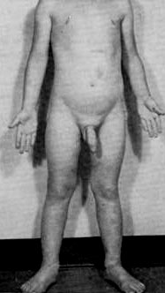
Endocrine activity of the Adrenal Cortex
Hyper-secretion:
Adrenogenital Syndrome
In pre-pubertal males it causes the rapid development of secondary sexual characters

Slide 11
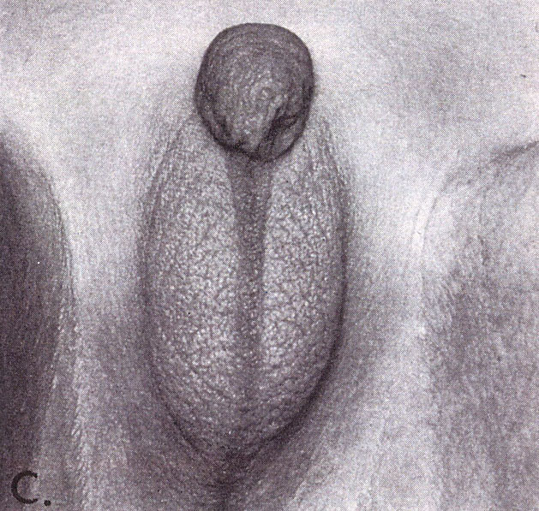
Endocrine Activity of the Adrenal Cortex
Hyper-secretion:
Adrenogenital Syndrome
in females causes beard growth, deeper voice, masculine distribution of body hair, and growth of the clitoris to resemble a penis.
Picture:
Virilizing adrenal hyperplasia in a newborn female baby, DHEA was converted to testosterone

