Slide 1
Adrenal (Suprarenal )Medulla
Dr Taha Sadig Ahmed

Slide 2
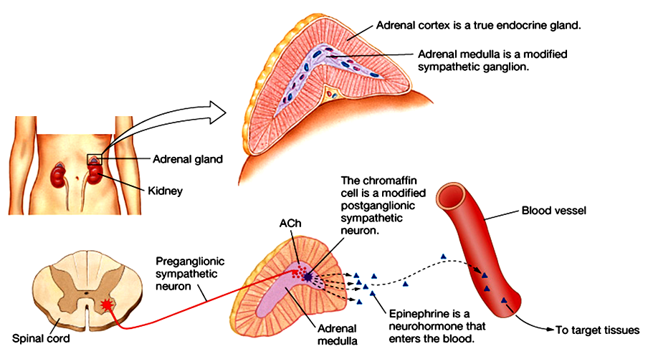
The adrenal medulla constitutes the inner part of the suprarenal gland , and comprises 20% of the gland..
It is of Neuroectodermal origin
It is not essential to life if the animal is kept under sheltered conditions without any external stress . However , if not in sheltered conditions , it is highly unlikely that the animal will go on surviving , because real life is not devoid of stress .
The adrenal medulla is actually a ganglion of the sympathetic nervous system , since its origin is the embryonic neural crest ( i.e. its cells are actually neurons )

Slide 3
Adrenal medulla secretions are derived from tyrosine :
Tyrosine Dopamine Norepinephrine Epinephrine
Phenylethanolamine N-methyltransferase (PNMT) is an enzyme found in the adrenal medulla that converts norepinephrine (noradrenaline) to epinephrine (adrenaline).
PNMT is not present in postganglionic sympathetic nerves → which release only norepinephrine and no epinephrine
Therefore, it can be said that the only source of adrenaline in the bloodstream is the adrtenal medulla .
(1) epinephrine (adrenaline) constitutes around 80% of its secretion ) , whereas (2) norepinephrine (noradrenaline) constitutes around 20% of its secretion ),
and it also secretes (3) a small amount of dopamine
( all in response to stimulation by preganglionic sympathetic nerves)
Epinephrine is the more potent stimulator of the heart and metabolic activities
Norepinephrine is more influential on peripheral vasoconstriction and raing the blood pressure

Slide 4
Norepinephrine ( Noradrenaline) is metabolised into normetanephrine and Vanillyl mandelic acid (VMA ) .
High urine VMA is one of the diagnostic tests for Pheochromocytoma .
Another test is plasma metanephrine testing

Slide 5
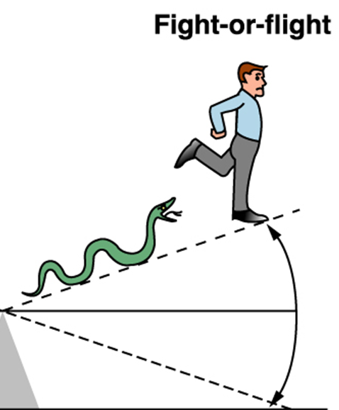
NE & Epinephrine Effects
Stimulates the “fight or fight” reaction
Eye : pupil dilation
Heart : increased heart rate & force of contraction → increased cardiac
output & BP (blood pressure)
TPR ( Total Peripheral Resistance )
Arteriolar constriction (→ raised BP.
norepinephrene is causing more effect )
Bronchioles → Bronchiolar dilation
Liver : glycogenolysis, gluconeogenesis ;
Skeletal muscle → glycogenolysis
Increased blood glucose
Metabolic Rate →Increased ,
epinephrene is causing more effect than NE (5-10 times)

Slide 6
NE & Epinephrine Effects (Contd)
skin: Increase sweating
GIT and Bladder:
Sphincter contraction
Wall relaxation
GIT :Decreased gastrointestinal secretion and motility
Kidney : Renin secretion

Slide 7
Stress
Stress causes the hypothalamus to secrete corticotropin-releasing factor (CRF), which stimulates the anterior lobe of the pituitary to secrete adrenocorticotropic hormone (ACTH)
ACTH regulates glucocorticoid and aldosterone secretion
Can stimulate a 20-fold increase in blood cortisol in minutes
High cortisol inhibits hypothalamic CRF secretion and pituitary ACTH secretion when stress has passed

Slide 8
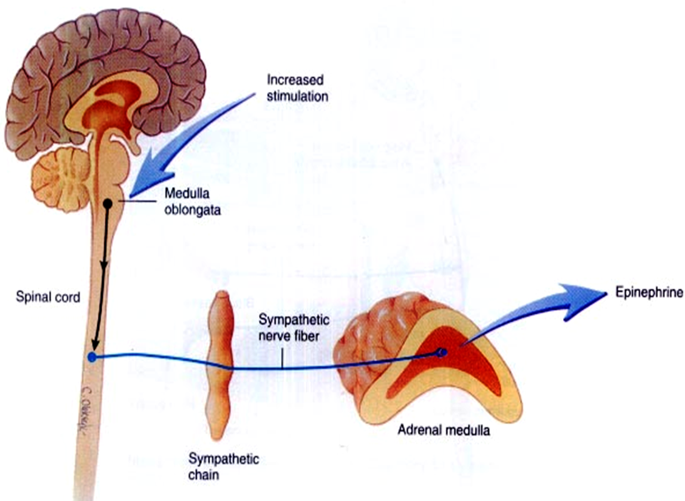
The adrenal medulla is, functionally , integral part تعتبر جزء لا يتجزof the sympathetic system .
80% of its secretion is Epinephrine ( EP) and
20% of its secretion is Norepinephrine (NE ).
EP in the bloodstream , on the other hand , comes solely from the adrenal medulla .
BUT → NE in blood comes from BOTH adrenal medulla and postganglionic sympathetic nerves
This is because postganglionic sympathetic nerves can not synthesize EP from its precursor NE , because they lack the enzyme ( PNMT) needed for conversion of NE into EP .

Slide 9
Pheochromocytoma
Pheochromocytoma is a tomor of adrenal medullan .
It can be life threatening if not recognized & not treated.
It can develop at any age, but most often occurs in middle age.
Symptoms & signs →
Sudden bouts of headache ( most common symptom ) ,
pallor ,
Excessive sweating
Palpitations ( the patient is conscious of his heart beats, and feeling that his heart is beating more strongly & rapidly than used to be )
Tachycardia and high blood pressure

Slide 10
Pheochromocytoma
Pheochromocytoma is a tomor of adrenal medullan .
It can be life threatening if not recognized & not treated.
It can develop at any age, but most often occurs in middle age.
Symptoms & signs ا→
Sudden bouts of headache ( most common symptom ) ,
pallor,
Excessive sweating
Tachycardia
Palpitations ( the patient is conscious of his heart beats, and feeling that his heart is beating more strongly & rapidly than used to be )
Sense of extreme fear and anxiety
Episodic hypertension

Slide 11
Abdominal pains
Weight loss
Orthostatic hypotension (a fall in systolic BP greater than 20 mmHg or a fall in diastolic BP greater than 10 mmHg upon standing)
Elevated blood glucose level (due primarily to catecholamine stimulation of lipolysis (breakdown of stored fat) leading to high levels of free fatty acids and the subsequent inhibition of glucose uptake by muscle cells.
Furthermore , stimulation of beta-adrenergic receptors leads to glycogenolysis and gluconeogenesis and thus elevation of blood glucose levels).
High urine VMA is one of the diagnostic tests for Pheochromocytoma .

Slide 12
Diagnostic tests for pheochromocytoma include the following:
Plasma metanephrine testing: 96% sensitivity, 85% specificity
24-hour urinary collection for catecholamines and metanephrines: → High urine VMA is one of the diagnostic tests for Pheochromocytoma .

Slide 13
Thanks

