Slide 1
Calcium Homeostasis
Dr Taha Sadig Ahmed

Slide 2
Physiological Importance of Calcium
Calcium is essential for normal →
(1) structural integrity of bone and teeth .
(2) Blood clotting ( coagulation ) .
(3) Enzymatic regulation .
(4) Hormonal secretion .
(5) Neurotransmitter release ( e.g. ACh release at the NMJ ).
(6) Nerve excitability ( normal ECF Ca²⁺ concentration is essential for neuronal membrane stability & RMP )
(7) Muscle contraction .

Slide 3
Bone serves as a major reservoir for Ca⁺⁺ storage : 99% of calcium is in the skeleton .
However , very little Ca²⁺ can be released from it .
Calcium is present in bone as calcium phosphate .

Slide 4
Calcium in blood
The total blood Ca⁺⁺ concentration is around = 10 mg / dl
It exists primarily in 2 equal fractions , each one comprising 50% of the total blood calcium (5mg/dl) →
(A) Free , ionized Ca⁺⁺ ( free to react ) → 50 % of total blood calcium → Ca⁺⁺ = 5mg/dl
(B) Non-ionized ( bound ) Ca⁺⁺ → 50 % of total blood calcium → Ca⁺⁺ = 5mg/dl
Because it is free and unbound , the ionized Ca⁺⁺ is the only form of Ca⁺⁺ which is biologically active. The non-ionzed fraction is bound & not free & not biologically active .

Slide 5
(B) The Non-ionized ( non-free, bound) ) Calcium
This non-ionized ( bound) calcium (50% of ECF calcium ) in turn is divided into →
(1) Protein-bound → around 40% of total ECF calcium .It is bound mainly o albumin , & a smaller fraction is bound to globulin
(2) Complexed ( bound) to anions ( Phosphate , Sulfate & Citrate ) forming complexed salts of them) → 10 % of total ECF calcium .,

Slide 6
Binding of calcium to albumin is pH-dependent
Acute respiraqory alkalosis increases calcium binding to protein → thereby decreases ionized calcium level
When ionized calcium falls below normal, permeability of neuronal cell-membranes to sodium increases → depolarization → hyperexcitability of the nervous system → patients become prone to develop → Tetany , tetanic muscle contractions & seizures .

Slide 7
Consequencies of Abnormal Calcium Levels
Decreased Ca⁺⁺ plasma Ca⁺⁺ [hypocalcaemia]
Increase excitability of nerve and muscle cell membranes → tetany, hyper reflexia, spontaneous twitching, muscle cramps, tingling and numbness.
Increased plasma Ca⁺⁺ conc. [Hypercalcaemia]
Cardiac arrhythmias, decrease neuromuscular excitability, lethargy, constipation, polyuria and polydepsia.

Slide 8
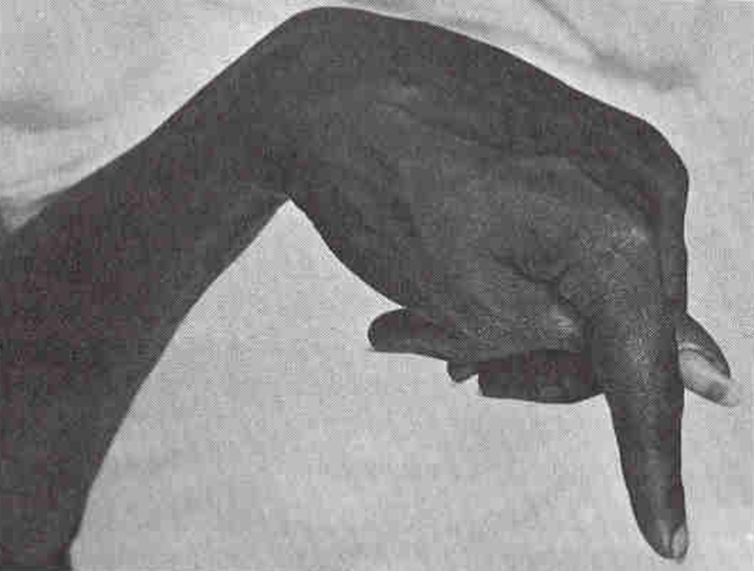
Tetany , clinically manifested by → carpopedal spasm

Slide 9
Binding of calcium to albumin is pH-dependent
Acute respiraqory alkalosis increases calcium binding to protein → thereby decreases ionized calcium level
When ionized calcium falls below normal, permeability of neuronal cell-membranes to sodium increases → depolarization → hyperexcitability of the nervous system → patients become prone to develop tetanic muscle contractions & seizures .

Slide 10
99% of total – body Ca⁺⁺ is contained in bone.
Bone is not a fixed unchanging tissue, it is constantly being remodeled it can either withdraws Ca⁺⁺ form ECF or deposit it there.
Increase in protein con. in total ca⁺⁺ con.
Decrease in protein con. In total ca⁺⁺ con.
The effects on ionized Ca⁺⁺ conc. are in significant.
Changes in anion con. Alter the ionized Ca⁺⁺ con. e.g.
plasma phosphate con. The conc. of Ca⁺⁺
complex to phosphate
ionized Ca⁺⁺ con.

Slide 11
Hormonal Regulation of Calcium
3 principal hormones regulate serum Ca⁺⁺ level .
2 of them increase it :
(1) Vitamin D3 (1,25-dihydroxy ) ( taken in food & synthesized in the skin )
(2) Parathyroid hormone (PTH) : polypeptide hormone secreted by Parathyroid Glands .
And the third one one decreases it :
(3) Calcitonin : polypeptide hormone secreted by Parafollicular (C ) cells of Thyroid Gland
NB : While PTH and vitamin D act to increase plasma Ca⁺⁺ → only calcitonin causes a decrease in plasma Ca⁺⁺.

Slide 12
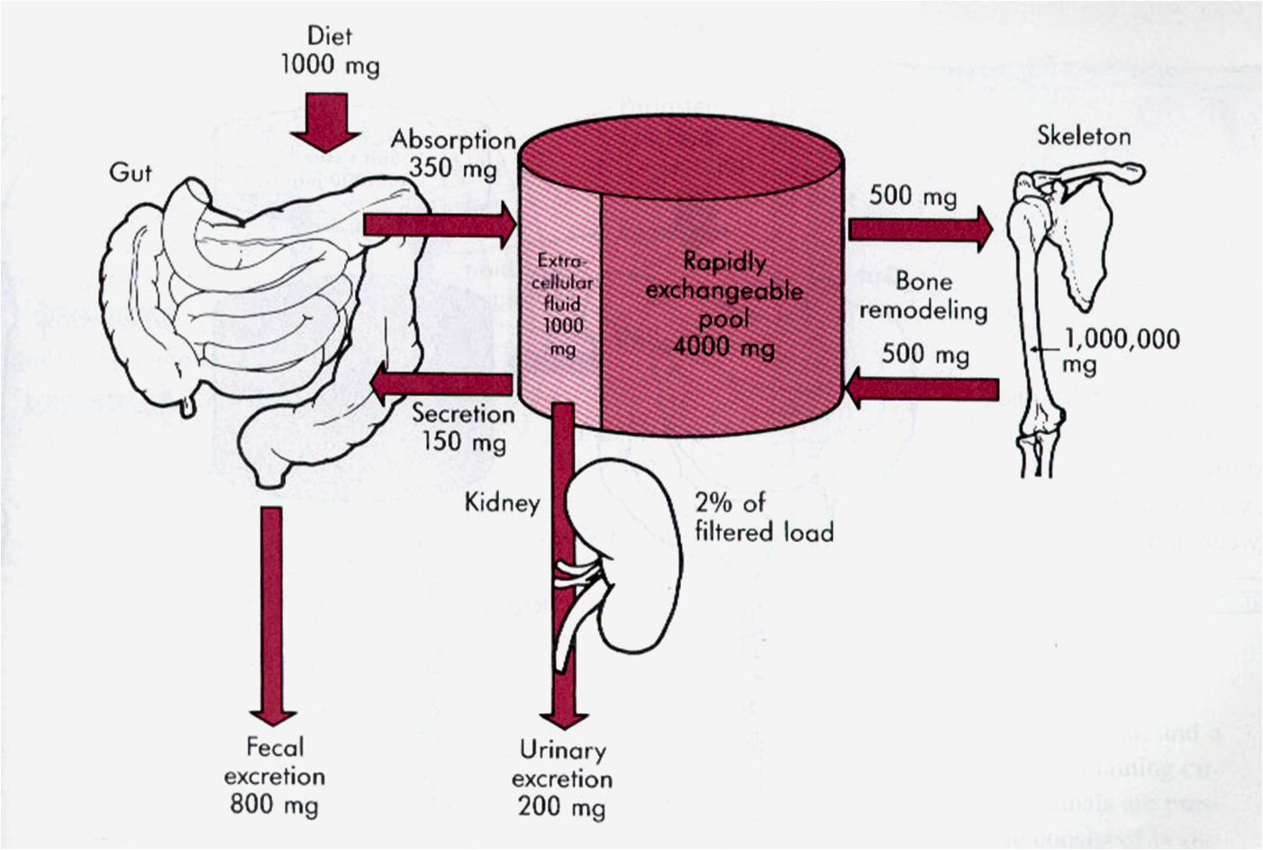
Calcium ion concentration in the ECF is maintained by
Intestine
Bone
Kidney

Slide 13
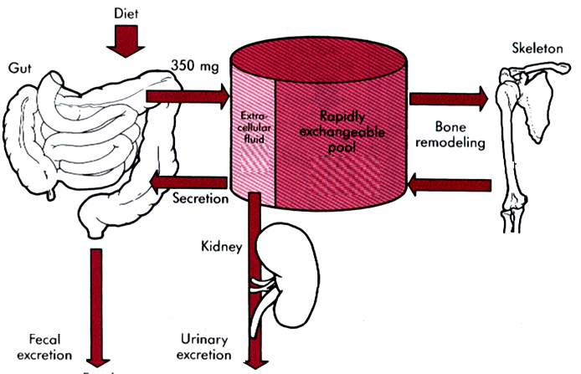
Hormonal Regulation of Ca++ :
Vitamin D3 →
increases blood Ca++ level
by →
(1) stimulating dietary calcium absorption by the intestine
(2) stimulating osteoclasts
( that remove calcium from bone )
Parathyroid hormone
( PTH) →
increases Ca⁺⁺ levels
by→
(1) stimulating Ca⁺⁺ resorption from bone ( by activating, osteoclasts ) → passing Ca⁺⁺ to the ECF
(2) Stimulating Ca++ reabsorption (and phosphate excretion) by the kidneys
Calcitonin →
decreases blood Ca⁺⁺ levels → by stimulating bpne –forming cells (osteoblasts ) and inhibitong bone-resorbing cells ( osteoclasts ) .
Notes:
Some books claim that PTH also increases intestinal absorption of dietary calcium

Slide 14
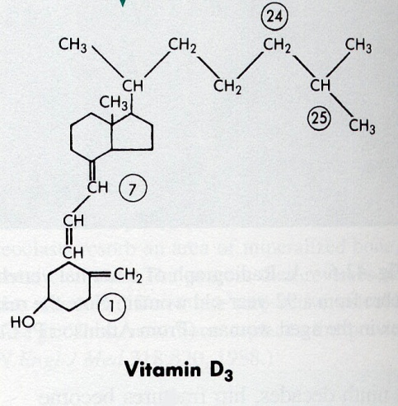
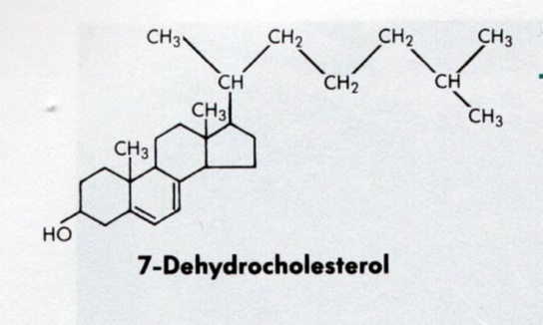
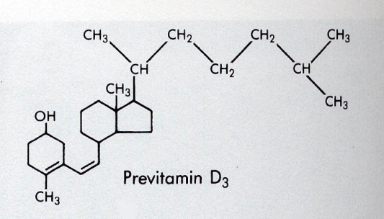
Vitamin D
Keratinocytes in the skin synthesize 7-dehydrocholesterol .
7-dehydrocholesterol is photoconverted ( by UV light in skin) to Cholecalciferol (previtamin D3 ) ,
This form of Vitamin D is inactive, it requires modification to the active metabolite, 1,25-dihydroxy-D → by two hydroxylation reactions → the first one occurs in the liver and the second one in the kidney
When there is limited exposure to the sun , dietary vitamin D is essential .
If there is no sufficient exposure to the sun , or if there is ditary deficiency in vitamin D → Rickets ( in children ) or Osteomalacia ( in adults ) occur .
PTH stimulates Vit D synthesis

Slide 15
Vitamin D deficiency leads to a disease characterized by softening of bone
If it occurs in choildren → it is called Rickets
If it occurs in adults → it is called Osteomalacia
Most affected areas :
Metaphyses of long bones subjected to stress →
Wrists
Knees
Ankles

Slide 16
Clinical Features
Delayed dentition ( delayed teething )
Bowed legs(due to the effect of weight bearing on the legs) and Short stature
Swelling of wrists and ankles
Rachitic rosary
Craniotabes

Slide 17
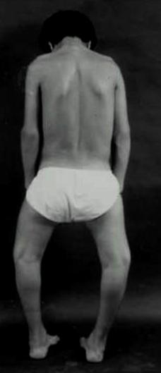
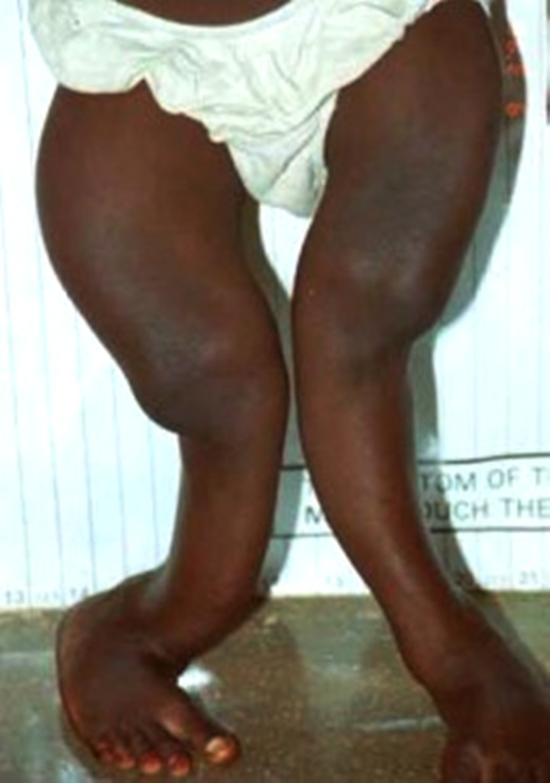
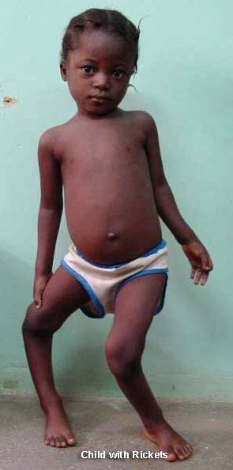
Osteomalacia- an adult disease characterized by a gradual softening and bending of the bones
Metaphyseal widening in wrists & knees + signs of bone rarfaction
Bowed legs ( Bowing of legs )
Knock-knees

Slide 18
Thanks

