Slide 1
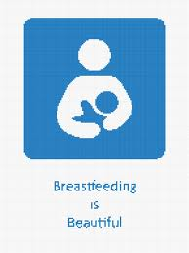
BREASTFEEDING
BY: RUBANA BAABBAD
CONSULTANT NEONATOLOGIST
Head of breastfeeding committee
MEMBER OF NATIONAL COMMITTEE OF BREASTFEEDING SUPPORT

Slide 2
contents
Introduction
Breastfeeding definitions
Breast milk contents
Advantages of breastfeeding
Preparation of the prospective mother
Establishing and maintaining the milk supply
Technique of breastfeeding
Expression of breastmilk
Contraindications

Slide 3
قال الحق تبارك وتعالى: (وَالْوَالِدَاتُ يُرْضِعْنَ أَوْلَادَهُنَّ حَوْلَيْنِ كَامِلَيْنِ لِمَنْ أَرَادَ أَنْ يُتِمَّ الرَّضَاعَةَ) [البقرة :233 ].

Slide 4
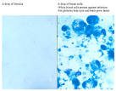
introduction
Breastfeeding is the normal feeding for infants during the first months of life which can ‘t be replicated .
It contains over 200 known component.
Breast milk bring both nutritive& non nutritive signals to the neonate .
It contain fat ,carbohydrate, proteins, menirals,vitamins,hormons, living cells, complements, enzymes,
Colostrum:
definition & contents.

Slide 5
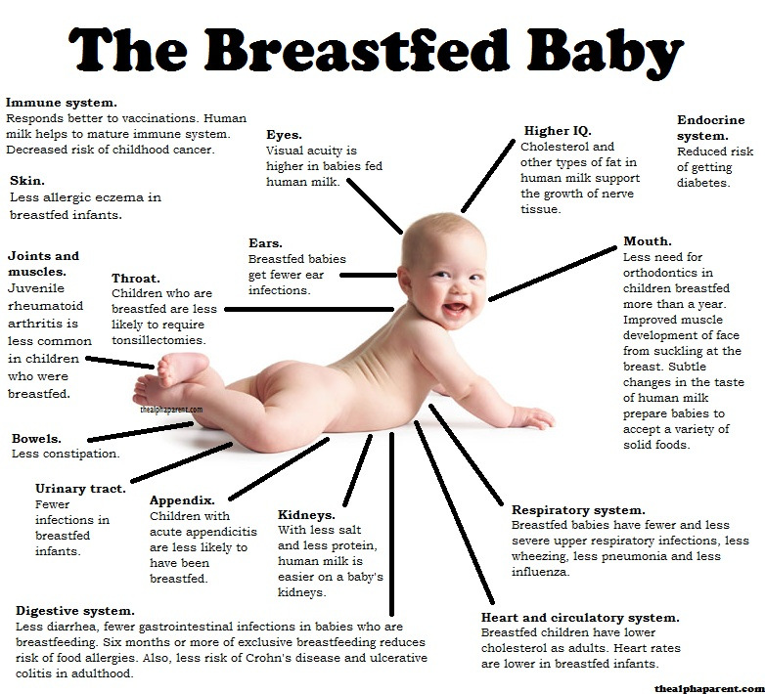

Slide 6
Breastfeeding Definitions
Exclusive breast milk
Total breast milk
Predominant breast milk
Partial
No

Slide 7
Advantages of breastfeeding
Superior health outcomes in breastfed infant
Protection during breastfeeding | Protection after weaning in early childhood | Protection later in childhood
Gastrointestinal and respiratory infections | Gastrointestinal and respiratory infections | Obesity
Urinary infections | Wheezing | Types I and II diabetes
Sepsis and meningitis | Celiac disease | Leukemia/lyphomas
Atopic dermatitis | Growth faltering | Crohn disease
Food allergies | Cognition | Cognition
Wheezing | Visual acuity | Strong, secured personality
Necrotizing enterocolitis
Celiac diseas
Growth faltering
Visual acuity

Slide 8
Benefits For Mothers
Medical: postpartum recovery
Impowerment (psychological benefits).
Improved health risks:
decrease risk of osteoporosis
Protection against ovarian censer.
reduced incidence of breast cancer.

Slide 9
Preparation of the prospective mother
Most women are physically capable of breastfeeding, provided the receive sufficient encouragement and are protected from discouraging experiences and comments while the secretion of breast milk is becoming established.
Physical Factors: leading to a good breastfeeding include: good health, having enough rest, freedom of worry, treatment of any disease, and adequate nutrition.
Retracted & inverted nipples.

Slide 10
Establishing and maintaining the milk supply
The most satisfactory stimulus to the secretion of human milk is regular and complete emptying of the breast; milk production is produce when the secreted milk is not drained.
The breastfeeding should begin as soon after delivery as the condition of the mother and the baby permits, preferably within the first hours.

Slide 11
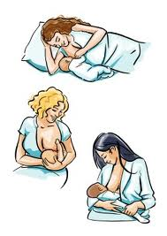
Technique & positions of breastfeeding

Slide 12
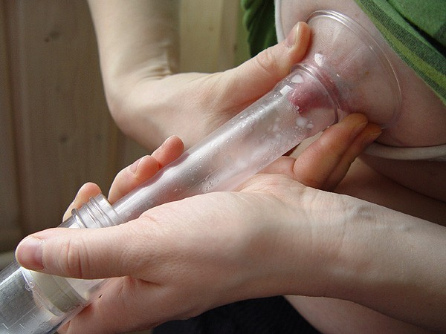
Expression of breastmilk

Slide 13
Contraindications
It is important to look at the entities that put the mother or infant at significant risk and are not remedial.
Infectious Diseases:
Life – threatening illnesses in the mother:
Medications:

Slide 14
THANK YOU ALL

