Slide 1
The Uterine Corpus
Emad Raddaoui, MD, FCAP, FASC
Hala Kfoury, FRCPA, KSUF

Slide 2
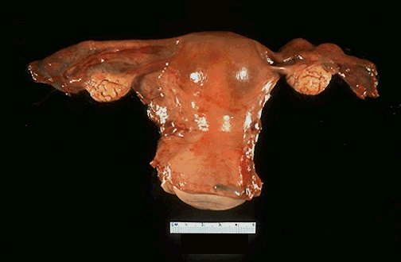

Slide 3
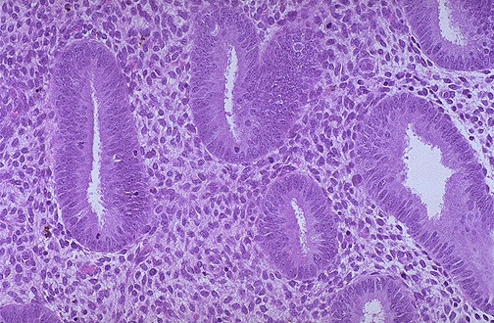
Proliferative Endomertium
Notes:
Proliferative endomertium

Slide 4
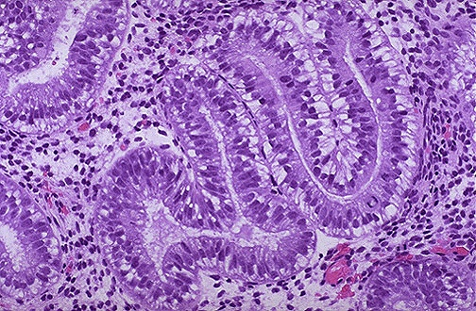
Secretary Endometrium
Notes:
Secretary Endometrium

Slide 5
Objectives
At the end of this lecture, the student should be able to:
Recognize acute and chronic endometritis
Know the risk factors, clinical presentation, macroscopic and histological features of endometrial hyperplasia and carcinoma.
Understand the pathology and clinical features of uterine leiomyomas.
Appreciate that leiomyoma (fibroid) is the commonest neoplasm arising in the female genital tract.

Slide 6
Acute endometritis
Is most often related to intrautreine trauma e.g. after an abortion either spontaneous or induced, complications of pregnancy, medical instrumentation or intrauterine contraceptive devices.
Is most often caused by Staphylococci, Streptococci.
Others like N. gonorrhoeae, gram-negative bacilli and occasionally fungi and viruses can also cause infection.

Slide 7
Chronic endometritis
Chronic endometritis is associated with :
Intrauterine contraceptive device use
pelvic inflammatory disease
retained products of conception following an abortion or delivery.
The etiologic agent is often not apparent and the patient is said to have non-specific chronic endometritis.

Slide 8
Chronic endometritis
Patients present with irregular bleeding.
Histologically, the presence of plasma cells in the endometrium is diagnostic. The stromal cells become spindled and swirl around the glands.
Sometimes granulomatous endometritis is noted in patients with tuberculosis.

Slide 9
Endometrial polyp
Is a localized benign overgrowth of endometrial tissue covered by epithelium.
Endometrial polyps are most common in women between 40 and 50 years.
The polyp may cause irregular bleeding.
It may be broad-based and sessile, pedunculated or attached to the endometrium by a slender stalk.
The size is variable from 1mm to a mass that fills the endometrial cavity.
Occasionally a polyp may protrude through the external os.

Slide 10
Endometrial polyp
Histology
Composed of glands of variable size and shape, fibrotic stroma and thick-walled blood vessels.
Clinical behavior:
Endometrial polyps are benign with no malignant potential but Sometimes malignant tumors may be found in them.

Slide 11
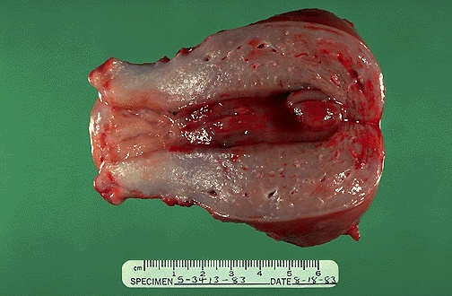

Slide 12
Leiomyoma (Fibroid)
Leiomyoma is a benign tumor of smooth muscle origin.
It is the most common neoplasm of the female genital tract and probably the most common neoplasm in women.
Is more common in women of African lineage.
Clinical and gross appearances
Patients may present with irregular bleeding, pelvic pain, pelvic mass, infertility.
The tumor is estrogen responsive and often increases in size during pregnancy and decreases in size during menopause.
It can be single or multiple. Mostly it is multiple.

Slide 13
Leiomyoma (Fibroid)
Leiomyoma may be located anywhere in the myometrium.
Submucosal tumors are present immediately below the endometrium, may be pedunculated and occasionally protrude though the cervix.
Intramural tumors, the most common, lie within the myometrium.
Subserosal fibroids lie beneath the serosal covering of the uterus or are pedunculated and attached to the serosa.
Pedunculated ones may undergo torsion and infarction or loose their connection to the uterus and become attached to another pelvic organ forming a "parasitic leiomyoma".
Grossly : the tumors appear as well circumscribed, spherical, dense and firm-to-hard masses with whorled, tan-white cut surfaces.

Slide 14
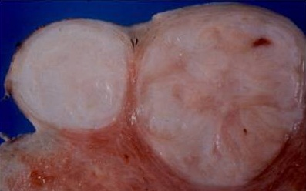
Leiomyoma. Note whorled cut surface

Slide 15
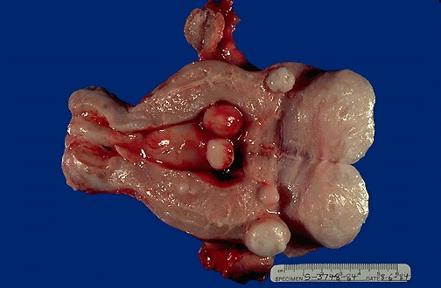

Slide 16
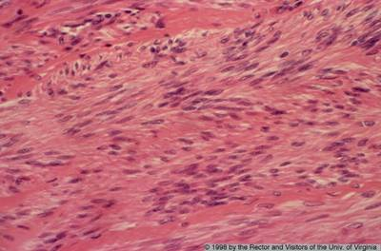
Leiomyoma composed of interlacing fibers of bland smooth muscle with collagenous stroma between bundles

Slide 17
Leiomyoma (Fibroid) Degenerative changes
Atrophy — the tumor reduces in size at menopause or after pregnancy following drop in estrogen level.
Hyaline change (hyalinization) — Usually occurs as the tumor "ages".
Myxoid and cystic change.
Calcification — common in menopausal women.
Septic with necrosis of the center due to circulatory inadequacy.
Red degeneration— venous thrombosis and congestion with interstitial hemorrhage may occur, most commonly in pregnancy. This is usually accompanied by pain, which may produce a clinical picture of acute abdomen.

Slide 18
Leiomyoma (Fibroid) Clinical behavior
This is a benign tumor with no appreciable malignant potential (incidence of malignant transformation is 0.1-0.5%).
It may cause anemia from heavy bleeding, or urinary or bowel obstruction (subserosal or parasitic tumors)
In pregnant women it may cause spontaneous abortion, precipitate labor, obstructed labor ,post partum hemorrhage (due to interference with uterine contraction), and red degeneration.

Slide 19
Endometrial Hyperplasia

Slide 20
Endometrial Hyperplasia
It refers to a process in which there is a proliferation of endometrial glands.
The glands are irregular size and shape with an increase in gland/stroma ratio compared to proliferative endometrium.
It is induced by persistent, prolonged estrogenic stimulation of the endometrium.

Slide 21
Endometrial Hyperplasia
The endometrial hyperplasia may progress to endometrial carcinoma.
The development of cancer is based on the level and duration of the estrogen excess.
The risk depends on the severity of the hyperplastic changes and associated cellular atypia.

Slide 22
Endometrial Hyperplasia, causes
A common cause is a succession of anovulatory cycles (failure of ovulation ).
It may also be caused by excessive endogenously produced estrogen in
-polycystic ovary syndrome including Stein-Leventhal syndrome,
-granulosa cell tumors of the ovary
-excessive ovarian cortical function (cortical stromal hyperplasia)
Prolonged exogenous administration of estrogenic steroids without counter balancing progestins

Slide 23
Endometrial Hyperplasia ,Clinical
Milder forms of hyperplasia tends to occur in younger patients
The great majority of mild hyperplasia regress , either spontaneously or after treatment .
The more severe forms ,occur predominantly in peri- and postmenopausal women .This form has a significant premalignant potential.
Patients usually present with abnormal uterine bleeding .

Slide 24
Endometrial Hyperplasia: microscopy
Characterized by proliferation of both glands and stroma.
In spite of proliferation of both components, glandular overcrowding occurs.
Endometrial hyperplasia is histologically classified according to:
1) Architecture as: simple or complex depending on the degree of glandular complexity and crowding, and
2) Cytologic features as: with or without atypia.

Slide 25
Endometrial Hyperplasia: classification
With atypia
Simple hyperplasia
Without atypia
With atypia
Complex hyperplasia
Without atypia.

Slide 26
Endometrial Hyperplasia: microscopy
Simple hyperplasia (cystic hyperplasia) — glands are cystically dilated and dispersed within abundant cellular stroma and give a "Swiss Cheese" appearance.
Complex hyperplasia —characterized by complex crowded glands with papillary infoldings and irregular shapes.
The crowded glands are back-to-back with very little intervening stroma.
Both simple and complex hyperplasia can be with or without atypia.

Slide 27
Endometrial Hyperplasia: Clinical behavior and premalignant potential
Some endometrial hyperplasia revert to normal spontaneously or with medical treatment, others persist as hyperplasia, and a few progresses to endometrial adenocarcinoma.
Generally, patients who have hyperplasia with atypia are more likely to develop carcinoma than those without atypia.

Slide 28
Endometrial Hyperplasia: Clinical behavior and premalignant potential
The risks for developing adenocarcinoma in each are as follows:
- Complex atypical — 30%
- Simple atypical — 10%
- Complex — 3%
- Simple — 1%
Atypical hyperplasia in postmenopausal women appears to have a higher rate of progression to adenocarcinoma.

Slide 29
Endometrial Hyperplasia, Risk Factors
Obesity
Western diet
Nulliparity
Diabetes Mellitus
Hypertension
Hyperestrinism

Slide 30
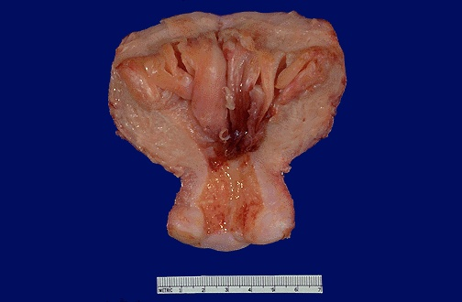

Slide 31
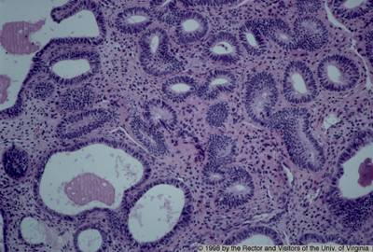
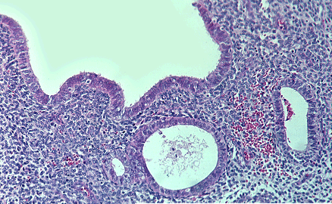
Simple hyperplasia with dilated glands

Slide 32
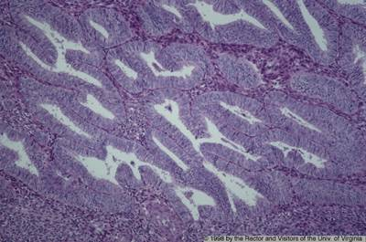
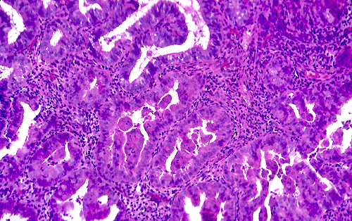
Complex atypical hyperplasia with back-to-back arrangement of glands and papillary tufting

Slide 33
Endometrial adenocarcinoma
Epidemiology:
It is the most common invasive tumor of the female genital tract in the U.S.
Worldwide, it is the fifth commonest cancer in women.

Slide 34
Risk Factors, Adenocarcinoma
Obesity (women with upper body fat have 3 times the risk of women with lower body fat),
Estrogen therapy
Nulliparity (as a result of infertility due to chronic anovulation),
Chronic anovulation
Late menopause
Hypertension
Diabetes
Tamoxifen therapy
High socioeconomic status.
The disease may follow atypical hyperplasia but may occur independently of it especially in older patients.

Slide 35
Endometrial adenocarcinoma
Clinical presentation
Most patients are between 50 and 59 years.
Endometrial adenocarcinoma manifests as marked leukorrhea and abnormal vaginal bleeding.
The tumor may grow in a diffuse or polypoid pattern.
It often involves multiple areas of the endometrium

Slide 36
Endometrial Adenocarcinoma :morphology
May closely resemble normal endometrium
May be exophytic
May be Infiltrative
May be polypoid

Slide 37
Endometrial adenocarcinoma, histology:
The commonest type is :
Endometrioid adenocarcinoma.
Other types include:
Clear cell
Adeno-squamous
Papillary serous carcinoma.
Endometrioid carcinoma may show areas of benign looking squamous epithelium ( adenoacanthoma).
In adenosquamous carcinoma both glandular and squamous components appear malignant.

Slide 38
Endometrial adenocarcinoma, prognosis:
Clinical behavior depends on the histologic type, the grade (degree of differentiation) and the stage (extent of spread).
Endometrioid carcinoma has a better prognosis than the other histological types, which tend to occur at a higher stage.
Staging is based on:
Degree of myometrial invasion, cervical, adnexal and adjacent pelvic organ invasion,
Result of peritoneal fluid cytology and
Distant organ metastasis.
Lymph node status is an important prognostic factor.

Slide 39
Endometrial Carcinoma,prognosis:
75% of patients present with stage I disease and these have 95% 5-year survival.
The tumors associated with unopposed estrogen tend to have low histologic grade and clinical stage, hence tend to have better prognosis.
These usually occur in young women.
20% of endometrial carcinoma there is no association with hyperestrinism or preexisting hyperplasia ,these cancers tend to occur late in life and have a poor prognosis.

Slide 40
Endometrial Carcinoma , Grading and staging
Grading is from 1 to 3
Staging is from 1 to 4
Stage 1 : Confined to uterus corpus
Stage 2 : Cervix involvement
Stage 3 : beyond the uterus ,but within the true pelvis
Stage 4 : Distant metastasis/ extrapelvic extension.

Slide 41
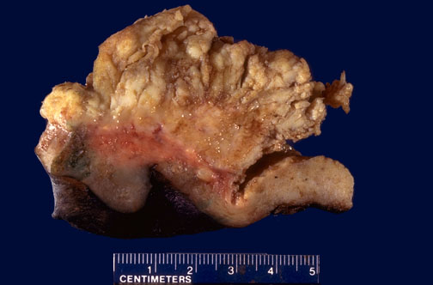
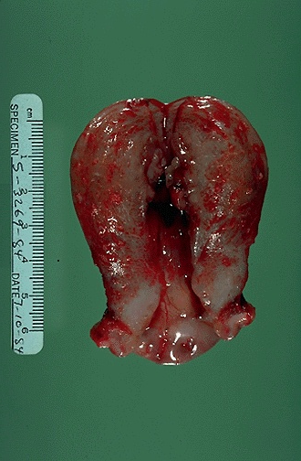

Slide 42
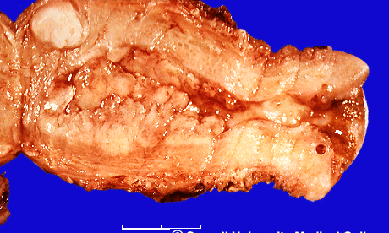

Slide 43
