Slide 1
Reproductive System, Ovarian Cysts and Tumors
Emad Raddaoui, FCAP, FASC hala kfoury, FRCPA, ksuf

Slide 2
Objectives
At the end of this lecture, the students should have a working knowledge of:
The pathology of the major types of ovarian cysts (follicular and luteal).
The classification and pathology of common ovarian tumours including surface epithelial, germ cell, stromal and metastatic neoplasms.

Slide 3
Ovaries
Ovarian mass Can be either :
- Physiological or Neoplastic
- Benign or Malignant
The most important medical problems in ovaries are the neoplasms
Death from ovarian cancers is more than that of cervix and uterus together
Silent growth of ovarian tumors is the rule ,which make them so dangerous

Slide 4
Ovarian
Cysts and Tumors
Non neoplastic cysts are common but they are not serious problems
Primary inflammation of ovaries is rare
Salpingitis of fallopian tubes frequently causes periovarian reaction (Salpingo-Oophoritis)

Slide 5
Non-Neoplastic and Functional Cysts of ovary
Non Neoplastic Cyst are more common than the neoplastic .
Corpus Luteum and Follicular cysts→physiological cysts.
A corpus luteum cyst results from delayed resolution of a corpus luteum’s central cavity and hemorrhage into this persistent mature corpus luteum.
This condition is self-limited.

Slide 6
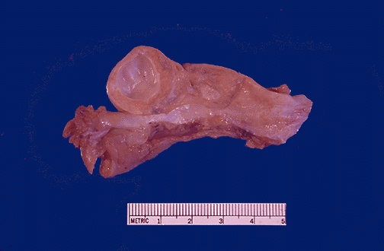
Are thin walled fluid filled structures lined internally by granulosa cells and externally by theca interna cells.
They arise from the ovarian follicles and are less than 5 cm
Are due to distension of un-ruptured graafian follicle.
Follicular cysts:
Occasionally such cysts may reach several centimeters in size and, if they rupture, can cause abdominal pain.

Slide 7
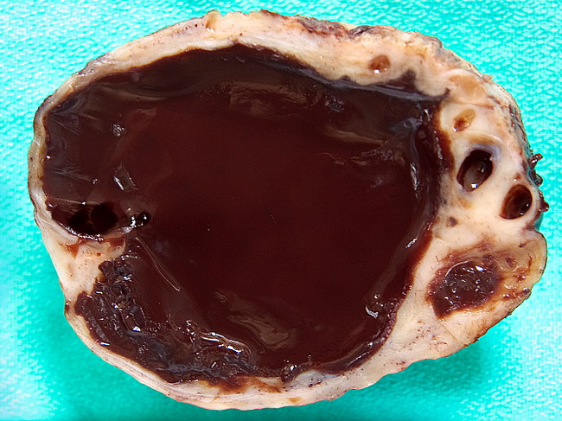
Chocolate/ Endometriotic cyst
Chocolate cyst is a blood containing cyst resulting from endometriosis with hemorrhage.

Slide 8
Ovarian Neoplasms- Introduction
The fifth most common cancer in US women
80% are benign – young (20-45)
20% are Malignant - older (>40)
6% of all cancers in women.
50% deaths due to late detection.

Slide 9
Ovarian Neoplasms: Risk Factors
Null parity
Gonadal Dysgenesis
Family History
Ovarian cancer genes
  BRCA1 (17q12) & BRCA2(13q12)
  (Cancer suppressor, Breast & ovary)

Slide 10
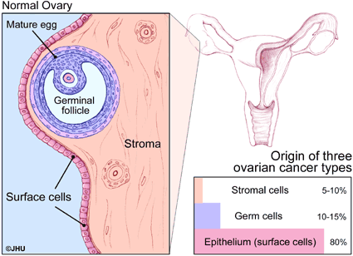
Ovarian Tumors
  Because the three major cell types make up the normal ovary, there are > 25 types of ovarian tumors each with many variants

Slide 11
Ovarian Tumors classification
There are THREE main types of primary ovarian tumors:
Epithelial Surface Tm : are derived from the cells on the surface of the ovary. This is the most common form of ovarian cancer and occurs primarily in adults.
Germ Cell Tm :ovarian tumors are derived from the egg producing cells within the body of the ovary. This occurs primarily in children and teens and is rare by comparison to epithelial ovarian tumors.
Sex Cord Tm :ovarian tumors are also rare in comparison to epithelial tumors and this class of tumors often produces steroid hormones.
In addition cancers derived from other organs can also spread to the ovaries Secondary /Metastatic Tumors

Slide 12
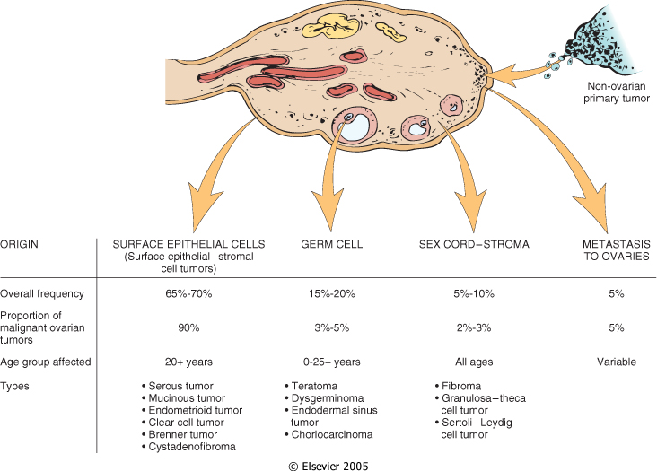

Notes:
Derivation of various ovarian neoplasms and some data on their frequency and age distribution

Slide 13
Surface Epithelial tumors:
Most common primary neoplasms
90% of malignant tumors of ovary
Serous (tubal)
Mucinous (endocervical & intestinal)
Endometrioid
Transitional cell - Brenners.
Morphologically
  Cystic – eg:Cystadenomas
  Solid/cystic –eg: Cystadenofibromas
  Solid – eg:adenofibromas

Slide 14
Surface Epithelial tumors
All types can be benign, borderline , or malignant
Benign : -gross: mostly cystic
microscopic: fine papillae, single layer covering (no stratification), no nuclear atypia, no stromal invasion
Borderline : gross: cystic / solid foci
microscopic; papillary complexity, stratification, nuclear atypia, no stromal invasion
Malignant : gross: mostly solid & hemorrhage / necrosis
microscopic: papillary complexity, stratification, nuclear atypia, stromal invasion
Notes:
Benign Tumors : are NOT cancer. Benign tumors are very rarely life-threatening. They do not spread and invade other tissues. Benign tumors can usually be removed and only infrequently grow back.
Borderline/ LMP Tumors :are a borderline form of cancer that may eventually spread and invade other tissues. This is a gray zone. Most of these tumors are benign but a few spread and progress. There are certain features that allow the pathologist to predict with some degree of confidence how one of these tumors will behave. These appear to be low grade cancers with limited invasive potential. They have better prognosis than malignant. Between the clearly benign and the solid malignant tumors we can see the tumors of low malignant potential. LMP tumors may seed the peritoneum, the implants of tumors are non invasive. Sometimes may behave as invasive peritoneal implants
Malignant Tumors :are cancer. Malignant cancer will spread beyond the ovary, invading and damaging other organs of the body. The spread of cancer beyond its tissue of origin is called metastasis.

Slide 15
Serous Tumors:
Frequently bilateral (30-66%).
75% benign/borderline, 25% malignant.
One unilocular cysts, papillary/less solid →benign/borderline
Tall columnar ciliated epithelium.
Papillary, solid, hemorrhage, necrosis or adhesions→malignancy
.
Extension to peritoneum – bad prognosis.
Notes:
May be solid ,usually cystic
The tumors are subdivided into benign (60%), borderline (15%) and malignant (25%).
Serous tumors are often bilateral. The more malignant the lesion, the more likely it is to be bilateral. The tumors are often cystic and filled with a clear serous fluid but sometimes may be mucoid.

Slide 16
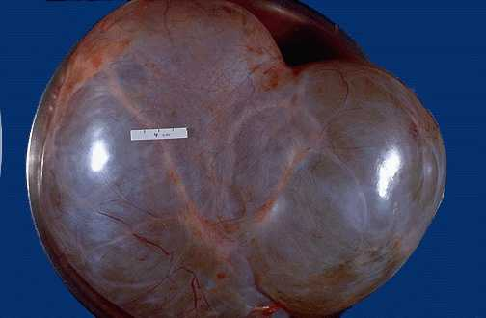
Serous Cystadenoma

Slide 17
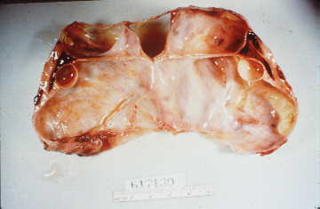
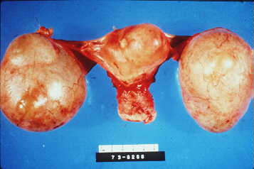
Serous Cystadenoma:
Bilateral cystadenoma
Notes:
Benign Tumors : are NOT cancer. Benign tumors are very rarely life-threatening. They do not spread and invade other tissues. Benign tumors can usually be removed and only infrequently grow back

Slide 18
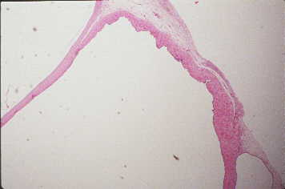
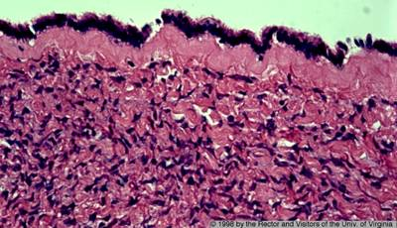
Serous Cystadenoma
single layer of columnar ciliated
Fine papillae
Notes:
Benign serous tumors, called serous cystadenomas, are frequently large, entirely cystic and thin-walled, and commonly unilocular. They are lined by smooth epithelial surface and contain thin, clear yellow fluid.

Slide 19
Malignant Serous Tumors
Malignant serous tumors (serous cystadenocarcinoma) is the commonest malignant ovarian tumor, forming about a third of all cancers of the ovary.
The tumors are partly cystic and partly solid with exuberant excrescences, often with necrosis and hemorrhage.
Ovarian surface involvement may be present.
These tumors usually present with ascites due to abdominal metastases

Slide 20
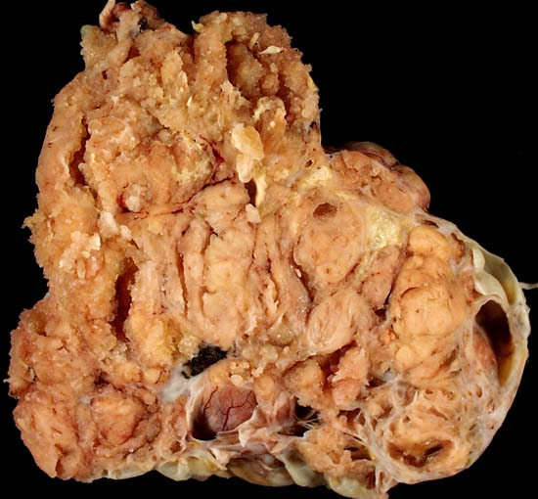
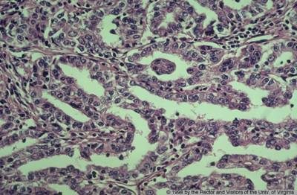
Serous cystadenocarcinoma
Papillary complexity
Nuclear
stratification& atypia
stromal invasion
Psammoma bodies

Slide 21
Mucinous Tumors:
Less common 25%, very large.
Rarely malignant - 15%.
Multiloculated, many small cysts.
Rarely bilateral – 5-20%.
Tall columnar, apical mucin.
Pseudomyxoma peritonei.

Slide 22
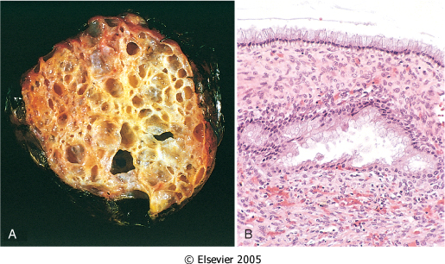

Slide 23
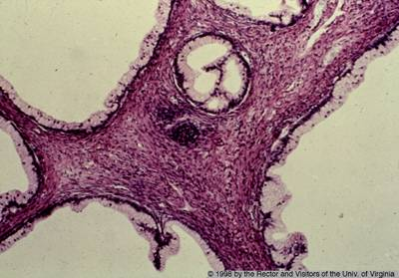
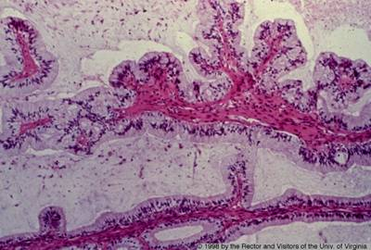
Mucinous cystadenoma
Multilocular cyst lined by single layer of columnar cells with basally placed nuclei and apical mucin.

Slide 24
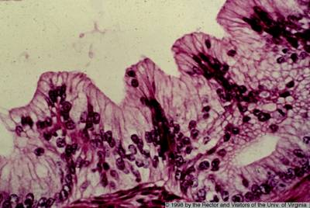
Mucinous cystadenoma-borderline
Papillary complexity
Nuclear stratification& atypia
No stromal invasion

Slide 25
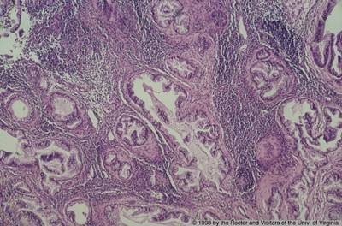
Mucinous cystadenocarcinoma
Papillary complexity
Nuclear stratification& atypia
stromal invasion
Notes:
Malignant Tumors :are cancer. Malignant cancer will spread beyond the ovary, invading and damaging other organs of the body. The spread of cancer beyond its tissue of origin is called metastasis.

Slide 26
Endometrioid tumors
most are unilateral (40% are bilateral)
cells look like endometrium even though they are coming from the ovary.
Most of them are malignant
about 20% of all ovarian tumors
many are associated with endometrial cancer (30%)
patient may have concurrent endometriosis

Slide 27
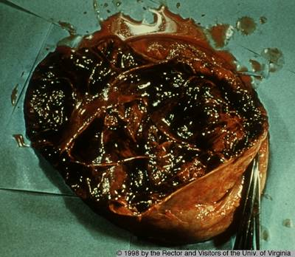
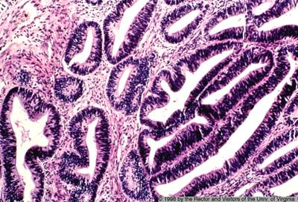
Endometrioid adenocarcinoma
Solid / cyst filled by hemorrhage & necrosis
stromal invasion by irregular malignant endometrial glands

Slide 28
Sex Cord-Stromal tumors
Granulosa Cell tuomr
Thecoma –Fibroma
Sertoli-Leydig cell tumor

Slide 29
Sex Cord Tumors:
Granulosa Cell Tumor
Unilateral, solid and cystic
Hormonally active tumor
The most common estrogenic ovarian neoplasm.
can be associated with endometrial hyperplasia and carcinoma
The adult form occurs mainly in postmenopausal women, associated with endometrial hyperplasia and carcinoma
The juvenile type occurs in the first two decades, cause precocious sexual development.

Slide 30
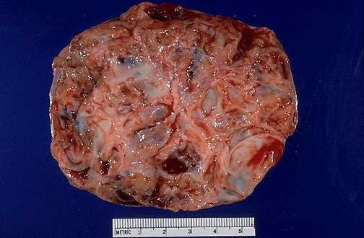
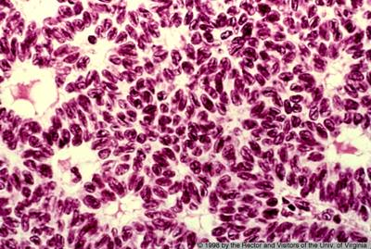
Sheets of granulosa cells containing spaces lined by the cells to give a follicle-like appearance (Call-Exner bodies).
Granulosa Cell Tumor
Solid with hemorrhage

Slide 31
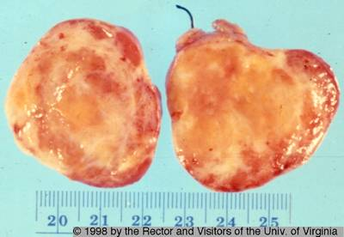
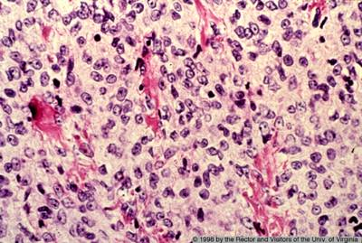
Thecoma-fibroma
Functional tumors producing estrogen
It occur in postmenopausal women
Endometrial hyperplasia or carcinoma may develop
Gross: Solid tumor with variegated yellow - orange appearance.
M/E: sheets of round to oval cells with pale cytoplasm containing lipid.
Notes:
Pure theca cell tumors also occur. They are functional tumors producing estrogen and occur in postmenopausal women.
Thecomas vary in size from small to large, solid tumors, and vary in color from yellow to orange depending on the amount of lipid content.
Fibrothecomas are a mixture of fibromas and thecomas

Slide 32
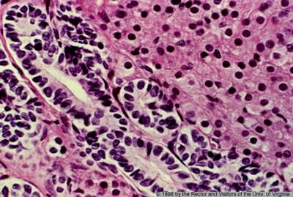
Sertoli-Leydig cell tumors
1% of ovarian neoplasms
It occur predominantly in young women.
Commonly androgenic, cause defeminization of women manifested as breast atrophy, amenorrhea, and loss of hair and hip fat , to virilization with hirsutism
M/E: Tubules lined by Sertoli cells and sheet of Leydig cells

Slide 33
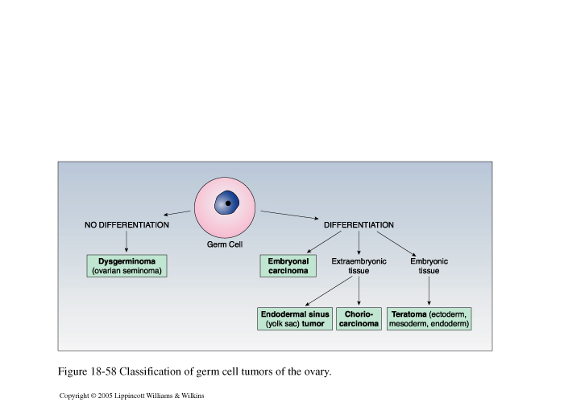
Germ cell tumor- classification

Slide 34
Dysgerminoma
The ovarian counterpart of the testicular seminoma
2% of all ovarian malignancies
Most common malignant germ cell tumor
Affects primarily younger females with the majority in the second and third decades.
It is the most frequently encountered ovarian malignancy in pregnancy
An excellent prognosis. Highly radiosensitive .
Composed of malignant germ cells, admixed with nonneoplastic chronic inflammatory cells and occasionally granulomatous inflammation

Slide 35
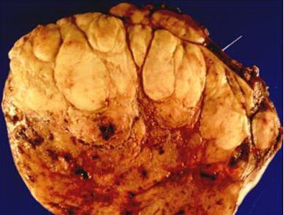
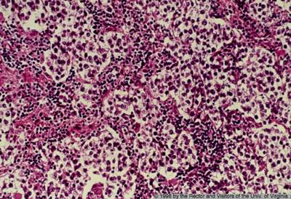
Dysgerminoma
Solid/ lobulated mass with foci of hemorrhage
sheets of monotonous rounded cells with pale cytoplasm and central nuclei

Slide 36
GCT: Embryonal carcinoma
uncommon ovarian germ cell neoplasm
usually occurs in combination with yolk sac tumor
occurs in children and young adults
Typically unilateral, solid tumor with hemorrhage and necrosis
Aggressive, highly malignant neoplasm that is radio-resistant but responds to combination chemotherapy

Slide 37
Endodermal sinus tumor (Yolk sac carcinoma)
Tumor is a highly malignant and clinically aggressive neoplasm
Most frequently in children and young females
can be pure or a component of a mixed germ cell tumor
almost always a unilateral solid or solid cystic
highly malignant neoplasm that is radio resistant but responds to combination chemotherapy
Fatal within 2 years of diagnosis
Associated with elevated serum AFP levels

Slide 38
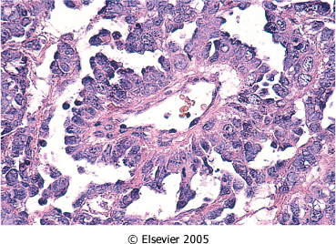
Its characteristic histologic feature is a glomerulus-like structure composed of a central blood vessel enveloped by germ cells within a space lined by germ cells (Schiller-Duval body)
Classic pattern shows perivascular formations (Schiller-Duval bodies) and eosinophilic globules that contain AFP

Slide 39
GCT: Choriocarcinoma
Rare
Occurs as a pure ovarian neoplasm or as a component of a mixed germ cell tumor
occurs in children and young adults
associated with elevated serum HCG levels
typically a unilateral, solid, hemorrhagic tumor
composed of malignant cytotrophoblast and syncytiotrophoblast
generally have metastasized widely through the bloodstream to the lungs, liver, bone, and other viscera by the time of diagnosis.

Slide 40
Germ Cell Tumors: Teratoma
15-20 % of Ovarian tumors.
Majority in the first 2 decades
The younger the patient ,the greater the likelihood of malignancy
Tumors are subdivided into mature, immature and monodermal.
Unlike those in the testis, the vast majority of ovarian germ cell tumors are benign mature cystic teratomas.
Immature teratomas are malignant and rare.

Slide 41
Germ Cell Tumors: Teratoma
  Mature cystic teratoma
  most common ovarian teratoma and most common ovarian germ cell tumor
  benign neoplasm that typically occurs during reproductive years
  cystic tumor with firm capsule, filled with sebaceous material and hair (occasionally teeth can be found), thickened area from which hair and teeth arise is called "Rokitansky's protuberance"
  composed of mature elements derived from all three germ layers (ectodermal elements such as skin, hair, sebaceous glands, and mature neural tissue predominate; cartilage, bone, respiratory and intestinal epithelium are common)
  complications include torsion, rupture, infection etc.

Slide 42
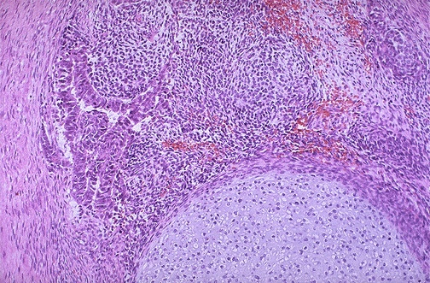
DERMOID CYST OF THE OVARY
(BENIGN CYSTIC TERATOMA OF THE OVARY)
Notes:
Complications of dermoid cyst- Torsion , infarction , struma ovarii and immature teratoma .

Slide 43
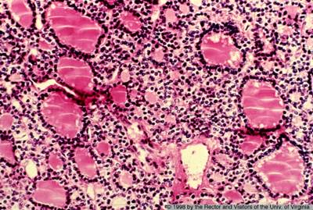
Germ Cell Tumors: Teratoma
Monodermal teratoma :
  a teratoma composed
  predominantly of one tissue element
  most common type is
  "struma ovarii", which is mature thyroid tissue
Immature teratoma
  usually a unilateral, solid tumor
  similar to mature teratoma but contains immature or embryonal tissues ,mainly neuroepithelium

Slide 44
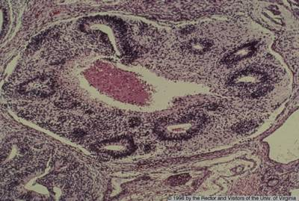
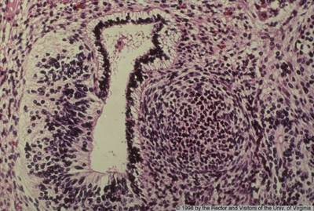
Immature Teratoma
primitive neuroepithelium with multiple neural tubes

Slide 45
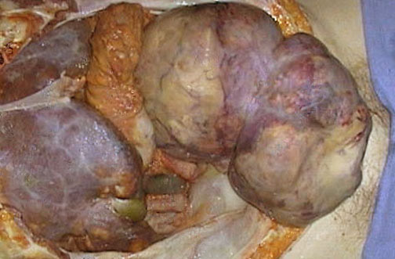
Krukenberg tumor
One of the most classic forms of metastatic carcinoma involving the ovaries is the Krukenberg tumor.
This tumor is a metastatic carcinoma
Composed of signet ring cells embedded within a hypercellular ovarian stroma that mimics sarcoma.
The most common sites of origin include stomach, colon and appendix.
Notes:
In metastatic Ca, primaries are Breast ,lung, G.I.T. and hematopoietic system.
Features suggesting the metastatic nature of an ovarian neoplasm include bilaterality, presence of multiple nodules of tumor, involvement of the surface and superficial cortex of the ovary, smaller tumor size.

