Slide 1
Reproductive practical block
Practical- I
Male reproductive organs

Slide 2
Male genital system
Normal anatomy and histology

Slide 3
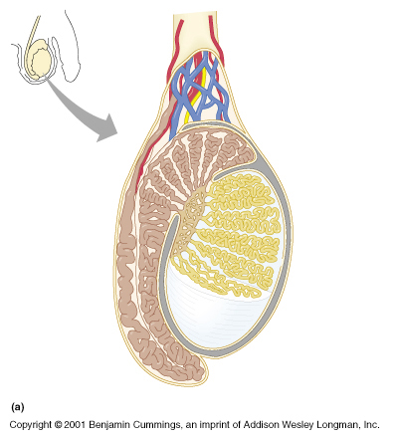

Slide 4
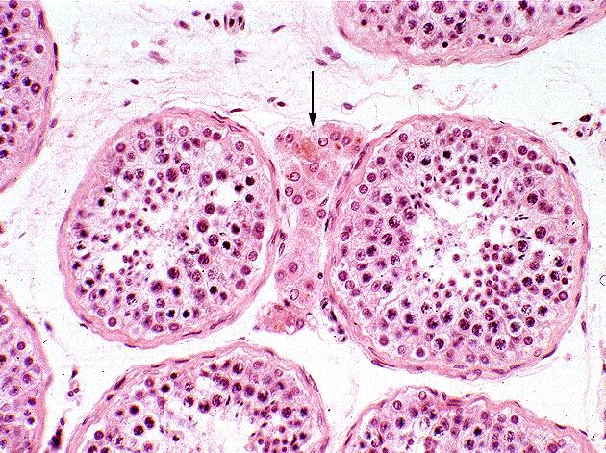
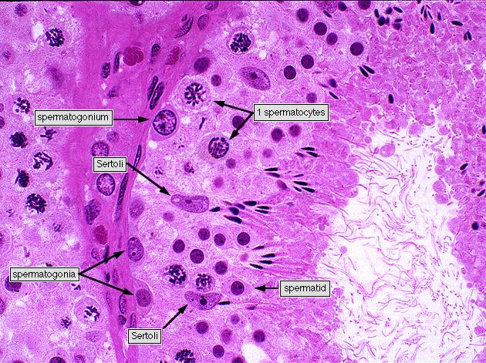

Slide 5
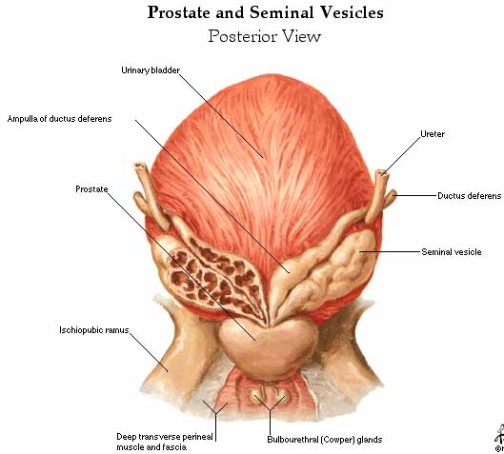
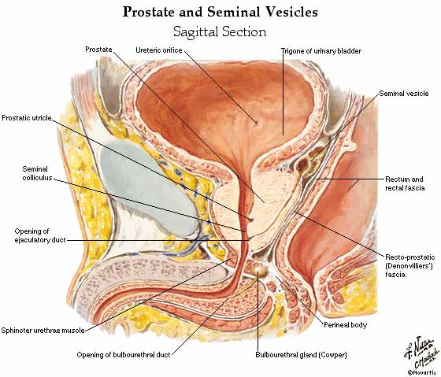
.
Notes:
Most carcinoma arise from the peripheral glands of the organ while nodular hyperplasia arise from centrally situated glands .

Slide 6
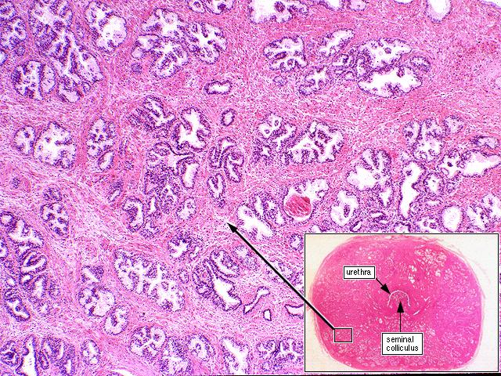
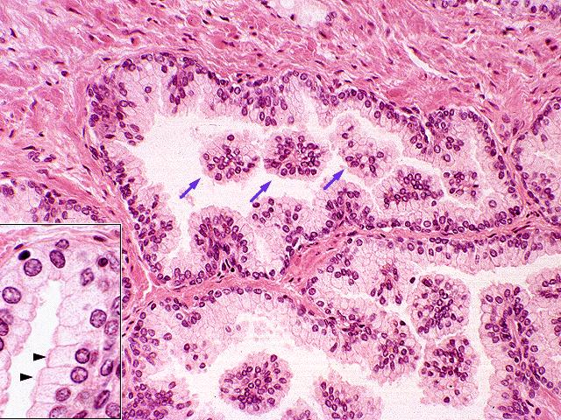
The prostate gland is shown to the right. The secretory glands, lined with simple columnar epithelium, differ somewhat in morphology as they move progressively from the urethra toward the gland periphery.
The glands near the urethra tend to enlarge with age and restrict the urethra, known as benign hypertrophy. Glands near the periphery are subject to carcinomatous change.
The glands have a characteristic folded appearance. There may also be distinct concretions that are spherical or oval concentrations of glycoprotein.
concretion

Slide 7
Gross and histopathology

Slide 8
1-Prostatic hyperplasia

Slide 9
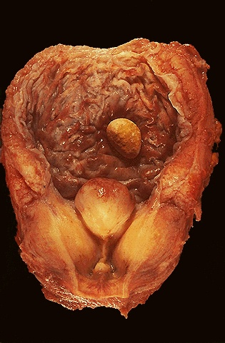
Prostatic hyperplasia

Slide 10
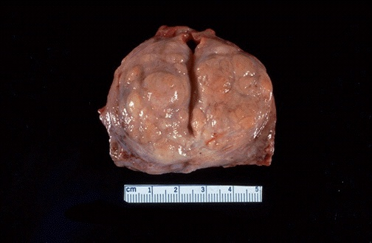
Hormone which can stimulate the benign prostatic hyperplasia is Testosterone-DHT
(diethylhydroxy testosterone).

Slide 11
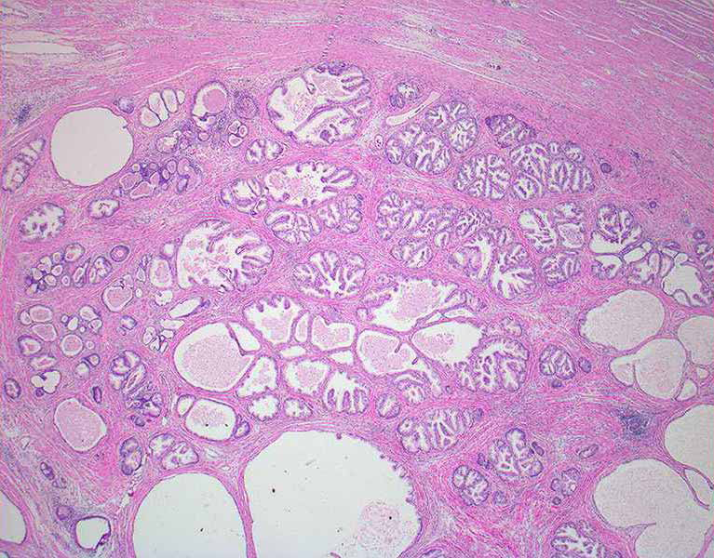

Slide 12
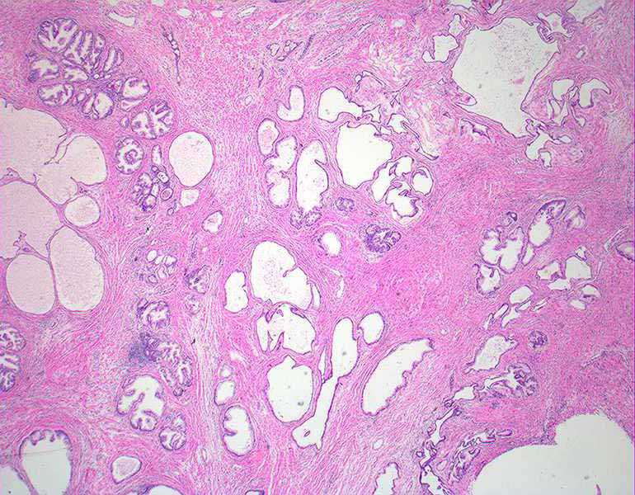
Hyperplastic fibromuscular stroma.
Glands lined by columnar and cuboidal cells

Slide 13
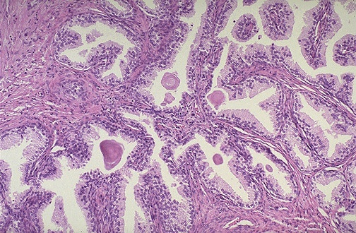
Corpora amylacea
Notes:
Hyperplastic fibromuscular stroma.
Glands lined by columnar and cuboidal cells

Slide 14
Hyperplasia of the prostate: Section of prostate shows:
Nodular hyperplasia of glandular and fibromuscular stromal tissue.
Each nodule shows large number of glands of variable sizes lined by an inner columnar and an outer cuboidal or flattened epithelium and some are cystically dilated.
Eosinophilic hyaline corpora amylacea is present in some glands.
There is increase in fibromuscular stroma around the glands with focal chronic inflammatory cell infiltration.

Slide 15
2-Seminoma of the testis

Slide 16
Seminoma
Pale and lobulated testicular mass with bulging and potato like cut surface with attached and congested spermatic cord . Most important risk factor is cryptorchidism (undescended testicle ) and ectopic testis .
It have a relatively good prognosis and is very radiosensitive

Slide 17
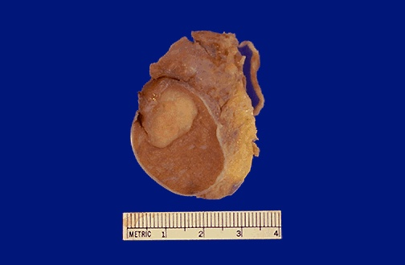

Slide 18
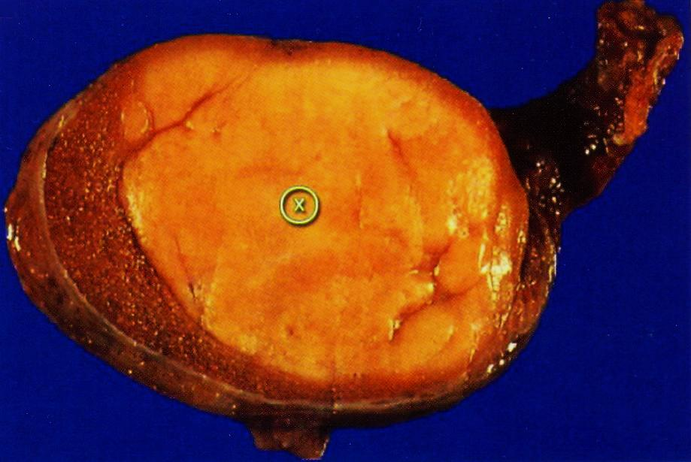
Partial replacement of the normal testicle by a pale and yellowish homogenous and solid mass.

Slide 19
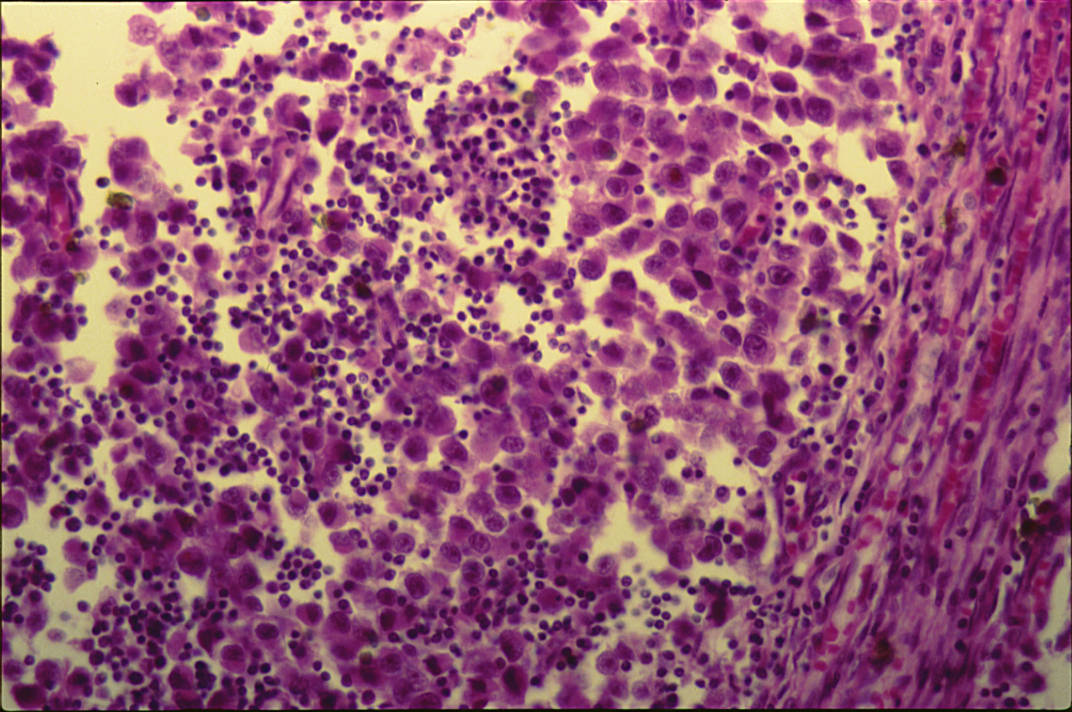
SEMINOMA OF THE TESTIS

Slide 20
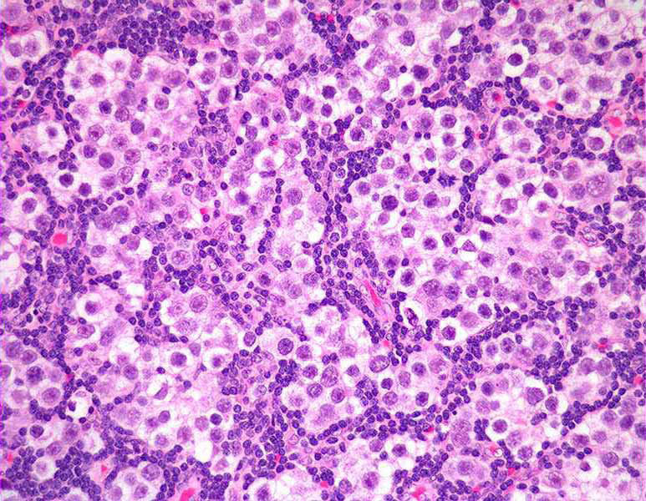
SEMINOMA OF THE TESTIS

Slide 21
Seminoma of the testis: Section of the testis shows:
A malignant tumour consisting of sheets of uniform malignant germ cells showing large vesicular nuclei and prominent nucleoli.
The clusters of malignant cells are separated by fibrous septae
Lymphocytes are infiltrating the septae and the tumor cells.

