Slide 1
Female genital system
Practical II
Dr Shaesta Naseem
10-4-14

Slide 2
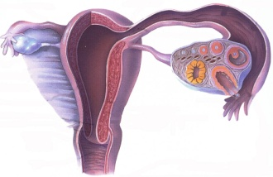
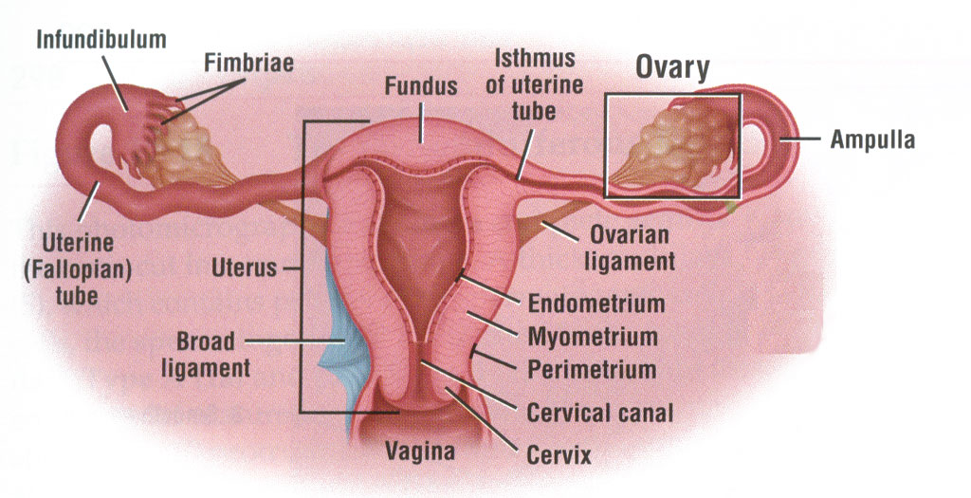
FEMALE REPRODUCTIVE SYSTEM
• OVIDUCT (UTERINE TUBES)
INFUNDIBULUM, AMPULLA, ISTHMUS, UTERINE
• UTERUS
FUNDUS, BODY (CORPUS), CERVIX

Slide 3
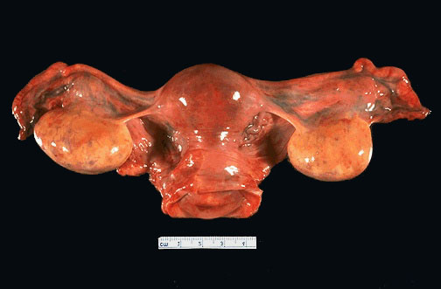

Slide 4
Female genital system
Gross and histopathology

Slide 5
Multiple leiomyoma

Slide 6
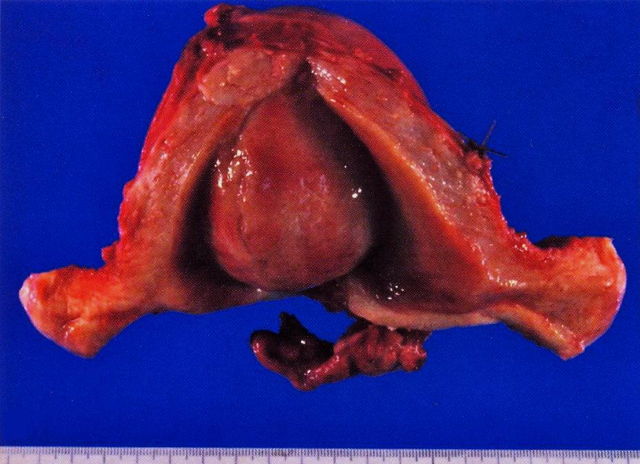

Slide 7
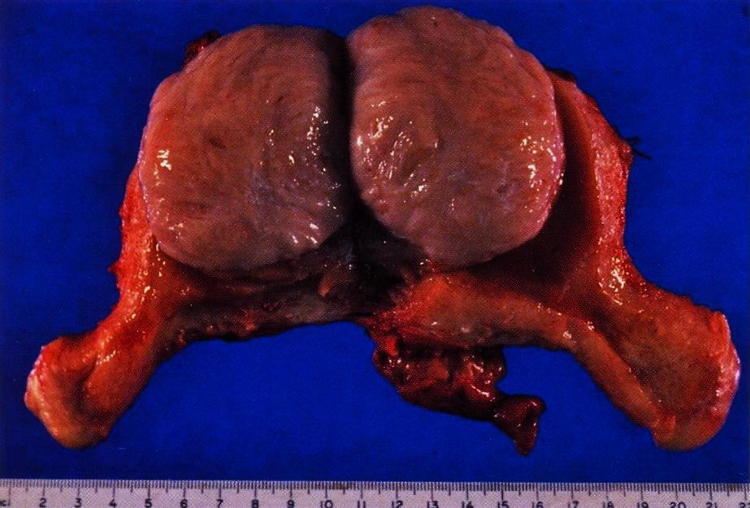

Slide 8
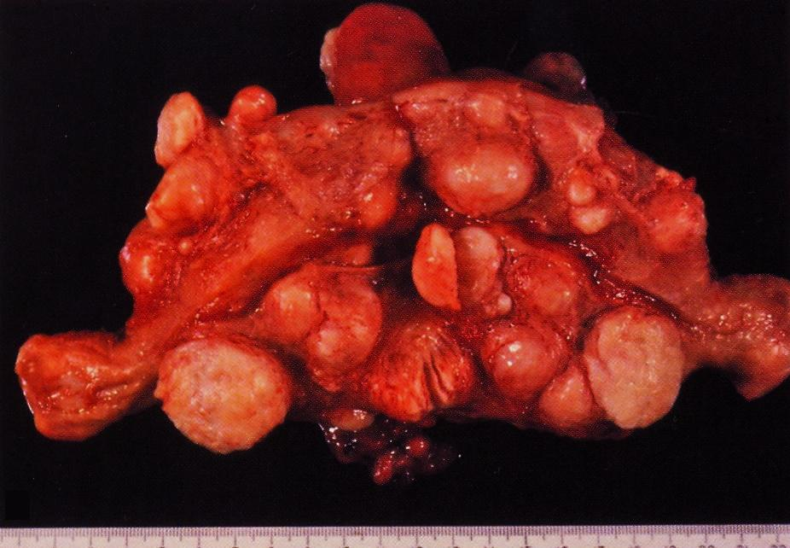
Multiple uterine leiomyomas
Uterus showing multiple pale and nodular tumor masses with a white and whorled cut surfaces.

Slide 9
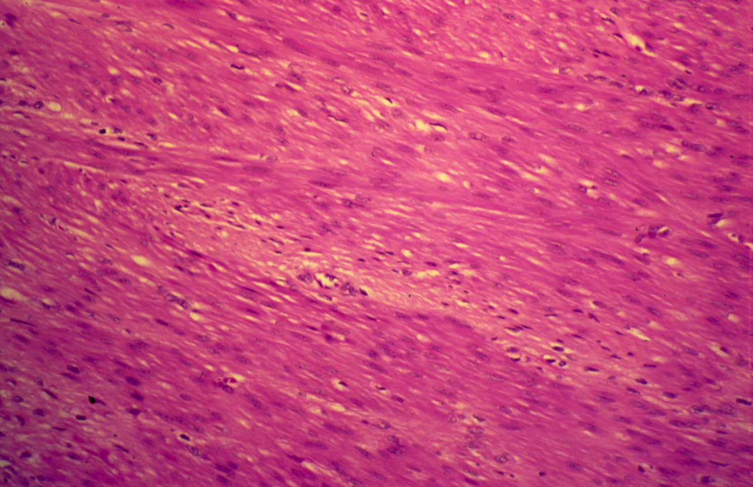
LEIOMYOMA (UTERINE)

Slide 10
Leiomyoma: Section of tumour shows:
A well demarcated tumor mass in the muscle coat of uterus without a definite capsule.
Benign tumour consists of interlacing bundles of smooth muscle and fibrous tissue.
The muscle cells are spindle shaped with elongated nuclei and eosinophilic cytoplasm.
Notes:
Benign neoplasm which has an excellent prognosis if excised.

Slide 11
Dermoid cyst of the ovary

Slide 12
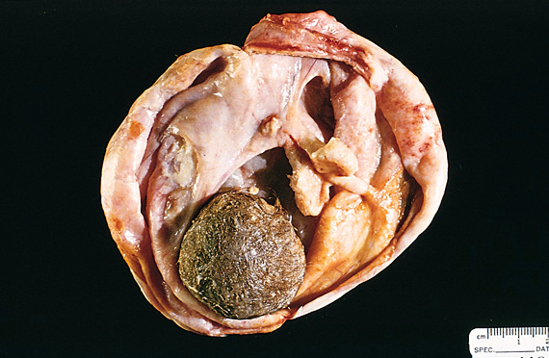
Benign cystic teratoma of ovary (dermoid cyst)
Multi-loculated cyst containing a ball of hair and sebum with areas of white calcifications.
Opened mature cystic teratoma ( dermoid cyst )
Notes:
Opened mature cystic teratoma ( dermoid cyst )

Slide 13
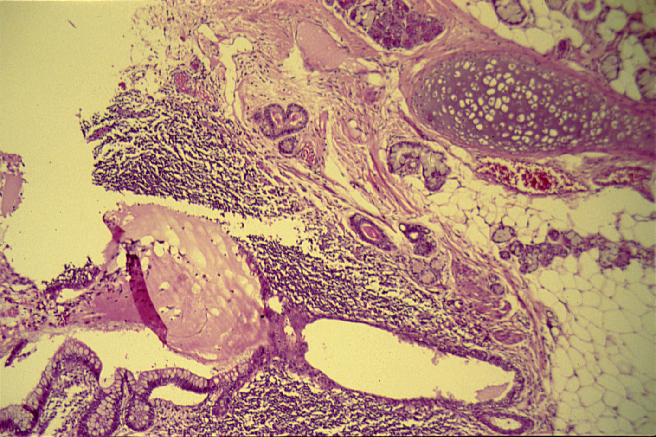
DERMOID CYST OF THE OVARY (BENIGN CYSTIC TERATOMA OF THE OVARY)
The picture shows cartilage , salivary glands ,fat , lymphoid tissue and intestinal epithelium

Slide 14
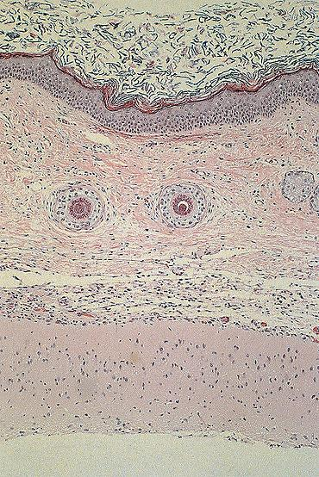
Keratinized squamous epithelium
Hair follicles.
Connective tissue.
Brain tissue.
Pregnancy test on urine and
Beta HCG (blood test) are done to exclude ectopic pregnancy
Picture shows skin tissue ( upper part ) beneath which there this brain tissue .

Slide 15
Dermoid cyst of the ovary: section of the cyst wall shows:
Stratified squamous epithelium
Underlying appendages (sweat glands, sebaceous glands, hair follicles)
Columnar ciliated epithelium, mucous and serous glands and
structures from other germ layers such as bone and cartilage
Lymphoid tissue, smooth muscle and large area of brain tissue containing neurons and glial cells.
Complications
Torsion, Infertility, Infection

