Slide 1
PPUBERTY
Physiology Lecture # 5
(Puberty)
Dr. Laila Al-Dokhi
Department of Physiology
College of Medicine
King Saud University

Slide 2
1. Definition of puberty. 2. Terms and events (thelarche, pubarche, menarche). 3. Hormonal changes ( gonadal and extra gonadl). 4. Female hormonal changes and male hormonal changes and secondary sexual characters. 5. Staging of pubertal development (tanner) in boys and girls. 6. Pubertal disorders ( precocious puberty and delayed puberty).
OBJECTIVES:

Slide 3
PUBERTY
A stage of human development when sexual maturation
and growth are completed and result in ability to reproduce.
Accelerated somatic growth
Maturation of primary sexual characteristics (gonads and genitals)
Appearance of secondary sexual characteristics (pubic and axillary hair, female breast development, male voice changes,...)
Menstruation and spermatogenesis begin

Slide 4
Puberty – Terms & Events
Thelarche: development of breast
Puberache: development of axillary & pubic hair
Menarche: the first menstrual period
Adrenarche: the onset of an increase in the secretion of androgens, responsible for development of pubic and axillary hair, body odour and acne.

Slide 5
Puberty – hormonal changes
Hormonal changes procede physical changes
Increased stimulation of hypothalamo-pituitary-gonadal axis
gradual activation of the GnRH (LHRH)
increases frequency and amplitude of LH pulses.
gonadotropins stimulate secretion of sexual steroids (estrogenes and androgenes)
extragonadal hormonal changes (elevation of IGF-I, and adrenal steroids)

Slide 6
Hypothalamic-Pituitary-Gonadal Axis
hypothalamus
GnRH
pituitary
Steroidal &
Non-steroidal
hormones
FSH/LH
ovary

Slide 7
Puberty:
Puberty – hormonal changes
Nocturnal GnRH pulsatility (LH secretion) precedes phenotypic changes by several years
First phenotypic changes:
breast development / testicular enlargement

Slide 8
Puberty – hormonal changes
in young children, LH and FSH levels insufficient to initiate gonadal function
between 9-12 yrs., blood levels of LH, FSH increase.
Hormonal changes precede physical changes.
amplitude of pulses increases, especially during sleep
high levels of LH, FSH initiate gonadal development

Slide 9
Puberty – hormonal changes
GH secretion from pituitary also increases
TSH (thyroid stimulating hormone) secretion from pituitary increases in both sexes:
increases metabolic rate
promotes tissue growth

Slide 10
Puberty – Female hormonal changes
surge of LH release initiates 1st ovarian cycle
usually not sufficient to cause ovulation during 1st cycle
brain and endocrine systems mature soon thereafter
estrogen levels in blood increase, due to growing follicles

Slide 11
Physical Changes
5 stages from childhood to full maturity
Marshall and Tanner (P1 – P5)
Reflect progression in changes o;f the external genitalia and of sexual hair
Secondary sexual characteristics
Mean age 10.5yrs in girls
Mean age 11.5 – 12yrs in boys

Slide 12
Puberty – Female hormonal changes
estrogen induces secondary sex characteristics:
growth of pelvis
deposit of subcutaneous fat
growth of internal reprod. organs, external genitalia
androgen release by adrenal glands increases (not as much as in male) growth of pubic hair, lowering of voice, growth of bone, increased secretion from sebaceous glands.

Slide 13
Staging of pubertal development (Tanner)
Pubertal development is classified according to the Tanner standard – 5 different stages
Girls: breast (B₁₋₅), pubic hair (Pu₁₋₅), axillary hair (A₁₋₅), menarche
Boys: testicular volume > 4 ml (Te), penis enlargement (G₁₋₅), pubic hair (Pu₁₋₅), axillary hair (A₁₋₅), spermarche
Monitoring of the pubertal growth acceleration
growth velocity is 2-3 times greater than prepubertal
sexual dimorfism in pubertal growth

Slide 14
Puberty: Girls
Breast enlargement usually first sign.
Thelarche
Menarche usually 2-3 yrs after breast development
Growth spurt peaks before menarche
Pubic and axillary hair growth: sign of adrenal androgen secretion
Starts at similar stage of apocrine gland sweat production and associated with adult body odour

Slide 15
Pubertal Stages (Tanner) Female
P1 Prepubertal
P2 Early development of subareolar breast bud +/- small amounts of pubic and axillary hair
P3 Increase in size of palpable breast tissue and areolae, increased pubic/axillary hair
P4 Breast tissue and areolae protrude above breast level. Further increased pubic/axillary hair growth
P5 Mature adult breast. Complete pubic/axillary hair growth

Slide 16
Puberty – Male hormonal changes
LH and FSH release increases ~10 yrs. of age
spermatogenesis; androgen secretion
adrenals also secrete androgens
androgens initiate growth of sex accessory structures (e.g. prostate), male secondary sex characteristics (facial hair, growth of larynx)

Slide 17
Puberty –Male hormonal changes
androgens causes retention of minerals in body to support bone and muscle growth
Sertoli cells also secrete some estrogen

Slide 18
Puberty: Boys
First signs often go unnoticed
Testicular enlargement (12-13 yrs)
Prepubertal testis – 2mls diameter
Puberty begins when volume reaches 4mls
Penile and scrotal enlargement occur approx 1 yr after testicular enlargement. Pubic hair appears at same time
Begins of spermatogenesis; androgen secretion

Slide 19
Pubertal Stages (Tanner) Male
P1 Prepubertal, testicular volume < 2mls
P2 Enlargement of scrotum and penis. Scrotum slightly pigmented. Few pubic hairs
P3 Lenghtening of penis. Further growth of testes and scrotum. Pubic hair darker
P4 Penis increases in length and thickness. Increased pigmentation of scrotum. Incresed pubic/ axillary hair
P5 Genitalia adult in size and shape. Completed pubic/axillary hair growth

Slide 20
Sleep dependent nocturnal rise in LH

Slide 21
Puberty – hormonal changes
HYPOTHALAMUS
GnRH AND GHRH
PITUITARY
GROWTH
LH & FSH
HORMONE
LIVER
OVARY
SEX STEROID SYNTHESIS
IGF-1
SEXUALMATURATION
SOMATIC
GROWTH

Slide 22
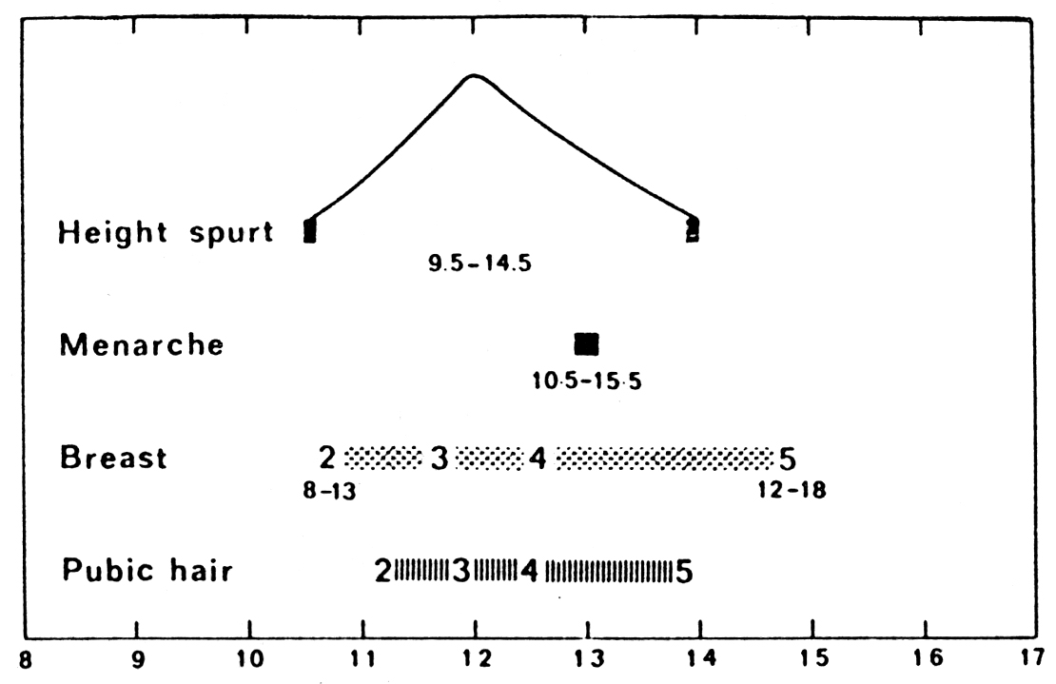
Sequence of normal puberty in girls

Slide 23
Normal pubertal development

Slide 24
Timing of Puberty
Genetics: 50-80% variation in pubertal timing.
trend toward earlier puberty exists within Western Europe and USA
examination of lifestyle changes may give clues regarding mechanisms inducing onset
one of the contributing factors: nutrition

Slide 25
Nutrition
Critical body weight must be attained before activation of the reproductive system”.
even though age of menarche is decreasing, the average body weight of menarche remains the same
earlier puberty due to improvement of nutrition, living conditions, healthcare?
evidence supporting hypothesis:
obese girls go through early menarche
malnutrition is associated with delayed menarche
primary amenorrhea common in lean female athletes
“bodyfat” setpoint very noticeable in girls with fluctuating body weight due to anorexia nervosa

Slide 26
Potential involvement of Leptin:
hypothalamus
Leptin
↓ NPY
↑GnRH
↑symp. n.s.
insulin
glucocorticoids
Adipocyte
(fat cell)
↓food intake
↑thermogenesis
↑reproduction

Slide 27
Pubertal disorders
Precoccious puberty
B. Delayed puberty

Slide 28
PRECOCIOUS PUBERTY
Precocious onset of puberty is defined as occurring younger than 2 SD before the average age
Girls <8 years old
Boys <9 years old
More common in females.
Uncommon in males (usually pathological).
Maybe associated with a growth spurt.
Gonadotrophin-dependent (true / central )
Gonadotrophin-independent

Slide 29
Gonadotrophin-dependent precocious puberty
(true / central )
Intra-cranial lesions (tumours, hydrocephalus, CNS malformations
Gonadotrophin secreting tumours – v. rare

Slide 30
Gonadotrophin-independent precocious puberty
Precocious pseudopuberty
No spermatogenesis or ovarian development
FSH & LH suppressed
Congenital adrenal hyperplasia (CAH)
Sex steroid secereting tumours
adrenal or ovarian

Slide 31
Delayed puberty - definition
Initial physical changes of puberty are not present
by age 13 years in girls
(or primary amenorrhea at 15.5-16y)
by age 14 years in boys
Pubertal development is inappropriate
the interval between first signs of puberty and menarche in girls/completion genital growth in boys is > 5 years

Slide 32
Causes of delayed puberty
Gonadal failure (Hypergonadotrophic hypogonadism)
Turner’s Syndrome
Post-malignancy chemo / radiotherapy / surgery
Polyglandular autoimmune syndromes
Gonadal deficiency
Congenital hypogonadotrophic hypogonadism (+anosmia)
Hypothalamic/pituitary lesions (tumours, post-radiotherapy)
Rare gene mutations inactivating FSH/LH or their receptors

Slide 33
Turner syndrome
Turner syndrome
Karyotype 45,X (45,X/46,XX, structural abnormalities of X chromosome)
Short stature (final height 144-146 cm)
Gonadal dysgenesis
Skletal abnormalities
Cardiac and kidney malformation
Dysmorfic face
No mental defect
Impairment of cognitive function)
Therapy: growth hormone, sex hormone substitution
H. Tuner, 1938

