Slide 1
Transplacental (Congenital) Infection
Ali M Somily MD

Slide 2
Objectives
To understand the epidemiology and clinical presentation of trans-plancental infections
To identify the most appropriate methods for the diagnosis of these infections
To be familiar with the management and prevention of these infection.

Slide 3
Terminology
Congenital
Perinatal
Neonatal
What is TORCH
Toxoplasmosis,
Other (syphilis ,parvovirus &VZV),
Rubella,
CMV,
Herpes( Hepatitis &HIV),
Notes:
Congenital In utero Trans placental
Perinatal During labour and delivery Exposure to genital secretions and blood
Neonatal After birth Direct contact, breast feeding or
nosocomial exposure

Slide 4
Risk and features of congenital infection
Risk of congenital infection:
Organism (Teratogenicity)
Type of maternal infection(Primary ,recurrent)
Time during pregnancy (1st,2nd,3rd Trimester)
features of congenital infection :
Intrauterine growth retardation(IUGR)
Skin rash
Microcephaly
Hepatosplenomegaly(HSM)
Thrombocytopenia
IgM, Persistent IgG
Notes:
Risk of IUI & fetal damage ;
Type of org.(teratogenic)
Type of maternal inf.(1º,R)
Time of inf .(1^{st ,}2nd or 3rd)

Slide 5
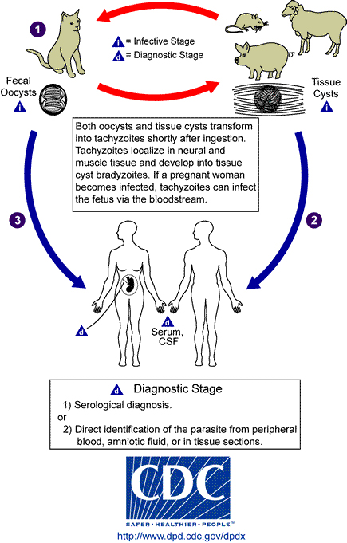
Toxoplasmosis
Toxoplasma gondii
Definitive host is the domestic cat
Contact with oocysts in feces
Ingestion of cysts (meats, garden products)
Can be transmitted from the mother to the baby

Slide 6
Epidemiolology
European countries (ie France, Greece)
Usually asymptomatic
Primary maternal infection in pregnancy
Infection (Transmission) rate higher with infection in 3rd trimester
Fetal death higher with infection in 1st trimester

Slide 7
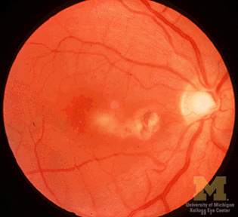
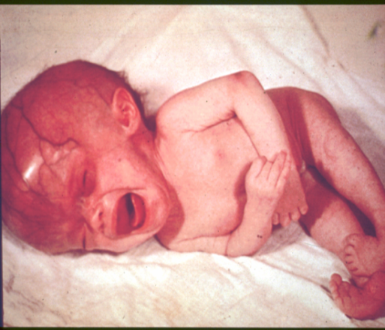
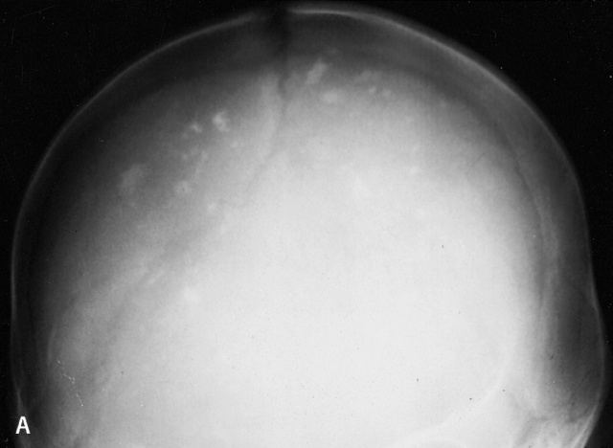
Clinical presentation
Mostly asymptomatic
Classic triad of symptoms:
Chorioretinitis
Hydrocephalus
Intracranial calcifications
Other symptoms include fever, rash, HSM, microcephaly, seizures, jaundice, thrombocytopenia, lymphadenopathy

Slide 8
Diagnosis , treatment and prevention
Diagnosis
Maternal serology IgM/IgA , IgG,
Fetal ultrasound/ tissue culture and PCR.
Newborn
Serology
Culture
PCR
Treatment
Spiramycin
Pyrimethamine and sulfadiazine
Prevention
Avoid exposure to contaminated food or water and undercooked meat
Hand washing

Slide 9
Syphilis
Treponema pallidum (spirochete)
Transmitted via sexual contact
Mother with primary or secondary syphilis
Typically occurs during second half of pregnancy

Slide 10
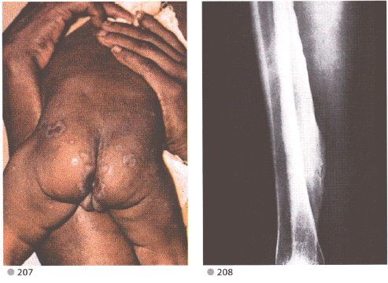
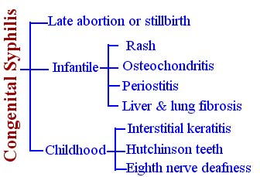
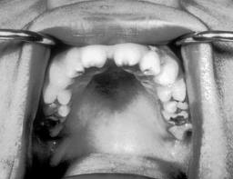
Clinical features
Intrauterine death in 25%
3 major classifications
and Funisitis (umbilical cord vasculitis)
Frontal bossing, Short maxilla, High palatal arch, Saddle nose , Perioral fissures
Notes:
Fetal: stillbirth, neonatal death, hydrops fetalis
Early congenital (typically 1st 5 weeks):Cutaneous lesions (palms/soles),HSM,Jaundice, Anemia, Snuffles, Periostitis and metaphysial dystrophy, Funisitis (umbilical cord vasculitis)
Late congenital: Frontal bossing, Short maxilla, High palatal arch, Hutchinson teeth, 8th nerve deafness, Saddle nose , Perioral fissures

Slide 11
Diagnosis and Treatment
Diagnosis
RPR/VDRL: nontreponemal test
MHA-TP/FTA-ABS: specific treponemal test
Confirmed if T. pallidum identified in skin lesions, placenta, umbilical cord, or at autopsy
Treatment
Penicillin G
Prevention
RPR/VDRL screen in ALL pregnant women early in pregnancy and at time of birth

Slide 12
Parvovirus P 19
Parvovirus P 19
Causative agent of Fifth disease (erythema infectiosum)
Spread by the respiratory route, blood and transplacental

Slide 13
Epidemiology
Most of the population is eventually infected.
Half of women of childbearing age are susceptible to infection.
Risk of fetal death highest when infection occurs during the second trimester of pregnancy (1st 20 wks of pregnancy (12%).
Minimal risk to the fetus if infection occurred during the third trimesters of pregnancy.

Slide 14
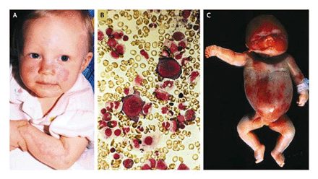
Clinical Faeture
Known to cause fetal loss through hydrops fetalis; severe anaemia, congestive heart failure, generalized oedema and fetal death
No evidence of teratogenecity

Slide 15
Diagnosis, and Treatment
Diagnosis
ultrasound
Serology IgM, persistant IgG
PCR
Traetment
intrauterine transfusions and administration of digoxin to the fetus.

Slide 16
Neonatal Varicella
90% of pregnant women already immune
Primary infection during pregnancy carries a greater risk of severe disease

Slide 17
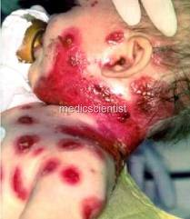
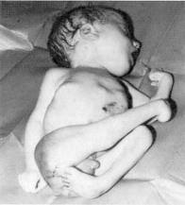
Clinical Features
First 20 weeks of Pregnancy
Up to 3% chance of transmission to the fetus, recognised congenital varicella syndrome;Scarring of skin, Hypoplasia of limbs, CNS and eye defects

Slide 18
Diagnosis
Test |  | Pregnant mother and Fetus | Neonate
Direct form the vesicles | Culture | + | +
 | DFA | + | +
 | PCR | + Fetal blood and amniotic fluid | +
Serology | IgM Rising IgG | + + | +
US and MRI |  | +

Slide 19
Treatment and Prevention
Acyclovir at first signs of varicella pneumonia
Pre-expoure;live-attenuated vaccines before or after pregnancy but not during pregnancy.
Postexposure Zoster immunoglobulin to susceptible pregnant women and infants whose mothers develop varicella during the last 5 days of pregnancy or the first 2 days after delivery and premature baby <28 wks of gestation

Slide 20
rubella
R=rubella
RNA enveloped virus, member of the togaviridae family
Spread by respiratory droplets and transplacentally

Slide 21
Epidemiology
Vaccine-preventable disease
No longer considered endemic.
Mild, self-limiting illness
Infection earlier in pregnancy has a higher probability of affected infant (first 12 wks 70% and 13-16 wks 20% and rare >16 wks of pregnancy)

Slide 22
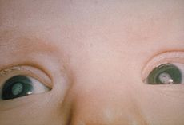
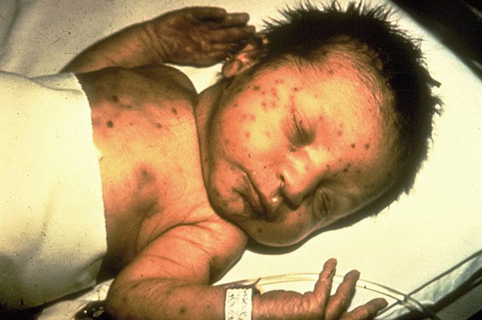
Clinical Features
Sensorineural hearing loss (most common)
Cataracts, glaucoma
Cardiac malformations
Neurologic (less common)
Others to include growth retardation, bone disease, HSM, thrombocytopenia, “blueberry muffin” lesions

Slide 23
Diagnosis
Maternal IgG is useless!
Viral isolation virus from nasal secretions, throat, blood, urine, CSF.
Serologic testing. IgM = recent postnatal or congenital infection.
Rising monthly IgG titers suggest congenital infection.

Slide 24
Treatment Prevention
Supportive care only with parent education
Prevention by immunization
Maternal screening
Vaccinate if not immune (avoid pregnancy for three months)

Slide 25
cytomegalovirus
C=cytomegalovirus
Most common congenital viral infection~40,000 infants per year.
Mild, self limiting illness

Slide 26
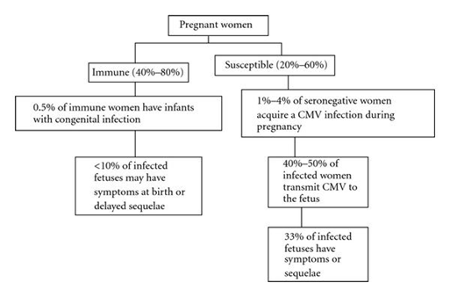
Epidemiology
Transmission can occur with primary infection or reactivation of virus but 40% risk of transmission in primary infection
Increased risk of transmission later in pregnancy but more severe sequalae associated with earlier acquisition

Slide 27
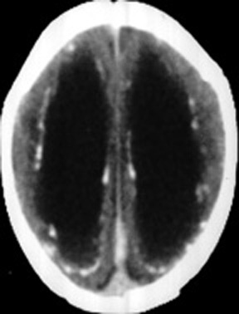
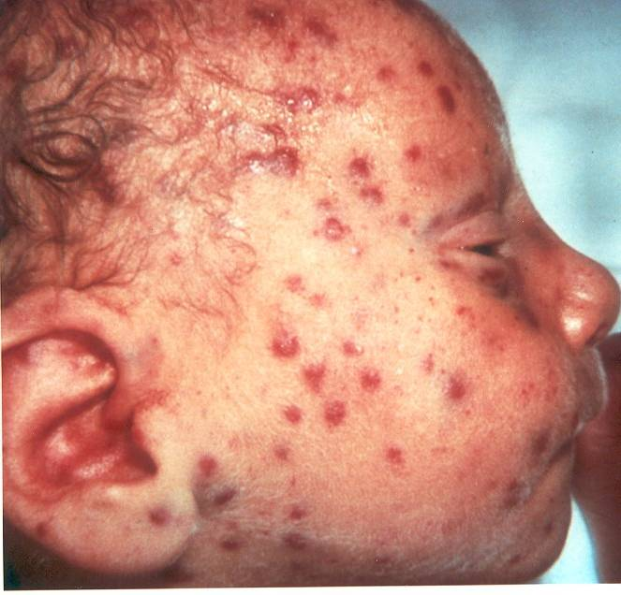
Clinical presentation
90% are asymptomatic at birth
Up to 15% develop symptoms later
Microcephaly, periventricular calcifications, neurological deficits, HSM, petechiae, jaundice, chorioretinitis
>80% develop long term complications: Hearing loss, vision impairment, developmental delay

Slide 28
Diagnosis
Maternal IgG shows only past infection
Viral isolation from urine or saliva in 1st 3 weeks of life
Viral load and DNA copies can be assessed by PCR
Detection of Cytomegalic Inclusion bodies in affected tissue
Serologies not helpful given high antibody in population

Slide 29
Treatment Prevention
Ganciclovir x6wks in symptomatic infants

Slide 30
herpes simplex
H=herpes simplex (HSV)
HSV1 or HSV2

Slide 31
Epidemiology
Primarily transmitted through infected maternal genital tract
Primary infection with greater transmission risk than reactivation
Rationale for C-section delivery prior to membrane rupture

Slide 32
Clinical presentation
Most are asymptomatic at birth
3 patterns of equal frequency with symptoms between birth and 4wks:Skin, eyes, mouth , CNS disease, Disseminated disease (present earliest)
Initial manifestations very nonspecific with skin lesions NOT necessarily present

Slide 33
Diagnosis and treatment
Diagnosis
Culture of maternal lesions if present at delivery
Cultures in infant
CSF PCR
Serologies is useless
Treatment
High dose of acyclovir

