Slide 1
Dr. Ali Somily
Laboratory Diagnosis of Vaginitis

Slide 2
Termonology and Pathogenesis
Vulvovaginitis, vulvitis, and vaginitis
Are general terms that refer to the inflammation of the vagina and/or vulva
Normal flora
Lactobacilli
Changes in the vaginal acidity or disturb the normal bacteria in the vagina may predispose to an infection.
Notes:
Lactobacillus or cytolytic vaginits is one of the most under-diagnosed types of vaginitis.
There is frequently a white discharge that may be mistaken for a yeast infection. Itching, irritation and burning of the vagina and vulva are frequent complaints. It is most often present during the 2 weeks before the onset of the menstrual period.
Lactobacillus is one of the normal microorganisms found in the vagina, along with yeast. An imbalance in the vagina can result in overgrowth of this microorganism. The diagnosis is made by examination of the discharge under the microscope. Treatment is a baking soda douche which can be made with 2 ounces of baking soda in a quart of warm water. The douche is used every other night for a week and 1-2 times per week thereafter as needed. Placing 2-4 tablespoons of baking soda in 1-2 inches of bath water once or twice daily provides external relief of symptoms. You should also avoid external sources of lactobacilli such as yogurt, discontinue medication to treat yeast, and use non-deodorized pads during your menstrual period.

Slide 3
Characteristics of the Vagina and Cervix in Women of Reproductive Age
 | Vagina | Cervix
pH | <4.5 | 7.0
Epithelial cells | Squamous | Columnar
Pathogens/ Syndrome | Bacterial vaginosis Candida species Trichomonas vaginalis | Neisseria gonorrhoeae Chlamydia trachomatis

Slide 4
VAGINOSIS/VAGINITIS
Most common reason for patient visit to OB/GYN.
Three primary infections in order of prevalence:
Bacterial vaginosis
Candidiasis
Trichomoniasis

Slide 5
Causes of vulvovaginitis
Bacterial : Bacterial vaginosis (40%)
Fungal : Candida vulvovaginitis (25%)
Parasitic : trichomonal vulvovaginitis (25%)
Low estrogen levels (called "atrophic vaginitis")
Allergic or irritation or injury response from spermicidal products, condoms, soaps, and bubble bath called “contact vulvovaginitis”.

Slide 6
History
General gyneclogical history
Menstrual history
Pregnancy
Sexual Hx
Contraception
Sexual relationship
Prior infection
General medical Hx
Allergies
DM
Malignancies
Immunodeficiecy
Medication OCP<steroids, duches
Symptoms

Slide 7
Bacterial Vaginosis
Most common of vaginal syndrom
A change in the balance of normal vaginal bacteria.
Very high numbers of bacteria such as
Gardnerella vaginalis, Mycoplasma hominis, Bacteroides species, and Mobiluncus species.
In contrast, Lactobacillus bacteria are in very low numbers or completely absent.

Slide 8
Clinical Features
Itching and burning.
Fishy-smelling (specially after sexual intercourse and menses) thin, milky-white or gray vaginal discharge.

Slide 9
Clinical presentation of BV

Slide 10
BV Sequelae
OB complication
Preterm delivery
Premature rupture of membranes
Amniotic fluid infection
Chrorioamnionitis
Postpartum endometritis
Premature labor
Low birth weight
GYN Complication
Pelvic inflammatory disease (PID)
Postabortal pelvic inflammatory disease
Posthysterectomy infections
Mucopurulent cervicitis
Endometritis
Increased risk of HIV/STD

Slide 11
Diagnosis
Related symptoms and sexual history.
Examination of introitus may reveal erythema of the vulva and edema of the labia.
Speculum examination.
A sample of the vaginal swab.

Slide 12
Office Diagnostics for Vaginitis
Empiric diagnoses often inaccurate and lead to incorrect treatment and management.
Need for rapid, accurate and inexpensive diagnostic tests.

Slide 13
OFFICE-BASED TESTS FOR VAGINITIS ARE UNDERUTLIZED
Simple, inexpensive, office-based tests were underutilized.
Microscopy
PH measurement
Whiff amine test

Slide 14
CLINICAL DIAGNOSIS OF BV
Clinical diagnosis.
3 out of 4 of these criteria.
_____________________________________
PH greater than 4.5
Positive Whiff test
Any clue cells
Homogenous discharge.

Slide 15
Clue cell wet mount

Slide 16
Gram Stain Diagnosis
Predominance of lactobacilli = normal.
mixed small gram-positive and gram-negative rods ± curved rods = BV.

Slide 17
Gram Stain Diagnosis (cont.)

Slide 18
Normal vaginal gram stain

Slide 19
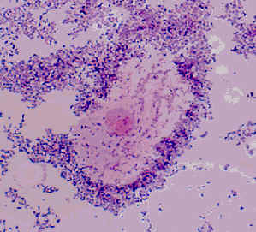
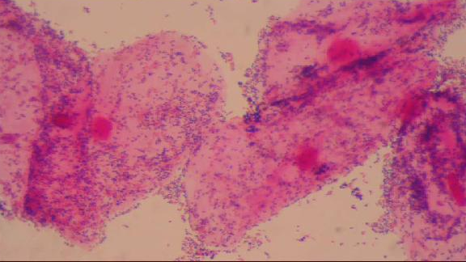
BV

Slide 20
Intermediate gram stain

Slide 21
PH TEST
PH indicator strips: pH 3.5 - 7.0
Place sample of vaginal secretion on test strip: read while still moist.
PH>4.5 indicates abnormality (i.e. BV-Trichomonas- or menstrual blood).
Be careful not to sample the cervix; cervical secretions and blood have a PH 7.0.

Slide 23
KOH "WHIFF" TEST
Sample of vaginal secretions are placed in a test tube with 10% KOH.
KOH alkalizes amines produced by anaerobic bacteria-results in a sharp "fishy odor"

Slide 24
WET MOUNT PREPARATION
Vaginal secretion sample from the anterior fornix and lateral wall
Place swab in test tube with small amount of normal saline and place sample on glass slide with cover slip
Visualize at both low and high power
Clue cells, yeast, trichomonas, WBC, bacteria.

Slide 26
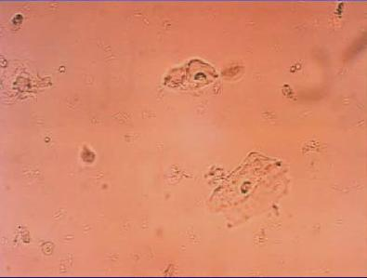
NORMAL-WET MOUNT

Slide 27
Normal vaginal Gram Stain

Slide 28
CANDIDIASIS
Overgrowth of a normal inhabitant of the vagina.
Predisposing factors: Pregnancy , DM, Immunocompramized conditions, antibacterial treatment .
Clinical Presentation : Irritation, pruritis, soreness, painful sexual intercourse burring on passing urine , and a thick, curdy, white (like cottage cheese) vaginal discharge.

Slide 29
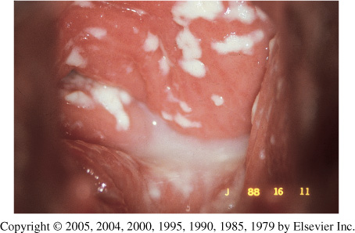

Slide 30
Diagnosis of VVC
Wet prep to see clumps of pseudohyphae.
Budding yeast and no pseudohyphae in patients with C glabrata.
KOH prep helpful but not always necessary.

Slide 31
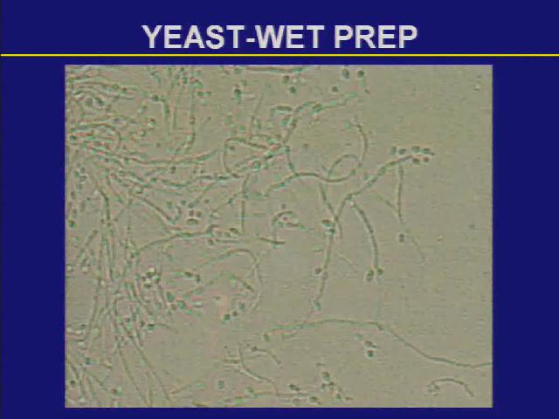
Yeast-Wet Prep

Slide 32
Candidiasis

Slide 33
Vaginal Yeast Cultures
Probably not routinely indicated - many women are colonized with Candida
If obtained must correlate with patient signs and symptoms
For recurrent infections culture and susceptibility testing may be helpful

Slide 34
TRICHOMONIASIS
Sexually transmitted parasite
Trichomonas is the most prevalent non-viral sexually transmitted disease (STD) agent.

Slide 35
Clinical Features
Vaginal discharge, pruritis in females, but may be asymptomatic.
Painful urination
Painful sexual intercourse
A yellow-green to gray, sometimes frothy, vaginal discharge.
The discharge is characteristically malodorous smelling
Males usually asymptomatic, but can cause Non-gonococcal urethritis .

Slide 36
Trichomonas Complications
Trichomonas associated with:
Premature rupture of membranes
Preterm labor and birth
Low birth weight
Increased transmission of other STDs including HIV

Slide 38
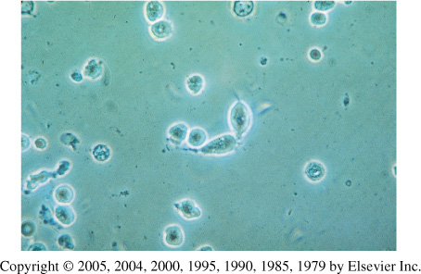
Trichomonas Wet Prep
Notes:
Trichomonas Scan the entire slide on low power magnification with reduced light for motile Trichomonas. · If motility is observed, switch to high power to positively identify Trichomonas. The flagella or undulating membrane should be visible. · If seen, report as Positive. If motile Trichomonas are not seen, report as Negative

Slide 39
Trichomonas-Pap Smear

Slide 40
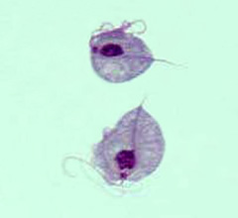
Culture is considered the gold standard for the diagnosis of trichomoniasis. Its disadvantages include cost and prolonged time before diagnosis

Slide 41
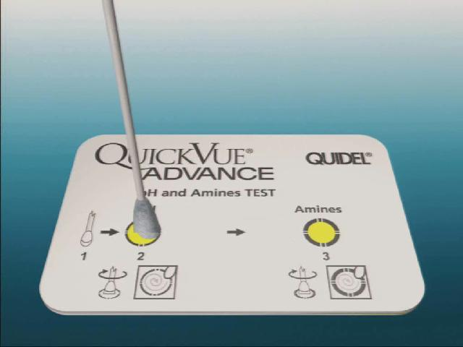
Other Methods of Diagnosis
EIA
Sensitivity 91.6%
Specificity 97.7%
DNA Probe

Slide 42
Clinical syndrom | Etiology | Treatment
Bacterial vaginosis Malodorous vaginal discharge, pH >4.5 | Etiology unclear: associated with Gardenella vaginalis mobiluncus, Prevotella sp., | Metronidazole Tinidazole
Trichomoniasis Copious foamy discharge, pH >4.5 Treat sexual partners | Trichomonas vaginalis | Metronidazole Tinidazole
Candidiasis Pruritus, thick cheesy discharge, pH <4.5 | Candida albicans 80-90%. C. Glabrata, C. tropicalis | Oral azole: Fluconazole Itraconazole

