Slide 1
Polycystic Ovarian Disease and Endometriosis
Emad Raddaoui, MD, FCAP, FASC
Associate Professor & Consultant

Slide 2
Polycystic Ovarian Disease (PCOD)
Polycystic ovaries are characterized by bilaterally enlarged polycystic ovaries, chronic anovulation and clinical manifestations secondary to excessive production of estrogens and androgens, mainly androgens.
The initial abnormality resulting in the syndrome is not known but is believed to be related to hypothalamus-pituitary dysfunction leading to oversecretion of luteinizing hormone (LH).
LH in turn stimulates the ovary to produce excess androgens. Secretion of follicle stimulating hormone (FSH) is inhibited resulting in repression of ovulation with follicle cyst formation.
High level of LH and low FSH
Other names for this syndrome include polycystic ovarian syndrome and Stein-Leventhal syndrome

Slide 3
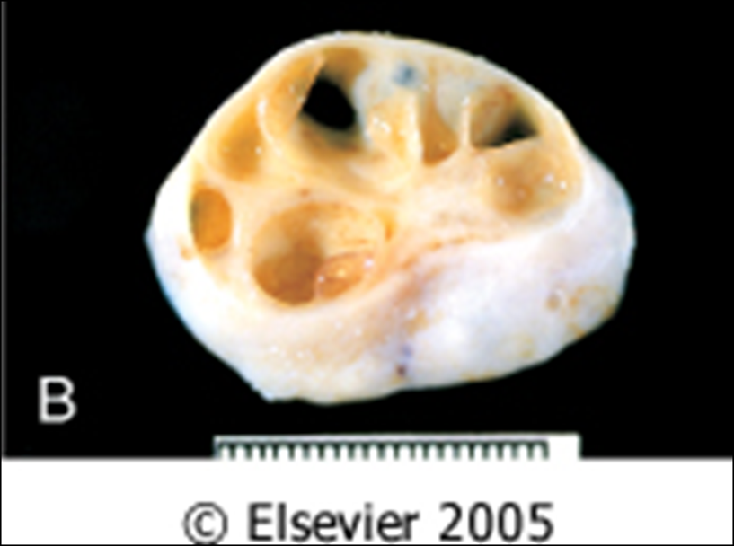
Polycystic Ovarian Disease
Clinical appearances.
The usual clinical presentation is a young woman (between 15 and 30 years) with
- secondary amenorrhea with anovulation
- oligomenorrhea or irregular menses
- infertility
- hirsutism
- virilism due to excessive amounts or effects of androgenic (masculinizing) hormones
- obesity
- acne

Slide 4
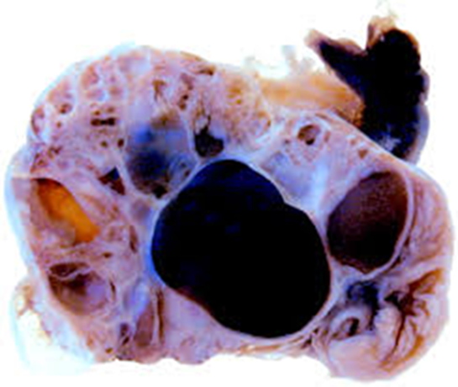
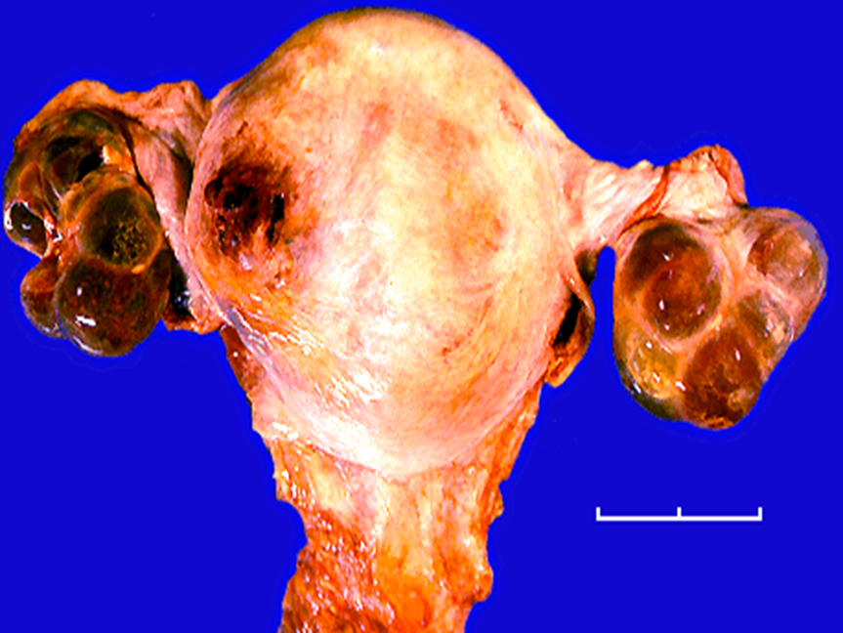
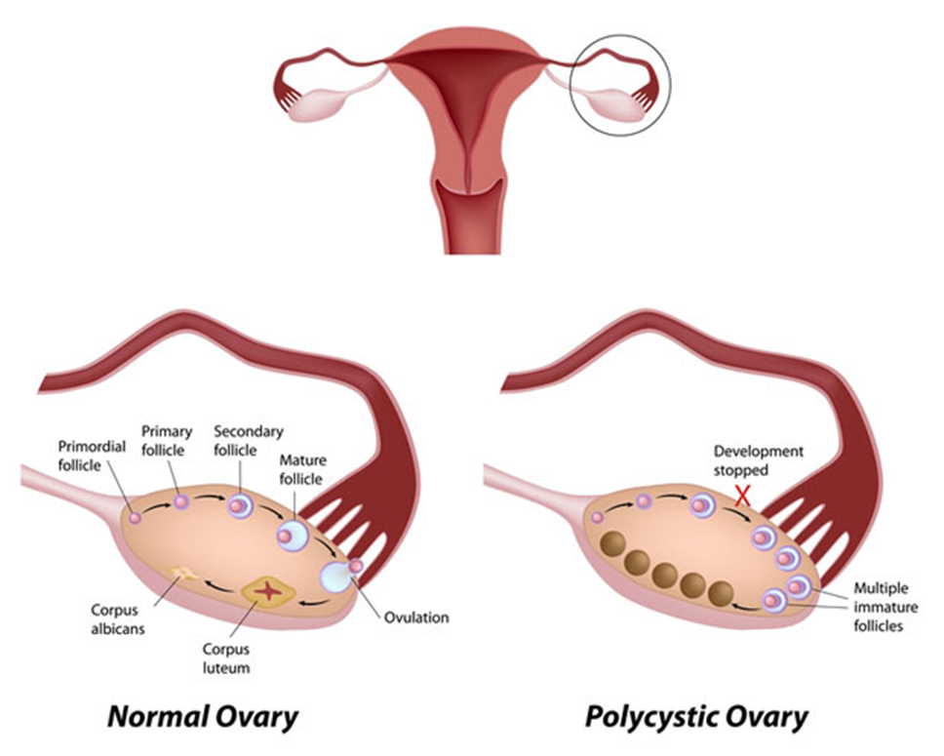
Polycystic Ovarian Disease
Grossly
Both ovaries are markedly enlarged usually twice normal in size and have a thickened, fibrotic gray white capsule with smooth pearl-white outer surface, studded with sub cortical cysts 0.5 to 1.5 cm in diameter.

Slide 5
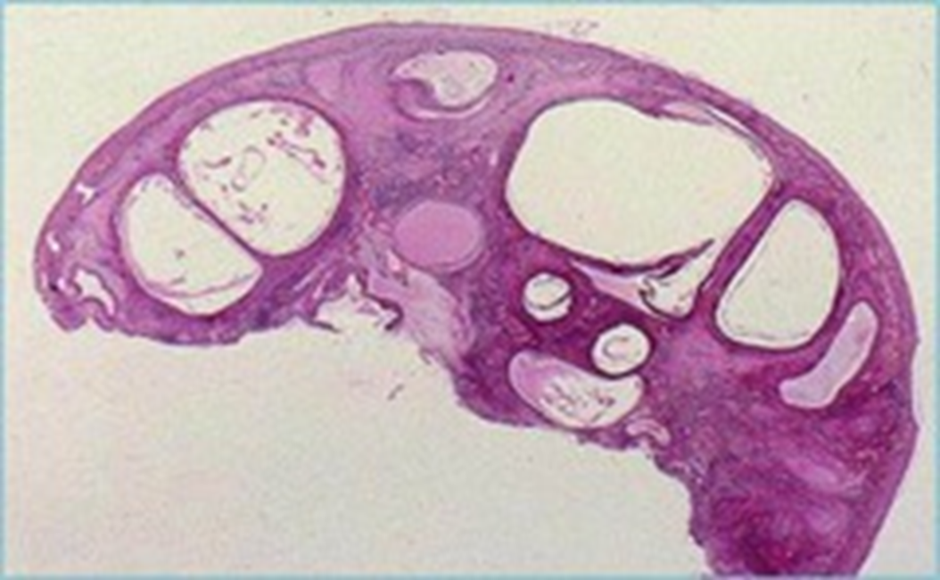
Polycystic Ovarian Disease
Histology
Microscopically, the outer portion of the cortex is thickened and fibrotic (cortical stromal fibrosis).
many follicle cysts lined by granulosa cells are present in the subcapsular cortex. The cysts have prominent outer theca interna layer, which is often luteinized.
Corpora lutea are frequently absent due to the anovulation.
The chronic anovulation results in unopposed estrogenic stimulation of the endometrium leading to a variety of appearances ranging from mild atypical hyperplasia to well-differentiated endometrial adenocarcinoma

Slide 6
Polycystic Ovarian Disease
Clinical behavior
Treatment with drugs that either induce ovulation (clomiphene or hCG) or regulate the menstrual cycle restores fertility.
Reduction of ovarian volume by wedge resection is also successful in initiating ovulation and restoring fertility.
The endometrial changes usually regress once ovulation is achieved.
Women with PCOS are at risk for the following:
Endometrial hyperplasia and endometrial cancer
Insulin resistance/Type II diabetes
High blood pressure
Depression/Anxiety
Dyslipidemia
Cardiovascular disease
Strokes
Weight gain
Miscarriage
Acanthosis nigricans (patches of darkened skin under the arms, in the groin area, on the back of the neck)
Autoimmune thyroiditis

Slide 7
Endometriosis
This is the presence of ectopic endometrial glands and stroma outside the uterus.
The lesions are usually found on the peritoneal surfaces of the reproductive organs and adjacent pelvic organs.
The most frequent location is the ovary (approx. 50%) followed by the pouch of Douglas, uterine ligaments. Occasional sites include the cervix, vagina, perineum, bladder, large bowel and the umbilicus. Rare lesions are seen as far as small bowel, kidneys, lungs and brain.
It has been reported in men. The sites involved have been the bladder, scrotum and prostate
Non-neoplastic.
Like the uterine endometrium it is responsive to the hormonal variations of the menstrual cycle.
It is characterized by menstrual type bleeding at the site of the ectopic endometrium, resulting in blood filled areas (e.g.chocolate cysts).

Slide 8
Endometriosis :Clinical appearances
Clinical presentation depends on the site of endometriosis.
Dysmenorrhea, cyclic abdominal pain and dyspareunia are common symptoms. Usually there is severe menstrual-related pain.
Often results in infertility.
Endometriosis usually appears as multiple red or brown (due to hemosiderin) 1mm to 5mm nodules (some may form larger masses or cysts). Dense fibrous adhesions may surround the foci.

Slide 9
Endometriosis
Repeated hemorrhage into foci in the ovary with each menstrual cycle produces cysts, which contain inspissated, chocolate-brown material, called "chocolate cysts” in which the ovaries turn into large cystic masses filled with brown fluid
Clinical behavior
Benign with no malignant potential. May recur after surgical excision but the risk is low.

Slide 10
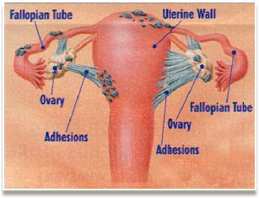
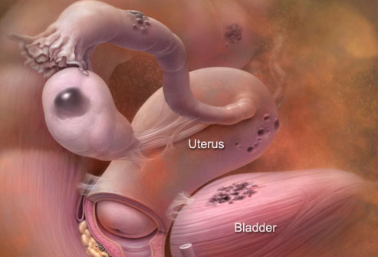
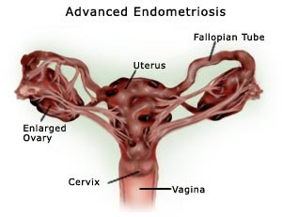
Endometriosis

Slide 11
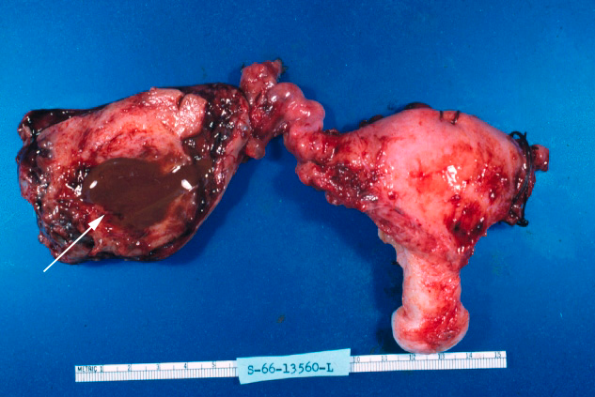
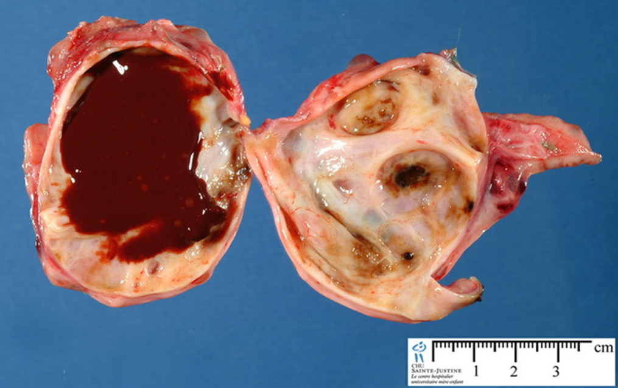
Chocolate cyst of ovary (endometriotic cyst)

Slide 12
Endometriosis
Histology
Microscopic diagnosis of endometriosis is made by the presence of ectopic endometrial glands and stroma. Macrophages containing hemosiderin (siderophages) may be present in lesions with previous hemorrhage.
When endometriosis develops in a muscular viscus, the smooth muscle around it is often hyperplastic.

Slide 13
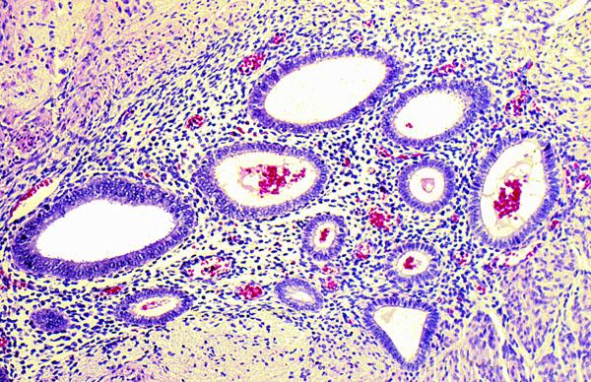
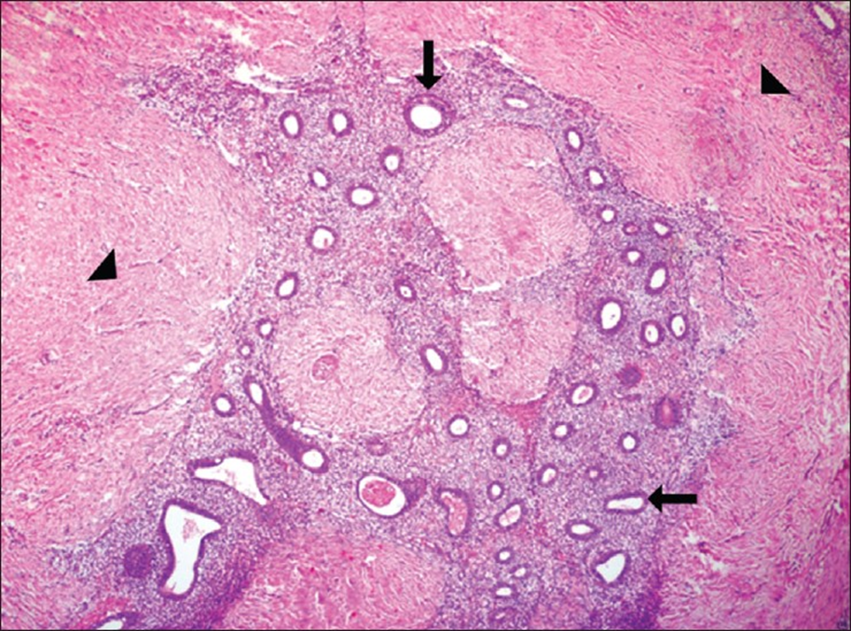
Endometriosis

Slide 14
Adenomyosis
This is defined as the presence of endometrial glands and stroma in the myometrium. The condition involves the posterior wall more often than the anterior wall but it may affect both walls in the same uterus.
The disease is primarily a disorder of parous women and occurs infrequently in the nullipara. It is associated with menorrhagia and severe dysmenorrhea. In about a third of patients there are no symptoms and the lesions are discovered accidentally.
When extensive the lesions produce myometrial thickening with small yellow or brown cystic spaces containing fluid or blood.
Occasionally, a proliferation of smooth muscle around a focus of adenomyosis produces a tumor called adenomyoma, which resembles uterine leiomyoma.
Clinical behavior.
This is a benign condition with no known malignant potential that regresses after the menopause

Slide 15
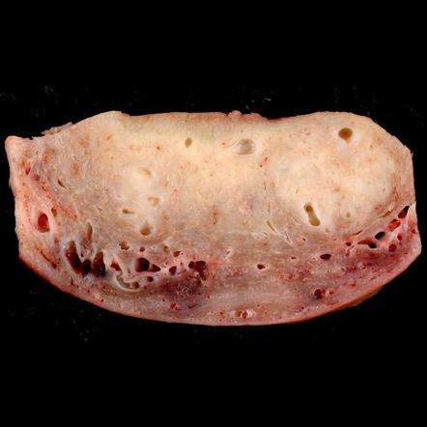
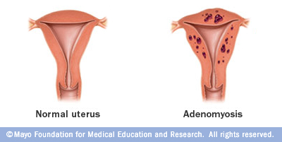
Adenomyosis

