Slide 1
Breast Pathology
Emad Raddaoui, FCAP, FASC
Associate Professor & Consultant

Slide 2
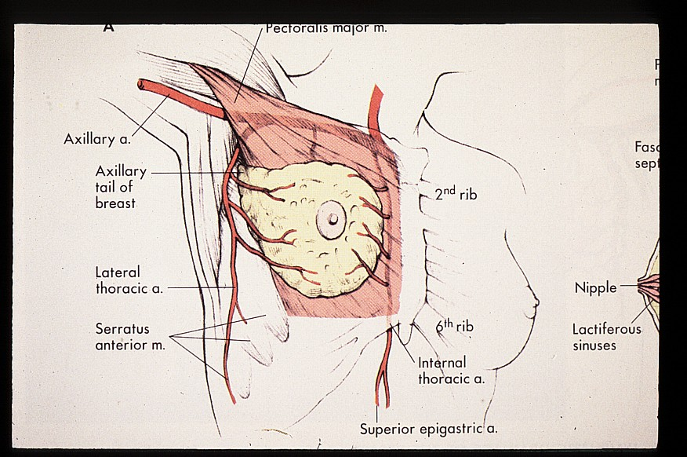
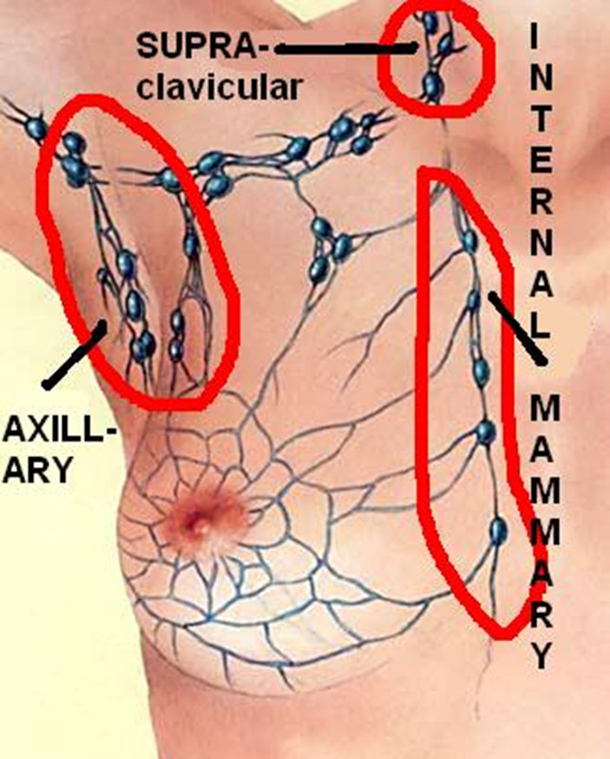
Lymphatic drainage of breast

Slide 3
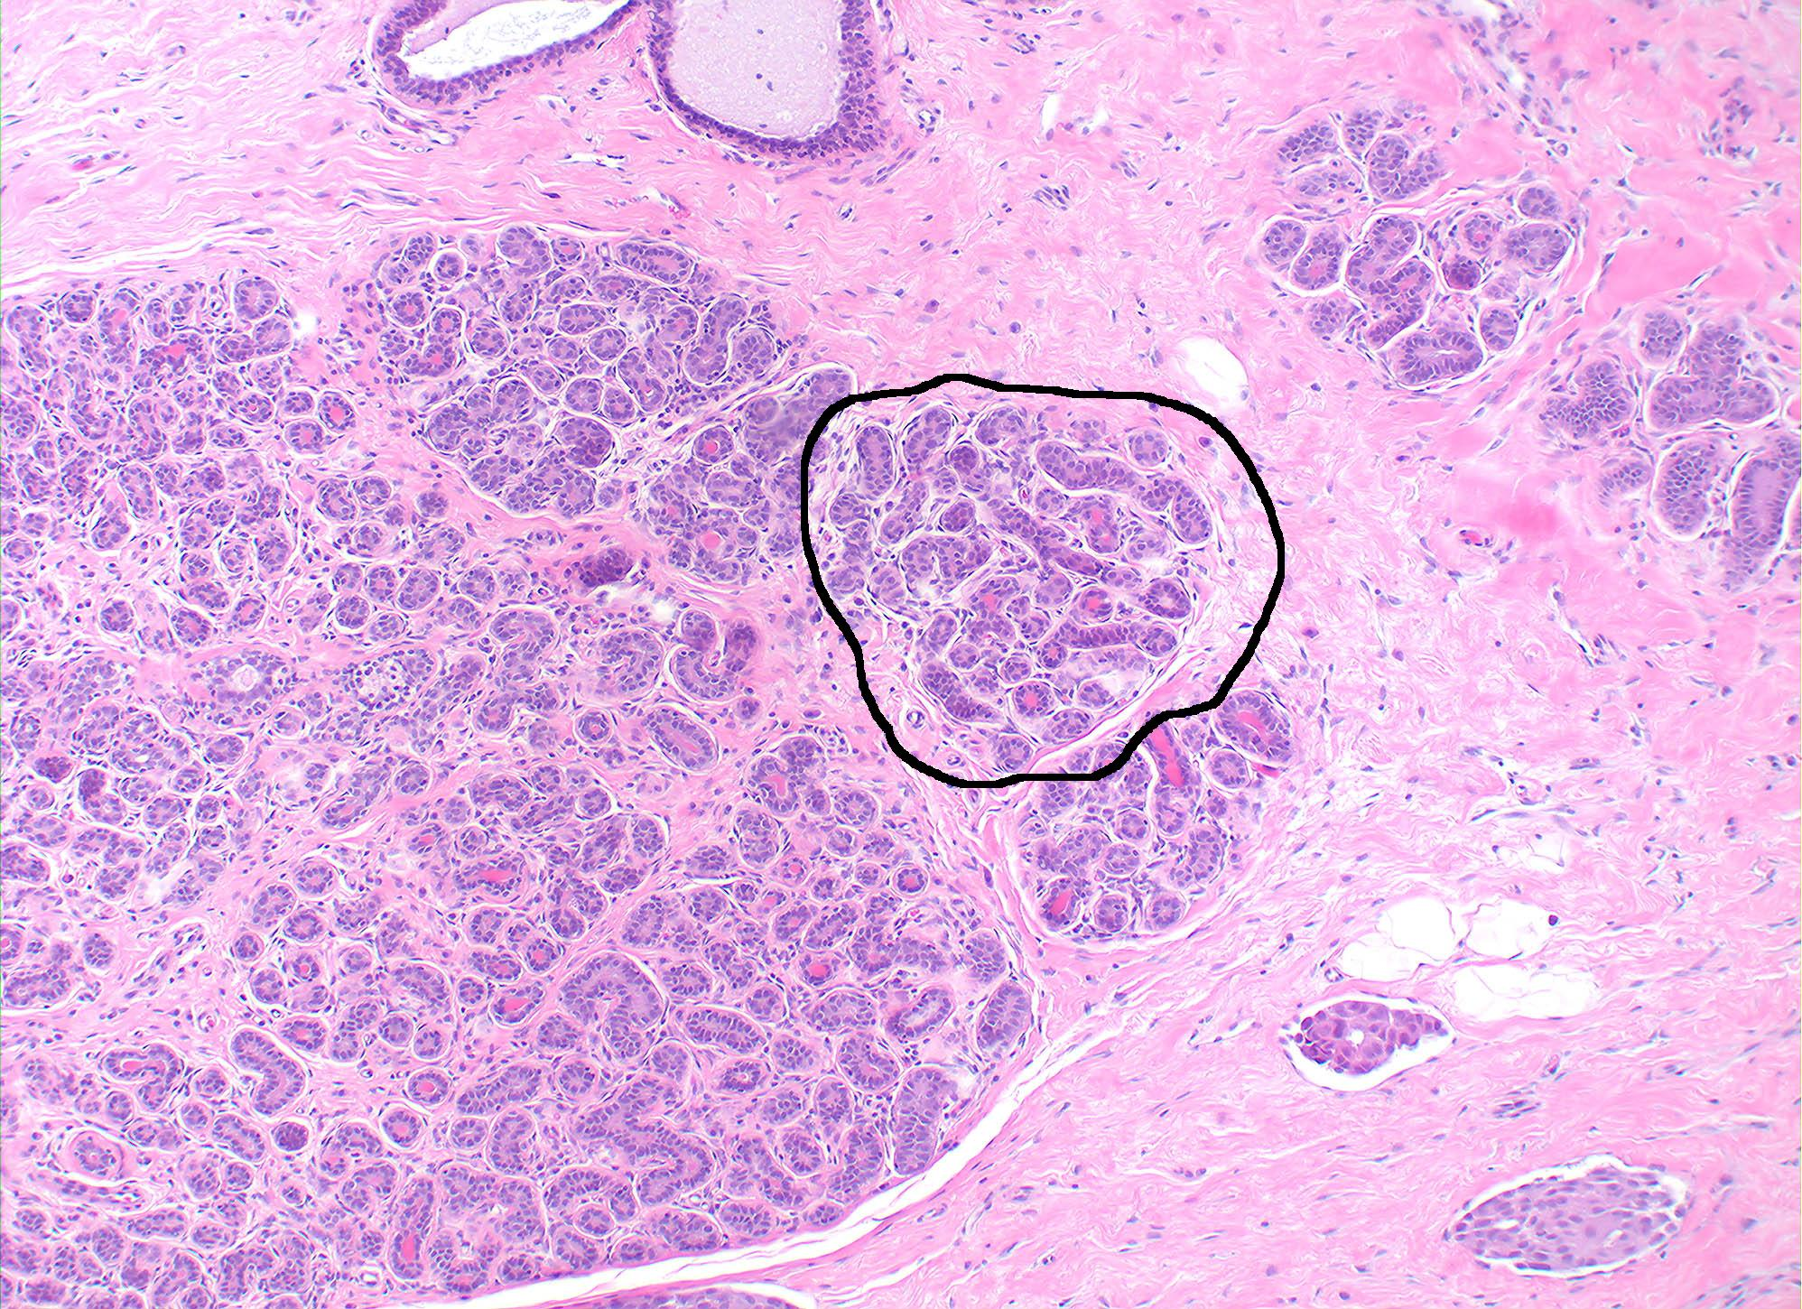
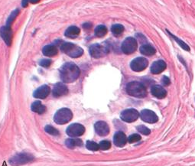
Anatomy
lobe
LOBE: (10 in whole breast)
LOBULE: (many per lobe)
ACINUI/ALVEOLI: (many per lobule)
DUCTS: INTRA- or INTER- LOBULAR, leading up to the lactiferous ducts in the nipple
lobule

Slide 4
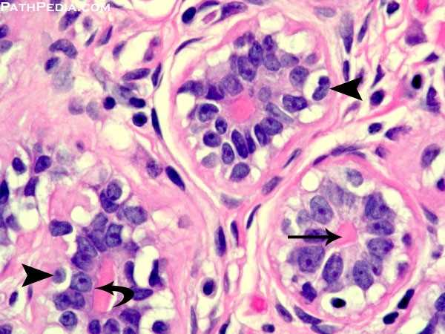
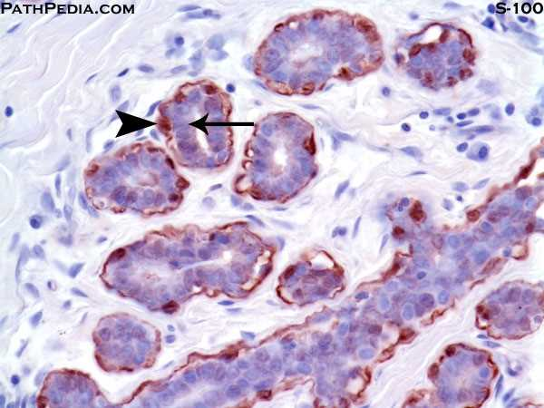
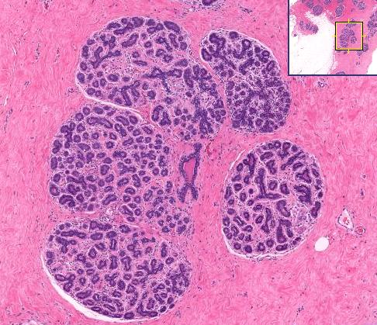
Breast acini
Each acini is lined by a bilayered epithelial and myoepithelial cells.
The S100 immunohistochemical stain shows a complete outer layer of myoepithelial cells

Slide 5
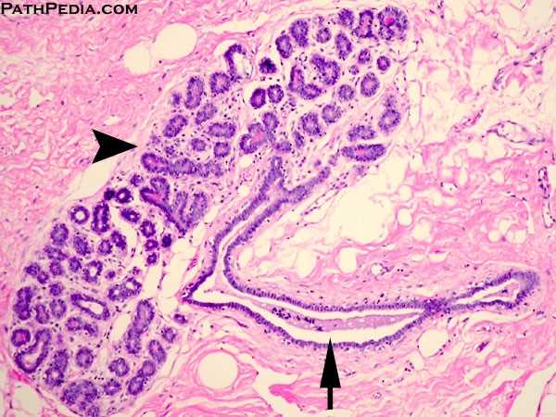
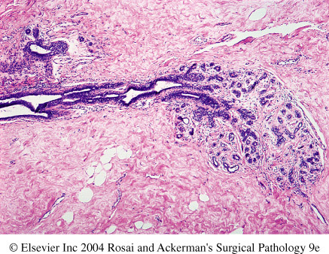
ducts
Six to ten major ductal systems originate at the nipple.
Branching of the large ducts leads to the terminal duct lobular units.
The TDU branches into grapelike clusters of small acini to form the lobule.

Slide 6
Objectives
Pathology of benign breast diseases.
At the end of this lecture, the student should be able to:
Know the ways that benign breast conditions can clinically present.
Know the common inflammatory conditions of breast (mastitis and abscesses).
Understand the pathology of fibrocystic change.
Know the common benign breast tumours with special emphasis on fibroadenoma and phyllodes tumour.
Know the risk of subsequent breast cancer in women with diagnosed benign breast tissue.
Breast cancer.
At the end of this lecture, the student should be able to:
Know the risk factors for the development of breast cancer.
Know the classification of breast cancer.
Understand the behavior and spread of breast cancer.
Know the prognostic indicators of breast carcinoma.

Slide 7
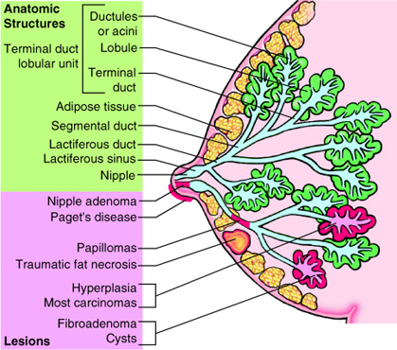
Pathology based on location

Slide 8
Clinical Presentation of Breast Diseases
Pain (mastalgia): is the most common breast symptom and may be cyclical with menses or noncyclical. Diffuse cyclical pain has no pathologic significance. Non-cyclical pain is usually associated with a focal site in the breast. Causes include ruptured cysts or areas of prior injury or infection, or sometime no specific cause. Although the great majority of painful masses are benign, about 10% of breast cancers present with pain, and all masses need to be investigated.
Palpable mass
Nipple discharge:
Milky discharge has not been associated with malignancy.
Bloody or serous discharges are most commonly associated with benign lesions but, rarely, can be due to a malignancy.

Slide 9
Mammographic screening
Mammographic screening was introduced in the 1980s as a means to detect small, nonpalpable, asymptomatic breast carcinomas. The value of mammography lies in its ability to identify small, nonpalpable cancers. The principal mammographic signs of breast carcinoma are densities and calcifications:
Densities(mass): Mammographic densities can be produced by invasive carcinomas, fibroadenomas, or cysts . Most neoplasms are radiologically denser than the intermingled normal breast tissue.
Calcifications: Calcifications form on secretions, necrotic debris, or hyalinized stroma.
Benign calcifications are often associated with apocrine cysts, fibroadenomas, and sclerosing adenosis.
Calcifications associated with malignancy are usually small, irregular, numerous, and clustered. Ductal carcinoma in situ (DCIS) is most commonly detected as mammographic calcifications. Mammographic screening has increased the diagnosis of DCIS.
Screening is generally recommended to start at age 40. Younger women usually
undergo mammography only if they are at high risk for developing carcinoma.

Slide 10
Breast lesions
Inflammatory lesions
Acute mastitis: staph infection most common
Periductal mastitis
Mammary duct ectasia means dilated ducts disease
Fat necrosis is usually due to mechanical trauma, surgical or otherwise
Lymphocytic mastopathy (sclerosing lymphocytic lobulitis) seen in diabetics
Granulomatous mastitis sarcoid, TB, etc., but mostly idiopathic
Benign epithelial lesions
Non proliferative breast changes (fibrocystic changes)
Proliferative breast disease without atypia
Proliferative breast disease with atypia /Atypical hyperplasia
Carcinoma in situ
DCIS
LCIS
Invasive carcinoma
Ductal carcinoma
Lobular carcinoma
Others/stromal tumors e.g. fibroadenoma, phyllodes tumors, sarcomas etc.

Slide 11
Mastitis
Acute mastitis: Almost all cases of acute mastitis occur during the first month of breastfeeding. Staphylococcus aureus is the most common causative organiasm. The breast is erythematous and painful, and fever is often present.
Periductal mastitis: This condition is not associated with lactation. There is strong association with cigarette smoking. It has been suggested that the vitamin A deficiency associated with smoking or toxic substances in tobacco smoke alter the differentiation of the ductal epithelium

Slide 12
Benign epithelial lesions of breast are divided into 3 basic types
Non proliferative breast changes (fibrocystic changes)
Proliferative breast disease without atypia
Proliferative breast disease with atypia (Atypical hyperplasia)

Slide 13
1- Non proliferative Breast Changes (Fibrocystic Changes)
It is the single most common disorder of the breast.
Older terminology is fibrocystic changes/disease—more recently referred to as non-proliferative changes/disease
“Changes” is generally considered to be more appropriate terminology than “disease” because the alterations are present in most women and are not associated with any risk of progression or development of cancer
Thought to be caused by hormonal imbalances e.g. relative in estrogens or of progesterone, or abnormal end-organ metabolism of the hormones
Between 20-55yrs, decreases progressively after menopause.
Could produce palpable breast mass, mammographic densities, calcifications ,or nipple discharge.

Slide 14
1- Non proliferative Breast Changes (Fibrocystic Changes) contd..
The cause of fibrocystic change is not known.
It may also present with pain, which may be cyclical.
No increased risk for cancer
Three patterns of morphologic changes :
Cysts formation and apocrine metaplasia:small to big in size, lined by benign flattened to columnar epithelium with apocrine metaplasia (large polygonal cells with abundant, eosinophilic cytoplasm)containing semi-translucent or turbid fluid. The cysts can rupture and cause inflammation
Fibrosis : contribute to the palpable firmness of the breast
Adenosis : Increase in the number of acini per lobule (note adenosis can be seen in pregnancy).

Slide 15
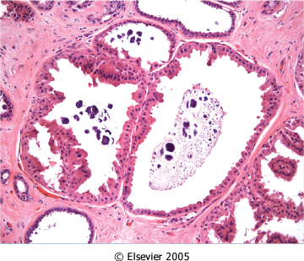
Figure 23-7 Apocrine cysts. Cells with round nuclei and abundant granular eosinophilic cytoplasm, resembling the cells of normal apocrine sweat glands, line the walls of a cluster of small cysts. Secretory debris, frequently with calcifications, is often present. Groups of cysts are common findings associated with clustered mammographic calcifications.
Downloaded from: Robbins & Cotran Pathologic Basis of Disease (on 11 November 2007 08:05 PM)
© 2007 Elsevier

Slide 16
2- Proliferative Disease without Atypia
Rarely form palpable masses
Detected as mammographic densities.
Incidental finding
e.g. Large duct papilloma present in 80% as nipple discharge.
Risk for cancer is 1.5 – 2 times normal
The following entities are included in this category:
Epithelial hyperplasia
Sclerosing adenosis
Complex sclerosing lesions/radial scar
Papillomas
Proliferative variant of fibrocystic disease.

Slide 17
2- Proliferative Disease without Atypia contd…
Epithelial Hyperplasia (usual epithelial hyperplasia).
Normal breast has a 2 layers of cells (epithelial and myoepithelial cells). Epithelial hyperplasia is defined as the presence of more than 2 layers.
Hyperplasia ranges from mild, moderate to florid.
Both epithelial and myoepithelial cells proliferate.
It can be seen in the ducts and the lobules and may fill and distend them.
It can be seen in fibrocystic disease in which case the fibrocystic disease becomes the of the proliferative type.
Note: No atypical architectural or cytologic features are present

Slide 18
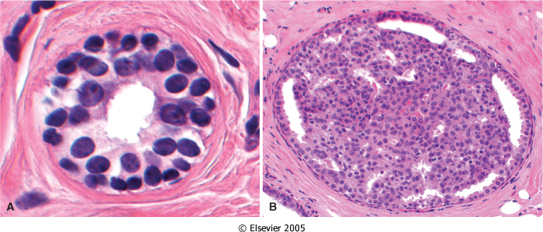
Figure 23-8 A, Normal. A normal duct or acinus has a single basally located myoepithelial cell layer (cells with dark, compact nuclei and scant cytoplasm) and a single luminal cell layer (cells with larger open nuclei, small nucleoli, and more abundant cytoplasm). B, Epithelial hyperplasia. The lumen is filled with a heterogeneous population of cells of different morphologies, often including both luminal and myoepithelial cell types. Irregular slitlike fenestrations are prominent at the periphary.
Downloaded from: Robbins & Cotran Pathologic Basis of Disease (on 11 November 2007 08:05 PM)
© 2007 Elsevier

Slide 19
2- Proliferative Disease without Atypia contd…
Sclerosing Adenosis.
This condition most often occurs as an incidental microscopic finding but may manifest as a palpable mass that may be mistaken clinically for cancer.
It is almost always associated with other forms of fibrocystic change.
Diffuse microcalcifications are commonly seen in the lesion, which may mimic carcinoma on mammography.
Microscopically, characterized by increased in number of acini (adenosis) and ducts with stromal fibrosis within lobules which compresses and distorts the lobule.
The involved terminal duct lobular unit is enlarged, and the acini are compressed and distorted by the surrounding dense stroma.

Slide 20
2- Proliferative Disease without Atypia contd…
Complex Sclerosing Lesion (Radial Scar).
Radial scars are stellate lesions characterized by a central nidus of entrapped glands in a hyalinized stroma
These lesions typically present as an irregular mammographic density and closely mimic an invasive carcinoma. can resemble irregular invasive carcinomas mammographically or on gross examination.
"scar" refers to the morphologic appearance, as these lesions are not associated with prior trauma or surgery.
There is a central nidus consisting of small tubules entrapped in a densely fibrotic stroma surrounded by radiating arms of epithelium with varying degrees of cyst formation and hyperplasia.

Slide 21
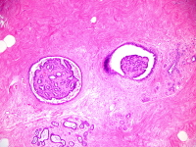
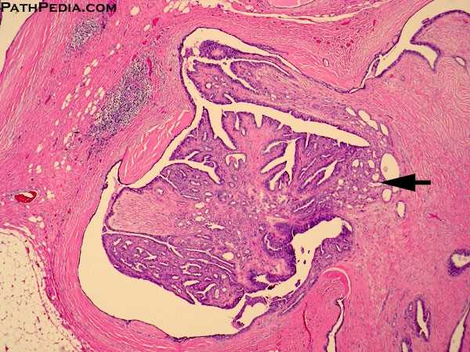
2- Proliferative Disease without Atypia contd…
Papillomas
Is a papillary tumor that arises from the duct epithelium including large ducts.
It arises more often in the central part of the breast from the lactiferous ducts (75%) but can occur in any quadrant.
Commonly solitary, consisting of a single tumor in one duct, but multiple discrete tumors in branches of the ductal system may occur.
Large duct papillomas are usually solitary and situated in the lactiferous sinuses of the nipple.
Small duct papillomas are commonly multiple and located deeper within the ductal system.
Small duct papillomas have been shown to increase the risk of subsequent carcinoma.
Nipple discharge, which may be bloody, is the most common presentation for central papillomas and less commonly of peripheral tumors.
A subareolar mass may be palpable.
Age range is from 30 to 50 years.

Slide 22
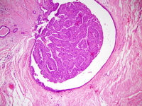
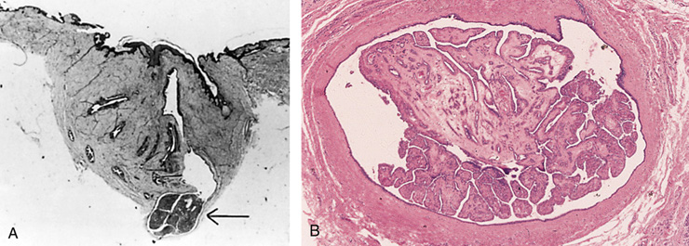
Intraductal papilloma

Slide 23
3- Proliferative breast disease with atypia (Atypical hyperplasia)
Risk for cancer is 4-5 times normal
Atypical hyperplasia is a cellular proliferation resembling ductal carcinoma in situ (DCIS) or lobular carcinoma in situ (LCIS) but lacking sufficient qualitative or quantitative features for a diagnosis of carcinoma in situ.
Include two entities
Atypical ductal hyperplasia
Atypical lobular hyperplasia
Atypical hyperplasia has some of the architectural and cytologic features of carcinoma in situ but lack the complete criteria for that diagnosis and is categorized as ductal or lobular in type

Slide 24
Pathologic lesion | Relative risk of development of invasive carcinoma | comments
NONPROLIFERATIVE BREAST CHANGES (Fibrocystic changes) | do not have an increased risk. | Fibrocystic disease
PROLIFERATIVE DISEASE WITHOUT ATYPIA | 1.5 to 2 times normal | Epithelial hyperplasia Sclerosing adenosis Complex sclerosing lesions/radial scar Papillomas Proliferative fibrocystic disease.
PROLIFERATIVE DISEASE WITH ATYPIA | 4.0 to 5.0 times normal | ADH ALD
CARCINOMA IN SITU | 8.0 to 10.0 times normal | DCIS LCIS

Slide 25
Breast cancer

Slide 26
Breast Carcinoma
The most common malignancy of breast is carcinoma
Carcinoma of the breast is the most common cancer in women
Women who lives to age 90 has a one in eight chance to have breast cancer
Mammographic screening increased dramatically the detection of small invasive cancers
DCIS by itself is almost exclusively detected by mammography ,so the incidence of DCIS is increased with the use of mammography.
The number of women with an advanced cancer is markedly decreased
The mortality rate started to decline. Currently only 20% of the women with breast cancer are expected to die of the disease.

Slide 27
Breast Cancer: Risk Factors
Age: increase incidence of breast cancer older women. Breast cancer is rare before 25 yrs, except familial forms . Majority (77%) of cases occur in women >50 yrs of age.
Age at Menarche: The younger a woman’s age at menarche, the higher her risk of breast cancer.
First Live birth: The earlier a woman has her first birth, the lower her lifetime risk for breast cancer. A woman who has her first birth after 30 years has an increased risk.
First Degree relative with Breast Cancer .
Women with history of cancer in first degree relative (mother, sister, aunt or daughter) are at higher risk of breast cancer. The risk increases with the number of affected first degree relatives.
NOTE: majority of cancers occur in women without such history.
At least two genes that predispose to breast cancer have been identified—BRCA 1 and 2
Breast Biopsy: Atypical hyperplasia increases the risk for breast cancer
Race: Overall incidence of breast cancer is lower in African American women . Generally caucasian have the highest rate of breast cancers

Slide 28
Breast Cancer: Risk Factors
Estrogen Exposure: Factors associated with exposure to increased levels of estrogen have been shown to increase a woman’s risk for breast cancer.These factors include early age at menarche, late age at menopause, nulliparity and late age at first child-birth. Also postmenopausal hormone replacement slightly increases the risk
Radiation exposure: Higher rate of breast cancer
History of breast cancer: Women who have had a breast cancer have a 10-fold increased risk of developing a second primary breast cancer.
History of Other Cancer: A history of cancer in the other breast or a history of ovarian or endometrial cancer
Geographic influence: Breast cancer is more common in Western industrialized countries than in developing countries. Four to seven times in USA and Europe higher than those in other countries.
Benign Breast Disease: As noted previously women with certain types of benign breast disease are at risk

Slide 29
Breast Cancer: Risk Factors
Dietary factors e.g. high fat intake and excessive alcohol consumption, and exposure to ionizing radiation have also been proposed as risk factors
Obesity: may play a role
Exercise: some studies showed degreased risk
Breast feeding: the longer the women breast feed, the lower the risk
Environmental toxins: pesticides .
Tobacco: Not associated with breast cancer,but associated with the development of peri-ductal mastitis,or sub-areolar abscess.

Slide 31
Breast Cancer: Risk Factors
The etiology of breast cancer in most women is unknown but most likely is due to a combination of the risk factors listed above i.e. genetic, hormonal and environmental factors
The major risk factors being hormonal and genetic (family history).
Breast carcinomas can, therefore, be divided into sporadic cases, possibly related to hormonal exposure, and hereditary cases, associated with family history or germ-line mutations
Hereditary Breast Cancer
A family history of breast cancer in a first-degree relative is reported in 13% of women with the disease
About 25% of familial cancers (or around 3% of all breast cancers) can be attributed to two highly penetrant autosomal-dominant genes: BRCA1 and BRCA2
Sporadic Breast Cancer
The major risk factors for sporadic breast cancer are related to hormone exposure: gender, age at menarche and menopause, reproductive history, breast-feeding, and exogenous estrogens. The majority of these cancers occur in postmenopausal women and overexpression of estrogen

Slide 32
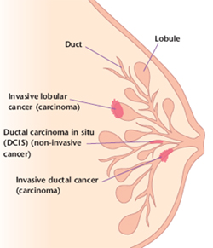
Breast Carcinoma: Classification
Almost all (majority) are Adenocarcinoma
Divided into
Carcinoma in situ( non-invasive)
Invasive carcinoma

Slide 33
Carcinoma in situ
This is epithelial proliferation that is still confined to the TDLU, has not invaded beyond the basement membrane and is therefore incapable of metastasis.
There are two subtypes:
Ductal carcinoma in situ (DCIS) or intraductal carcinoma 80%
2) Lobular carcinoma in situ. The incidence in autopsy studies is about 20%.

Slide 34
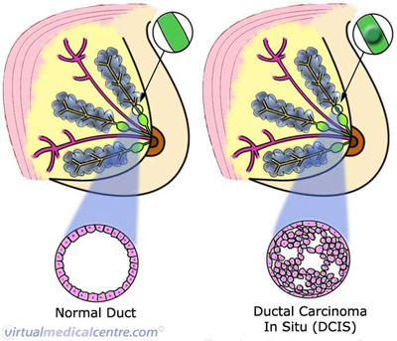
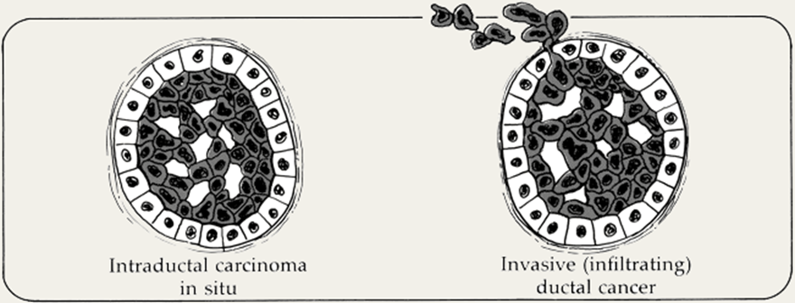
DCIS(Ductal Carcinoma In Situ)
By definition DCIS is a group of neoplastic lesions that are non-invasive and have proliferating malignant cells within the duct system but do not breach the underlying basement membrane
They have a very high risk of development of subsequent invasive carcinoma.
The tumor distends and distorts the ducts.

Slide 35
DCIS(Ductal Carcinoma In Situ)
DCIS occurs throughout the age range of breast carcinoma with mean age at diagnosis between 50 and 59 years, similar to the mean age of women with invasive ductal carcinoma.
Often multifocal—malignant population can spread widely through the duct system without breaching the basement membrane
Women with DCIS are at risk of recurrent DCIS following treatment.
Mammography is a very sensitive diagnostic procedure for detecting DCIS, as a substantial proportion is not palpable.
Mammographically detected microcalcifications are found in 72 to 98% of DCIS.
Rapidly increased in the past two decades
Half of mammographically detected cancers
Most frequently as a calcifications
Less frequently as a density or a vaquely palpable mass or nipple discharge

Slide 36
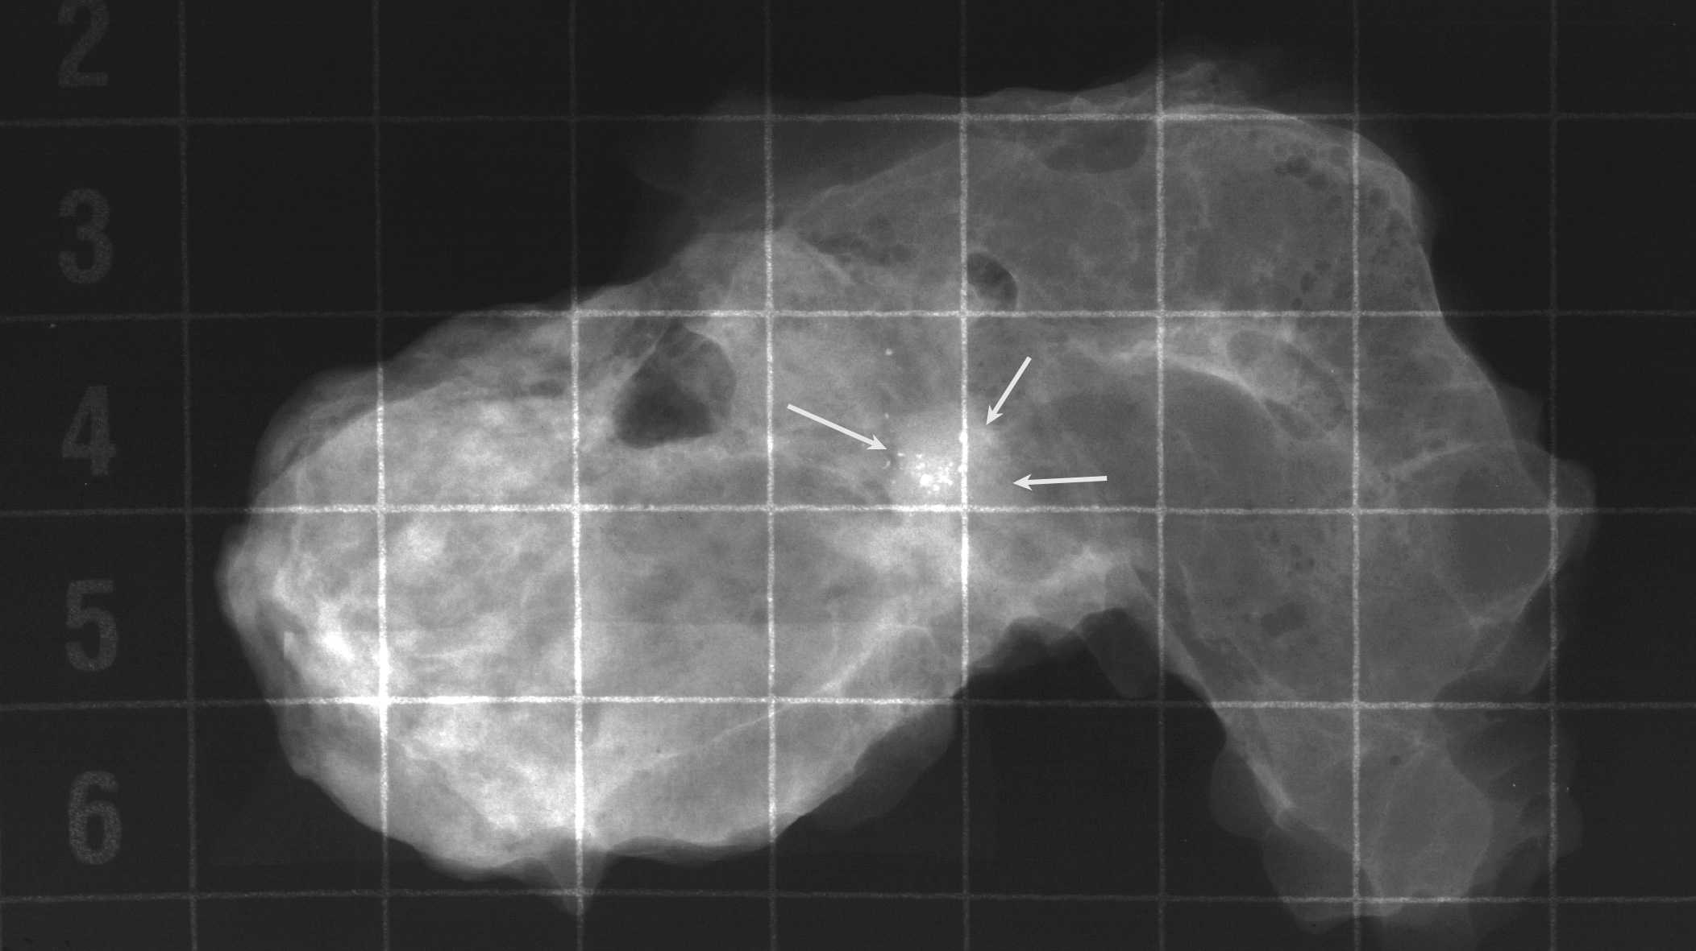
DCIS, microcalcifications
Notes:
This type of calcification represents about a 20% chance of malignancy and should be biopsied. This device helps pathologists to sample the areas of greatest concern more heavily.

Slide 37
DCIS( Ductal Carcinoma In Situ)
Different patterns/subtypes of DCIS can be seen e.g. comedo (central necrosis); cribiform (cells arranged around “punched-out” spaces); papillary, micropapillary and solid (cells fill spaces)
DCIS can be of different grades i.e. low, intermediate and high grade (e.g. comedo=high)

Slide 38
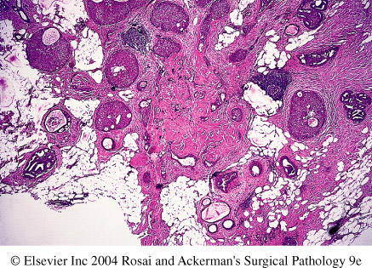
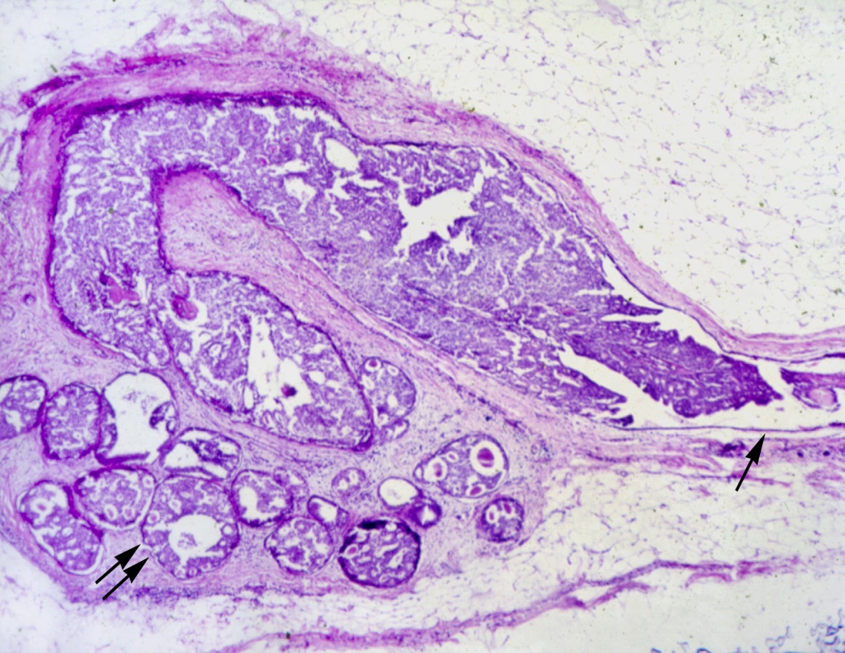
DCIS

Slide 39
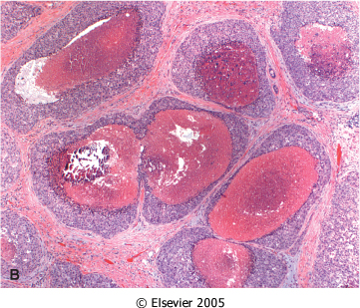
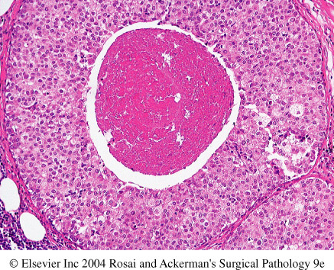
Comedo DCIS fills several adjacent ducts (or completely replaced lobules) and is characterized by large central zones of necrosis with calcified debris. This type of DCIS is most frequently detected as radiologic calcifications. Less commonly, the surrounding desmoplastic response results in an ill-defined palpable mass or a mammographic density.
© 2007 Elsevier
Downloaded from: Robbins & Cotran Pathologic Basis of Disease (on 28 April 2008 09:47 AM)

Slide 40
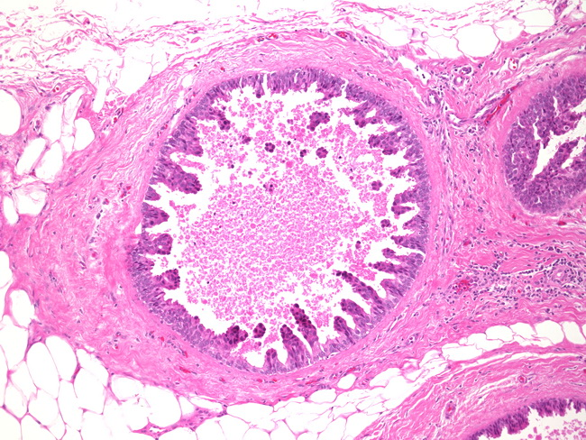
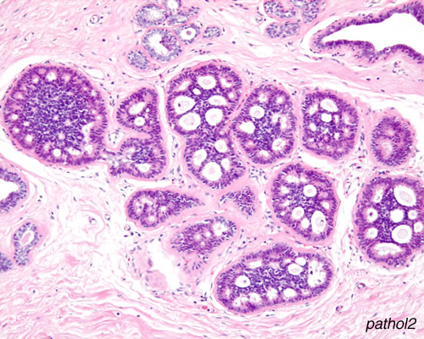
DCIS
Micropapillary DCIS.
Cribriform DCIS comprises cells forming round, regular ("cookie cutter") spaces. The lumens are often filled with calcifying secretory material.

Slide 41
DCIS
Clinical behavior: may vary depending on the subtype and the grade
Comedocarcinoma has essentially a 100% chance of becoming invasive if left untreated.
Pure cribriform/micropapillary carries only a 30% chance of becoming invasive carcinoma.
Treatment:
Wide local excision
mastectomy

Slide 42
Paget’s Disease
Paget's disease of the breast is a rare type of breast cancer that is characterized by a red, scaly lesion on the nipple and surrounding areola(1 to 2 %).
Paget’s disease of the nipple presents with an eczematous area of the nipple, which may be subtle or form an obviously eroded, weeping lesion.
Pruritus is common ,might be mistaken for Eczema, presents as a unilateral erythematous eruption with a scale crust.
Malignant cells, referred to as Paget cells and are found scattered in the epidermis.

Slide 43
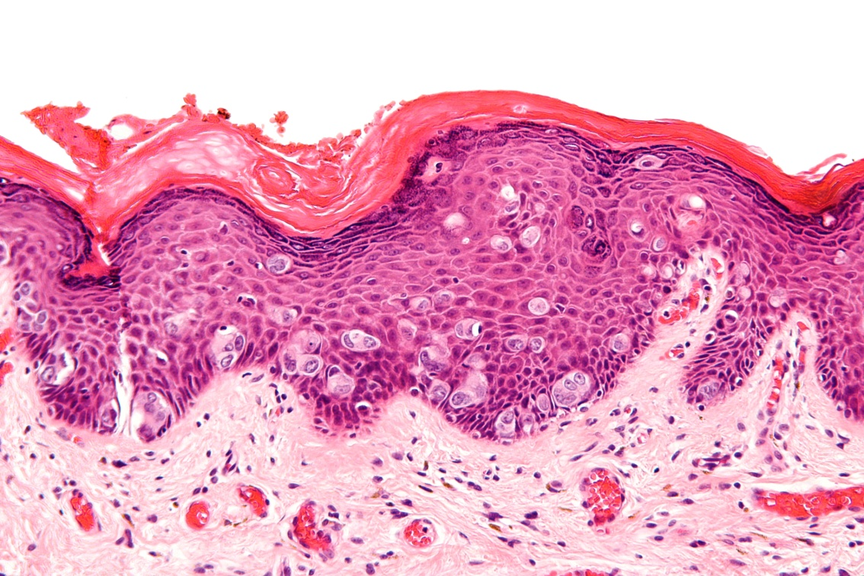
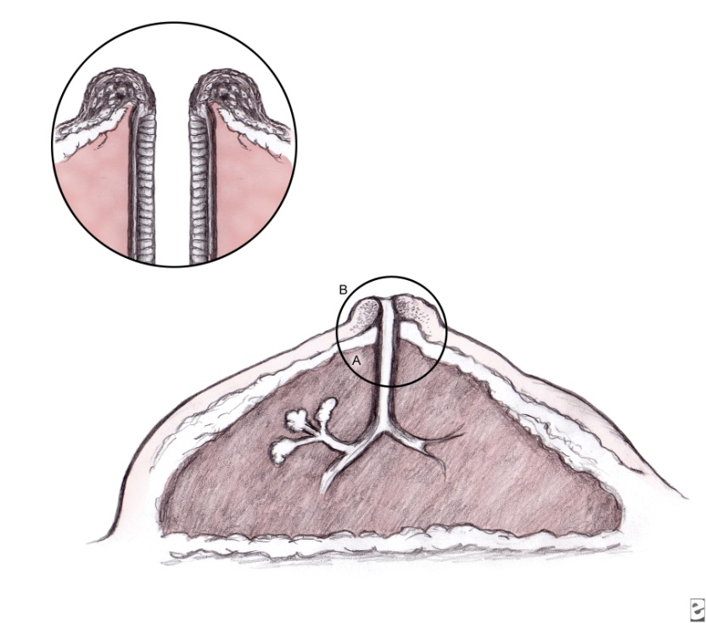
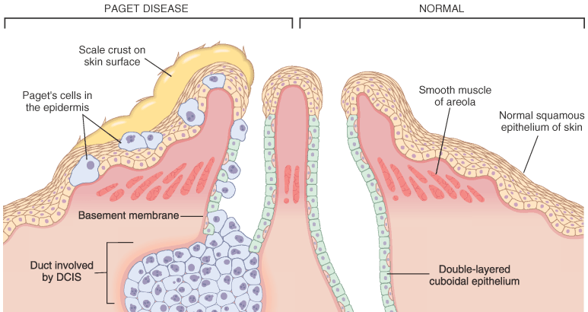

Slide 44
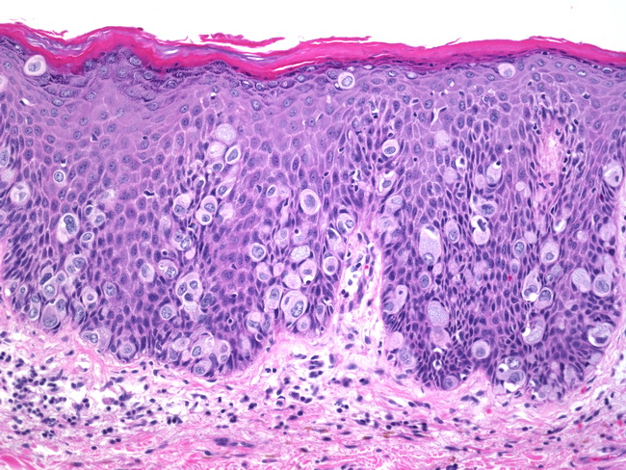
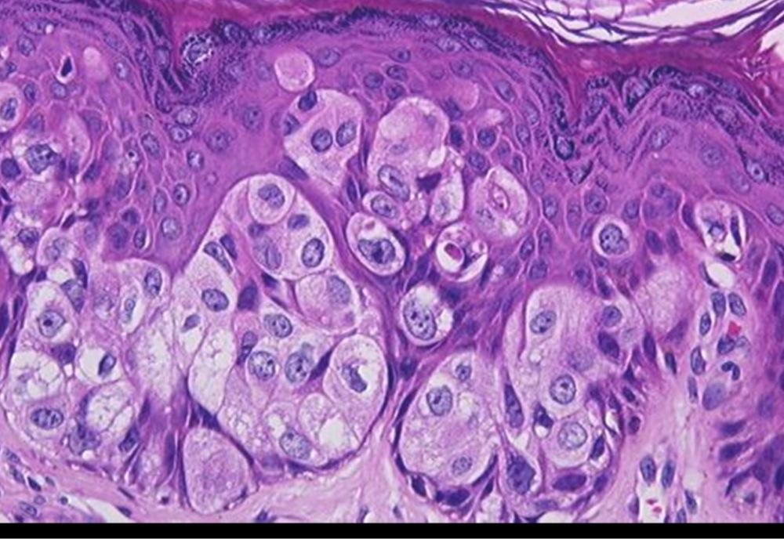
Pagets disease
The histologic hallmark of Paget’s disease of the nipple is the infiltration of the epidermis by large ductal neoplastic cells with abundant clear or pale cytoplasm and nuclei with prominent nucleoli. The cells usually stain positively for mucin.
Paget cells extend from DCIS within the ductal system into nipple skin without crossing the basement membrane
Palpable mass is present in 50 to 60% of women with Paget disease indicating an underlying invasive carcinoma.

Slide 45
LCIS -Lobular Carcinoma in Situ
Always an incidental finding in a biopsy performed for another reason
Infrequent (1% to 6% )of all carcinomas
Bilateral in 20% to 40% of women when both breasts are biopsied
LCIS is frequently multicentric and bilateral and subsequent carcinomas occur at equal frequency in both breasts
Lobular carcinoma in situ (LCIS) does not form a palpable mass and cannot be detected clinically, felt at operation or seen grossly on pathological examination.
Although LCIS may have microcalcifications, these are infrequent and so mammography has not been useful for detecting it.

Slide 46
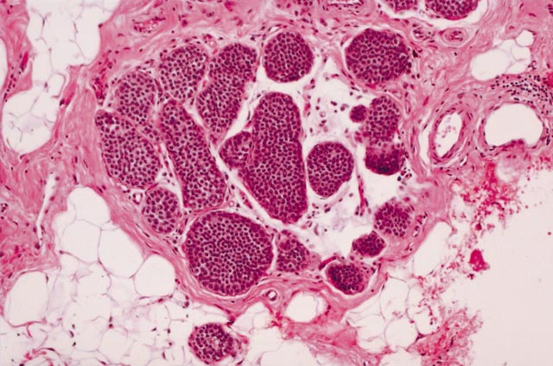
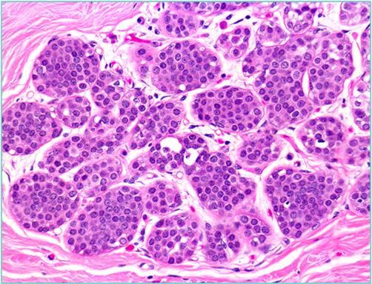
LCIS
The tumor presents as a coincidental finding in breast tissue removed for other reasons. The disease tends to be bilateral and multicentric.
Histology: monomorphic population of small, rounded, loosely cohesive cells fills and expands the acini of a lobule. The underlying lobular architecture can still be recognized.
Clinical behavior
If LCIS is left untreated, about 30% of women develop an invasive cancer within 20 years of diagnosis.
The invasive cancer may be ductal or lobular. LCIS is a marker of increased cancer in both breasts

Slide 47
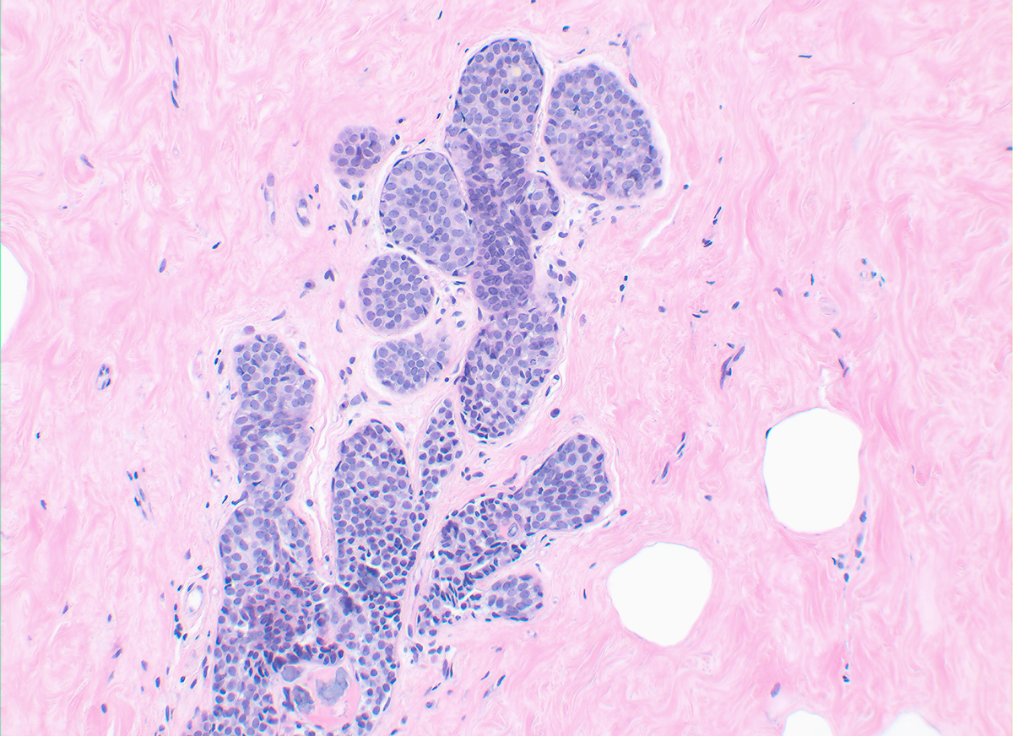

Slide 48
Invasive Breast Carcinoma: Classification
Invasive breast carcinoma is tumor that has extended across the basement membrane. This permits access to lymphatics and vessels and the potential distant metastases and thereby a lethal outcome. There are several different types of invasive carcinoma. Invasive breast carcinoma is subdivided into:
1- NOS Ductal 80%
2- Lobular 10%
3- tubular 6%
4-Mucinous(Colloid) 2%
5- Medullary 2%
6- Papillary 1%
7- Metaplastic Carcinoma 1%

Slide 49
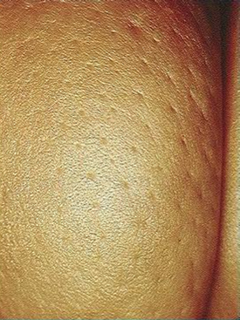
CLINICAL FEATURES OF INVASIVE BREAST CANCER
Palpable mass.
By the time a cancer becomes palpable, over half the patients will have axillary lymph node metastases.
Larger carcinomas may be fixed to the chest wall or cause dimpling of the skin.
Lymphatics may become so involved as to block the local area of skin drainage and cause lymphedema and thickening of the skin, a change referred to as peau d'orange.
When the tumor involves the central portion of the breast, retraction of the nipple may develop.

Slide 50
CLINICAL FEATURES OF BREAST CANCER
In older women undergoing mammography, invasive carcinomas most commonly present as a density.
Invasive carcinomas presenting as mammographic calcifications without an associated density are usually very small in size.
The term "inflammatory carcinoma" refers to the clinical presentation of a carcinoma extensively involving dermal lymphatics, resulting in an enlarged erythematous breast.
The diagnosis is made on clinical grounds and does not correlate with a specific histologic type of carcinoma

Slide 51
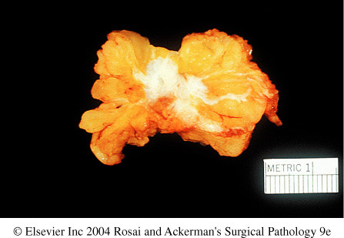
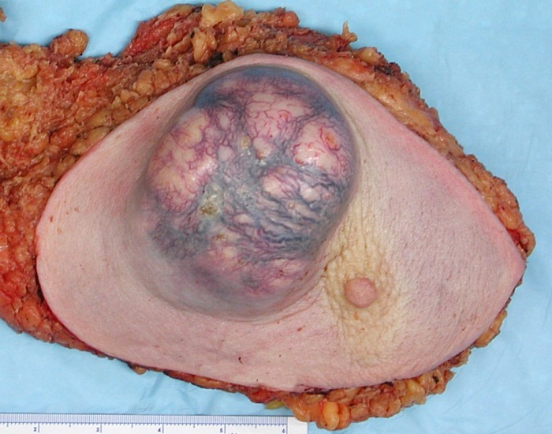
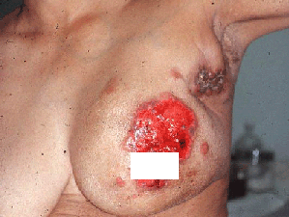
Invasive carcinoma

Slide 52
Invasive Ductal Carcinoma ,NOS
It is the commonest type of breast cancer, forming up to 80% of these cancers.
Most of these tumors excite a pronounced fibroblastic stromal reaction to the invading tumor cells producing a palpable mass with hard consistency (hence scirrhous carcinoma), which is the most common presentation.
The tumor shows an infiltrative attachment to the surrounding structures and may cause dimpling of the skin (due to traction on suspensory ligaments) or nipple retraction.

Slide 53
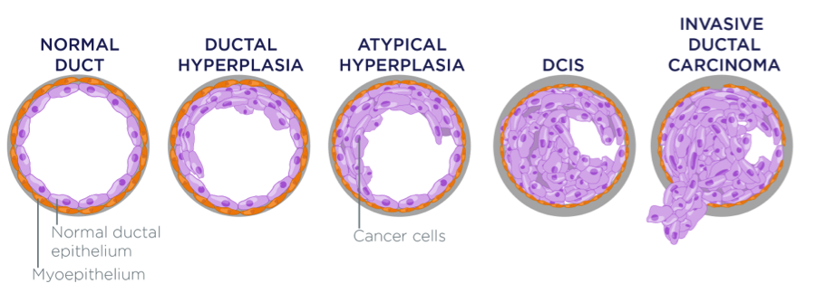
Invasive Ductal Carcinoma

Slide 54
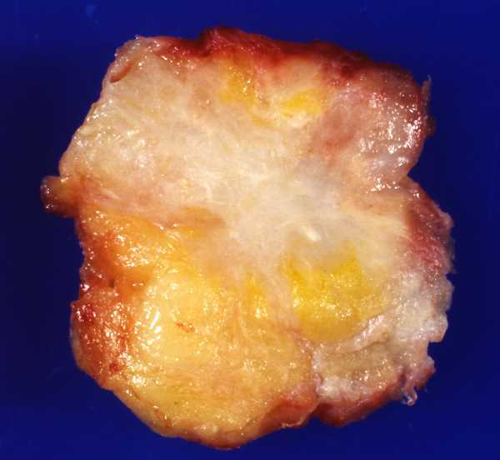
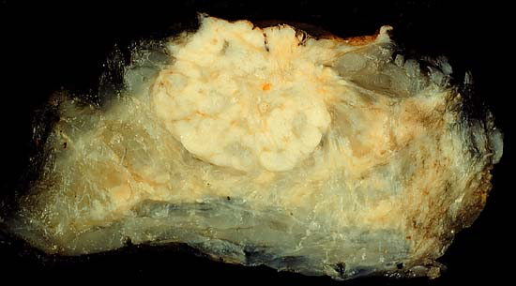
Invasive Ductal Carcinoma ,NOS
Grossly ,firm ,hard, and have an irregular border
Cut surface is gritty and shows irregular margins with stellate infiltration and in the center there are small foci of chalky white stroma and occasionally calcifications
Characteristic grating sound when cut or scraped
Could be soft and well demarcated
Accompanied by varying amounts of DCIS

Slide 55
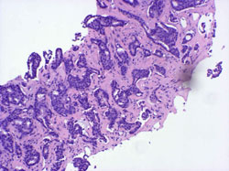
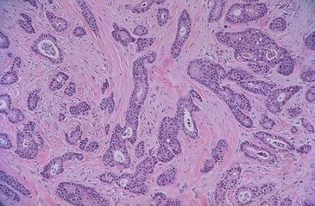
Invasive Ductal Carcinoma,NOS
Histologically, the tumor cells are larger than normal epithelium, and can assume a variety of patterns such as glandular formation, cords of cells, broad sheets of cells or a mixture of all these, usually within a dense stroma.
The tumors range from well differentiated, in which there is glandular formation, to poorly differentiated, containing solid sheets of pleomorphic neoplastic cells.
Carcinomas associated with a large amount of DCIS require large excisions with wide margins to reduce local recurrences

Slide 56
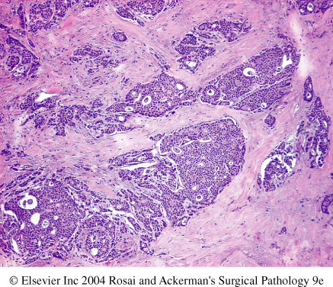
Invasive ductal carcinoma

Slide 57
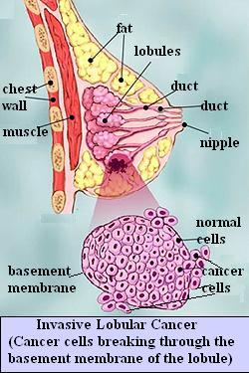
Invasive Lobular Carcinoma
It is the second most common type of invasive breast cancer forming up to 10% of breast cancers.
The tumor may occur alone or in combination with ductal carcinoma.
It tends to be bilateral more often than ductal carcinoma and multicentric.
The amount of stromal reaction to the tumor varies from dense desmoplasia to little reaction and therefore the presentation varies from a discrete mass to a subtle, diffuse indurated area.

Slide 58
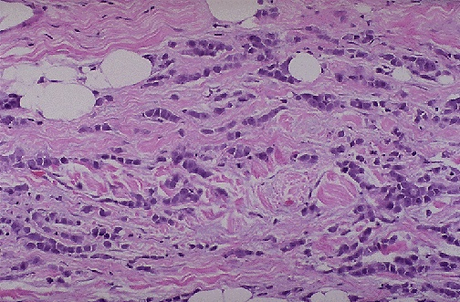
Invasive Lobular Carcinoma
Most are firm to hard with irregular margins
Single infiltrating cells ,often one cell width (indian file pattern)
No tubules or papillary formation
In about 10% of cases, tumors have mixed features of invasive ductal and lobular carcinomas.

Slide 59
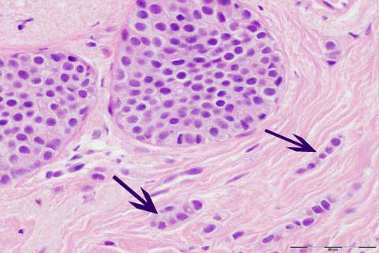
Invasive lobular carcinoma with area of lobular carcinoma in situ also

Slide 60
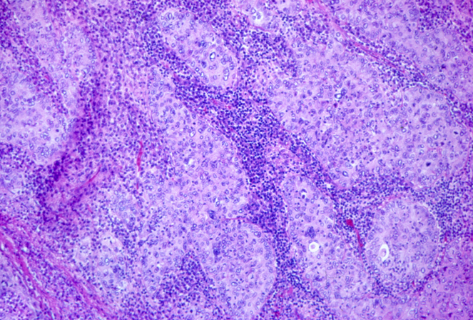
Medullary Carcinoma
This subtype of breast cancer presents as a well circumscribed mass.
May mistaken clinically and radiologically for fibroadenoma
It does not produce any fibroblastic (desmoplastic) reaction and therefore is soft and fleshy (encephaloid). On section foci of necrosis and hemorrhage are evident.
Microscopically, the tumor is composed of solid sheets of malignant cells and frequent mitoses. There is scant fibrous stroma. Lymphocytes and plasma cells surround the tumor cells.

Slide 61
Colloid Carcinoma/ Mucinous carcinoma
tends to occur in older women.
It is sharply circumscribed, lacks fibrous stroma and is slow growing.
Is soft and gelatinous and has a glistening cut surface.
It may be in pure mucinous or mixed in which it is associated with other types of invasive breast carcinoma.
The mucinous tumor is composed of small islands, occasionally forming glands, and isolated tumor cells floating in pools of extracellular mucin

Slide 62
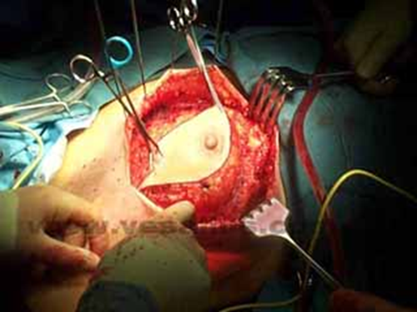
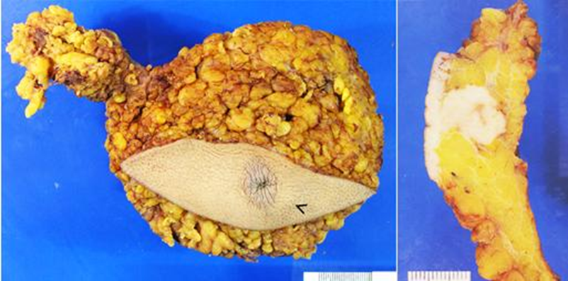
treatment
Wide local excision
Radical mastectomy

Slide 63
Breast Carcinoma , Major Prognostic Factors
Invasive or In situ disease: By definition, in situ carcinoma is confined to the ductal system and cannot metastasize. Breast cancer deaths associated with DCIS are due to the subsequent development of invasive carcinoma or areas of invasion undetected at the time of diagnosis. The great majority of women with adequately treated DCIS will be cured. In contrast, at least half of invasive carcinomas will have metastasized locally or distantly at the time of diagnosis.
Distant metastasis: Once distant metastases are present, cure is unlikely, although long-term remissions and palliation can be achieved. Favored sites for dissemination are the lungs, bones, liver, adrenals, brain, and meninges.
Lymph node metastasis: Axillary lymph node status is the most important prognostic factor for invasive carcinoma in the absence of distant metastases. The clinical assessment of nodal involvement is very inaccurate, therefore, biopsy is necessary for accurate assessment. With no involvement, the 10-year disease-free survival rate is close to 70% to 80%; the rate falls to 35% to 40% with one to three positive nodes and 10% to 15% in the presence of more than 10 positive nodes.

Slide 64
Breast Carcinoma , Major Prognostic Factors
Tumor Size: The size of the carcinoma is the second most important prognostic factor. The risk of axillary lymph node metastases increases with the size of the carcinoma.
Note : all the above parameters are used to stage the tumor. Stage is a combination of size, lymph node status and distant metastasis. Tumor size less than 2 cm is associated with a favorable prognosis. The single most important prognostic indicator is the lymph node status. Negative lymph nodes have the best prognosis. Involvement of 1 to 3 lymph nodes has an intermediate prognosis and 4 or more positive nodes have the worse prognosis.
Locally advanced disease: Tumors invading into skin or skeletal muscle are frequently associated with concurrent or subsequent distant disease. With increased awareness of breast cancer detection, such cases have fortunately decreased in frequency and are now rare at initial presentation.
Inflammatory Carcinoma: Women presenting with the clinical appearance of breast swelling and skin thickening have a particularly poor prognosis with a 3-year survival rate of only 3% to 10%.

Slide 65
Breast Carcinoma , Minor Prognostic Factors
Histologic Subtype: Infiltrating ductal and lobular carcinomas have the worst prognosis. Medullary and mucinous have intermediate and tubular and cribriform have the most favorable prognoses
Tumor Grade: This is calculated by the pathologist. Grading separates tumors into three categories according to the amount of well formed tubules, the degree of nuclear pleomorphism, and the mitotic rate. The most commonly used grading system to assess the degree of tumor differentiation (Bloom Richardson). There are three grades with grade 1 having better prognosis and grade3 having poorer prognosis.
Estrogen and progesteron receptors: 50% to 85% of carcinomas express estrogen receptors, such tumors are more common in postmenopausal women. Such hormone positive cancers have better prognosis. They respond well to specific chemotherapuetic drugs eg. Tamoxifen. Therefore reporting of ER/PR positivity is important when reporting breast cancer.

Slide 66
Breast Carcinoma , Minor Prognostic Factors
HER2/neu. (human epidermal growth factor receptor 2 or c-erb B2 or neu) is a glycoprotein overexpressed in 20% to 30% of breast carcinomas. Many studies have shown that overexpression of HER2/neu is associated with a poor prognosis. In addition, ongoing studies have shown that HER2/neu-overexpressing tumors respond very well to hormonal or anthracycline chemotherapy regimens eg. Trastuzumab (Herceptin). Therefore evaluation of HER2/neu is important when reporting breast cancer in order to help decide the chemotherapy plan.
Lymphovascular invasion: Tumor cells may be seen within vascular spaces (either lymphatics or small capillaries) surrounding tumors. This finding is strongly associated with the presence of lymph node metastases and is a poor prognostic factor in women without lymph node metastases.
Proliferative rates

Slide 67
Metastasis to vertebra

Slide 68
STROMAL TUMORS

Slide 69
STROMAL TUMORS
2 basic stromal tumors are
- fibroadenoma
- Phylloids tumor

Slide 70
Fibroadenoma
The most common benign tumor of the female breast and is composed of bengh proliferation of both epithelial and stromal elements.
Any age ,most common before age 30
classic presentation is that of a firm, mobile lump (“breast mouse”)
Giant forms can occur, especially in younger patients
It may increase in size during pregnancy and cease to grow and regress after menopause.
The tumor is usually solitary but may be multiple and involve both breasts.
The tumor is completely benign.
Rarely, carcinoma may arise within a fibroadenoma. The predominant type has been lobular carcinoma

Slide 71
Fibroadenoma
Spherical nodules
Sharply demarcated and circumscribed from the surrounding breast tissue and so is freely movable and can be shelled out
Freely movable (breast mouse)
Size vary
The cut surface is pearl-white and whorled.
Histologically, the tumor is composed of a mixture of ducts and fibrous connective tissue
Treatment: lumpectomy (only the lump is removed)

Slide 72
The lesion consists of a proliferation of intralobular stroma surrounding and often pushing and distorting the associated epithelium. The border is sharply delimited.
Downloaded from: Robbins & Cotran Pathologic Basis of Disease (on 28 April 2008 09:47 AM)
© 2007 Elsevier

Slide 73
Phylloides tumor
Phyllodes tumors, like fibroadenomas, arise from intralobular stroma. Although they can occur at any age, most present in the sixth decade, 10 to 20 years later than the average presentation of a fibroadenoma
Most present as palpable masses
Phyllodes tumors must be excised with wide margins to avoid the high risk of local recurrences.
The majority are low-grade tumors that may recur locally but only rarely metastasize. Rare high-grade lesions behave aggressively, with frequent local recurrences and distant hematogenous metastases in about one third of cases.

