Slide 1
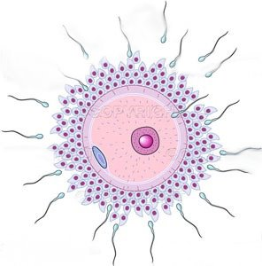
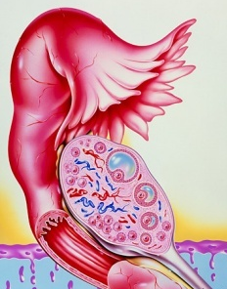
Drugs In
OVULATION INDUCTION

Slide 2
Drugs In
OVULATION INDUCTION
ILOs
By the end of this lecture you will be able to:
Recall how ovulation occurs and specify its hormonal regulation
Classify ovulation inducing drugs in relevance to the existing deficits
Expand on the pharmacology of each group with respect to mechanism of action, protocol of administration, indication, efficacy rate and adverse effects.

Slide 3
Prof. Mohamad Alhumayyd Dept. of Pharmacology

Slide 4
Hyperprolactinaemia
Ovulation Induction
Hypogonadotropic

Hypothalamus 
GnRH
◉
Anterior Pituitary 
FSH / LH 
Ovary
◉
Estrogens
Progestins
1.Antiestrogens
4.D₂ R agonists
SERMs;
Clomiphene
Tamoxifen
Bromocreptine
3.Gonadotrophins
HMGs; Menotropin
HCGs; Pregnyl
2.GnRH
(-)
GnRH-agonists
Leuprolin
Goserelin
5. POLYCYSTIC OVARIAN SYNDROME (PCOS)
Metformin
Normogonadotrophic


Slide 5
ANTIESTROGENS
1. CLOMIPHENE
Hypothalamus 
GnRH
◉
Anterior Pituitary 
FSH / LH 
Ovary
◉
Estrogens
Progestins
Pharmacological effects
Compete with estrogen on the hypothalamus and anterior pituitary gland; negative feed back of endogenous estrogen  GnRH 
production of FSH & LH  OVULATION
☒
Clomiphene
(-)
Indication
Female infertility;
not due to ovarian or pituitary failure  Normogonadotrophic
The success rate for ovulation 80% & pregnancy 40% .

Slide 6
Method of administration
Clomiphene given  50 mg/d for 5 days from 5th day of the cycle to the 10th day.
If no response give 100 mg for 5 days again from 5th to10th day
The drug can be repeated not more than 6 cycles .
ADRs
1.Hot Flushes & breast tenderness
2. Gastric upset (nausea and vomiting)
3. Visual disturbances (reversible)
4.  nervous tension & depression
5. Skin rashes
6. Fatigue
7. Weight gain
8. Hair loss (reversible)
9. Hyperstimulation of the ovaries & high incidence of multiple birth.

Slide 7
2. TAMOXIFEN
Is similar & alternative to clomiphene
But differ in being Non Steroidal
Used in palliative treatment of estrogen receptor- positive breast cancer.
But why not clomiphene ?

Slide 8
Ovulation Induction
Hypothalamus 
GnRH
◉
Anterior Pituitary 
FSH / LH 
Ovary
◉
Estrogen
Progestins
Hypothalamo-pituitary
1.Antiestrogens
SERMs;
Clomiphene
Tamoxifen
2.GnRH
(-)
GnRH-agonists
Leuprolin
Goserelin
Ovarian

Slide 9
2. GONADOTROPIN RELEASING HORMONE (GnRH)
Uses:
Induction of ovulation in patients with
hypothalmic amenorrhea (GnRH deficient)
Analgoues with agonist activity: Leuprolin, Goserelin
GnRH and agonists, given S.C. in a pulsatile(drip)
to stimulate gonadotropin release (1 – 10 µg / 60 – 120 min)
Start from day 2-3 of cycle up to day 10
Given continuously, when gonadal suppression is
desirable e.g.
precocious puberty and advanced breast cancer in women and prostatic cancer in men

Slide 10
HYPOTHALAMUS
GnRH
Agonists
GnRH
Continuous
Pulsatile
-
+
+
GnRHR
ANTERIOR PITUITARY
FSH
LH

Slide 11
ADRs OF GnRH Agonists
GIT disturbances, abdominal pain, nausea….etc
Headache
Hypoestrogenism on long term use 
→ Hot flashes
→ Libido
→ Osteoporosis
→ Rarely ovarian hyperstimulation  (ovaries swell & enlarge)

Slide 12
Ovulation Induction
Hypothalamus 
GnRH
◉
Anterior Pituitary 
FSH / LH 
Ovary
◉
Estrogen
Progestins
Hypothalamo-pituitary
1.Antiestrogens
SERMs;
Clomiphene
Tamoxifen
3.Gonadotrophins
HMGs; Menotropin
HCGs; Pregnyl
2.GnRH
(-)
GnRH-agonists
Leuprolin
Goserelin
Ovarian

Slide 13
3.GONADOTROPHINS
[FSH & LH]
Are naturally produced by the pituitary gland
For therapeutic use, extracted forms are available as;
1. Human Menopausal Gonadotrophin(hMG ) extracted from postmenopausal urine  contains LH & FSH MENOTROPIN
2. Human Chorionic Gonadotrophin(hCG) extracted from urine of pregnant women contains mainly LH) PREGNYL
Indication
Stimulation & induction of ovulation in infertility 2^{ndry} to gonadotropin deficiency (pituitary insufficiency)
Success rate for inducing ovulation is usually >75 %

Slide 14
GONADOTROPHINS
Method of administration
hMG is given i.m every day starting at day 2-3 of cycle for 10 days followed by
hCG on (10th - 12th day) for OVUM RETRIEVAL .
ADRs
FSH containing preparations; Fever Ovarian enlargement (hyper stimulation) Multiple Pregnancy (approx. 20%)
LH containing preparations; Headache & edema

Slide 15
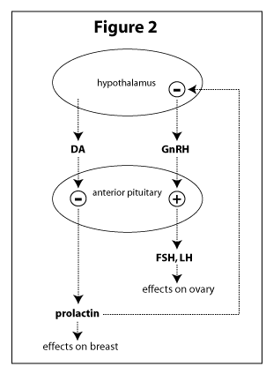
D₂ R Agonists
BROMOCREPTINE
Is an ergot derivative( not a hormone)
D₂ R Agonists binds to dopamine receptors in the anterior pituitary gland & inhibits prolactin secretion .
Bromocreptine
Mechanism
Indications
Female infertility 2^{ndry} to hyperprolactinaemia
ADRs
GIT disturbances; nausea, vomiting, constipation
Headache dizziness & orthostatic hypotension
Dry mouth & nasal congestion
Insomnia
Hyperprolactinaemia
No Ovulation

Slide 16
Drugs In
OVULATION INDUCTION
L
G
U
O
C
O
K
D

