Slide 1
Drugs affecting lactation and Breast milk
Dr.Abdullatif Mahesar
College of medicine 2014

Slide 2
Intended learning issues
Relation of drugs and lactation
Factors modifying passage of drugs in milk
Effects of drugs on milk production
Role of lactation on drugs excretion
Drug safety during lactation / use of safe drugs
Drugs contraindicated during lactation

Slide 3
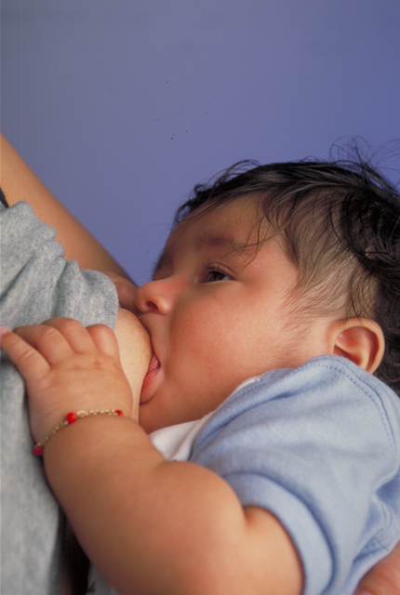
LACTATION
Human breast milk is the healthiest form of milk for human babies.
Provide the baby with immunoglobulins that are essential for protection against gastric and other infections
(IgA, IgM).

Slide 4
DRUGS AND LACTATION
Most drugs administered to breast feeding woman are detectable in milk.
The concentration of drugs achieved in breast milk is usually low.
how ever in certain cases presence of even small amount of drug may be considered.

Slide 5
BREAST FEEDING AND DRUGS
The epithelium of the breast alveolar cells is most permeable to drugs during the 1st week postpartum, so drug transfer to milk may be greater during the 1st week of an infants life.

Slide 6
Factors that affect passage of drugs into breast milk
1. Physiochemical character of the drug
Lipid solubility eg. barbiturates
Molecular weight e.g. Insulin,heparin
Degree of ionization eg. Heparin
PH
Plasma protein binding e.g warfarin
half life of the drug e.g oxazepam v/s diazepam
volume of distribution

Slide 7
MATERNAL FACTORS
Dose
Routes of administration topical admin is preferable
Health status of mother
the epithelium of breast is most permeable during the 1st week postpartum, drug transfer may be easier.
INFANT FACTORS
Premature born baby
Low birth weight
Health status
Infant with G6PD deficiency may develop hemolysis and hyperbilirubinemia with sulphonamides and antimalarial drug primaquine

Slide 8
The amount of a drug to which the baby
is exposed as a result of breast feeding
depends on:
The concentration of the drug in the milk at the time of feeding
The amount of milk consumed.
The amount of drug absorbed by the baby
The ability of the baby to eliminate the drug.

Slide 9
General consideration to minimize risk to nursing infant
Try breast-feeding immediately before taking a drug.
Special cautions are required in
Premature baby
Low birth weight
infant with impaired metabolism and excretory system.

Slide 10
General consideration to minimize the amount
Choose medications with the
Shortest half-life and highest protein-binding ability.
With the poorest oral/systemic absorption.
Medications with lowest lipid solubility.

Slide 11
DRUG CATEGORIES from hazardous to safer DRUG CATEGORIES
Cytotoxic drugs that may interfere with cellular metabolism of the nursing infant, cause possible immune suppression, effect on growth, neutropenia and association with carcinogenesis e.g. cyclophosphamide, cyclosporine, doxorubicin, methotrexate.
Drugs of abuse for which adverse effects on infant during breast feeding have been reported.eg. Amphetamine, cocaine, heroin, marijuana ,phencyclidine

Slide 12
Radioactive compounds, that require temporary cessation of breast feeding eg. Iodine ¹³¹.
Drugs for which the effects on nursing infants is unknown but may be of concern
Drugs that have been associated with significant effects on some nursing infants and should be given with nursing mothers with caution
Maternal medication usually compatible with breast feeding

Slide 13
PRECAUTIONS DURING BREAST FEEDING
Drugs with no safety data should be avoided or lactation should be discontinued.
Lactating mother should take medication just after nursing and 3-4 hours before the next feeding.
(to allow time for drug to be cleared from the mother’s blood – drug concentration in milk will be low).

Slide 14
AUGMENTATION OF LACTATION
Persistent and active suckling release both
prolactin and oxytocin to stimulate milk
Secretion.
Dopamine antagonists stimulate prolactin
secretion as
Metoclopramide
Phenothiazines
Haloperidol
Methyl dopa
Theophylline

Slide 15
SUPPRESSION OF LACTATION
L-dopa
Dopamine
Bromocriptine
Ergot derivatives
Androgens
Estrogen, oral contraceptives that contain high-dose estrogen and a progestin.

Slide 16
SUPPRESSION OF LACTATION
Thiazide diuretics
Pyridoxine
MAO inhibitors

Slide 17
DRUGS CONTRAINDICATED DURING LACTATION
Radioactive drugs eg.radioactive iodine
Anticancer drugs
Doxorubicin
Cyclophosphamide
Methotrexate
3. CNS acting drugs/drugs of abuse
Amphetamine
Heroin
Cocaine
4. Ergot derivatives: eg.ergotamine
5. Lithium
6. Some antibiotics eg.chloramphenicol

Slide 18
Drugs to be avoided during lactation
Barbiturates: Phenobarbitone
Benzodiazepines:diazepam
Antithyroid drugs: carbamizole
Hormonal contraceptives: estrogen
Analgesics :Aspirin
Antibiotics: Tetracyclines

