Slide 1
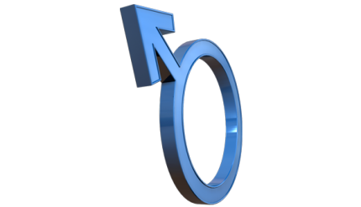
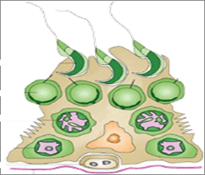
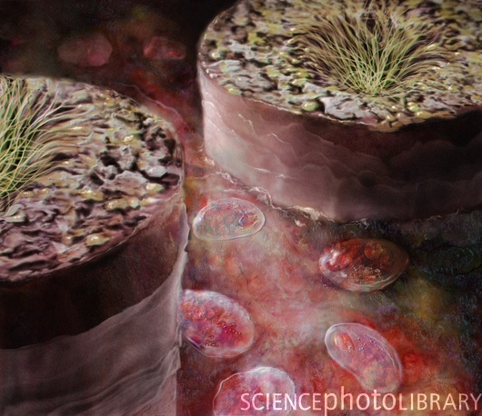
DRUGS USED IN
MALE INFERTILITY

Slide 2
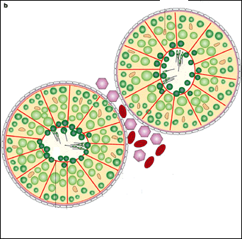
DRUGS USED IN
MALE INFERTILITY
ILOs
By the end of this lecture you will be able to:
Define male infertility
Recognize regulations contributing to male fertility & dysregulations leading to infertility
Classify hormonal & non-hormonal therapies used in male infertility whether being empirical or specific.
Expand on the mechanism of action, indications, preparations, side effects, contraindications & interactions of most hormonal therapies
Highlight some potentialities of emperical non-hormonal therapies

Slide 3
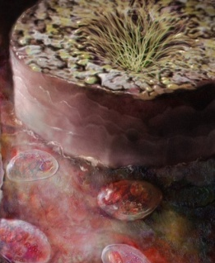
MALE INFERTILITY
Definition
Inability of a male to achieve conception in a fertile woman after one year of unprotected intercourse.
Prevalence
Approximately 15-20% of all cohabiting couples are infertile
In up to 50% of such cases(7.5-10%),males are responsible

Slide 4
In male infertility, the semen analysis is abnormal:
Count is low (oligospermia)
Sperms are absent in the ejaculate(azoospermia)
Sperm motility is seriously affected(asthenospermia).
Sperms are totally immobile or dead (necrospermia)

Slide 5
Causes of Male Infertilty
Idiopathic
Infection, e.g. Prostatitis, TB, etc.
Sexually transmitted diseases
Injury, e.g., Testicular trauma, Irradiation.
Tobacco, ALCOHOL (central and peripheral).
Thermal Stress- Tight fitting clothes & prolonged period of sitting, riding(bicycle riding, horse riding).
Spinal cord injury.
Prolactin- secreting tumor of the pituitary gland.
Hypogonadotrophic hypogonadism.
Ejaculatory duct obstruction.
Testicular cancer.
Medications- chemotherapy, anabolic steroids

Slide 6
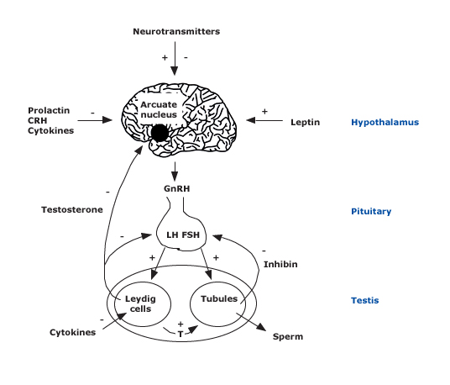
LH stimulates testosterone synthesis, and FSH regulates spermatogenesis.
Schematic representation of the hypothalamic-pituitary-testicular axis shows the site of action of follicle stimulating hormone (FSH) and luteinizing hormone (LH) in the testes. Testosterone (T) and inhibin are produced by the testes.
Testosterone has a negative feedback on the hypothalamus and LH production, while inhibin has a negative feedback on FSH production.
Notes:
corticotropin-releasing hormone (CRH)

Slide 7
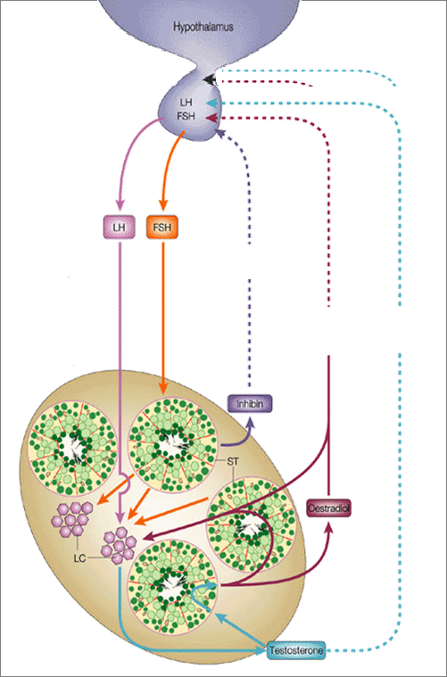
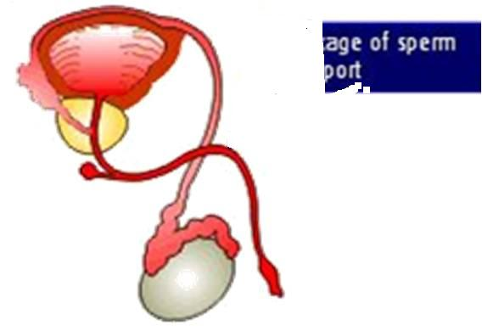
If WRONG INFERTILITY
HYPOTHALAMUS
Pulsatile Secretion
GnRH
3. Problems of Sperm Transport
GnHs
E facilitate –ve of T on GnRH & GnHs
POST-TESTICULAR
LH
FSH
-ve
-ve
Initiation & Maintenance of spermatogenesis
-ve
+ve
PRE-TESTICULAR
Inhibin
4. Problem in Erection & Ejaculation
Estradiol
+ve
1. Problems related to Hormone Production
5DHT
2. Problems related to Sperm Production
TESTOSTERONE
TESTICULAR
LHTestosterone Pulsatile
(chronic LH  makes testis refractory)
MALE INFERTILITY
Notes:
LC=Leydig cells, ST= Sertoli cells

Slide 8
Needs 3 -6months. before semen quality changes
DRUG TREATMENT OF MALE INFERTILITY
HORMONAL THERAPY
NON-HORMONAL THERAPY
SPECIFIC
EMPERICAL
EMPERICAL
SPECIFIC
Hyperprolactinaemia DA₂₋ Agonists
Hypothyroidism Thyroxine
Congenital Adrenal Hyperplasia  Glucocorticoids
Erectile Dysfunction PDE 5 inhibitors,e.g. sildenafil(viagra),vardenafil(levitra),tadalafil(cialis),Alprostadil.
Premature Ejaculation SSRIs(e.g. fluoxetine)
Infection of testes,prostate &UTAntibiotics
Euogonadotrophic Hypogonadism  (T only) Antiestrogens; SERMs & Aromatase Is
Idiopathic  Androgens, Antiestrogen, GnH(FSH)
Hypogonadotrophic hypogonadism  2^{ndry} Hypogonadism ( Hypothalamo-Pituitary )
(T &  FSH / LH )
Pulsatile GnRH, hCG, hMG, Androgens, Clomiphene
Kallikrein
Antioxidants; e.g.vit E, vit.c
Zinc Supplements
Folic acid
L-Carnitine
Hypergonadotrophic Hypogonadism 
P^{ry} Hypogonadism (T &LH ) Assisted Reproduction (invitro fertilization)

Slide 9
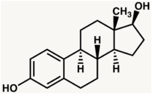
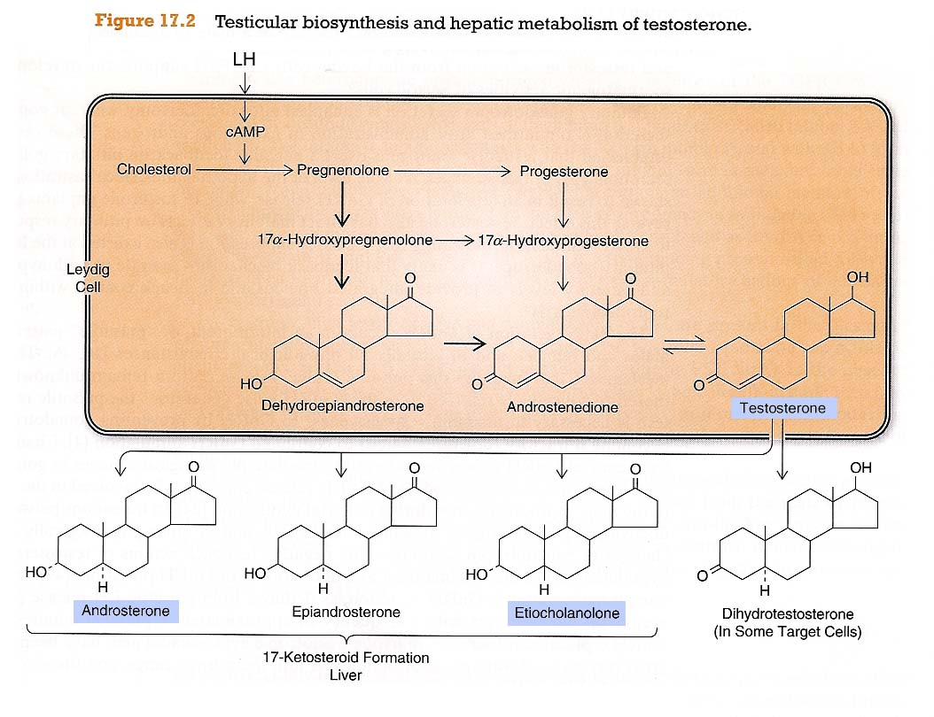
HORMONAL THERAPY
> in brain, bone, liver, adipose t.
1. ANDROGENS
AROMATASE
Estradiol
In NATURE
> in accessory sex organs
5-α-REDUCTASE
Leydig C
DHT
TESTOSTERONE
Principle male sex hormone produced in testis(> 95%), small amount in adrenals.
1. Testosterone
2. Synthetic Androgens;
Derived from Testosterone
Esters; proprionate, enanthate, cypionate
Or derivatives as Fluoxymesterone, Methyltestosterone, Danazol
Derived from DHT; Mesterolone

Slide 10
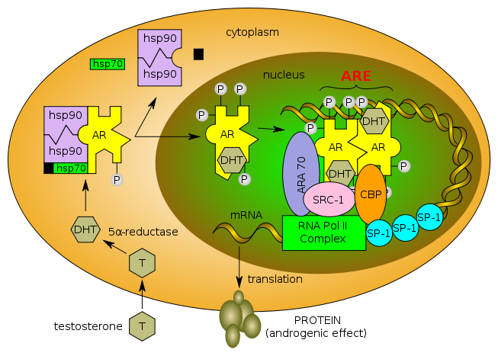
Mechanism of action of testosterone
A.(prostate,seminal vesicles&skin converted by α-reductase to DHT
PROTEIN
TESTOSTERONE

Slide 11
B. Bones and Brain
Testesterone is metabolized to estradiol by c-p450 aromatase.
Bones: estradiol accelerates maturation of cartilage into bone leading to closure of the epiphyses & conclusion of growth.
Brain: estradiol serves as the most important feedback signal to the hypothalamus(esp. affecting LH secretion).

Slide 12
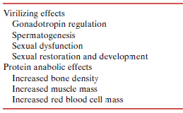
1. ANDROGENS Effects
Androgens have anabolic &/or masculinizing effects in both males & females
ACTIONS DIVIDED INTO
○ Testosterone & Synthetic Androgens
Anabolic Steroids
Not used in infertility

Slide 13
1. ANDROGENS
Kinetics of Testesterone
Ineffective orally(inactivated by 1st pass met.) I.M or S.C.
Skin patch & gels…. are also available
Binds to Sex Hormone Binding Globulin [SHBG]
t1/2 = 10 –20 min
Inactivated in the liver.; 90% of metabolites excreted in urine.
Synthetic androgens  less rapidly metabolized & some are excreted unchanged in urine
Synthetic Androgens
Derived from Testosterone
Esters; proprionate, enanthate, cypionate in oil (prolong action) for IM; every 2-3 weeks
Other derivatives as Fluoxymesterone, Methyltestosterone, Danazol  given Orally; daily
Derived from DHT; Mesterolone  given Orally; daily

Slide 14
1. ANDROGENS
INDICATIONS
As Testesterone Replacement Therapy(TRT)
Therapy for androgen deficiency in adult male infertility.
In delayed puberty with hypogonadism
 give androgen low, slow & spaced for fear of
premature fusion of epiphyses  short stature.
high doses of exogenous testosterone suppress spermatogenesis markedly in normal men
( –ve feed back on GnHs).

Slide 15
Adverse effects of Androgens
1. Specific
Excess androgens(if taken > 6 wks) can cause impotence, decreased spermatogenesis &gynecomastia (androgen converted to estrogen).
2. General Effects
Alteration in serum lipid profile: HDL & LDL, hence, risk of premature coronary heart disease.
Salt & water retention leading to edema.
Hepatic dysfunction;  bilirubin & cholestatic jaundice.
Behavioral changes; physiologic dependence,↑ aggressiveness, psychotic symptoms
Polycythemia(increase synthesis of RBC)  risk of clotting.
3. In young
Premature closing of epiphysis of the long bones.
Reduction of testicular size

Slide 16
Contraindications
1. ANDROGENS
Male patients with cancer of breast or prostate
Severe renal & cardiac disease → predispose to edema
Psychiatric disorders
Hypercoagulable states
Polycythemia
Interactions
+ corticosteroids  oedema
+ warfarin  metabolism   bleeding
+ insulin or oral hypoglycemics  hypoglycemia
+ propranolol   propranolol clearance  efficacy
Mesterolone
More safely given in  testosterone or in 2ndry hypogonadism.
Why???
1. Not aromatised into estrogens no –ve of GnHs  encourages natural testosterone production spermatogenesis is enhanced
2. Unlike other oral synthetic androgens it is not hepatotoxic.

Slide 17
2. GnRH
Used in hypothalamic dysfunctionandrogenization & spermatogenesis
Given as Pulsatile GnRH therapy (4-8 ug subcut every 2 hours) using a portable pump.
Exogenous excess of GnRH  down-regulation of pituitary GnRH receptors &  LH responsiveness.
ADRs; Headache, depression, generalized weakness, pain , gynecomastia and osteoporosis.
3. GnHs
Used in 2ndry hypogonadism (FSH or both FSH or LH absent)  spermatogenesis
GnHs replacement must be combined; hCG (3 x 2000 U/w. IM.2 ms.) followed by hCG + hMG (3x 75 to 3 x 150 U /w. IM. 6 -12 ms).
ADRs; Headache, local swelling (injection site), nausea, flushing, depression, gynecomastia, precocious puberty (early puberty).
human chorionic gonadotropin (hCG), human menopausal gonadotropin (hMG)

Slide 18
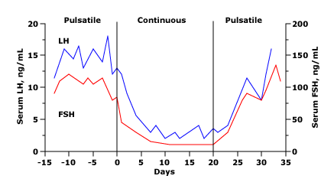
Pulsatile GnRH therapy
Serum LH and FSH concentrations in an ovariectomized monkey.
Pulsatile administration (given for six minutes every hour) of gonadotropin-releasing hormone (GnRH) maintains serum FSH and LH concentrations.
In comparison, a continuous infusion of GnRH (middle panel) leads to rapid and reversible suppression of both LH and FSH release.

Slide 19
4. Antiestrogens
Because estrogens  –ve feedback on hypothalamus  GnRH pulse frequency & pituitary responsiveness to GnRH , so antiestrogens  Gn RH & improve its pituitary response.
4.a. SERMs
Tamoxifen, Clomiphene
Tamoxifen
Clomiphene
Both drugs can induce libido & bad temper in men (aggression)
4.b. Aromatase Inhibitors
Anastrozole
Blocks conversion of testosterone to estrogen within the hypothalamus
All are used for inducing spermatogenesis in oligozoospermia(count is low)
Given as daily dose over a period of 1–6 months.
Best to improve sperm count & motility with good pregnancy rates

Slide 20
Non-HORMONAL THERAPY
Sometimes is very promising, to improve sperm quality and quantity.
Antioxidants
Protect sperm from oxidative damage
KALLIKREIN
Has proteolytic activity, cleaving kininogen to kinins important for sperm motility.
FOLIC ACID
Plays a role in RNA and DNA synthesis during spermatogenesis & has antioxidant properties.
ZINC
Plays an important role in testicular development, spermatogenesis & sperm motility.
L-CARNITINE
Is highly concentrated in the epididymis & are important for sperm metabolism & maturation

Slide 21
DRUGS USED IN
MALE INFERTILITY
GOOD LUCK

