Slide 1
CLINICAL POINTS OF HEAD AND NECK
Essam E. Abdel Hadyldin

Slide 2
Scalp
Layers of the scalp;
Skin,
connective tissue
aponeurosis (epicranial),
loose areolar tissue,
Pericraniaum.

Slide 3
Laceration;
Even small, it causes sever blood loss, often difficult to stop
Local pressure is the only satisfactory masseur method to stop bleeding. ……………………………...(why)
Deep sutures is mandatory ……………………………...(why)
In automobile accidents it is common for large lacerated area of the scalp which is attached (hanged) by narrow pedicle, suturing is not followed by necrosis.
Wounds caused by blunt objects closely resembles the incised wound

Slide 4
Life threatening scalp hemorrhage;
encircle the head just above the ears and eyebrows with a tie (tourniquet)………….. (why)

Slide 5
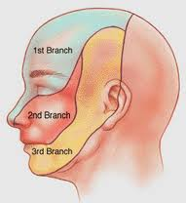
Sensory innervation of the face
Trigeminal nerve and its three divisions;
Ophthalmic
Maxillary
Mandibular .
Great auricular nerve (C2 & C3)

Slide 6
Trigeminal Neuralgia
It is a common clinical condition.
The patient is usually a middle age female, suffers from sever facial pain in the area of distribution of the mandibular and maxillary division of the trigeminal nerve, (the ophthalmic division usually escape).
Pain-free interval may last for minutes to weeks.
The etiological factor; microvascular affection
No abnormal signs on physical examination

Slide 7
Motor supply of the face
Facial nerve;
Damage to the facial nerve in the internal acustic meatus or the parotid gland by tumor or in the facial nerve canal ( perineuritis) (Bell’s palsy) facial muscles paralysis; distortion of the face, drooping of the lower eye lid and the angle of the mouth will sage on the affected side
This is lower motor neuron lesion
Upper motor neuron lesion (pyramidal) will leave the upper part of the face normal (bilateral corticobulbar fibers)

Slide 8
Blood supply of the face
Arterial supply;
Facial artery
Superficial temporaal
Transverce facial.
Supraorbital
Supratrochlear.

Slide 9
Tacking the patient’s pulse; by anesthetist
The superficial temporal artery as it crosses the zygomatic arch anterior to the ear
The facial artery as it winds around the lower margin of the mandible anterior to masseter muscle.
It is rare for skin flaps to necroses follow plastic surgery

Slide 10
Venous drainage;
Dangerous area of the face; bounded by the upper lip, nose and eyes.
Boil in this region can cause thrombosis of the facial vein, spread of organism through the inferior ophthalmic vein to the cavernous sinus;
cavernous sinus thrombosis.

Slide 11
Temporomandibular joint (TMJ)
Dislocation; sometime occurs when the mandible is depressed; the joint is unstable so minor injury or just yawing will pull the disc forward beyond the summit , the head of the mandible lies in front of the articular tubercle
Reduction is by pressing the a gloved thumbs down on the lower molar teeth (to overcome the tension of temporalis and masseter)and push the jaw backward (to overcome the spasm of lateral ptrygoid).

Slide 12
salivary gland
Parotid
Malignant tumor involving the facial nerve leads to unilateral facial paralysis.
Painful parotitis,
infection of the parotid gland trough the parotid duct or via blood stream.
The pain experienced is due to the limitation of the swollen gland by the parotid fascia (part of the investing deep fascia)

Slide 13
Swelling of the Submandibuar salivary gland and enlargement of the Submandibuar lymph nodes my be confused
Meticulous search for infection in the area drained by Submandibuar lymph nodes; scalp. Face , maxillary sinus and mouth cavity especially acute infection of the tooth

Slide 14
Lingual nerve injury
As it passes from the infratemporal to the submandibular fossa, in close relation the last lower molar tooth, it is labile to be damaged in difficult extraction of an impacted third molar tooth.
Spontaneous complete recovery from the altered sensation occurs within 8 weeks in 85% to 94% of cases.

Slide 15
Skull fractures
The anterior cranial fossa; is manifested by epistaxis and cerebrospinal rhinorrhea.
The middle cranial fossa; fracture is common due to numerous foramina, cavities and air sinuses, it is manifested by leakage of blood and CSF from the external auditory meatus .
The posterior cranial fossa; fracture is manifested by escape of blood into nape of neck , later it appears in the posterior triangle

Slide 16
Facial bones fractures
Car accidents, boxing and fall are the common causes of facial fractures.
Signs of fractures include deformity, ocular deformity, abnormal movements accompanied by crepitation, and malocclusion of teeth.
The most common fractures are nasal bones, zygomatic bone and mandible.
Maxillofacial fractures occur as a massive facial trauma

Slide 17
Intracranial hemorrhage
Extradural hemorrhage;
Subdural hemorrhage;
Subarachnoid hemorrhage;
Cerebral hemorrhage

Slide 18
Extradural hemorrhage
Injury of the meningeal arteries or veins anterior division of the middle meningeal artery
Increase of the intracranial pressure with pressure on the motor area in the precentral gyrus

Slide 19
subdural hemorrhage
Subdural hemorrhage due to tearing of the superior cerebral veins at points of entrance to the superior sagittal sinus as a result of blow or bran displacement within the skull
Blood is accumulated between the dura and archnoid
Blood clot is removed through burr holes in the skull

Slide 20
Subarchnoid hemorrhage
Subarchnoid hemorrhage; due to leakage of aneurysm on the circle of Willis.
It is diagnosed by withdrawing heavily blood stained cerebrospinal fluid through lumber puncture.

Slide 21
Cerebral hemorrhage
Cerebral hemorrhage due to rupture of lenticulostriate artery branch of middle meningeal artery
It involves vital fibers of corticospinal and corticobulbar in the internal capsule
Leads to loss of consciousness, paralysis is evident when consciousness is regained.

Slide 22
Platysma
Thin sheet of muscle extends between body the mandible downwards over the clavicle onto the anterior chest wall
Innervated by cervical branch of facial never

Slide 23
Platysma
Tone and neck incisions;
Laceration and surgical incision must be carefully sutured since the tone of platysma can pull the scar tissue resulted in broad unsighted scar

Slide 24
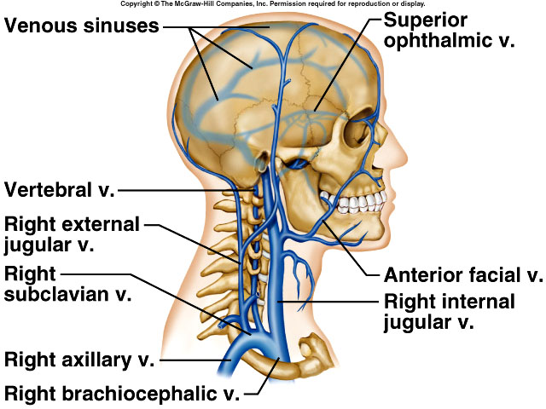
Internal jugular vein

Slide 25
Internal jugular vein
It begins at the jugular foramen as continuation of the sigmoid sinus draining brain face and neck.
It descends in the carotid sheath
It unites with the subclavian vein behind medial end of the clavicle to form the brachiocephalic vein.
It has two dilatations; superior and inferior bulbs and bicuspid valve directly above the inferior bulb

Slide 26
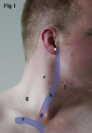
Catheterization
It descends from a point halfway between the tip of mastoid process and angle of the jaw, to the sternoclavicular joint,
Just above the sternoclavicular joint, it lies beneath skin depression , between the sternal and clavicular heads of sternocleiodomastoid muscle
Posterior approach;
Two fingerbreadth above the clavicle at posterior border of the sternocleiodomastoid muscle.
Anterior approach;
At the apex of triangle formed by clavicle and the two heads of sternocleiodomastoid muscle.

Slide 27
External jugular vein
Begins behind angle of the mandible by union of posterior auricular and posterior division of retromandibular veins.
Descends obliquely across the sternomastoiud muscle
Just above the clavicle it drains into the subclavian vein.
Subclavian v

Slide 28
External jugular vein
Because of the right side is in a most direct line with the superior vena cava it is the most common used for catheterization
It is catheterized halfway between the level of cricoid cartilage and the clavicle.
During inspiration when the valves are open

Slide 29
Subclavian vein
It is a continuation of the axillary vein at the outer border of the 1st rib.
It lies below and in front of the 3rd part of subclavian artery behind the clavicle on upper surface of the 1st rib.
At the medial border of scalenus anterior it joins the internal jugular vein to form the brachiocephalic vein.

Slide 30
Catheterization
It lies immediately posterior to the medial third of the clavicle.
It is more medially placed on the left than the right side
The needle is inserted just below the lower border of the clavicle at junction of medial third and outer two thirds.
It is pointed upward and posteriorly towards the middle of the suprasternal notch.

Slide 31
Deep fascia
Consists of areolar type of connective tissue supporting the muscle, vessel, and viscera of the neck.
In certain areas, it forms well defined fibrous sheets;
Investing layer.
Pretracheal layer.
Prevertebral.
It is condensed around vessels to form well defined fibrous sheets;
Axillary sheath.
Carotid sheath.

Slide 32
Deep Cervical Fascia

Slide 34
Deep fascia and fascial spaces
Between the dense layers of deep fascia is loose connective tissue form potential spaces visceral retropharyngeal submandibular and masticatory
Organisms from the mouth pharynx esophagus or teeth can spread among the facial planes and spaces
Reaching up to the superior mediastinum

Slide 35
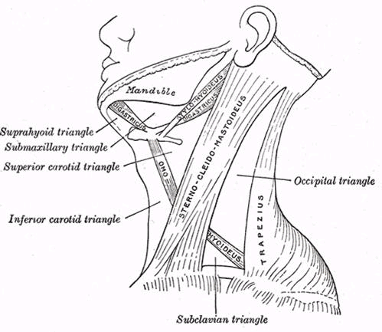

Slide 36
Sternocleidomastoid muscle
Strong thick muscle crosses the side of the neck protects the underlying sot structures from blunt trauma
Strangulation
Suicide attempts by cutting throat often fails

Slide 37
Common carotid arteries
The cervical portions of the common carotids resemble each other so closely that one description will apply to both
Each vessel passes obliquely upward,
from behind the sternoclavicular articulation,
to the level of the upper border of the thyroid cartilage,
where it divides into the external and internal carotid arteries.

Slide 38
Common carotid artery
At the upper border of the thyroid cartilage it divides to external and internal carotid arteries.
At point of division there is a localized dilatation, the carotid sinus, which serves as reflex pressoreceptor mechanism.
The carotid body is a small structure lies posterior to point of bifurcation, it is considered as a chemoreceptor.

Slide 39
Common carotid artery
Carotid pulse just beneath the anterior border of sternomastoid at the level of the superior border thyroid cartilage
In case of carotid sinus hypersensitivity pressure on one or both carotid can cause excessive slowing of the heart rate brdycardia , fall of blood pressure, cerebral ischemia with fainting

Slide 40
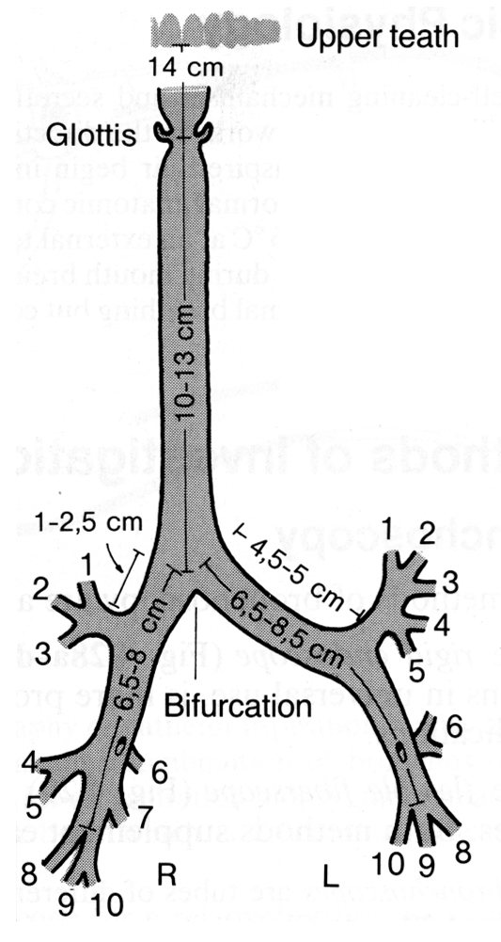
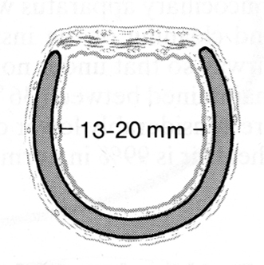
TRACHEA
The trachea is a fibromuscular tube
It is attached to the cricoid cartilage at approximately the 6th cervical vertebra.
It is 10 to 13 cm long in the adult.
Its wideness 13-16 mm in women and 16-20 mm in men.
Its lumen is held open by 16 to 20 horseshoe-shaped cartilaginous rings.
The posterior part of the tracheal tube is formed by the membranous part which lies in contact with the anterior esophageal wall.

Slide 41
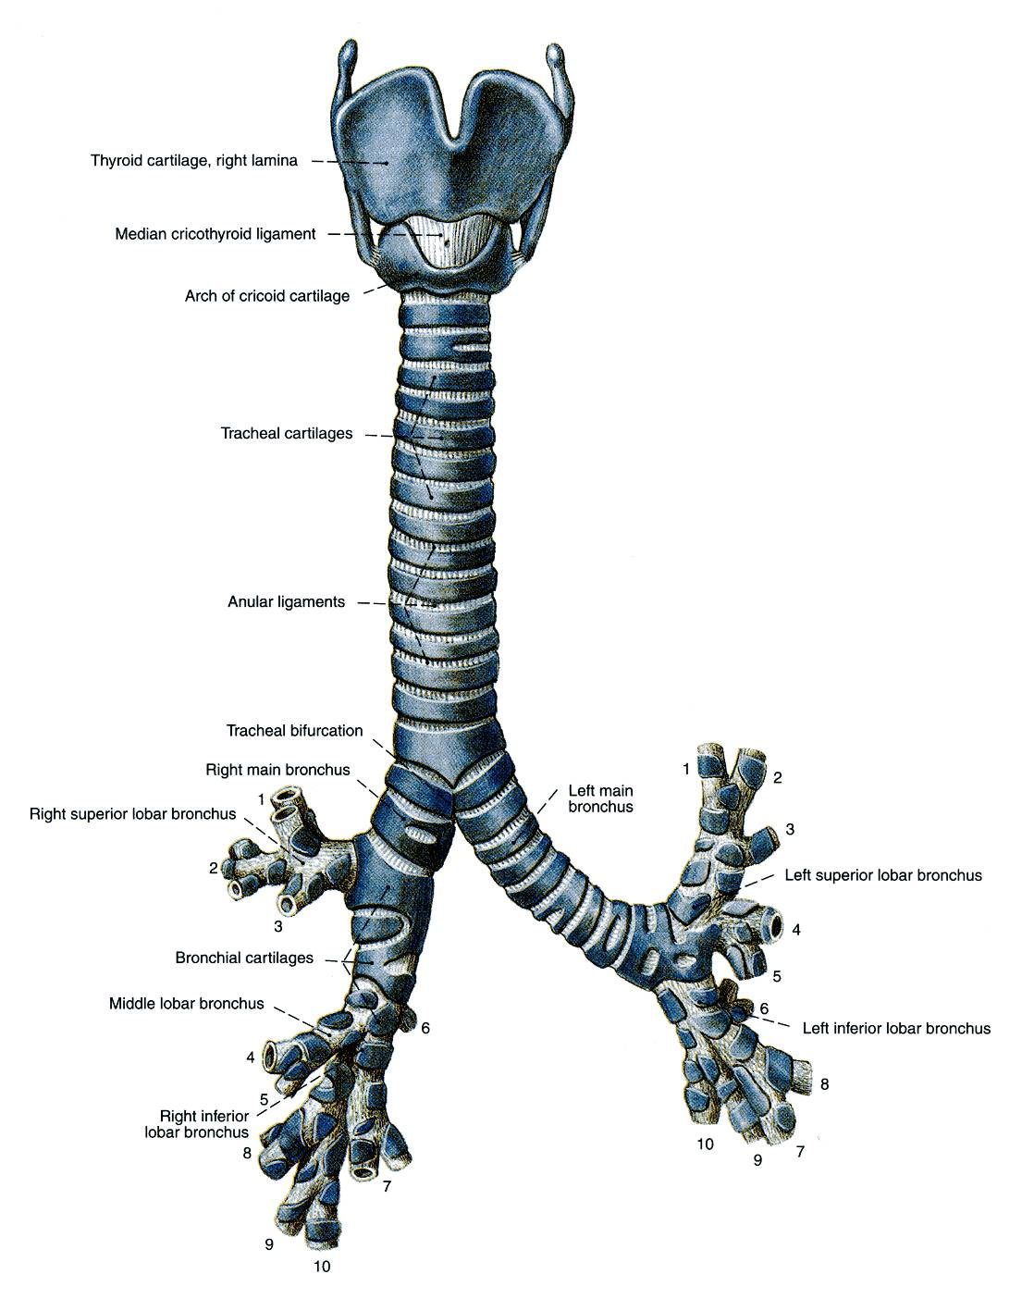
The carina, the tracheal bifurcation into two main bronchi, at the level of lower border of the 4th thoracic, in deep inspiration it descends to the level of the 6th thoracic vertebra.
It has an angle of 55° open inferiorly.
The right main bronchus lies at an angle of about 17° to the midline and the left bronchus at an angle of about 35°.

Slide 42
TRACHEOSTOMY
Tracheotomy
Operative procedure that creates an artificial opening in the trachea.
Tracheostomy
Creation of permanent or semi permanent opening in trachea.

Slide 43
TRACHEOSTOMY
Indications
Upper Airway Obstruction.
Pulmonary Ventilation, Toilet.
Elective Procedure

Slide 44
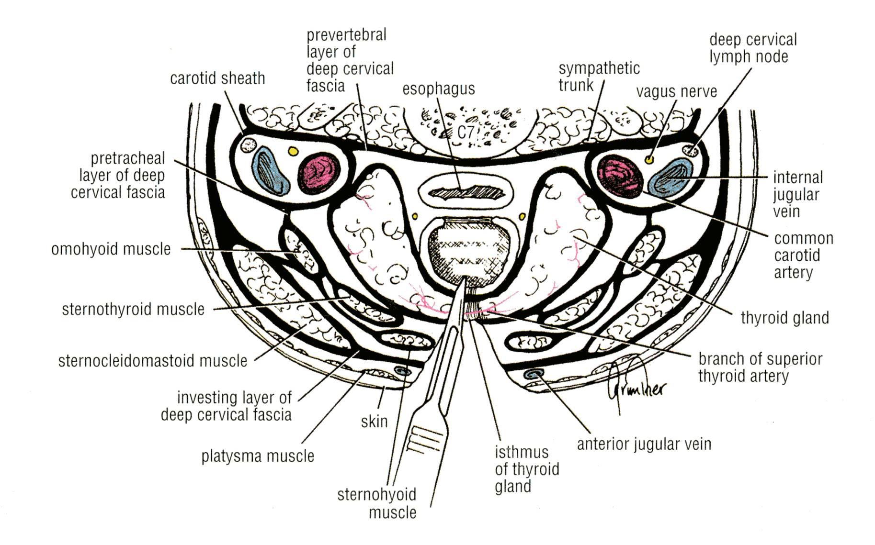
procedure
Meticulous attention to anatomic detail has to be observed, because of the presence of ;
Major vascular structures (carotid arteries and internal jugular vein).
Thyroid gland.
Nerves (recurrent laryngeal branch of vagus and vagus nerve).
Pleural cavities, and the esophagus.

Slide 45
A vertical tracheal incision is made, and the tracheostomy tube is inserted.

Slide 46
Complications of Tracheostomy
Hemorrhage:
The anterior jugular veins located in the superficial fascia close to the midline should be avoided.
If the isthmus of the thyroid gland is transected, secure the anastomosing branches of the superior and inferior thyroid arteries that cross the midline on the isthmus.
Nerve paralysis:
The recurrent laryngeal nerves may be damaged as they ascend the neck in the groove between the trachea and the esophagus.
Pneumothorax:
The cervical dome of the pleura may be pierced. This is especially common in children because of the high level of the pleura in the neck.
Esophageal injury:
Damage to the esophagus, which is located immediately posterior to the trachea, occurs most commonly in infants; it follows penetration of the small-diameter trachea by the point of the scalpel blade.
Tracheal stenosis:

Slide 47
Larynx
Specialized organ that provides a protective sphincter at inlet of air passage and is responsible for voice production
Position of larynx :
it lies in front of laryngeo-pharynx.
opposite C3-C6 vertebrae. superiorly :
it is continuous with laryngeo-pharynx. inferiorly :
it is continuous with trachea.

Slide 48
Structure of larynx :
-it consists of 9 cartilages connected together by ligaments & membranes and moved by muscles. -it is lined with M.M.
Thyroid, cricoid & base of arytenoid cartilages are hyaline cartilages (ossified), / but epiglottis, coriculate, apex of arytenoid and its vocal process & cuneiform are elastic fibrocartilages.

Slide 49
IMPORTANT ANATOMICAL AXES FOR ENDOTRACHEAL INTUBATION
The upper airway has three axes that have to be brought into alignment if the glottis is to be viewed adequately through a laryngoscope;
The axis of the mouth,
The axis of the pharynx,
The axis of the trachea.

Slide 50
IMPORTANT ANATOMICAL AXES FOR ENDOTRACHEAL INTUBATION
The following procedures are necessary:
First the head is extended at the atlanto-occipital joints.
This brings the axis of the mouth into the correct position.
Then the neck is flexed at cervical vertebrae C4 to C7 by elevating the back of the head off the table, often with the help of a pillow.
This brings the axes of the pharynx and the trachea in line with the axis of the mouth.

Slide 51
Complications of Intubation
Hypoxemia
Aspiration
Bronchospasm
Trauma (teeth, vocal cords, airway)

Slide 52
Thank you

