Slide 1
THE PROFESSIONAL MEDICAL STUDENT (COMMITTED STUDENT)
Prof. Ahmed Fathalla Ibrahim, MD, MSc, PhD, DHPE

Slide 2
OBJECTIVES
At the end of the lecture, students will be able to:
Define the words “Professional” & “Medical Professionalism”.
Understand and appreciate professional values, behaviors, attitudes, as well as commitments.
Provide examples of behaviors that may be linked to professional behavior.
Discuss the difficulties towards assessment of professionalism.

Slide 3
MEDICAL PROFESSIONALISM
VALUES, BEHAVIORS & COMMITMENTS

Slide 4
PROFESSIONAL
Q: WHAT?
A: To conform to technical & ethical standards of one profession.
Q: WHY?
A: - lets people know you are a reputable حسن السمعة person to work with.
- conveys intelligence and poise إتزانregarding your position.

Slide 5
PROFESSIONAL
Q: How?
A: By being:
Polite
Well-spoken
Cool & calm under any circumstances
Well prepared ahead of / or in time
Able to communicate well with your team
Able to maintain certain standard/level of behavior consistently

Slide 6
MEDICAL PROFESSIONALISM
It is the way we conduct (as physicians) with our interactions with patients & society.
It includes values, behaviors & attitudes acquired during: medical school education, postgraduate training & daily experiences interacting with patients & physicians.
The professional role requires that physicians demonstrate a commitment to their patients, profession and society through ethical practice ممارسة أخلاقية, participation in profession regulation and a commitment to physician health and sustainable practice.

Slide 7
PRINCIPLES مبادئOF PROFESSIONAL BEHAVIOR FOR MEDICAL STUDENTS
Good clinical care
Maintaining good medical practice
Teaching, training & assessing
Relationships with patients
Working with colleagues
Probity إستقامة
Health
Avoiding cheating and plagiarism احتيال

Slide 8
APPROPIRTE BEHAVIORS EXPECTED OF STUDENTS DURING TRAINING
1- Respect for self, patients, peers, other physicians and health care professionals:
Altruism الإيثار and empathy التعاطف ,
Honesty and integrity النزاهة ,
Caring,
Maintenance of patient confidentialityسرية ,
A professional appearance,
Sensitivity to multiple cultures and lifestyles,
Punctualityدقة .

Slide 9
APPROPIRTE BEHAVIORS EXPECTED OF STUDENTS DURING TRAINING
2- Good communication with patients, colleagues and allied health professionals:
Identification of your role to patients,
Notification of your team, supervisors and the administrative office if you have any planned or unplanned absences,
3- Insight بصيرةinto the limits of one's knowledge and skills and a commitment to learning and maintenance of competence:
The ability to receive and respond to feedback and critique of self, and to manage conflict appropriately,
Attendance at scheduled teaching sessions and assigned clinical activities.

Slide 10
HOW TO TEST STUDENT FITNESS TO PRACTICE?
Ask the following questions:
Has a student’s behavior harmed patients or put patients at risk of harm?
Has a student shown a deliberate disregard تجاهل متعمدof professional and clinical responsibilities towards patients or colleagues?
Is a student’s health impairment compromising تؤثر patient safety?
Has a student abused a patient’s trust or violated a patient’s autonomy إستقلالor other fundamental rights?
Has a student behaved dishonestly, or in a way designed to mislead or harm others?

Slide 11
PROFESSIONAL VALUES القيم
respect,
trust,
Compassion تراحم,
altruism,
Integrity نزاهة ,
justice,
protection of confidentiality,
leadership, and
Collegialityالزمالة .

Slide 12
PROFESSIONAL COMMITMENTS إلتزامات
teaching and mentoring توجيه,
participating in and promoting medical research,
collaborating with colleagues and other health professionals for services potentially required and to those who need them,
advocating الدعوةfor social justice and the public health
taking responsibility for one’s own health and well-being,
supporting impaired colleagues, and
protecting patient safety.

Slide 13
Day to day honesty is crucial to become a good professional
Cheating or plagiarism in written assignments;
cheating in exams, quizzes, class work
in logging information, e.g. marking of attendance for those absent from class
passing on someone else’s work as their own
Doing group assignment when asked for an individual response
Not giving credit to those who deserve it

Slide 14
BLOOM’S TAXONOMY تصنيفOF EDUCATIONAL OBJECTIVES
Three domains of learning were identified:
Cognitive نطاق معرفي
Affective نطاق وجداني
Psychomotor نطاق حركي

Slide 15
HOWEVER
To develop a taxonomic model of professionalism, the focus needs to shift from learning to performance. It does not matter how much a student knows about professionalism. What is important is how well a student performs as a professional.

Slide 16
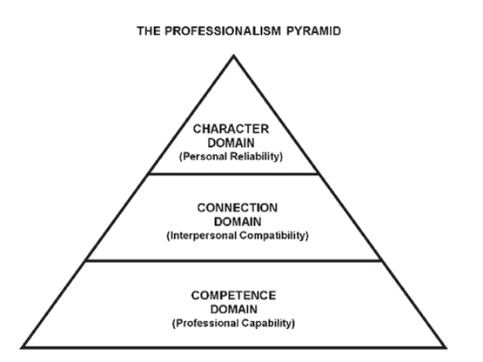

Slide 17
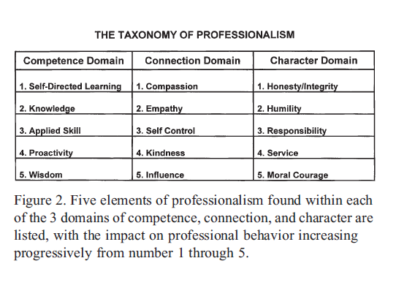
How each is reflected in students? Discuss / Examples

Slide 18
COMPETENCE DOMAIN “the knowledge and skill to function at an acceptable level”
1) Self-directed learning:
* involves the ability to recognize what one needs to learn and the capacity and motivation to learn it.
2) Knowledge
* essential to practice Medicine
3) Applied skill:
* Skill is the “know how” to apply what you know.
4) Proactivity: روح المبادرة
* Knowledge and skill are of no value unless the physician takes action to put them to good use.
5) Wisdom: الحكمة
* At the highest level of competence, professionals must be able to exercise sound judgment, make wise decisions, and solve problems by thinking critically and carefully analyzing options.

Slide 19
CONNECTION DOMAIN “ability to communicate & develop positive social relationships”
1) Compassion: الشفقة
* “people don't care how much you know until they know how much you care.”
2) Empathy: التعاطف
* Communication barriers begin to dissolve when a physician sincerely seeks to understand how the other person thinks and feels.
3) Self-control:
* Physicians who allow their behavior to deteriorate when they are stressed or upset will find their capacity to function as a patient care advocate significantly diminished.

Slide 20
CONNECTION DOMAIN “ability to communicate & develop positive social relationships”
4) Kindness: العطف
* By demonstrating courtesy, respect, and warmth toward all people, connections are strengthened and solidified.
5) Influence:
* The ability to motivate & inspire other people.
* It is a progress from being a cooperative team player to being an influential leader.
* enables the physician to effect change in a patient's behavior.

Slide 21
CHARACTER DOMAIN “Professionals of character perceive that they are part of something larger than themselves and that their lives have meaning”
1) Honesty/Integrity: الأمانة و النزاهة
* Physicians need to be open and honest as the first step in earning trust.
2) Humility: التواضع
* You should be more concerned about a positive outcome for the patient than about personal recognition or reward.
3) Responsibility:
* A sense of responsibility is what provides the motivation to perform all necessary tasks with a commitment to excellence, even when no one is watching.

Slide 22
CHARACTER DOMAIN “Professionals of character perceive that they are part of something larger than themselves and that their lives have meaning”
4) Service:
* A service mentality creates a natural desire to help other people and generates true satisfaction from performing such service.
5) Moral courage: الشجاعة الأدبية
* Is to do what one knows to be right even when unpleasant consequences might result.
* Patients come to know that if there is any way possible to provide needed service, this physician will find a way to do it.

Slide 23
IN SUMMARY
True patient care advocates are servant-leaders who demonstrate excellence with character by being fully adept in all 3 domains of professionalism.
They are likely to be trusted and valued by those they serve and respected as leaders by those with whom they work.
Their capability, compatibility توافق, and reliability synergize in the workplace to produce optimal patient outcomes, while inspiring others to do the same.

Slide 24
ASSESSING PROFESSIONALISM

Slide 25
WHY ASSESS PROFESSIONALISM???
Assessment helps to:
Demonstrate the importance of professionalism
Motivate students to learn
Identify those who are outstanding (should be rewarded)
Identify those who are unsatisfactory (either refer for remedial action or dismiss)
Evaluation of our curriculum: “Does our curriculum enable our students to learn what we want them to”

Slide 26
WHAT SHOULD BE ASSESSED???
In the past, focus on ‘deficit model’, i.e. looking for unprofessional behavior.
Moving towards seeing professionalism as having a set of identifiable positive qualities and behavior.
Can those positive things be measured/scored?
Intangible غير ملموسة
Based on opinion of assessor
Curricular objectives are very diverse

Slide 27
WHAT SHOULD BE ASSESSED???
One suggestion
1. Clinical competence
2. Communication skills
3. Ethical and legal understanding
4. Wise application of principles of professionalism
if it can’t be measured, it can’t be improved,
students don’t respect what is expected; but they respect what is inspected

Slide 28
WHAT SHOULD BE ASSESSED???
Standard setting
– Norm-referenced (compare to a reference group)
– Criterion-referenced (compare to a pre-set standard, usually decided by an expert panel)
Problems:
* Do we know what is the norm?
* Who are the experts?

Slide 29
WHAT SHOULD BE ASSESSED???
The Know-Can-Do Learning Pyramid
Do
Can
Know

Slide 30
WHAT SHOULD BE ASSESSED???
Assessment of ‘Know’
Knowledge of theories, concepts and principles
Ability to identify then analyze dilemmas
Usually within a context e.g. a case
Written test

Slide 31
WHAT SHOULD BE ASSESSED???
Assessment of ‘Can’
Performance-based
E.g. OSCE with standardized patient
Focuses on behavior and skills
‘best behavior’
At least, we know that the student possesses necessary skills

Slide 32
WHAT SHOULD BE ASSESSED???
Assessment of ‘Do’
Refers to how medical students/ doctors actually behave in practice
Most relevant outcome
However, it is also the most poorly done
Needs direct observation: time-consuming
Privacy of the relationship between doctor and patient: covert سريةobservation unacceptable
Patient satisfaction questionnaires

Slide 33
WHEN SHOULD BE ASSESSED??? Before entry
Well-recognized that future doctors should possess not only cognitive skills but also professional characteristics
Medical schools need to devise selection processes that would help identify candidates with the right attributes
Focus on non-cognitive aspects
Were you assessed in any way when you entered medical college? (Discuss/share the experience/s)

Slide 34
WHEN SHOULD BE ASSESSED??? Before entry
Possible strategies to assess non-cognitive characteristics
– Letters of recommendation
– Interviews
– Specific questionnaires?
Problems:
– Put on one’s best front
– Potential for development during medical education

Slide 35
WHEN SHOULD BE ASSESSED??? Continuous assessment
Faculty observation during contact / other
Peer observation during academic year
Evaluation of what students ‘do’: observations in real clinical practice
More likely to be formative
‘You cannot judge if someone is professional just based on observations for one or two days. You need to observe for a longtime.’

Slide 36
WHEN SHOULD BE ASSESSED??? At Exit
Too late
Summative
Could be useful for any future clinical practice requirements/selection procedures for higher education etc.

Slide 37
HOW SHOULD BE ASSESSED??? Focus on
Multiple assessments
Multiple assessors
Contextual
Share experiences and examples

Slide 38
HOW SHOULD BE ASSESSED??? Difficulties
Objectivity
Reliability
Validity
Symmetry
What does a mark mean?
Model answer vs. individual styles

Slide 39
Guidelines: important items where professionalism will be required
Consent موافقةtaking
Decision making
Truth telling
Confidentiality
Research ethics
Euthanasia القتل الرحيم
End-of-life care
Religious interface with medicine
Organ donation

Slide 40
Early Note of Concern (ENC) ملاحظات مثيرة للقلق
Used by some universities
Separate from grades

Slide 41
Commonly reported ENC
Substandard clinical care
Introducing as ‘doctors’
Misusing group resources
Unauthorized access to medical records
Failure to complete course evaluations
Failure to comply with college rules
Abuse / child or else
40% of ENC were in first 2 years
60% from the final two years

Slide 42
Student Health Care and consults
Some experts recommend screening medical students for depression at various stages
As it is closely linked to unprofessional behavior
Discuss how to enhance professional behavior in medical students? Based on some assessments; like behavior during exams, group learning etc.

Slide 43
SO WHAT???

Slide 44
SO WHAT???
Still inadequately addressed
What if someone ‘fails’?
What are the penalties of ‘failing’?
What remedial measures do we have?
What disciplinary actions can we take?
Would our medical school fail a student purely based on professional issues?

Slide 45
Conclusion
Assessment of professionalism is absolutely vital in medical education but yet loaded with difficulties and methodological limitations.
Important for every medical school to develop a valid and reliable assessment system for professionalism.
‘It is generally agreed that it is better to measure uncertainly the significant than to measure reliably and validly the trivial التافه.’
Ultimate goal: Train better doctors

Slide 46
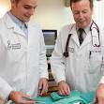
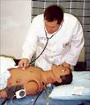
LET’S PUT A SCENARIO FOR
A DAY IN THE LIFE OF A PROFESSIONAL MEDICAL STUDENT

Slide 47
OTHER READINGS
Arnold L. Assessing Professional Behavior: Yesterday, Today, and Tomorrow. Academic Medicine, 2002; 77(6): 502- 515.
Wong J. Assessing Professionalism. http://gec.kmu.edu.tw/gec2/conf/951209/file/05-Josephine_Wong.pdf‏
McDonagh D. Medical professionalism. Northeast Florida Medicine Supplement, 2008; www . DCMS online . Org.
Arnold L & Stern DT. What is medical Professionalism. In Stern DT: Measuring Medical Professionalism;2006. Oxford, Oxford University Press.
Whiting D. Should Doctors ever been professionally required to change their attitude. Clin. Ethics, 2009; 4: 67-73.

Slide 48
OTHER READINGS
Vikram J. Assessment of medical students’ attitudes towards professionalism. http://www.medicine.heacademy.ac.uk/newsletter/article/93/
Medical Professionalism. Australian Medical Association; 2010, http://ama.com.au/node/5424.
Malcolm P et al. The "Pyramid of Professionalism": Seven Years of Experience With an Integrated Program of Teaching, Developing, and Assessing Professionalism Among Medical Students Academic Medicine; 2008, 83(8): 733-741.

Slide 49
THE END
THANK YOU

