Slide 1
Initiative, Integrity, Trustworthiness
Professionalism
روح المبادرة , النزاهة , الجدارة بالثقة
Professor Ahmed A. Adeel

Slide 2
Objectives
Upon completion of this lecture ,students should be able to :
Understand the meaning and principles of initiative, integrity and trustworthiness.
Discuss the place of initiative , integrity and trustworthiness in medical professionalism.
Discuss practical examples about initiative, integrity & trustworthiness.
Apply knowledge learnt to a case scenario.

Slide 3
INITIATIVE : definition
The act of creating or starting.
To make a conscious effort to do things without being told to and to find alternatives if an option is not possible.
A professional with initiative possesses the aptitude to bring forth new ideas .
To take action of his own without having to wait for instructions.
To take actions that are in your long-term best interests and in the interest of your patients .
It means doing more than is expected.
It is about problem solving and creativity

Slide 4
INITIATIVE : characteristics
People with initiative are starters and self-motivators.
Have the ability to begin or to follow energetically with a plan or task and take the initiative in trying to solve the problem.
What separates the most successful from the rest is their ability to take the imitative and do what needs to be done before anyone else recognizes it needs to be done.
Initiative also follows optimism, the ability to maintain a positive mental attitude .Your initiative is enabled by the belief that a positive outcome is possible.

Slide 5
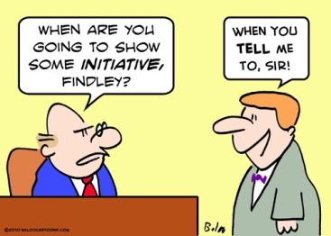
INITIATIVE: suggestive questions
Questions to indicate your level of initiative
Do I take action before it is required or necessary?
Am I known for doing more than is expected of me?
Do I take action to develop my own personal and professional plans?
Am I finding new ways improve my class group work and my community ?

Slide 6
INITIATIVE: examples
As a student
As a medical practitioner

Slide 7
INTEGRITY: definition
The word "integrity" stems from the Latin adjective integer (whole, complete),(عدد صحيح). Integrity carries the sense of wholeness: a person of integrity, like a whole number, is a whole person, undivided, complete.
Dictionary.com :
Adherence to moral and ethical principles; soundness of moral character; honesty
The American Heritage Online Dictionary :
Steadfast adherence to a strict moral or ethical code

Slide 8
INTEGRITY: definition
Cambridge Online Dictionaries :
The quality of being honest and having strong moral principles that you refuse to change .
Merriam-Webster Online Dictionary
Firm adherence to a code of especially moral or artistic values; incorruptibility

Slide 9
What is integrity?
doing the right thing when no one is watching.
doing what is right rather that what is perhaps easy.
It is the bridge between character and conduct.
Integrity is intertwined with honesty, reliability, and responsibility.

Slide 10
INTEGRITY: characteristics
Being consistently honest
Always performing high quality work regardless of whether it will receive notice from others,
Following through on commitments.
Giving credit where credit is due and not taking credit for another employee’s idea or work.

Slide 11
INTEGRITY: characteristics
Stand up for their beliefs openly and boldly.
Listen to their consciences and live by their principles no matter what others say and no matter the personal cost.
Have the courage to do what is hard or costly or failure is probable.
Don’t do any thing they feel is wrong.

Slide 12
LACK OF INTEGRITY: examples in student life
DISHONESTY BY STUDENTS:
Copying from another student examination paper or from a “crib-sheet”
Having someone else write a paper or complete a homework assignment,
Plagiarizing,
Signing an attendance sheet for a classmate,
False medical reports
Falsifying information from the medical history or physical examination.
Cyberplagiarism: obtaining information from the internet without proper citation.
Studies indicate that students who cheat are more likely to be dishonest with their patients in
clerkships and medical practice .

Slide 13
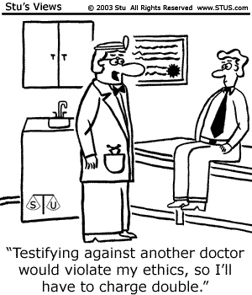
LACK OF INTEGRITY: examples in medical practice
Fraudulent or inappropriate billing
Manipulating medical records to conceal complications to pass review, or prevent lawsuit ;
Hospitalizing patients/operating solely for more money ;
Serving as expert witnesses when not qualified to do so.
Falsifying curricula vitae.
Keeping quiet on misconduct of a colleague.

Slide 14
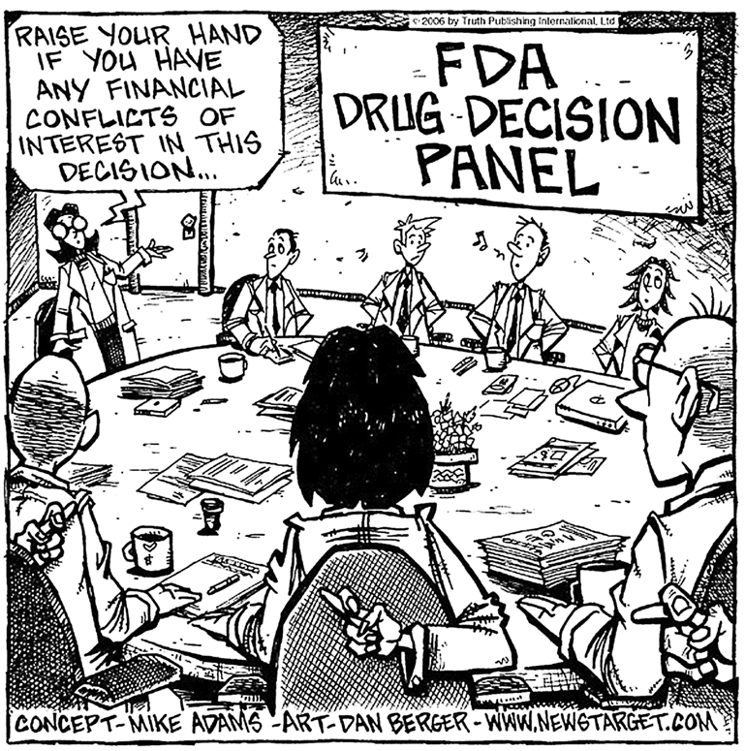
LACK INTEGRITY: examples in medical practice
Conflict of interest ( COI) {تضارب المصالح}:
A situation in which someone who has to make a decision in an official capacity stands to profit personally from the decision. For example, a judge who rules on a case involving a company in which he or she owns stocks has a conflict of interest.

Slide 15
LACK OF INTEGRITY: examples in medical practice
Physicians who accept substantial company-sponsored gifts or all-expense-paid trips.
Unprofessional, or questionable physician interactions with big business
The pharmaceutical industry’s effort to alter physicians’ behavior
Sponsoring CME activities, the companies create an ideal marketplaces for its products.

Slide 16
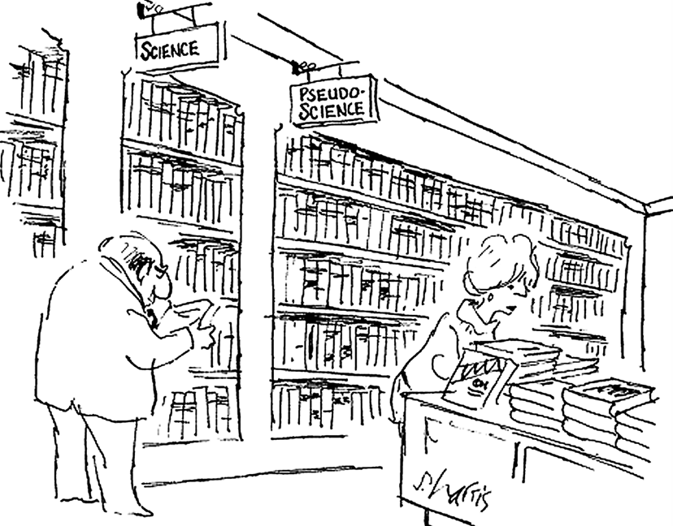
LACK OF INTEGRITY: examples in medical research
Dishonesty in medical research :
1) ambitious investigators whose quest for fame overshadows their integrity
2) Drug companies that attempts to capture a dominant share of the pharmaceutical market

Slide 17
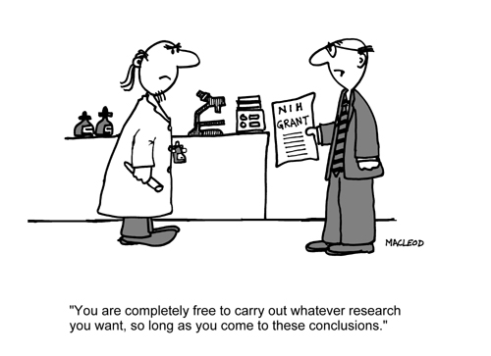
LACK OF INTEGRITY: examples in medical research
Fabricating or manipulating research results the most serious form of dishonesty in the medical research.
Fabricated or manipulation of data in the medical literature.

Slide 18
Trust and trustworthiness

Slide 19
Trust and trustworthiness
You should

Slide 20
Trust and trustworthiness

Slide 21
Trust and trustworthiness
Trust is when a doctor is believed by the patient in the process of their relationship .
Trustworthiness means that the doctor acts in a positive and favorably attitude toward demands and expectations of the patient

Slide 22
Difference between trust and trustworthiness
Trust as a sociological construct refers to people’s expectations. typically for goodwill, advocacy and competence (and/or good outcome).
Trustworthiness : the trait of deserving trust and confidence .It is influenced by :
Patients prior perception about the doctor/ organization , could influenced by third party .
Willingness of doctor to listen and how he communicates how he conducts himself .
Compassion and positive attitude towards patients

Slide 23
Why do we need trust in health care?
For the patient :
Patients are often in a weak state physically
and emotionally .
Trust in the healer is essential to healing itself.
For the physician:
A trusting patient would reveal the full extent of their medically relevant history , cooperate in the physical exam, and act on recommendations for tests or treatments
Patients who trust their doctors rate their care more favorably.
When he feels trusted the physician performs better .

Slide 24
Building trust:
Listening and compassionate communication with patient .
By keeping promises
By being honest, reliable
and principled
By never inappropriately betraying a confidence.
Observing ethical principles like integrity
Meeting expectations in personal appearance competence and performance.

Slide 25
Building trust : Honesty
Sometimes a person who is truthful can make a mistake and be wrong about what the truth is. Honest mistakes can hurt trust, but a person who makes a mistake is not dishonest.
Sometimes by telling the patients the truth e.g. about medical errors financial gains , a patient might lose trust in a doctor.

Slide 26
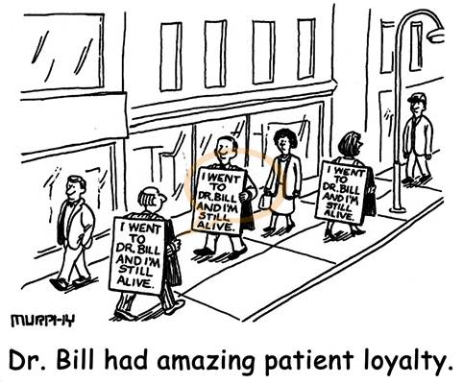
Building trust: patient loyalty
General Definition : loyalty is a steadfast and devoted attachment that is not easily turned aside.
Patient’s loyalty is a patient's
likelihood to return to a
healthcare facility or a doctor .
Loyalty reflects patient satisfaction and is enhanced by understanding the needs of the patient.

Slide 27
TAKE HOME MESSAGES
To have the initiative you need to be proactive and hopeful.
Trustworthiness is the cornerstone of the practice of medicine.
Integrity is the most important value in all stages of professional medical practice .

